Slide 1
Securing Single Page Applications with Token Based Authentication
Stefan Achtsnit
WeAreDevelopers Conference
April 2016
Notes:
JSON Web Token format rules the world

Slide 2
Outline
Single Page Application Security
Token Based Authentication
Client Tokens
JSON Web Token format
Web Application Security 101
Cross-site scripting
Cross-site request forgery -> Double submit cookie
Implementation Challenges
Who should be in charge of the authentication token – JS client or Browser?
How to revoke issued tokens?
Notes:
common attack vectors in web application security

Slide 3
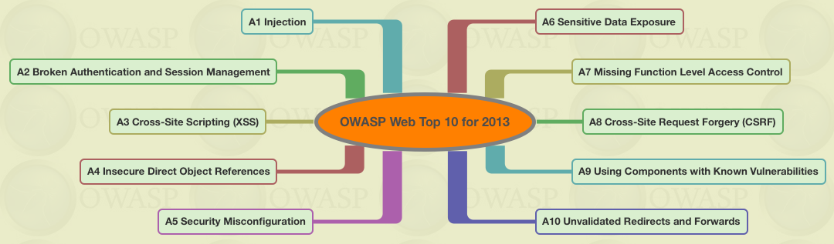
Single Page Application Security
no sensitive information like keys on clients
prevent malicious code from running in your application (Cross-site scripting – see upcoming slide)
secure user credentials (Man-in-the-middle attacks)
strive for consistent authorization, i.e. UI rendering based on same rules as used for API (Client Tokens)
Notes:
Open Web Application Security Project (OWASP) pages are excellent resource
with the switch from server side web applications to SPAs you’ll find yourself building access control logic several times, for your front end and your back end

Slide 4
Client Tokens
self-contained set of claims that assert an identity and a scope of access that can be shared (no silo)
{
"subject": "jdoe",
"name": "John Doe",
"admin": true,
"expiration": 12-04-2016 23:55 UTC
}
signed and optionally encrypted
flexible, e.g. extend with "issuer“ claim for verification, add application specific ACLs
stateless (token revocation - see upcoming slide)
Notes:
pass real assertions and not just a session identifier
structured way to declare who a user is and what they can access - they can be used by your UI and your backend to make decisions, they can be shared, compare that to a session identifier, a session id hast no meaning per se, sessions are silo, you need to look them up somewhere to figure out the information and they only have a meaning within your system
freedom to design your own access control language - just include what makes sense for your application

Slide 5
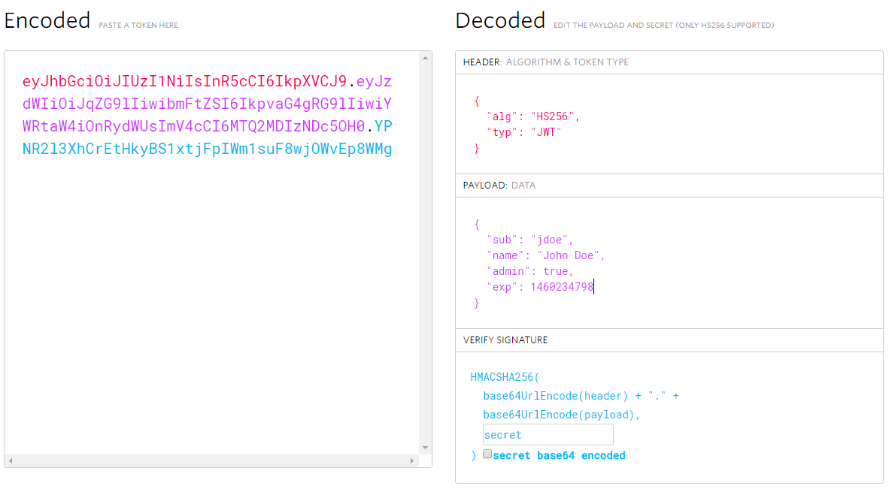
JSON Web Token (JWT) format
de facto standard token format
sign with strong key and always verify token
encrypt for sensitive information (JSON Web Encryption)
security considerations as for session identifiers
Notes:
JSON Web Token (JWT) specification is gaining traction quickly

Slide 6
Cross-site scripting (XSS)
<script>alert('hi!');</script>
attacker pushes malicious JS code into application
canonical example: script tag in user comment
various categories like stored, reflected or DOM-based attacks
OWASP - XSS Prevention Cheat Sheet
always validate user input and escape everything
be careful with dynamically loaded JSON, CSS, HTML templates,…
Content Security Policy (CSP)
3rd party JS libraries are still problematic, everything accessible by JS like tokens stored in web storage may be exposed -> possible alternative: use cookie storage with HttpOnly flag for tokens
Notes:
browser has no way of telling the difference between good or bad code - from the browser’s perspective, the script originated from the web application, so it is automatically treated as a trusted resource
far from full story
can’t ensure protection against XSS attacks you shouldn’t make authentication information - regardless if it is a session identifier or a JWT - accessible to JS

Slide 7
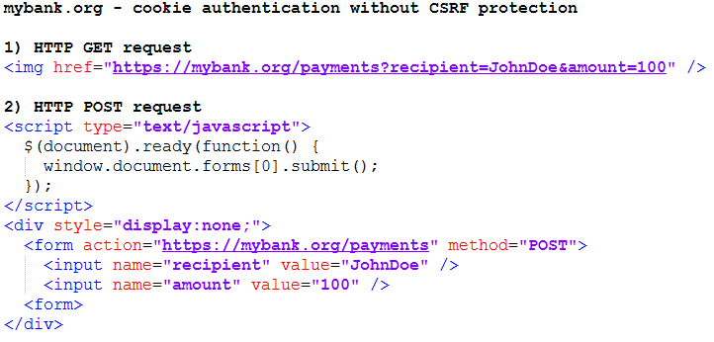
Cross-site request forgery (CSRF)
browser automatically sends cookies set on a given domain with every request made to that domain (regardless of where those requests originated)
OWASP - CSRF Prevention Cheat Sheet
no side effects with HTTP GET
use Double submit cookie with HTTP POST for SPAs
Notes:
Synchronizer Token (aka Anti Forgery Token), where a dynamic hidden variable is added to any input form
Origin header which can’t be set by JS client

Slide 8
Double submit cookie
create random value during authentication process
add this value as additional claim to the provided client token
e.g. {
"subject": “jdoe",
"name": "John Doe",
"admin": true,
"expiration": 12-04-2016 23:55 UTC,
"xsrfToken": 63be08af-0264-47af-b2b9-6d56e8f6428a
}
put this value in further authentication cookie (with HttpOnly cookie flag set to false), so that JS client can read value and forward it with corresponding HTTP header in subsequent requests
server side API code can compare client token claim with submitted HTTP header value during token verification (stateless!)
protection based on same-origin policy for cookies - only JS code running on the origin domain can read this second cookie!

Slide 9
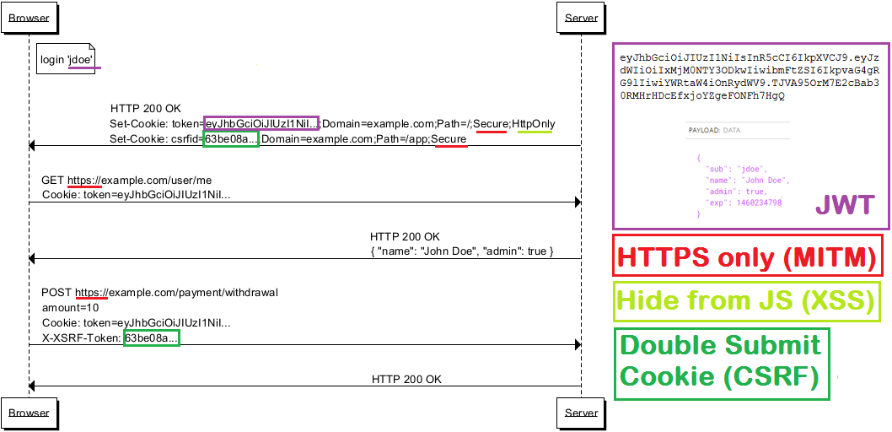
Request Flow Example

Slide 10
Who is in charge of the token?
 | JS client | Browser
Transmission | Authorization: Bearer <JWT> manual coding effort, only when necessary, works with any domain (Cross-Origin Resource Sharing) | Cookie: token=<JWT> automatically sent, overhead when not necessary, not possible across domains i.e. with external APIs
Storage | various options, e.g. web storage (accessible only from storing subdomain, 5MB limit) cookie storage (accessible from multiple subdomains, 4KB limit) | cookie storage
MITM | SSL must be managed by code | Secure cookie flag forces SSL
XSS | manual coding effort | implicit with HttpOnly cookie flag to prevent JS access
CSRF | not applicable | manual coding effort (e.g. Double submit cookie)

Slide 11
How to revoke tokens?
 | Renewal approach | Blacklisting approach
Characteristic | stateless | stateful
Mechanism | two kinds of tokens used: Access Tokens as usual with a short expiration and Refresh Token with a longer expiration for the renewal of Access Tokens when they expire (OAuth2!) | Identifier ("jti" claim) added to Access Token and checked against blacklist during token verification
Consequence | client flow implementation not trivial, additional server logic only within authentication API | transparent for client, blacklist must be available to all server APIs

Slide 12
Recommendation
follow a token based approach with JWT
avoid cross-domain architecture if possible
CSRF protection is easy to get right, XSS protection is easy to get wrong
store token in cookie with HttpOnly (XSS) and Secure flag (MITM)
use Double submit cookie (CSRF)
start with a simple token revocation mechanism
do your homework and don’t reinvent the world
Open Web Application Security Project (OWASP)
https://www.owasp.org/index.php/Top_10_2013
https://www.owasp.org/index.php/XSS_%28Cross_Site_Scripting%29_Prevention_Cheat_Sheet
https://www.owasp.org/index.php/Cross-Site_Request_Forgery_%28CSRF%29_Prevention_Cheat_Sheet
JSON Web Token
https://jwt.io
Thank you!

