Slide 1
Service Discovery 101
Stefan Achtsnit
Polyglot Developer Meetup Vienna
2016

Slide 2
Outline
The need for Service Discovery
Service Discovery strategies
Demo time

Slide 3
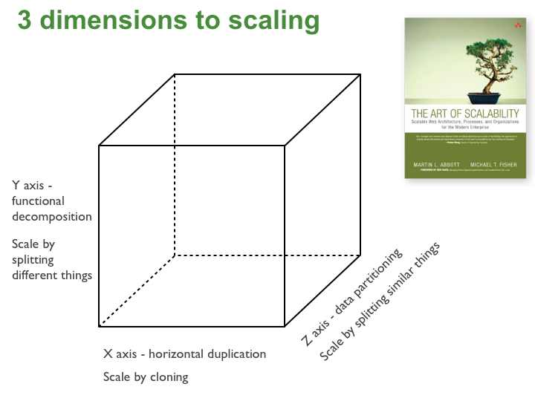
Scale Cube
Notes:
microservices = Y axis

Slide 4
Microservice Architecture
scale via functional decomposition
mediate client communication
design for eventual consistency
expect services to come and go (this talk!)
automate deployment
expose runtime statistics and metrics
Notes:
shifting complexitiy to avoid monolithic hell, big ball of mud
barrier to adopt new tools/frameworks/technologies
obstacle to continuous deployment
reactive, resilient, declarative style for call coordination and error propagation
API Gateway also for caching, access control, metering, monitoring
event driven architecture, event sourcing

Slide 5
Expect services to come and go!
auto-scaling, i.e. set of service instances may change dynamically
server failures, i.e. service instances have dynamically assigned network locations
upgrades/configuration changes
Notes:
practical goals

Slide 6
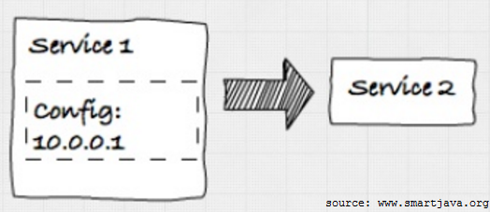
Hardcoded IP
doesn‘t scale
not resilient to failures
config locality
Notes:
maintenance nightmare

Slide 7
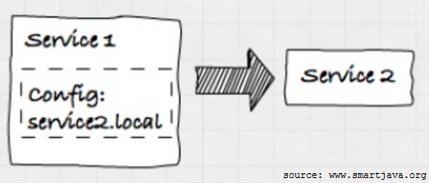
DNS
doesn‘t scale
not resilient to failures
DNS server required
Notes:
level of indirection but name still hardcoded

Slide 8
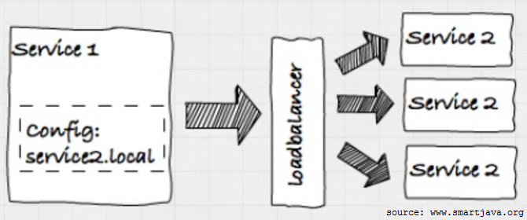
DNS with Loadbalancer
scale out
failure detection possible (loadbalancer support?)
loadbalancer new single point of failure
dynamic load balancer reconfiguration not trivial
Notes:
how to register services and check health
programmatic access to loadbalancer

Slide 9
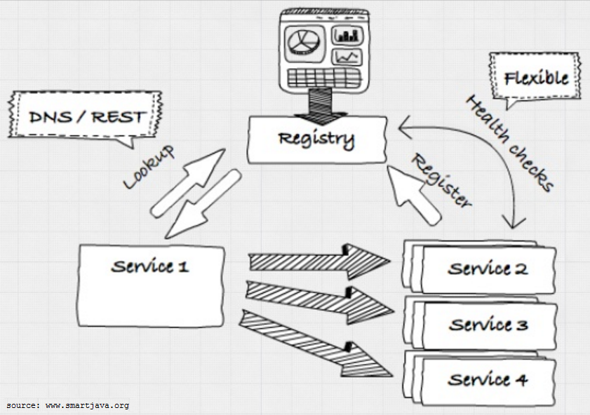
Service Registry
scale out (fully automatable)
failure detection
distributed key-value store for configuration
Notes:
consul, etcd, zookeeper, netflix eureka,…
no service config but lookups
health checks

Slide 10
Service Discovery Patterns
client-side vs server-side discovery
self-registration vs third-party registration
Check out
https://www.nginx.com/blog/service-discovery-in-a-microservices-architecture/
http://microservices.io/
Notes:
e.g. Registrator

Slide 11
Demo time
consul (dead-man switch)
consul-template (HAProxy)
envconsul
Notes:
Consul
service discovery through REST and DNS
simple registration using REST
distributed key-value store
health checking
overview global state
HAProxy for load balancing
environment variables

Slide 12
Summary
A Service Registry is necessary for robust systems, as
services may be started and stopped in any order,
servers may fail/be restarted,
configuration may be changed!
Recommendation: Consul by HashiCorp
Thank you!

