Slide 1

Hybrid Application Monitoring (AppDynamics)
Digital Journey Overview
Maturity Assessment Report

Slide 2
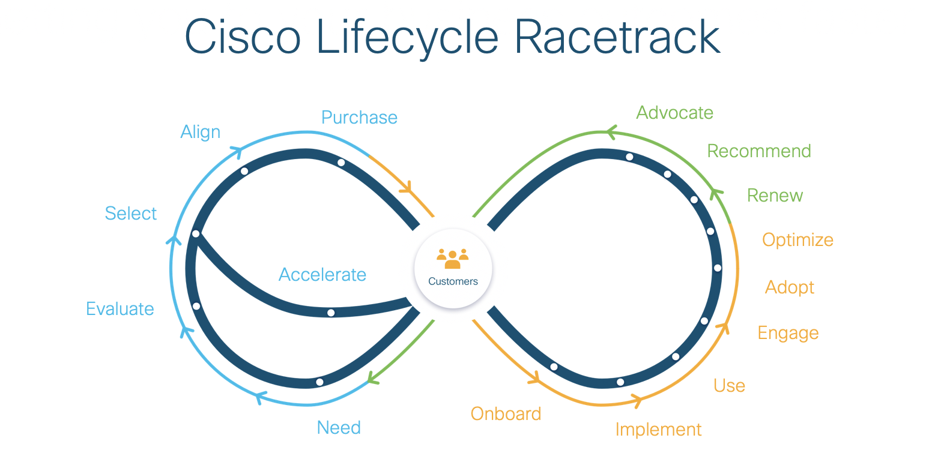

Slide 3
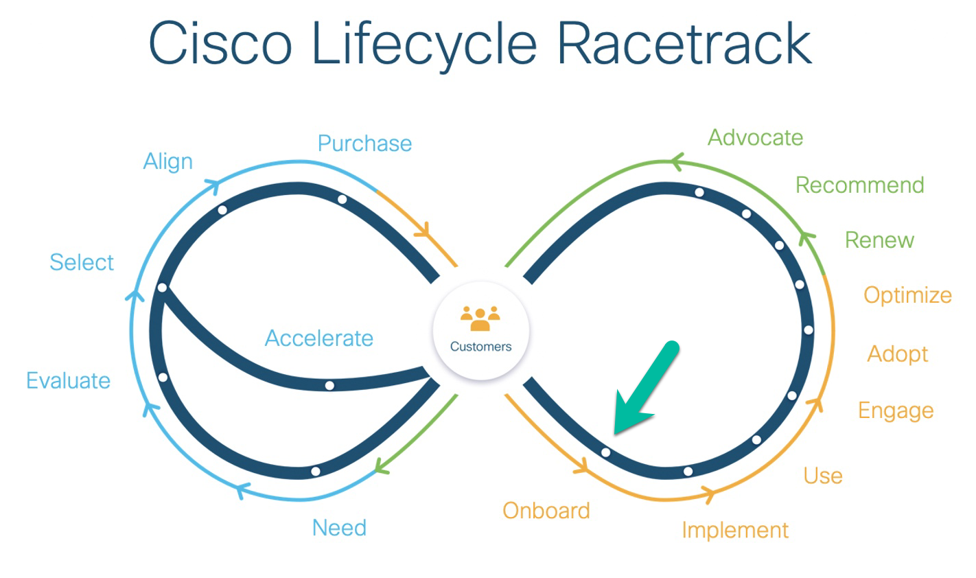
Hybrid Application Monitoring Pitstop: Onboard

Slide 4
Pitstop: Onboard has failed health check best-practices

Slide 5
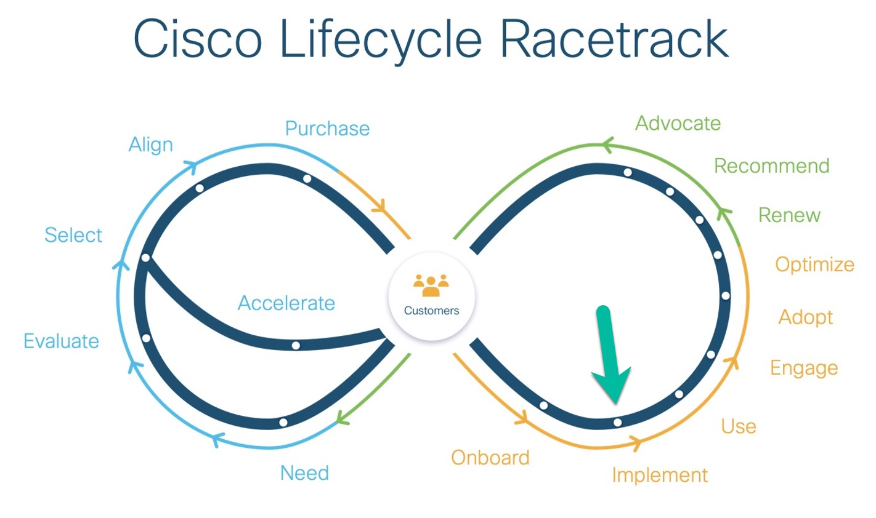
Hybrid Application Monitoring Pitstop: Implement

Slide 6
Pitstop: Implement has failed health check best-practices

Slide 7
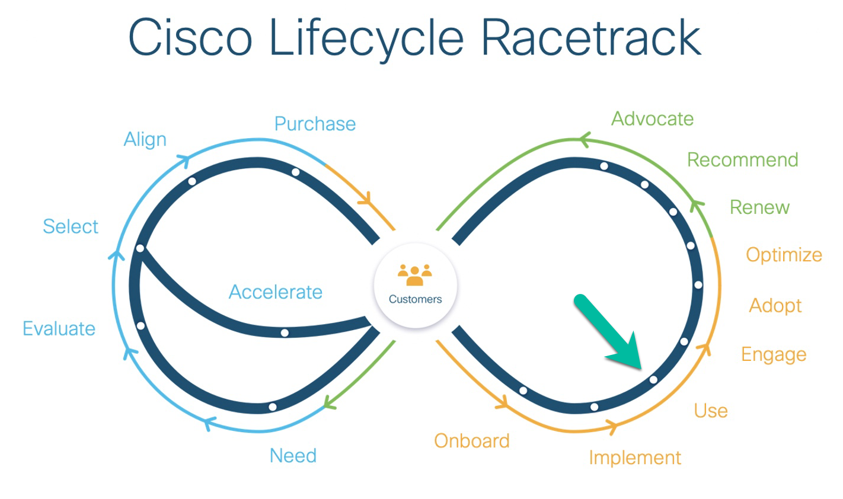
Hybrid Application Monitoring Pitstop: Use

Slide 8
Pitstop: Use has failed health check best-practices

Slide 9
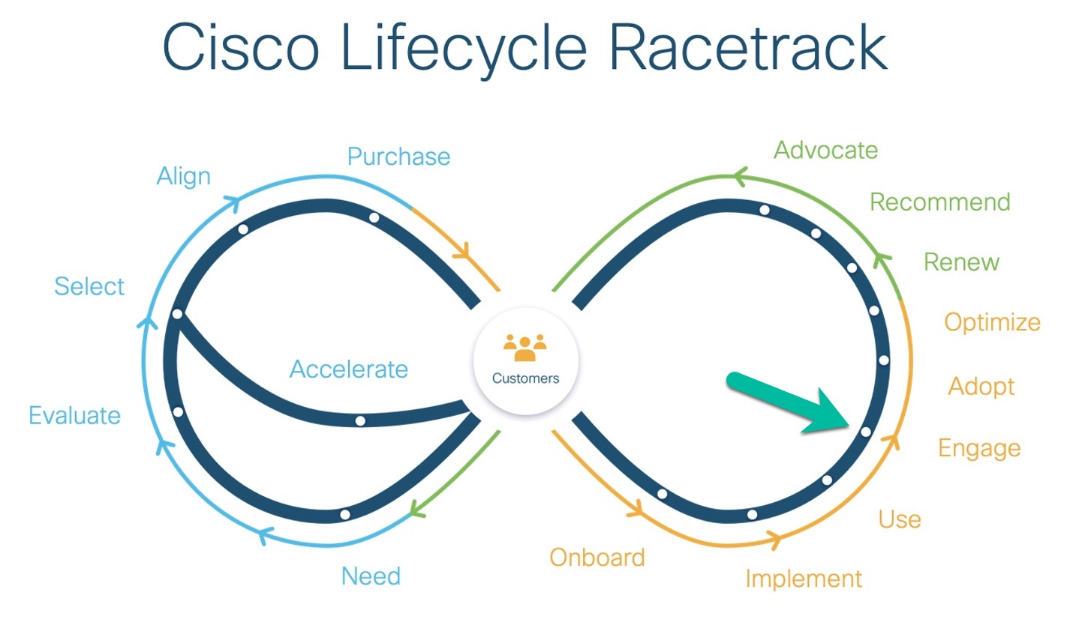
Hybrid Application Monitoring Pitstop: Engage

Slide 10
Pitstop: Engage has failed health check best-practices

Slide 11
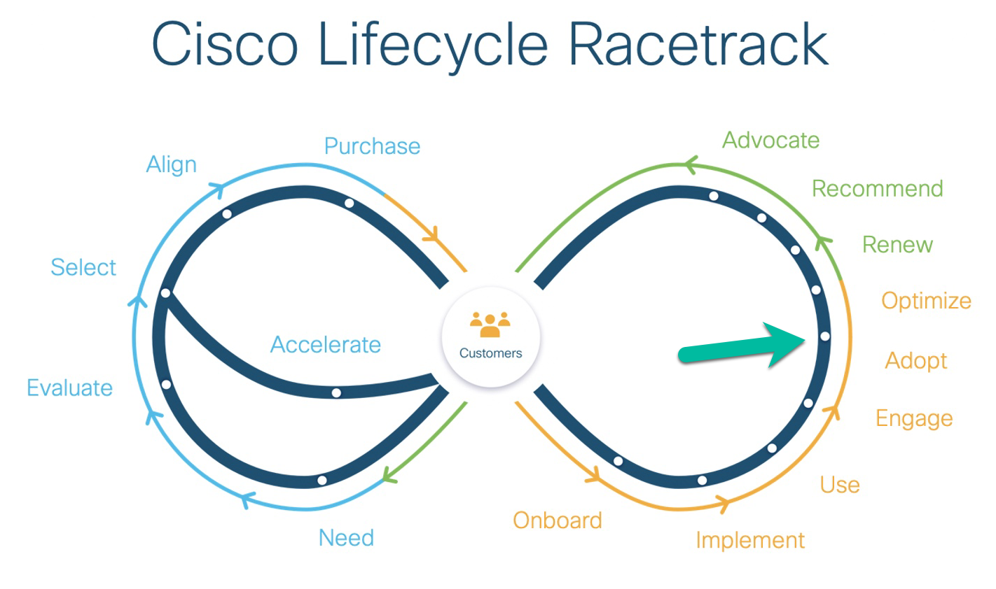
Hybrid Application Monitoring Pitstop: Adopt

Slide 12
Pitstop: Adopt has failed health check best-practices

Slide 13
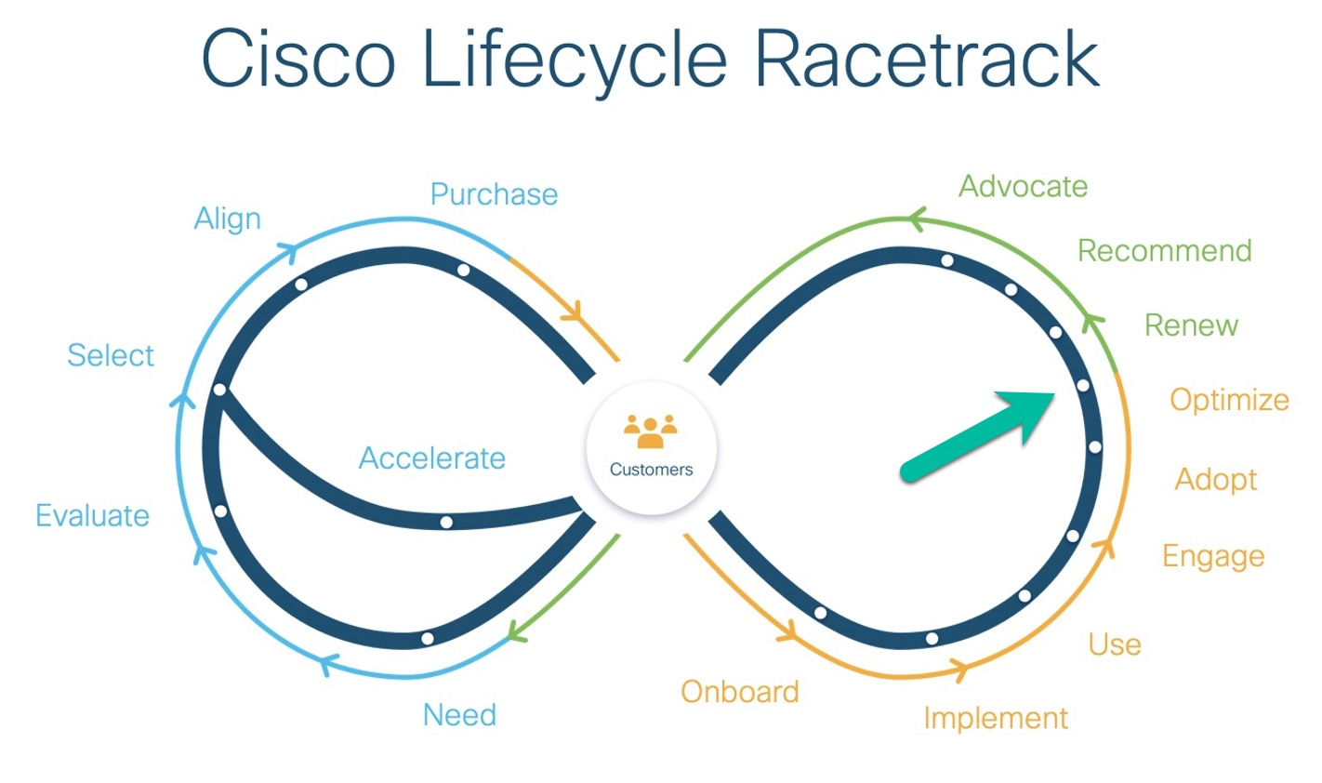
Hybrid Application Monitoring Pitstop: Optimize

Slide 14
Pitstop: Optimize has failed health check best-practices

