Slide 1

Hybrid Application Monitoring (AppDynamics)
Digital Journey Overview
Maturity Assessment Report

Slide 2
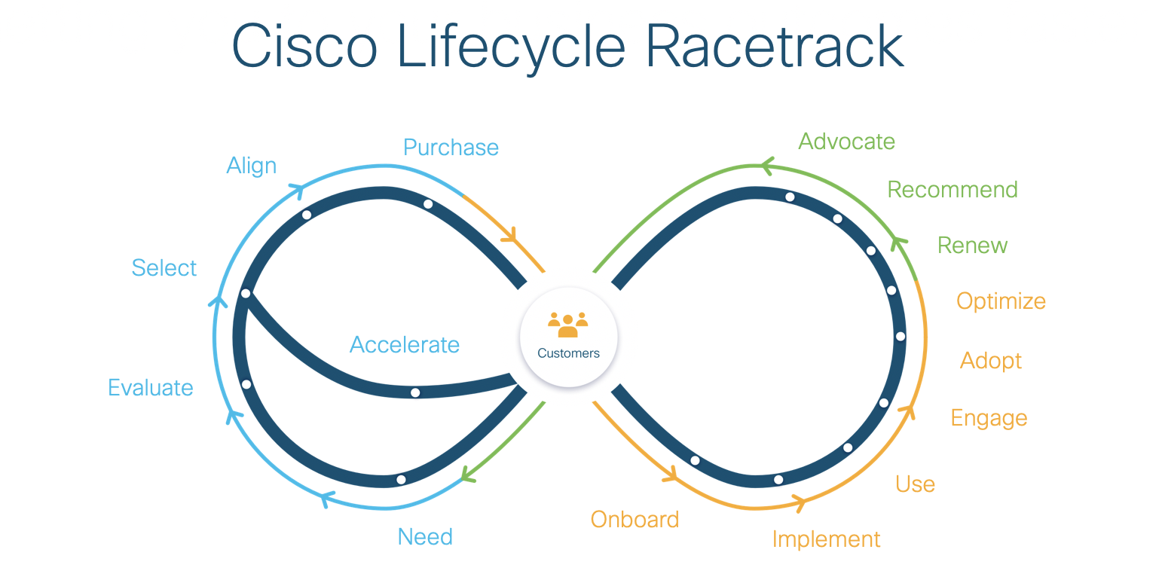

Slide 3
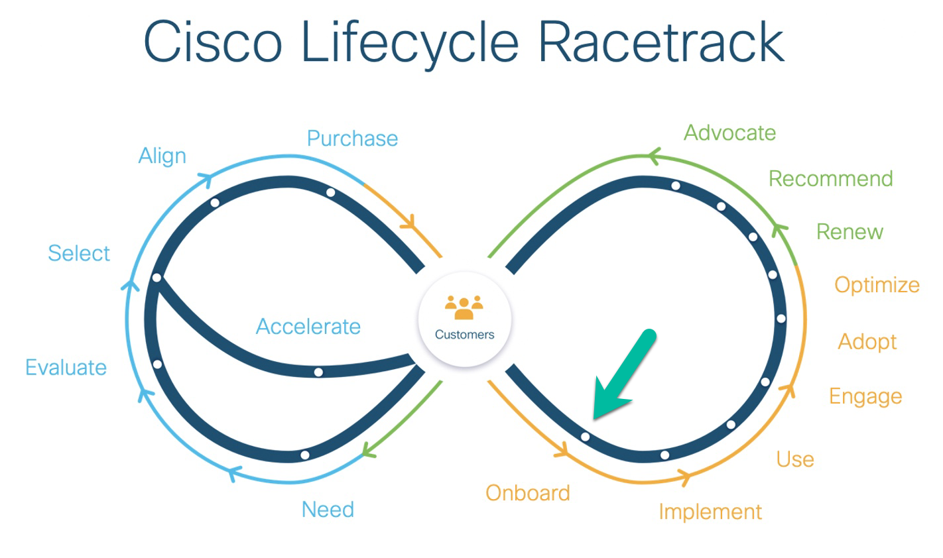
Hybrid Application Monitoring Baseline Journey – Onboard

Slide 4
Onboard failed health check recommendations

Slide 5
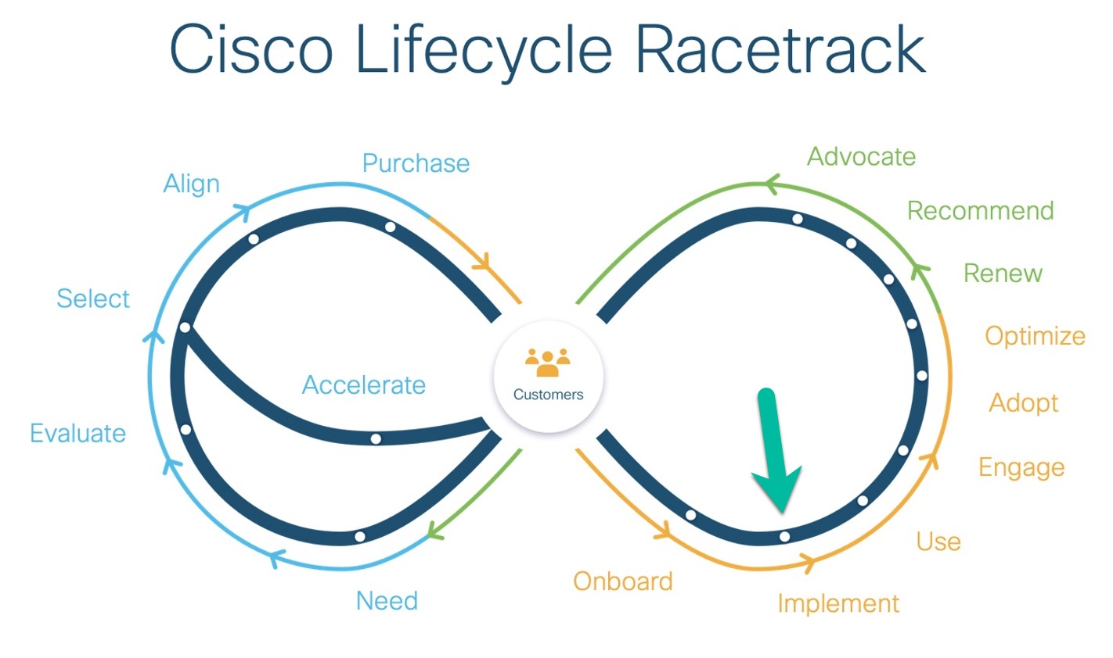
Hybrid Application Monitoring Baseline Journey - Implement

Slide 6
Implement failed health check recommendations

Slide 7
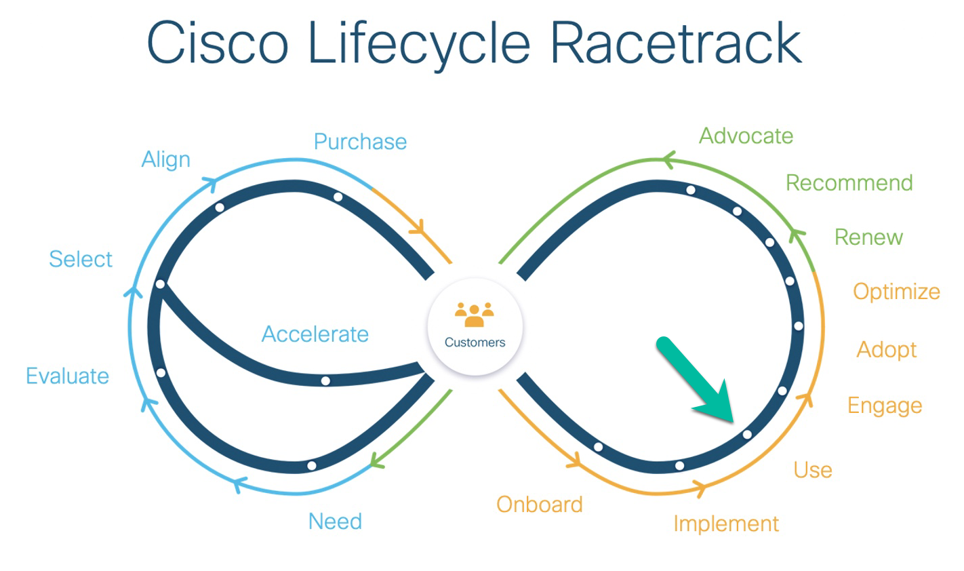
Hybrid Application Monitoring Baseline Journey - Use

Slide 8
Use failed health check recommendations

Slide 9
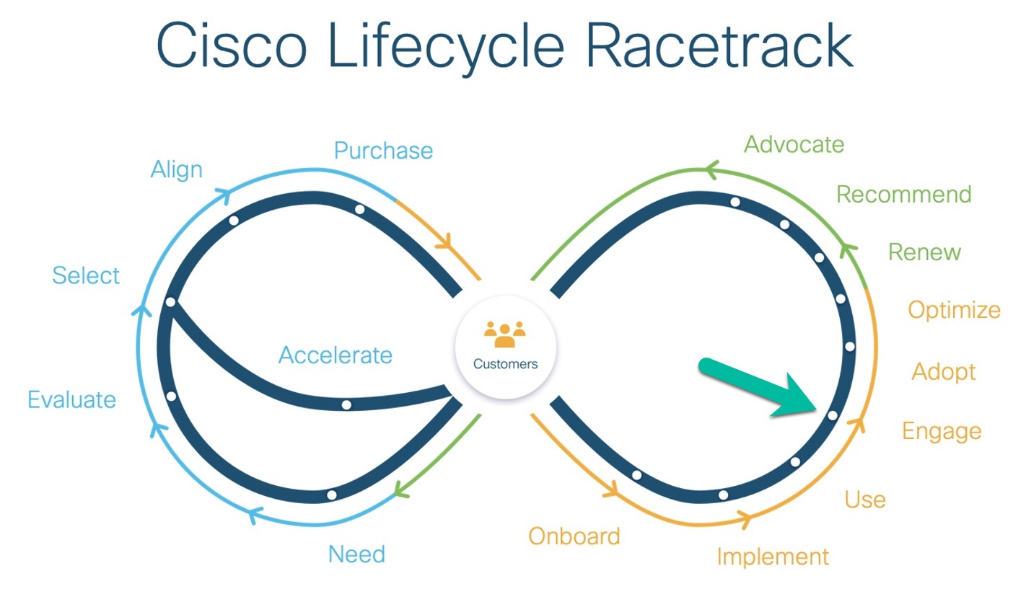
Hybrid Application Monitoring Baseline Journey - Engage

Slide 10
Engage failed health check recommendations

Slide 11
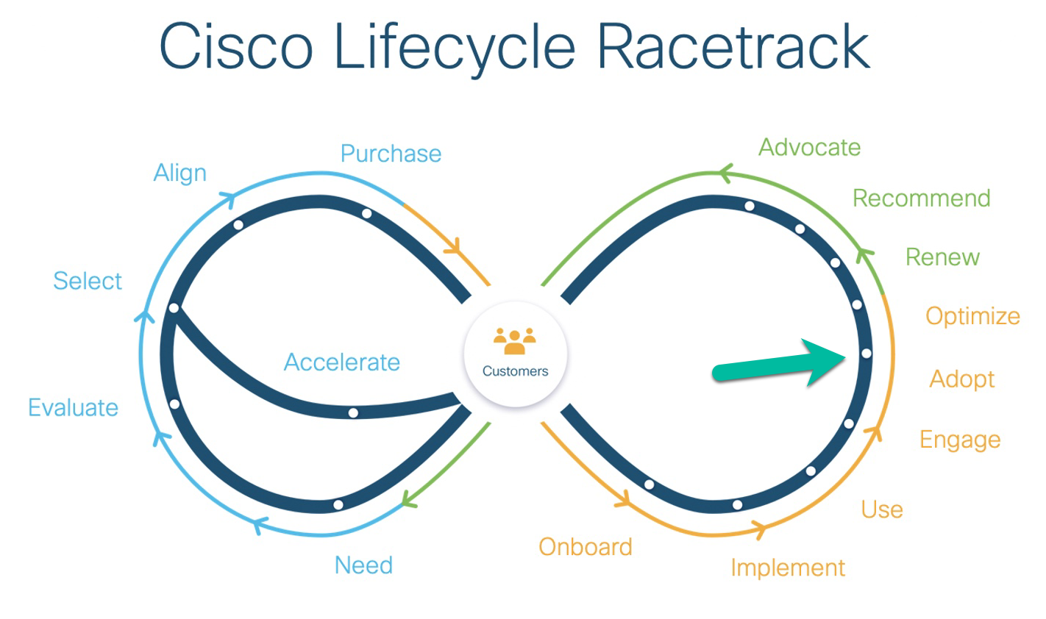
Hybrid Application Monitoring Baseline Journey - Adopt

Slide 12
Adopt failed health check recommendations

Slide 13
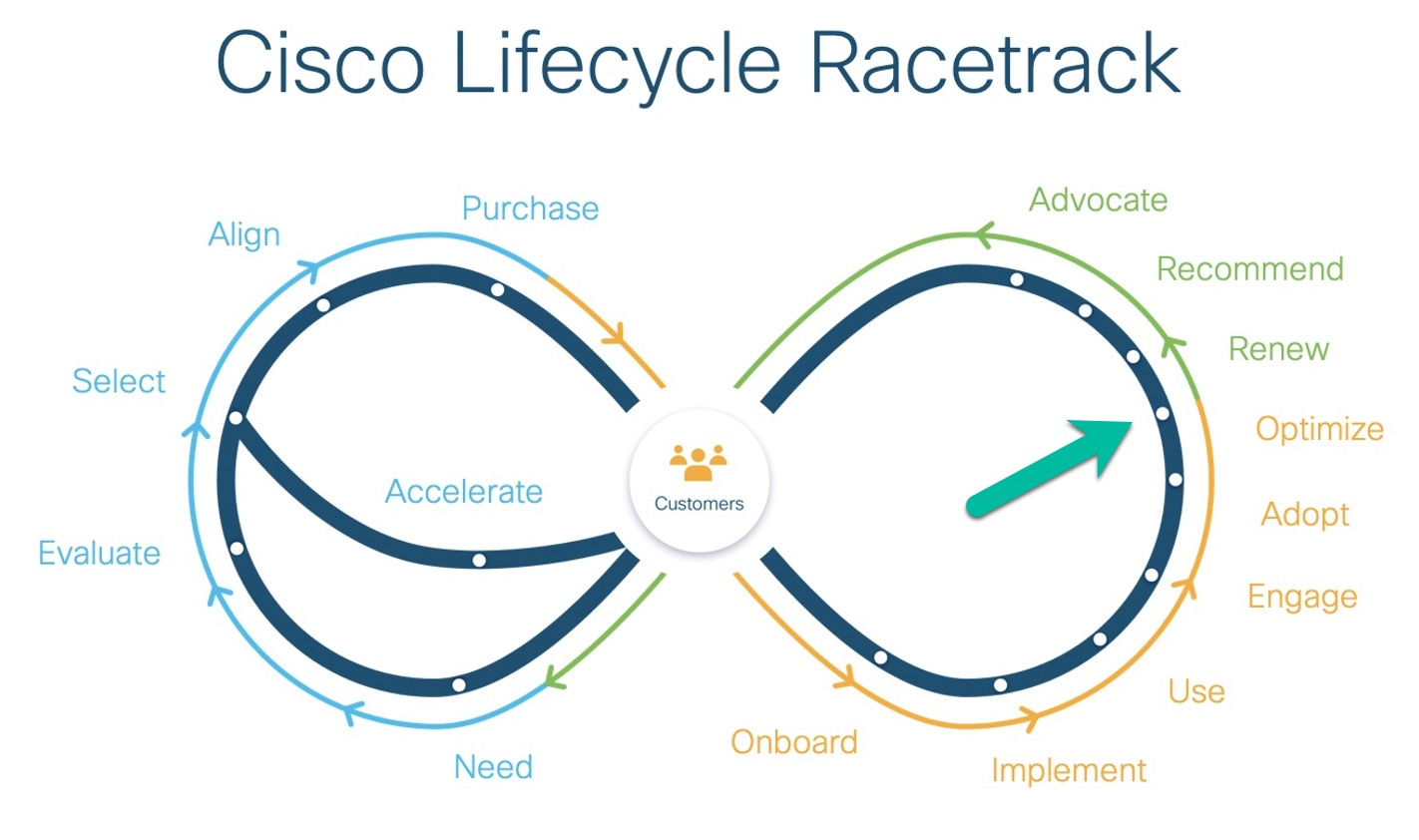
Hybrid Application Monitoring Baseline Journey - Optimize

Slide 14
Optimize failed health check recommendations

