Slide 1


Slide 2


Slide 3
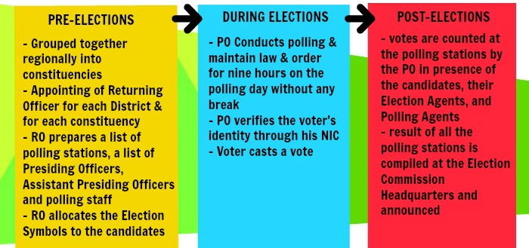
In the present electoral system of Pakistan, the National Assembly is elected directly by the people of Pakistan. The Election Commission of Pakistan is a constitutionally established institution responsible for holding elections countrywide. The diagram below shows how the commission holds an election in the country.

Slide 4
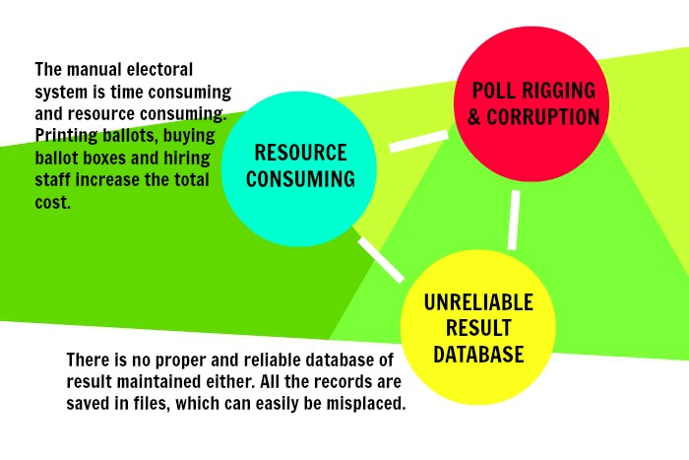

Slide 5



Slide 6
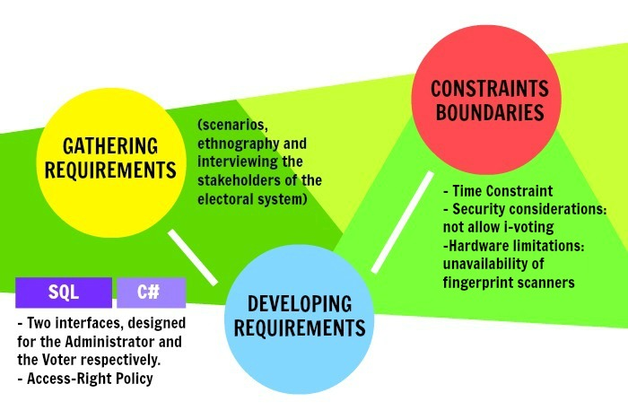
Notes:
Technologies used: SQL, C#
-CONSTRAINTS:
- Time Constraint: The system needs to be developed and tested in the month of December. Hence, the developer team has decided to use already learnt concepts of C# programming language to design the interface of the program and SQL to create the database.
- Security considerations: Vote Dou shall not allow i-voting. I-voting is voting from one's personal computer, mobile phone, television via the internet. As i-voting doesn’t ensure the validity of a person’s vote, the Vote Dou software shall not provide the facility of online voting. Polling booth shall be guarded with security personnel that would prevent any external threats from disrupting the process of voting.
-Hardware limitations: Vote Dou 1.0 is a working prototype implementation of the actual e-voting system. Presently, it cannot avail the finger print user authentication procedure to secure user logins due to unavailability of scanners. In the future versions, the development team can either utilize the scanning devices already available in the market or write a program to scan and match a picture captured using a digital camera.

Slide 7

Vote Dou 1.0 is an electronic voting system that will automate the process of casting a vote and counting votes. It is presented as an alternative to the existing parliamentary voting procedure present in Pakistan.
Notes:
A

Slide 8



There are three types of users that will operate the software as follows. Each of these users will be provided a username and password to access the system.
The database administrator - The DBA plays the administrative role in the system. He manages the election details in the database and grants different access rights to users. He is entrusted with the job of inserting details about the election candidates, the eligible voters and the constituencies.
The election officer -The election commission can filter the results by Constituency or Party Name and generate a report to announce results.
The Voter - The voter shall login into the system using his CNIC number. If verified, he can cast a vote and submit it. Every voter can cast only one vote.
Notes:
A

Slide 9
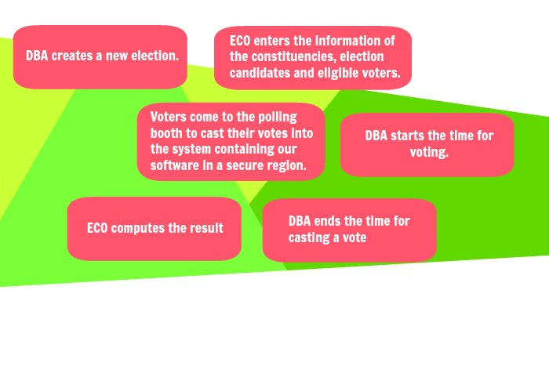
The Diagram of the system shows how the election shall proceed with Vote Dou and how the system functions relate to each other.
Notes:
N

Slide 10

Notes:
G

Slide 11


Slide 12
Vote Dou 1.0 provides a set of tools that allow voters to cast ballots while the election commission collects votes and outputs the final result. It performs the following functions:
It implements a user access right policy through user identity authentication at login. Each user is provided with a username, a password and different access rights according to the roles of the Administrator, Election Commission Officer and the Voter.
It provides the administrator with an easy-to-understand interface to manage elections. A new election session can be created or an existing one can be edited using an election ID. Information about the constituencies, candidates and voters can be inserted, edited and deleted.
The Voter Interface runs on the electronic voting machines located at the polling stations and is used to cast a vote by the voter.
It provides the Election Commission officer with a user-friendly interface to view the election information and compute the results. The officer can filter the results by Constituency or Party Name and generate a report to announce results.
The administrator can create a backup of an election session and store all the information about the contesting candidates, voters, constituency results and final results.
Notes:
User identity authentication at login & Access Right Policy.
Logging in to the Vote Dou software shall require user identity authentication. The system should be password protected with utmost care being taken by the ECO, ensuring that the passwords are provided only to the required individuals. As an improvement to the user identity authentication process, Fingerprint of the users can be scanned to log in to the system. The scanned finger prints is matched against the finger print of the specific individual stored in the NADRA database. A scanning device is needed to acquire the finger print and will be connected to the voting terminal that runs Vote Dou.
2) Pre-voting phase Requirements
In the pre-voting phase the database administrator (DBA) creates a new election and enters the information of the constituencies, election candidates and eligible voters using the information provided by the Election Commission of Pakistan. This phase constitutes of a number of functionalities as shown in the use case:
3) Voting & Post-Voting phase Requirements
In the voting phase,
the database administrator starts the time for voting.
Voters come to the polling booth to cast their votes into the system containing our software in a secure region.
Eventually,
the database administrator ends the time for casting a vote.
It provides the Election Commission officer with a user-friendly interface to view the election information and compute the results. The officer can filter the results by Constituency or Party Name and generate a report to announce results.

Slide 13
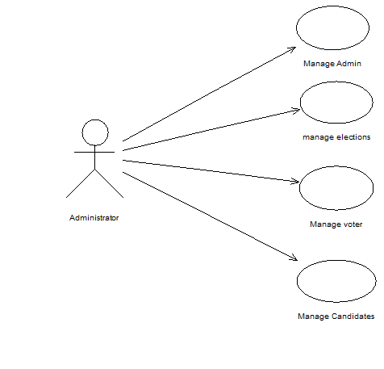
2) Pre-voting phase Requirements
In the pre-voting phase the database administrator (DBA) creates a new election and enters the information of the constituencies, election candidates and eligible voters using the information provided by the Election Commission of Pakistan. This phase constitutes of a number of functionalities as shown in the use case:

Slide 14
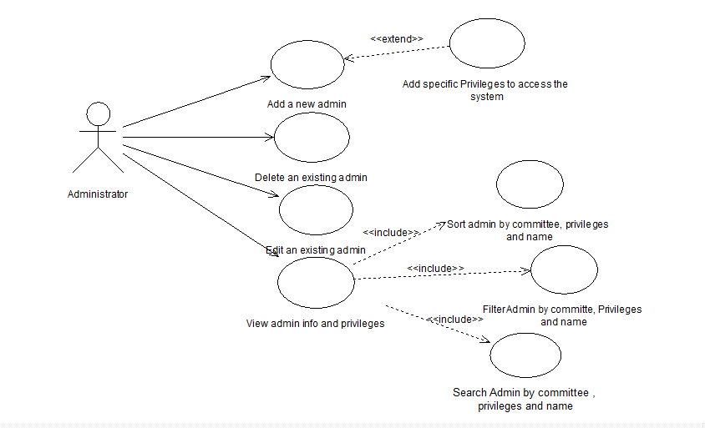
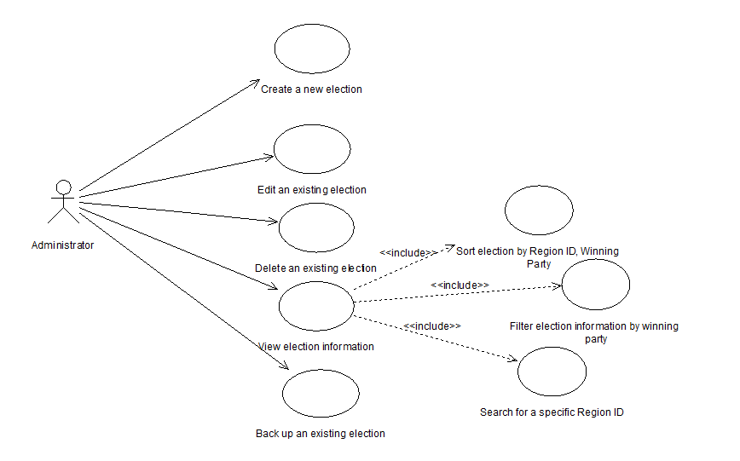
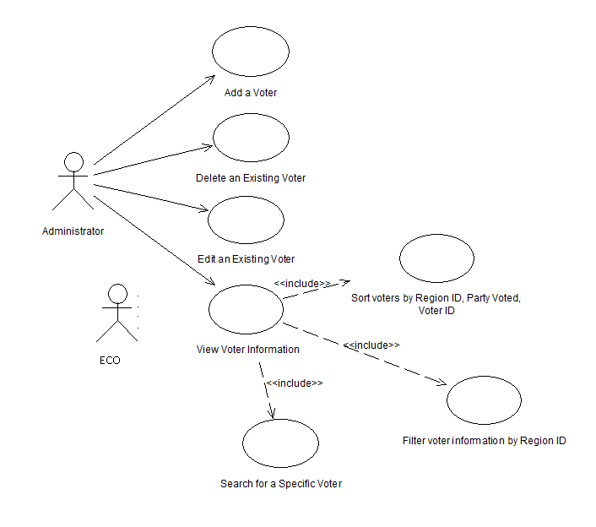
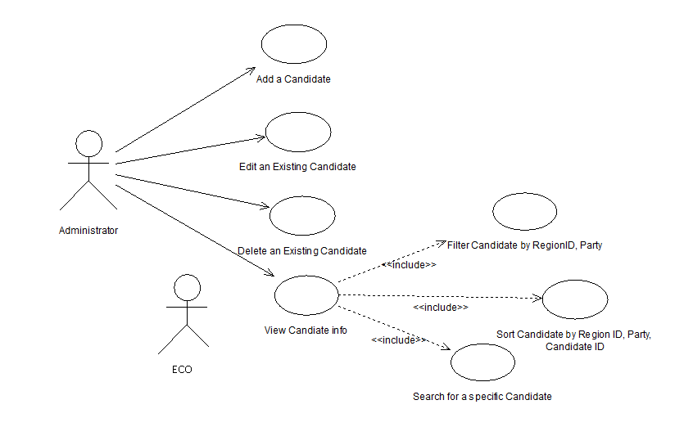
The Manage Administrator Module
The Manage Elections Module
The Manage Voter Module
The Manage Candidate Module

Slide 15
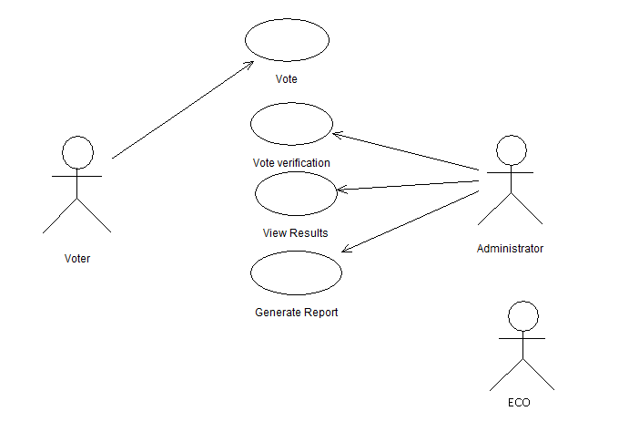
3) Voting & Post-Voting phase Requirements
In the voting phase,
the database administrator starts the time for voting.
Voters come to the polling booth to cast their votes into the system containing our software in a secure region.
Eventually,
the database administrator ends the time for casting a vote.
It provides the Election Commission officer with a user-friendly interface to view the election information and compute the results. The officer can filter the results by Constituency or Party Name and generate a report to announce results.

Slide 16
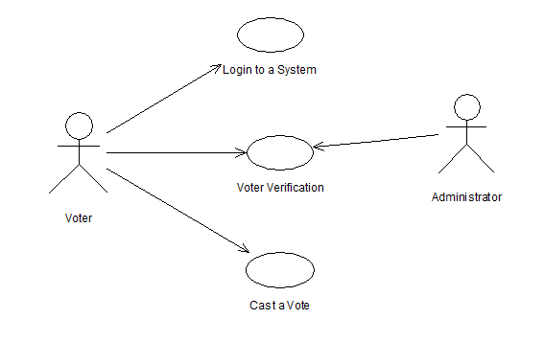
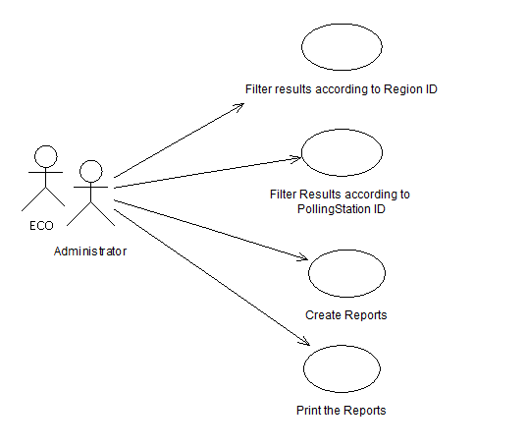
Submit a Vote Module
Result Management Module

Slide 17
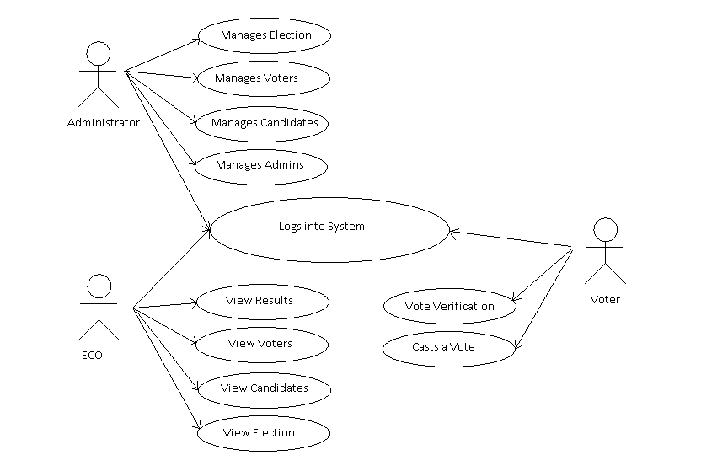
The following use case diagram encapsulates the entire system and all possible actors.

Slide 18
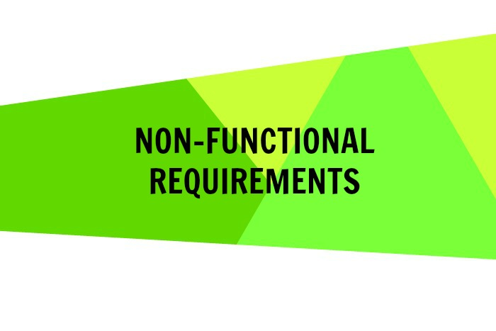

Slide 19
1. Safety and Security Requirements
We considered the possible loss that could result from the product use. This included password leak, hacking and i-voting.
Vote Dou must not violate the ISO security standards and it must be in compliance with the ACM/IEEE ethical standards.
Password protected login. Password to be provided to each user with different access rights according to the roles of the Administrator, Election Commission Officer and the Voter. (Requirement)
The passwords generated should contain a minimum of 7 alpha-numeric characters.
Integrating a finger scanning device with the software that checks the user’s finger print against the finger print of the user that is stored in the NADRA database. (Recommended)
Complete protection to safeguard the data against malicious users that may attempt to hack into the database and manipulate the election results. Experts in security and hacking must be asked to check for any loop holes in the security.
Notes:
POSSIBLE LOSS THAT COULD RESULT FROM PRODUCT USE
If the login process is not password protected, the validity of a person’s vote will not be ensured. Hence, Logging in to the Vote Dou software shall require user identity authentication. The system should be password protected with utmost care being taken by the ECO, ensuring that the passwords are provided only to the required individuals. As an improvement to the user identity authentication process, Fingerprint of the users can be scanned to log in to the system. The scanned finger prints is matched against the finger print of the specific individual stored in the NADRA database. A scanning device is needed to acquire the finger print and will be connected to the voting terminal that’s runs Vote Dou.
If the database is hacked, confidential information about the voter can be leaked or fake votes can be casted. Hence, Preventive measures should be taken to ensure that hacking into the Vote Dou database is impossible.
Vote Dou shall not allow i-voting. I-voting is voting from one's personal computer, mobile phone, television via the internet. As i-voting doesn’t ensure the validity of a person’s vote, the Vote Dou

Slide 20
2) Software Quality Attributes
RELIABILITY: The system’s availability and data integrity cannot be jeopardized at any cost
ROBUSTNESS: It is crucial that the system does not produce unwanted results in the case of a system failure
ADAPTABILITY: As there will be both educated people and uneducated people using the software, it is very important that the software provides a simple user interface.
MAINTAINABILITY: Vote Dou 1.0 must be designed and implemented in such a manner that it is adaptable to both software and hardware upgrades.
Notes:
Software Quality Attributes
RELIABILITY
The system’s availability and data integrity cannot be jeopardized at any cost. As the system plays a very significant role in the national elections, a system crash means that the software is unavailable to cast and submit a vote at a polling station. This will affect the whole voting process and cause inconvenience to both the voters and the election commission officers. Hence, the system must be properly tested using validation and defect checks and all the errors should be debugged. The mean time to failure should not be less than 2400 hours.
It is very important that that the software ensures data integrity as well. All database transactions must be carried out using COMMIT and ROLLBACK statements and locking to ensure data consistency. Moreover, a complete protection must be provided to safeguard the data against malicious users that may attempt to hack into the database and manipulate the election results. Experts in security and hacking must be asked to check for any loop holes in the security.
ROBUSTNESS
It is crucial that the system does not produce unwanted results in the case of a system failure. In case of a failure, all processing transactions should be rolled back and there should be no loss of information or data corruption in any situation. The probability for data corruption on failure should be 0. It should not take more than 5 minutes for the system to restart in case of a failure (preferably 3 minutes) as time plays an important part in the process of an election.
During the testing phase, test cases should be modeled to perform defect testing using correct inputs, extreme inputs (maximum/minimum values) and incorrect data with known errors. This will check how the system will cope with errors during execution.
ADAPTABILITY
Vote Dou 1.0 will be presented as an alternative to the existing parliamentary voting procedure present in Pakistan. Hence, its adaptability to the working domain is significant. As there will be both educated people and uneducated people using the software, it is very important that the software provides a simple user interface. The interface must only demand basic operations such as entering the NIC number and clicking on the respective candidate of the constituency belonging to a certain party from both the national and provincial assemblies.
The voters will be using this software for the first time during the elections so it is necessary that the voters adapt to the system easily and quickly. They should not make a mistake while casting their votes electronically. The average number of people to make a successful poll before a voter error occurs should be 10000. The mean time taken for the voter to cast the vote after logging in should be 45 seconds.
MAINTAINABILITY
An important requirement is maintainability and evolution of the system. Vote Dou 1.0 must be designed and implemented in such a manner that it is adaptable to both software and hardware upgrades. Hardware upgrades may include scanning devices to implement the finger print security system. Software upgrades may include expanding the functionality or adding a firewall.
This flexibility to change can be implemented using classes and inheritance.

Slide 21
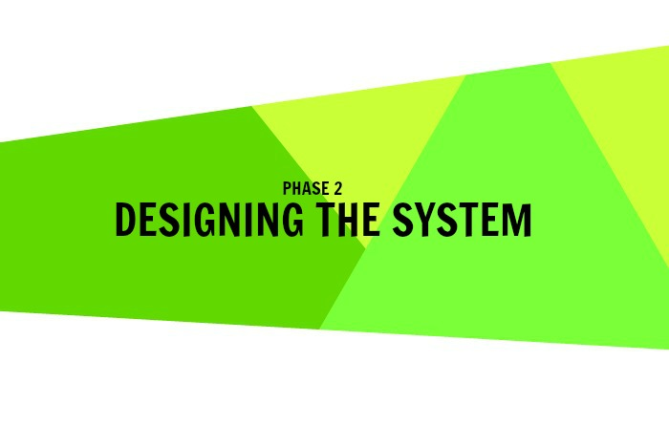
Notes:
N

Slide 22
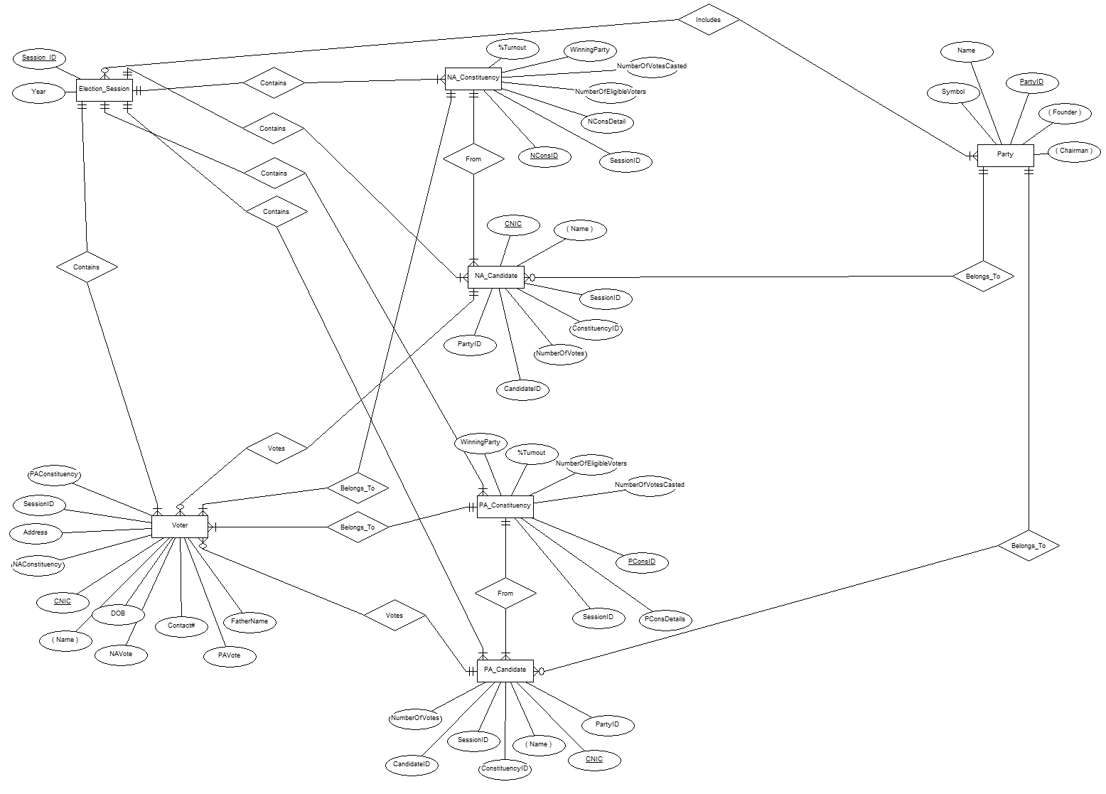
Entity Relationship Diagram
Start
End
Type

Slide 23

Administrator (Admin_ID, First Name, Last Name, CNIC, Contact, Password) (BCNF)
ECO(ECO_ID, First Name, Last Name, CNIC, Contact, Password) (BCNF)
Mega Relations
Voter(CNIC, First Name, Last Name, Contact, Father Name, Date Of Birth, Address, Session ID, Password, NAConstituency ID, PAConstituency ID, NA Candidate ID, PA Candidate ID, Voted)
Election(Session ID, Year, Type, StartTiem,EndTime PAConstituency ID, PAConstituency Details, NAConstituency ID, NAConstituency Details, Candidate ID, First Name, Last Name, CNIC, Party ID, Party Name, Founder)
BCNF? No.
Good Design? No.

Slide 24
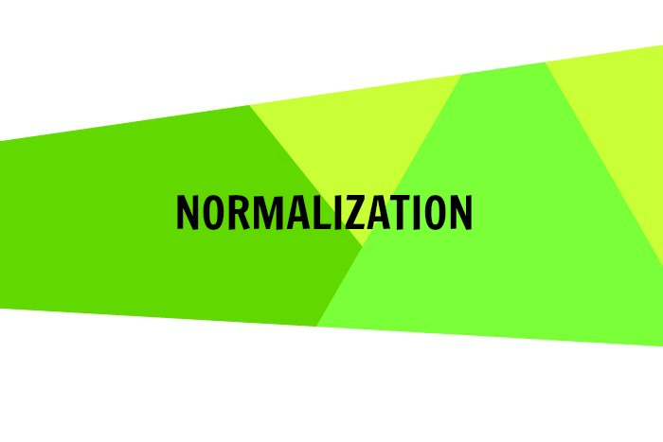

Slide 25
Functional Dependencies
Voter CNIC -----> First Name, Last Name, Contact, Father Name, Date Of Birth, Address
Election Session ID ----->Year,Type,StartTime,EndTime
PAConstituency ID -----> PAConstituency Details,
NAConstituency ID -----> NAConstituency Details,
Candidate ID -----> First Name, Last Name, CNIC
Candidate ID ------>Party ID
Party ID -----> Party Name, Founder
Voter CNIC, Session ID----->NAConstituency, Candidate ID
Voter CNIC, Session ID----->PAConstituency, Candidate ID
Voter CNIC, Session ID-----> Password, Voted
Multi Value Dependencies
Voter CNIC----->>Session ID
Election Session ID, PAConstituency ID ----->> Candidate ID
Election Session ID , NAConstituency ID ----->> Candidate ID

Slide 26
Voter(CNIC, First Name, Last Name, Contact, Father Name, Date Of Birth, Address, Session ID, Password, NAConstituency, PAConstituency, NAVote, PAVote, Voted)
Voter CNIC -----> First Name, Last Name, Contact, Father Name, Date Of Birth, Address
Voter CNIC----->>Session ID
Voter CNIC, Session ID ---->Password, Voted
Voter CNIC, Session ID----->NAConstituency, Candidate ID
Voter CNIC, Session ID----->PAConstituency, Candidate ID
R1(CNIC, First Name, Last Name, Contact, Father Name, Date Of Birth, Address) (BCNF)
R2(CNIC, Session ID, Password, NAConstituency ID, PAConstituency ID, NA Candidate ID, PA Candidate ID, Voted ) (4NF)

Slide 27
Election(Session ID, Year, PAConstituency ID, PAConstituency Details, NAConstituency ID, NAConstituency Details, Candidate ID, First Name, Last Name, CNIC, Party ID, Party Name, Founder, Chairman)
Election Session ID ----->Year, Type, StartTime, EndTime
R3(Session ID, Year, Type, StartTime, EndTime) (BCNF)
R4(Session ID, PAConstituency ID, PAConstituency Details, NAConstituency ID, NAConstituency Details, Candidate ID, First Name, Last Name, CNIC, Party ID, Party Name, Founder, Chairman)
Candidate ID -----> First Name, Last Name, CNIC, Party ID
Party ID -----> Party Name, Founder
R5(Candidate ID, First Name, Last Name, CNIC, Party ID, Party Name, Founder)
R6(Candidate ID, Session ID, PAConstituency ID, PAConstituency Details, NAConstituency ID, NAConstituency Details)
Party ID -----> Party Name, Founder
R7(Party ID, Party Name, Founder) (BCNF)
R8(Candidate ID, First Name, Last Name, CNIC, Party ID) (BCNF)
Candidate ID -----> Party ID

Slide 28
R9(Candidate ID, Session ID, PAConstituency ID, PAConstituency Details, NAConstituency ID, NAConstituency Details)
Election Session ID, PA/NAConstituency ID ----->> Candidate ID
NAConstituency ID -----> NAConstituency Details,
PAConstituency ID -----> PAConstituency Details,
R10(Candidate ID, Session ID, PA Constituency ID, PAConstituency Details)
PAConstituency ID -----> PAConstituency Details
R12(PA Constituency ID, PAConstituency Details) (BCNF)
R13(PA Constituency ID , Candidate ID, Session ID) (4NF)
R11 (Candidate ID, Session ID,NA Constituency ID, NAConstituency Details)
NAConstituency ID -----> NAConstituency Details
R14(NA Constituency ID, NAConstituency Details) (BCNF)
R15(NA Constituency ID , Candidate ID, Session ID) (4NF)

Slide 29

Notes:
Number of tables, names, detailed table, constraints

Slide 30
Main Tables
Administrator (Admin_ID, First Name, Last Name CNIC, Contact, Password)
ECO(ECO_ID, First Name, Last Name CNIC, Contact, Password)
Voter(CNIC, First Name, Last Name, Contact, Father Name, Date Of Birth, Address)
PA Constituency (PAConstituency ID, Constituency Details)
NA Constituency (NAConstituency ID, Constituency Details)
Candidate(Candidate ID, First Name, Last Name, CNIC, Party ID)
Party ( Party ID, Party Name, Founder, Chairman)
Election Session(Session ID, Year, Type, Start Time, End Time)
Transaction Tables
Participating Voters (CNIC, Session ID, Password, NAConstituency, PAConstituency, NAVote, PAVote, Voted)
Sessional PA Constituency (Constituency ID, Session ID)
Sessional NA Constituency (Constituency ID, Session ID)
PA Contesting Candidate (Candidate ID, Constituency ID, Session ID)
NA Contesting Candidate (Candidate ID, Constituency ID, Session ID)

Slide 31
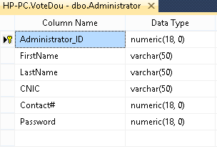
Constraints on Administrator Table
alter table Administrator
add constraint Admin_PK
Primary key(Administrator ID);
alter table Administrator
add constraint Admin_CNIC_unique unique(CNIC);
alter table Administrator
add constraint Admin_password_unique unique(Password);
alter table Administrator
add constraint Admin_CNIC_check check(LEN(CNIC) = 15)

Slide 32
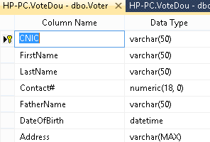
Constraints on Voter Table
alter table Voter
add constraint Voter_PK
Primary Key(CNIC);
alter table Voter
add constraint Voter_CNIC_check check(LEN(CNIC) = 15)
alter table Voter
add constraint Voters_DOB_Check check
(DATEDIFF(year, DateOfbirth,GETDATE()) >=18);

Slide 33
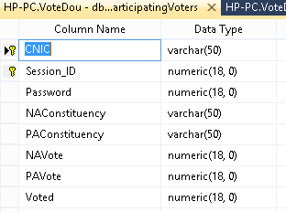
Constraints on Participating_Voter Table
ParticipatingVoter_PK Primary Key(CNIC, Session_ID)
Voter_Password_Unique Unique(Password);
voter_NAConstituency_fk foreign key (NAConstituency) references NAConstituency (NAConstituency_ID);
voter_PAConstituency_fk foreign key (PAConstituency) references PAConstituency (PAConstituency_ID);
voter_session_fk foreign key (Session_ID) references ElectionSession (Session_ID);
voter_CNIC_fk foreign key (CNIC) references Voter (CNIC);
Voter_NAVote_fk foreign key (NAVote) references Candidate (Candidate_ID);
voter_PAVote_fk foreign key (PAVote) references Candidate (Candidate_ID);

Slide 34


Slide 35
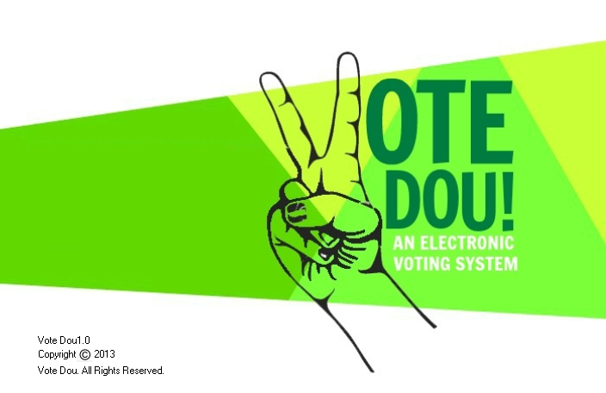
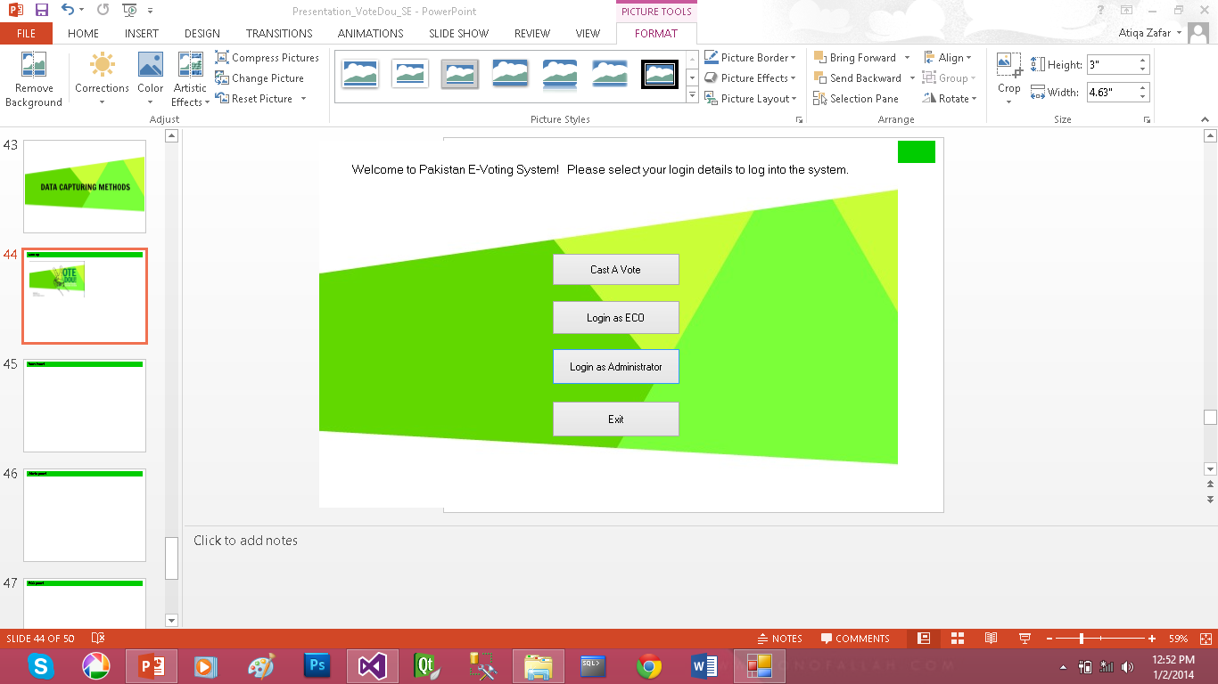
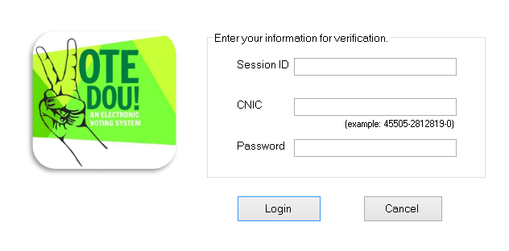
Start up

Slide 36
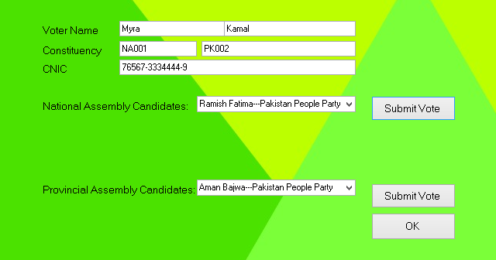
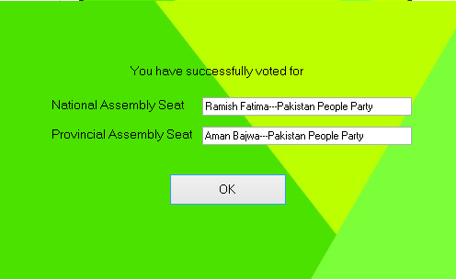
Voter Panel

Slide 37
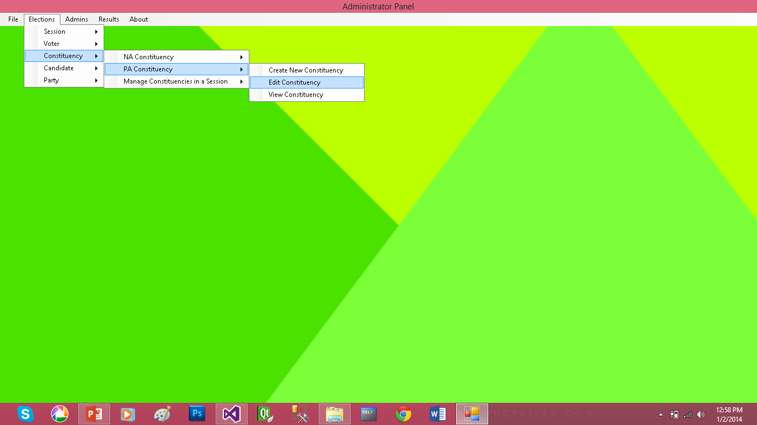
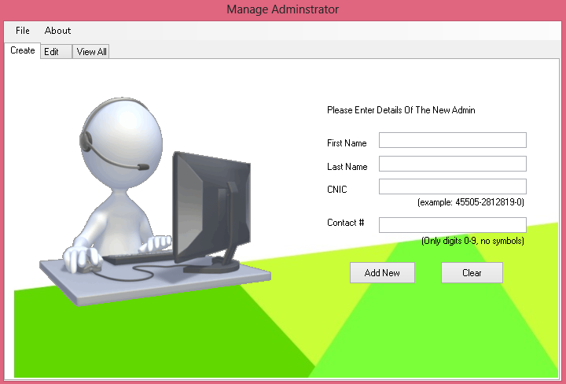
Admin panel

Slide 38
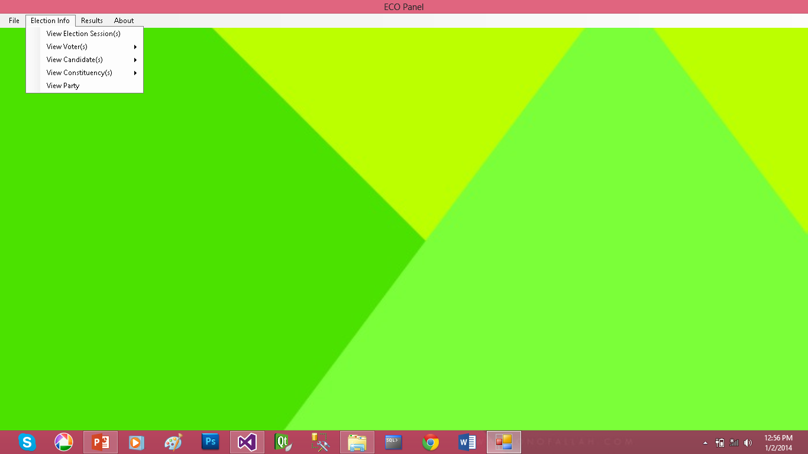
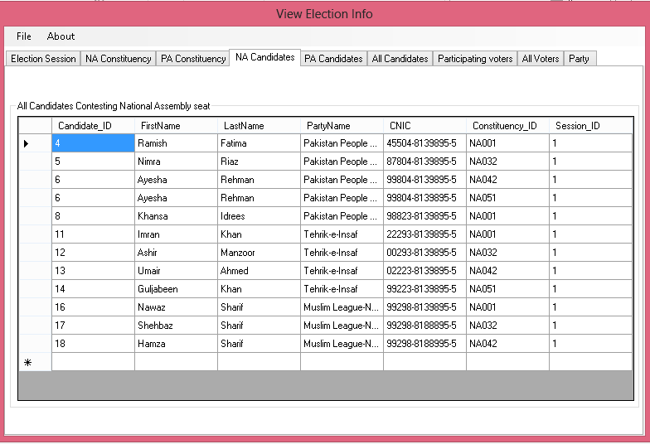
ECO panel

Slide 39


Slide 40
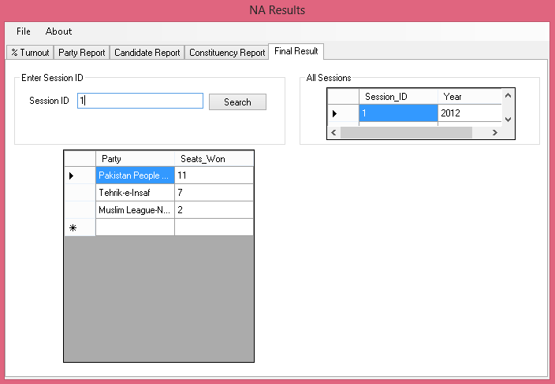
NA result

Slide 41
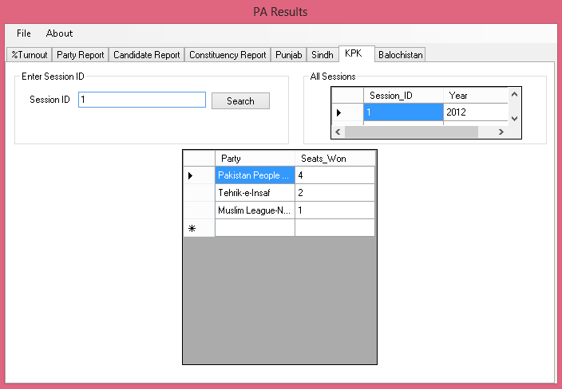
PA Result

Slide 42


