Slide 1


Slide 2


Slide 3
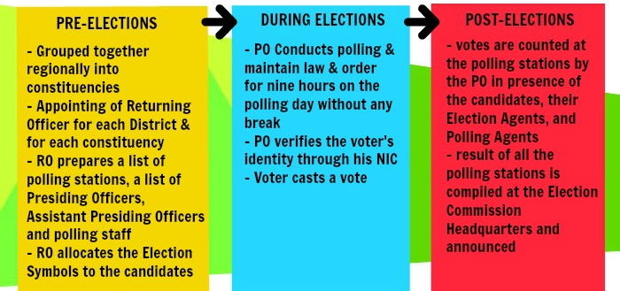
In the present electoral system of Pakistan, the National Assembly is elected directly by the people of Pakistan. The Election Commission of Pakistan is a constitutionally established institution responsible for holding elections countrywide. The diagram below shows how the commission holds an election in the country.
Drawbacks of the current system: 1) Poll Rigging and Corruption. 2) Time consuming & Resource consuming 3) No proper and reliable database of result is maintained

Slide 4



Slide 5
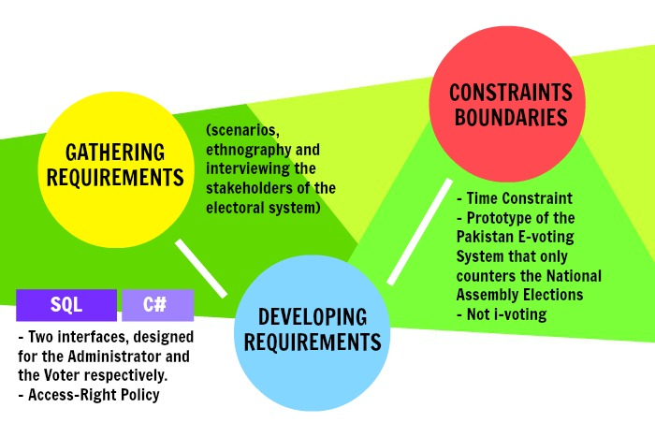

Slide 6


Slide 7
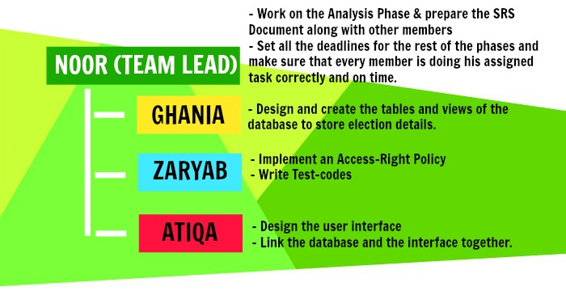
Our proposed database project is to provide a set of reliable, easy-to-use and secure tools that allow voters to cast ballots while the election commission collects votes and outputs the final result. Each of our four team members will work on one of these aspects.

