Slide 1
Dominence

Slide 2
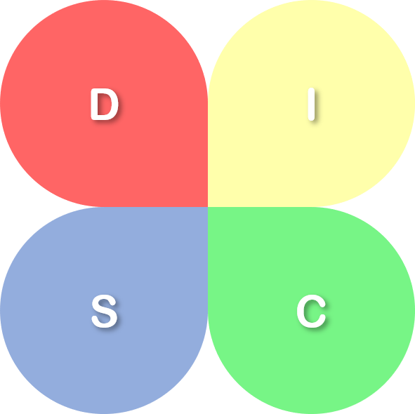
Dominance
(주도형)
Influence
(사교형)
Steadiness
(안정형)
Conscientiousness
(신중형)

