Slide 1
Variational Autoencoder
變分自編碼器
Since 2013

Slide 2
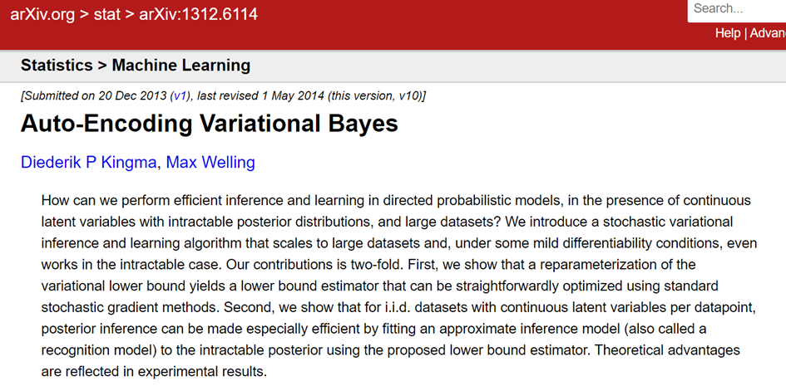
https://arxiv.org/abs/1312.6114

Slide 3
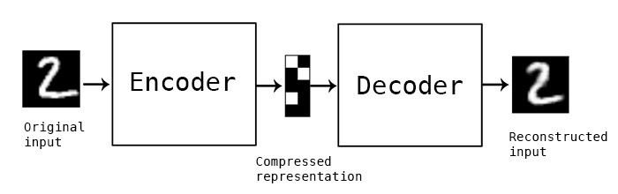
AutoEncoder

Slide 4
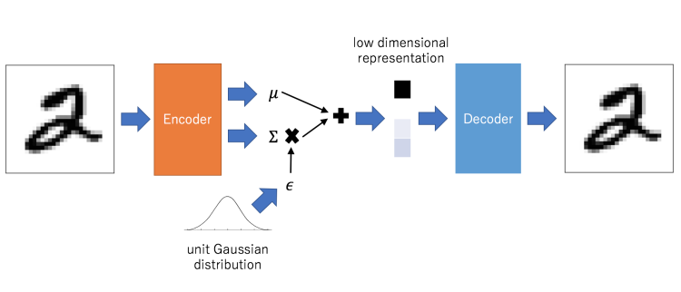
Variational Autoencoders

Slide 5
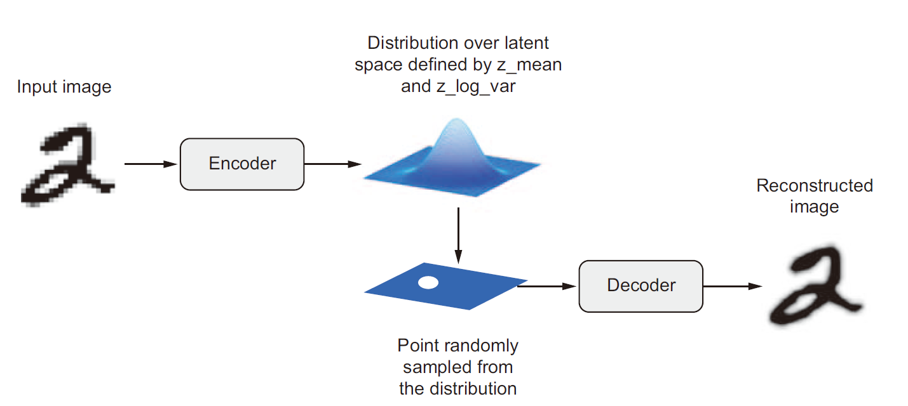
Variational Autoencoders

Slide 6
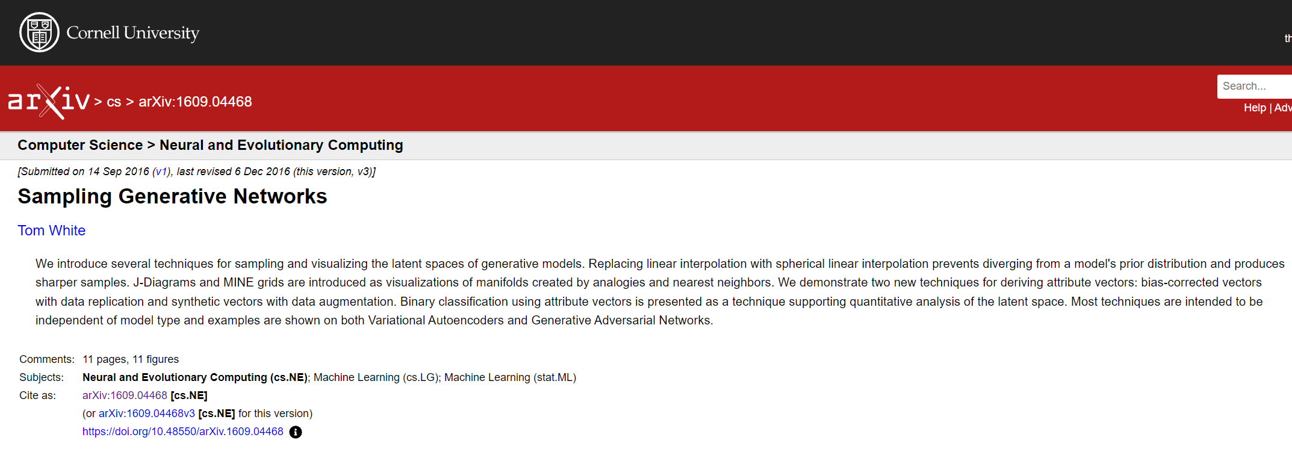

Slide 7
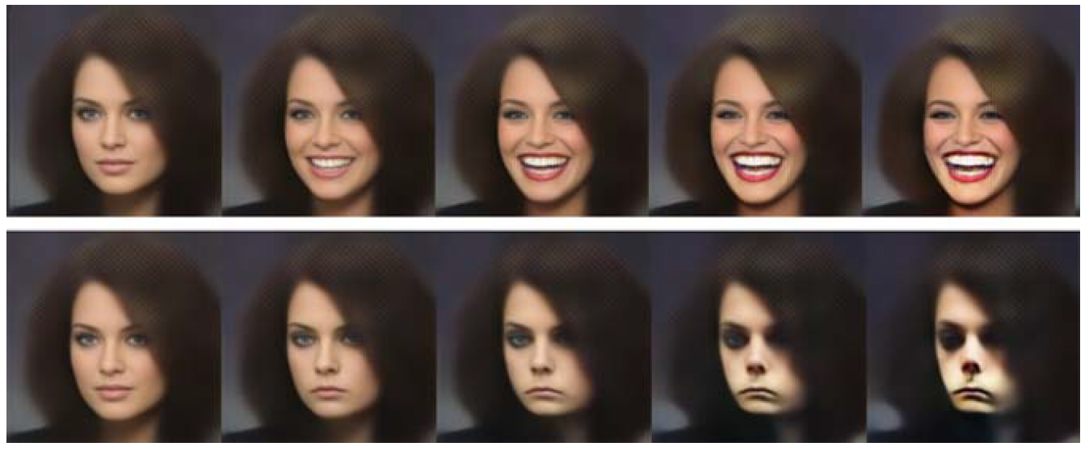
Variational Autoencoders

Slide 8
