Slide 1
Decision Tree

Slide 2



Process (1): Model Construction
Classification
Algorithms
Training
Data
Classifier
(Model)
IF rank = ‘professor’
OR years > 6
THEN tenured = ‘yes’

Slide 3


Process (2): Using the Model in Prediction
Tenured?
Unseen Data
Classifier
(Jeff, Professor, 4)

Slide 4
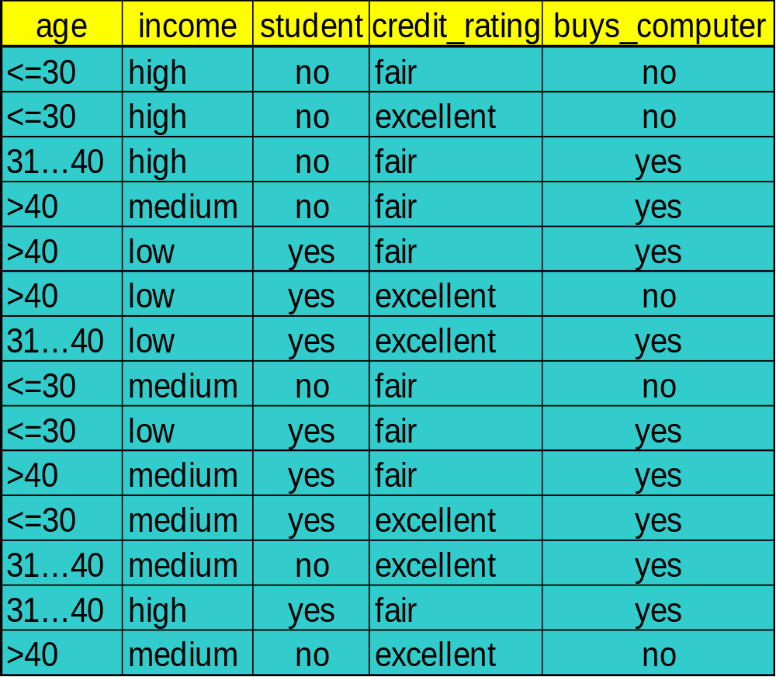
Training data set: Buys_computer
The data set follows an example of Quinlan’s ID3 (Playing Tennis)

Slide 5
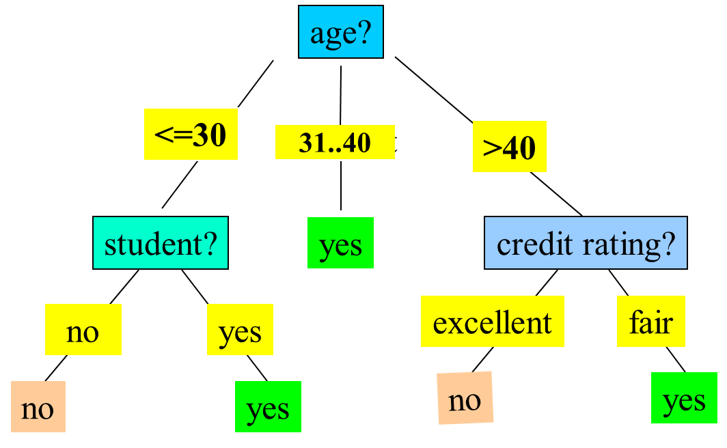
為什麼第一個節點是age
而不是income
RULE(規則)
IF age=31..40 Then buys_computer = yes
IF age>40 and cre =fair Then buys_computer = yes
………..

Slide 6


Brief Review of Entropy
m = 2

Slide 7



Attribute Selection Measure: Information Gain (ID3/C4.5)
屬性選擇 == > 選最大的Select the attribute with the highest information gain
Let p_{i} be the probability that an arbitrary tuple in D belongs to class C_{i}, estimated by |C_{i, D}|/|D|
Expected information (entropy) needed to classify a tuple in D:
Information needed (after using A to split D into v partitions) to classify D:
Information gained by branching on attribute A
Notes:
I : the expected information needed to classify a given sample
E (entropy) : expected information based on the partitioning into subsets by A

Slide 8



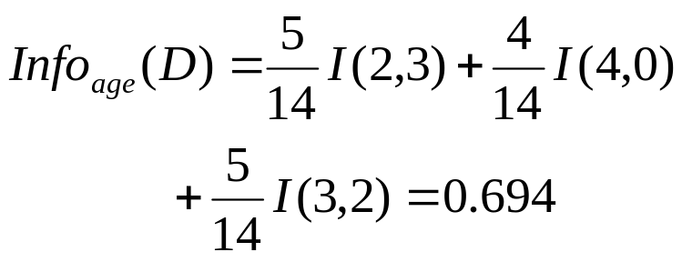

Attribute Selection: Information Gain
完整的
切割的

