Slide 1
Decision_tree

Slide 2
演算法實作: OO
class LinearRegression:
def __init__(self):
pass
def train_gradient_descent(self, X, y, learning_rate=0.01, n_iters=100)
def train_normal_equation(self, X, y):
def predict(self, X):
return np.dot(X, self.weights) + self.bias

Slide 3
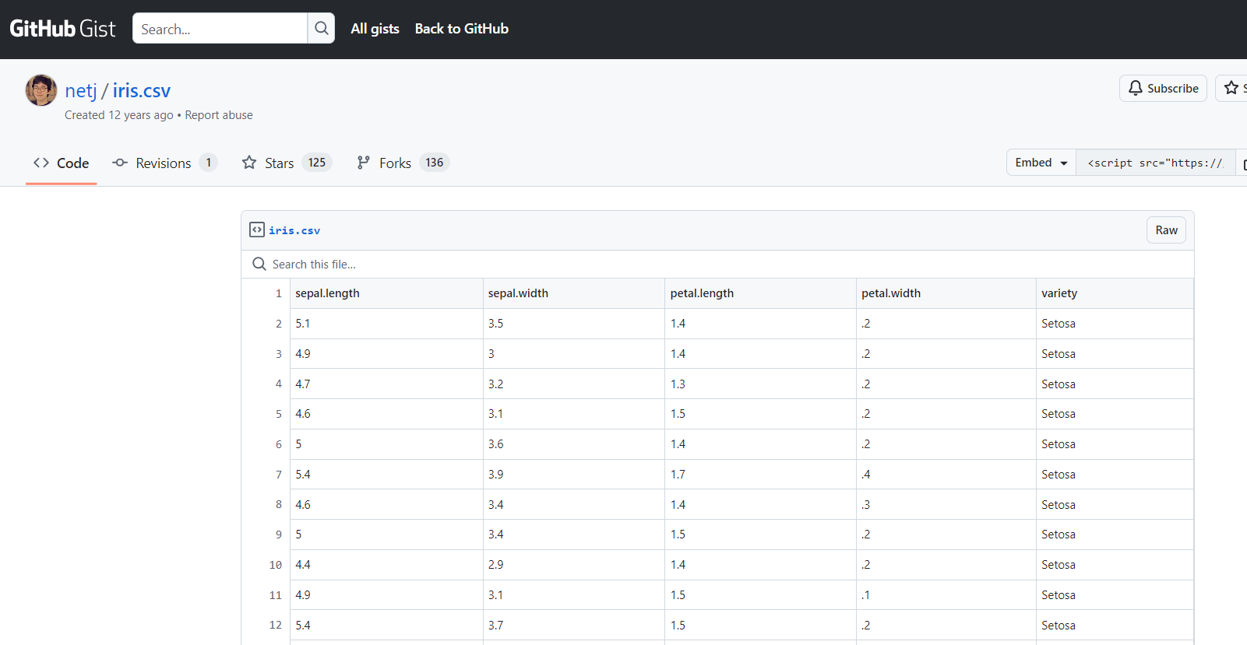
資料集(Data Set):IRIS

Slide 4
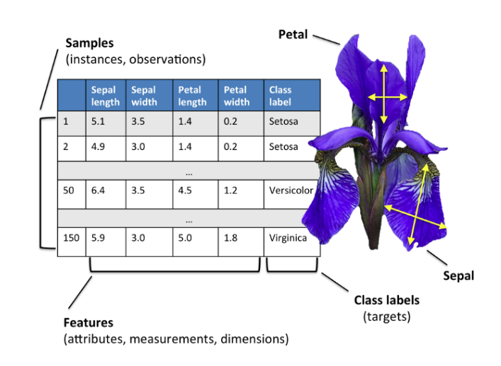
sklearn.datasets
https://scikit-learn.org/stable/datasets.html

Slide 5
sklearn.datasets
from sklearn.datasets import load_iris
# Load the Iris dataset
iris = load_iris()
# Access the features and target variable
X = iris.data # Features (sepal length, sepal width, petal length, petal width)
y = iris.target # Target variable (species: 0 for setosa, 1 for versicolor, 2 for virginica)
# Print the feature names and target names
print("Feature names:", iris.feature_names)
print("Target names:", iris.target_names)

Slide 6
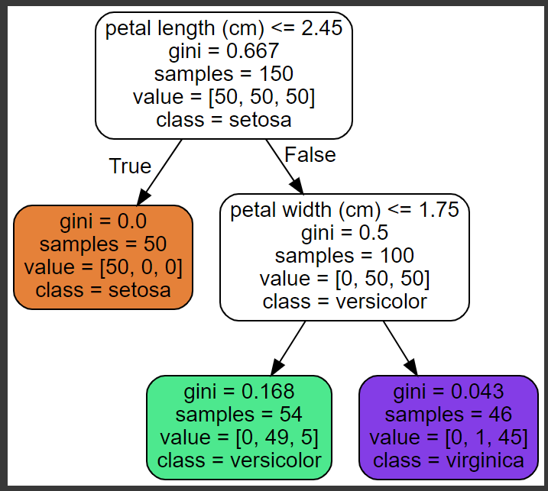
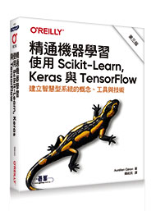
使用scikit-learn ch 6 Decision tree

Slide 7
