Slide 2
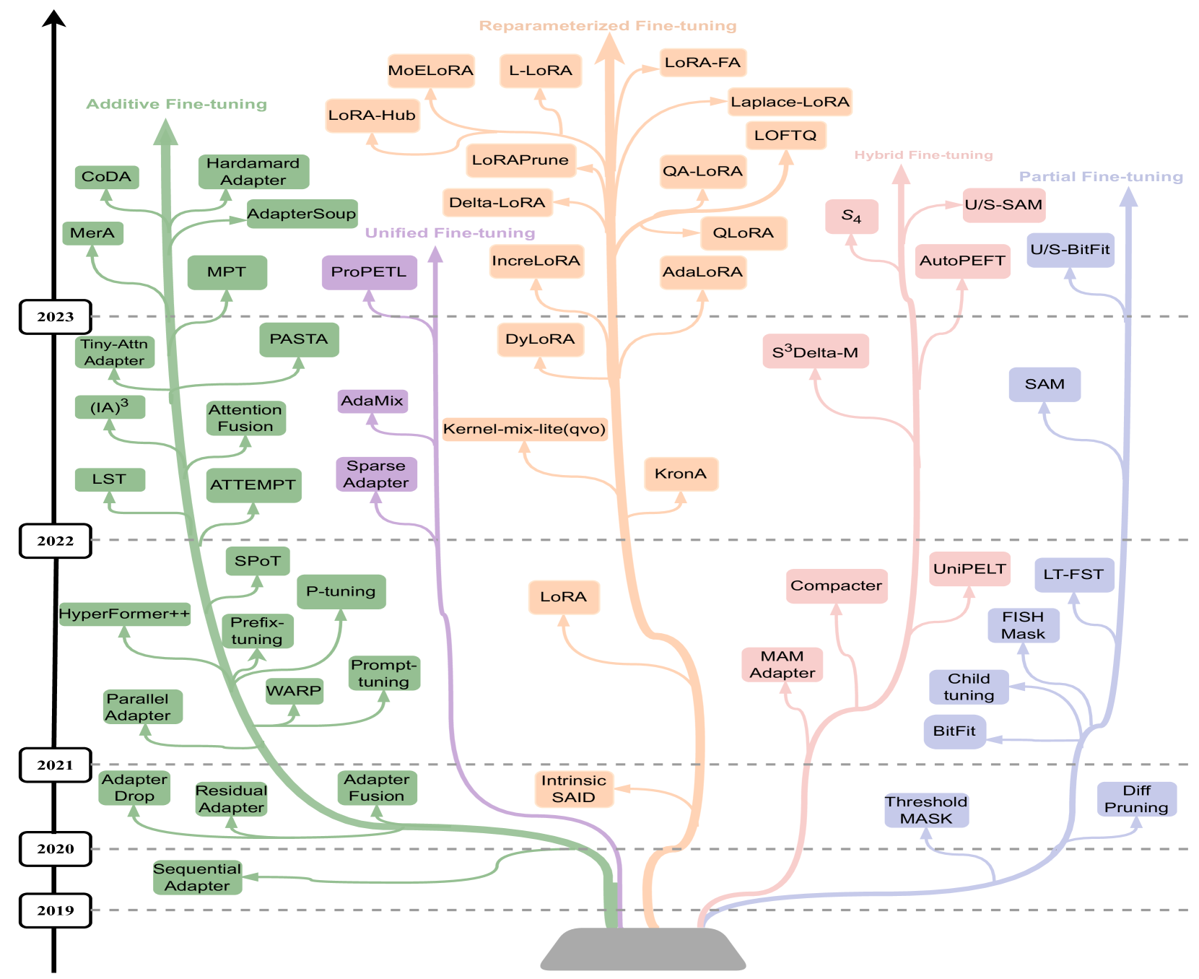
Parameter-Efficient Fine-Tuning (PEFT)

Slide 3
Dreambooth(2022)

Slide 4
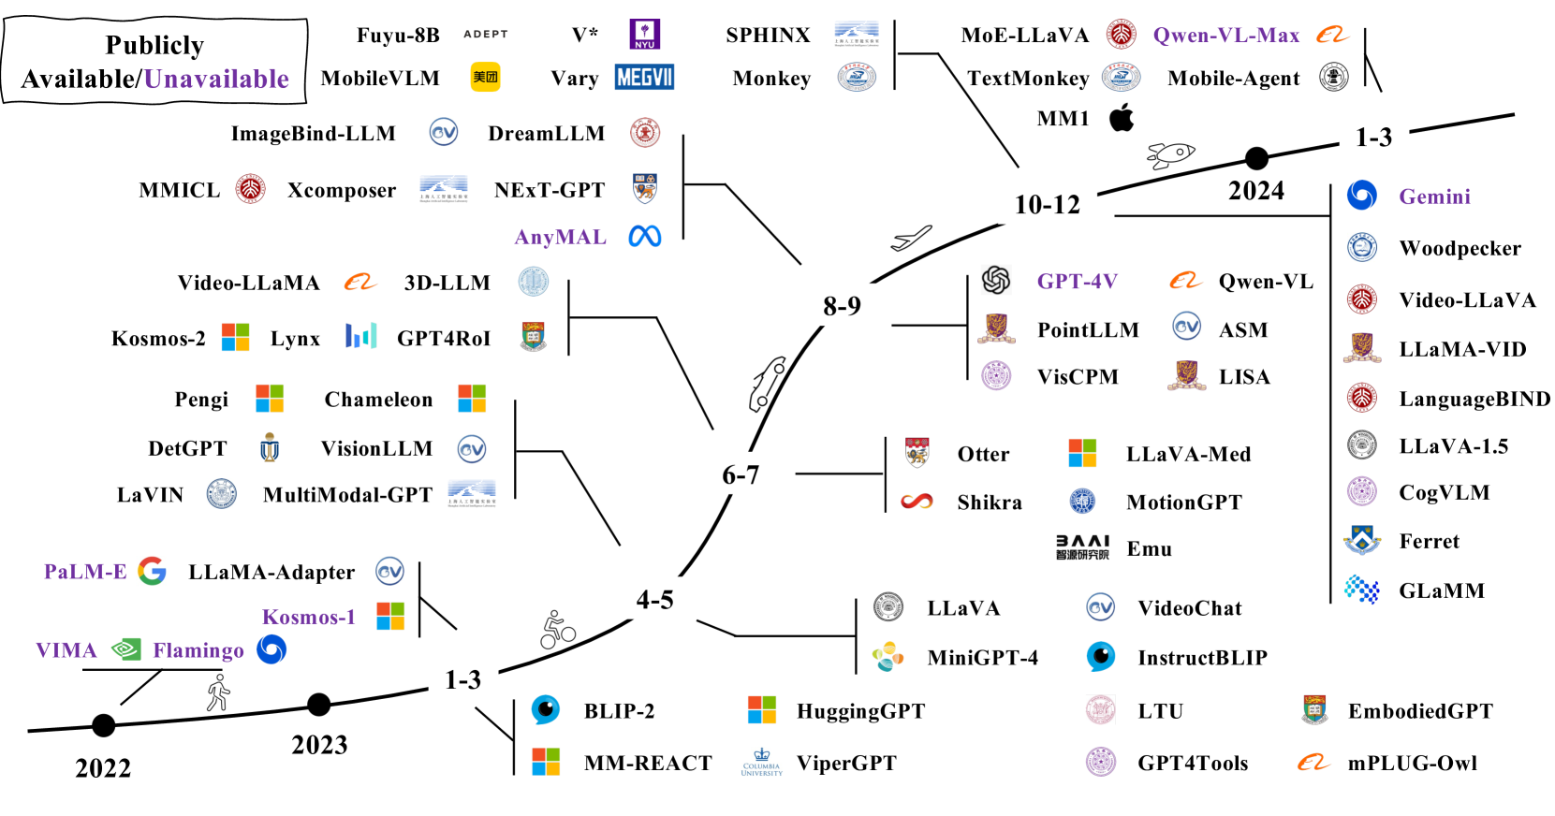
A timeline of representative MLLMs

Slide 5
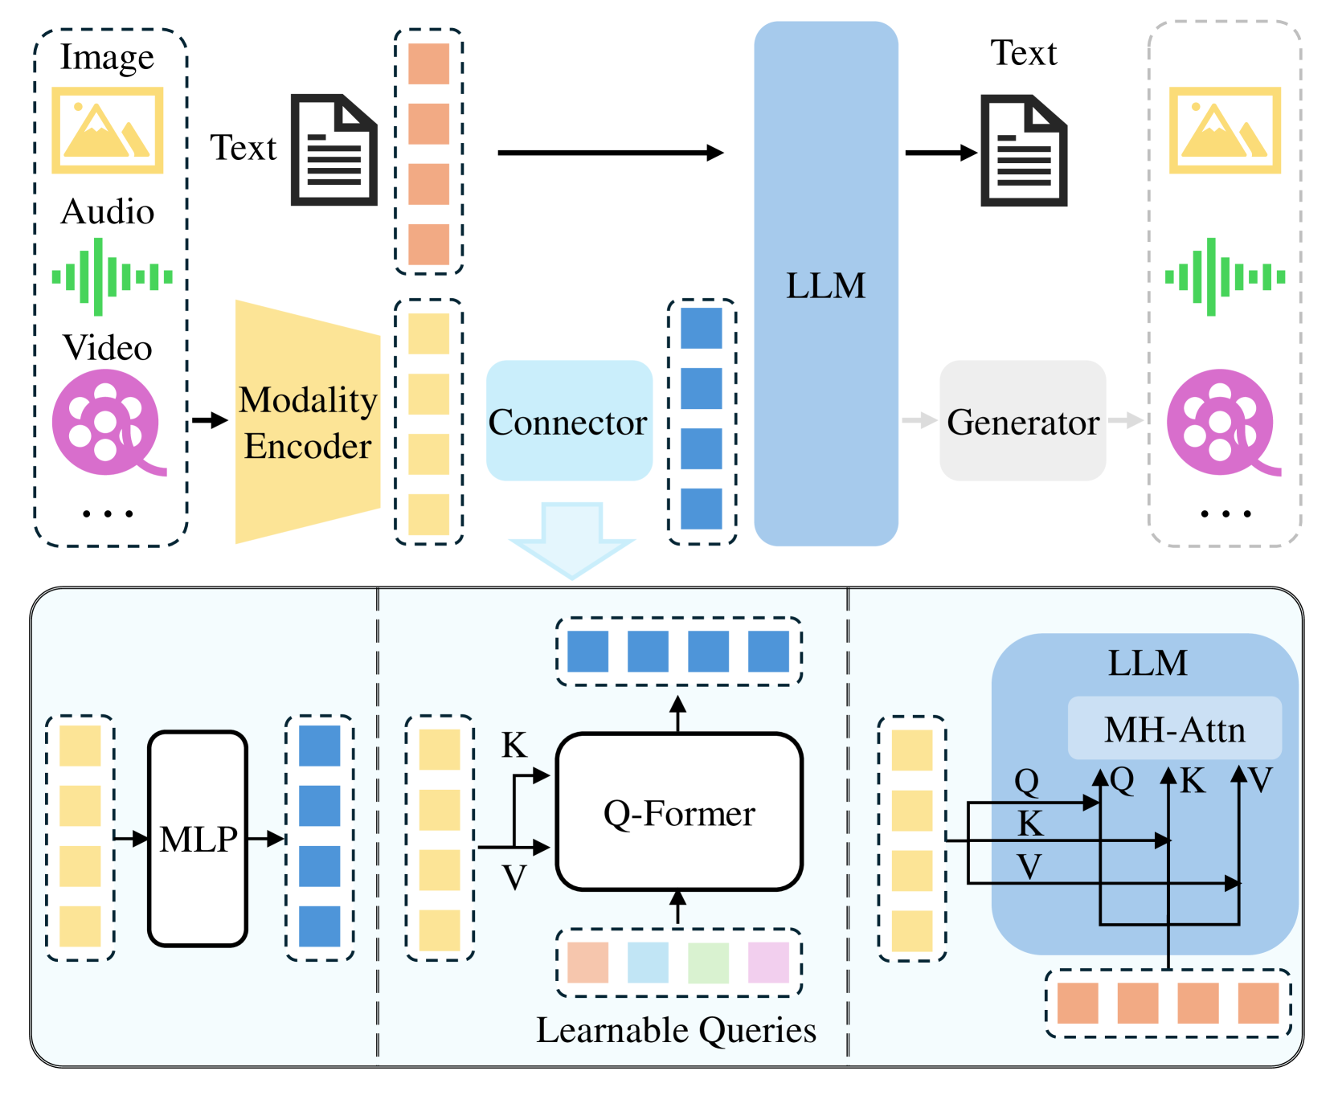
An illustration of typical MLLM architecture

Slide 6
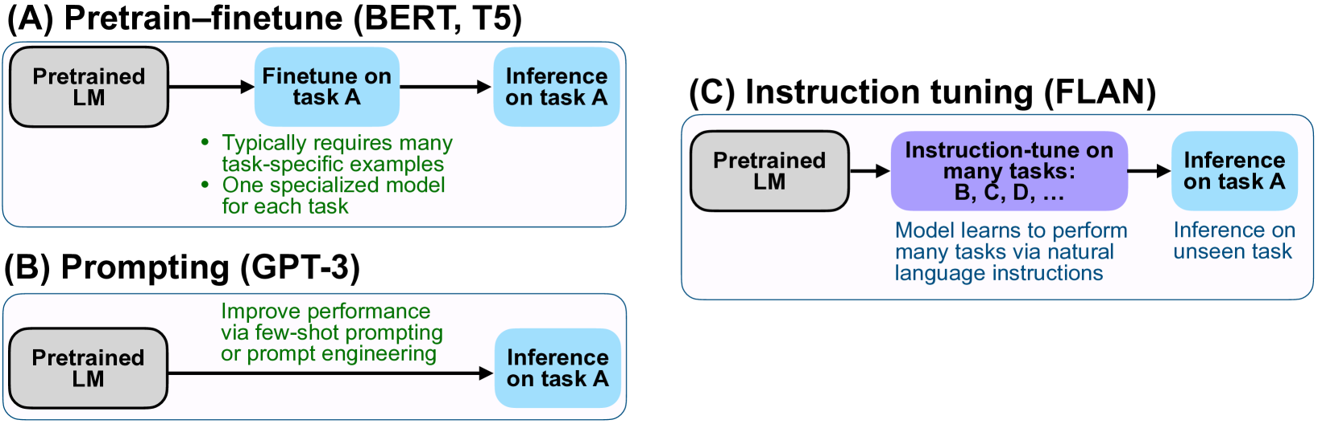

Slide 7
