Slide 1
cv

Slide 2
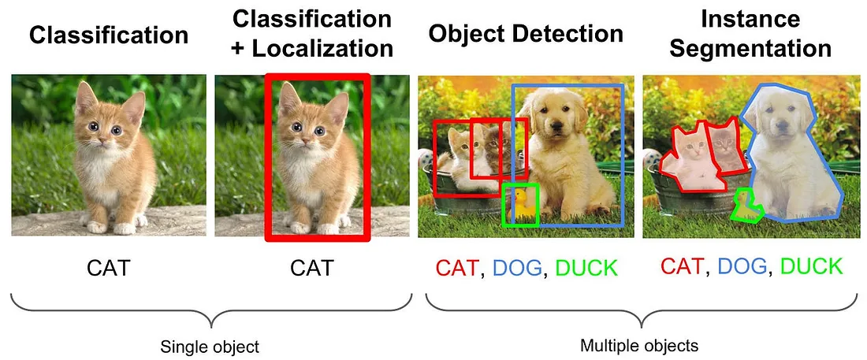

Slide 3
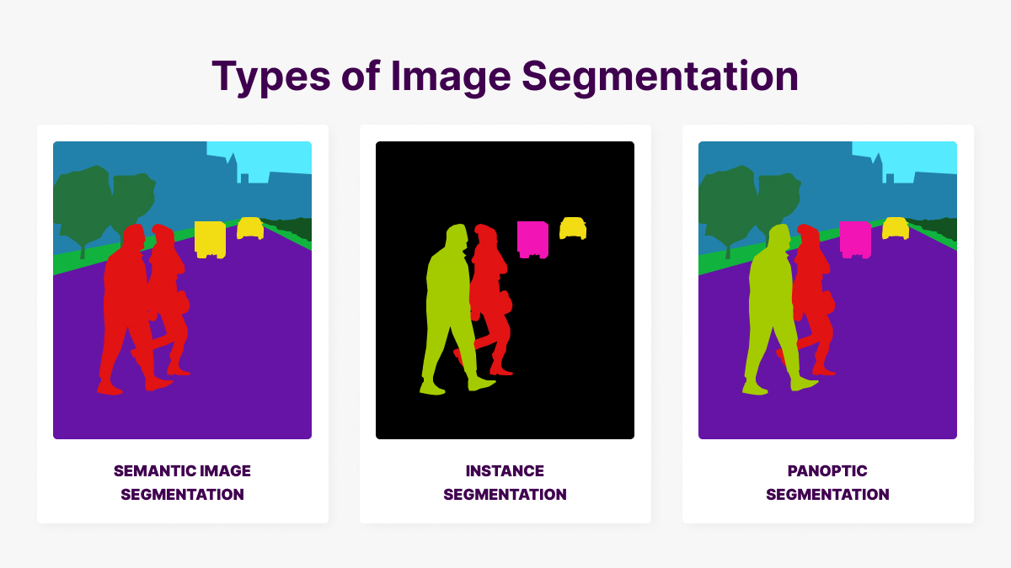
Image Segmentation
https://mindy-support.com/news-post/what-is-image-segmentation-the-basics-and-key-techniques/

Slide 4
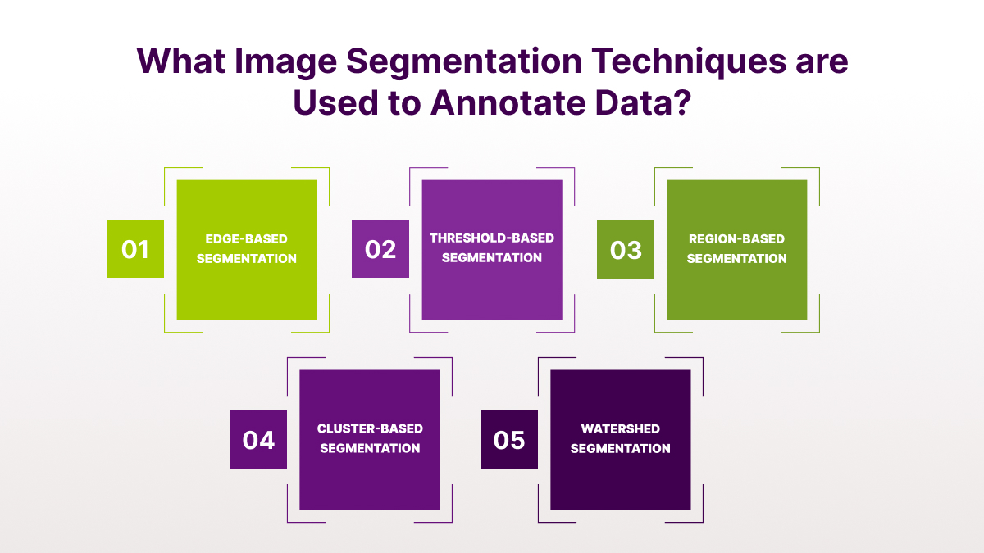

Slide 5
Type | Definition | Characteristics | Applications
Instance Segmentation | Detects and segments each object as a separate entity with unique boundaries. | - Identifies individual objects (e.g., cars, people). - Separates overlapping objects. - Does not require class information. | Object tracking, AR/VR, advanced object detection.
Semantic Segmentation | Labels each pixel with a class category (e.g., "sky," "road," "car"). | - Assigns dense class labels to every pixel. - Does not distinguish between different instances of the same class. - Background and objects grouped by class. | Road analysis, medical imaging, scene understanding.
Panoptic Segmentation | Combines semantic and instance segmentation for detailed labeling. | - Provides pixel-wise labeling by class and instance. - Differentiates objects and their instances. - Offers the most granular, high-quality information. | Autonomous vehicles, robotics, interactive AI systems.

Slide 6
Traditional Segmentation Techniques
Technique | Definition | Characteristics | Applications
Thresholding | Divides image pixels into classes based on intensity relative to a threshold value. | - Simple and efficient. - Binary output (foreground/background). - Effective for high-contrast images. - Global or adaptive. | Document scanning, basic object detection.
Region-based Segmentation | Groups pixels into regions based on similarity (e.g., color, texture, intensity). | - Can use "split and merge" or "graph-based" methods. - Requires criteria for similarity. - Handles non-uniform regions. | Medical imaging, scene segmentation, region analysis.
Edge-based Segmentation | Detects object boundaries based on intensity changes. | - Focuses on edges. - Common methods: Canny, Sobel, LoG. - May struggle with noisy or smooth regions. | Shape detection, contour extraction, feature recognition.
Clustering | Groups pixels with similar features into clusters using algorithms like K-means or mean-shift. | - Handles high-dimensional data. - Adaptable to various similarity metrics. - Limited accuracy in complex scenes. | Color-based segmentation, image simplification, feature extraction.

Slide 7
Deep Learning Techniques
Technique | Definition | Key Features | Applications
U-Net | A fully convolutional network designed for precise segmentation tasks, especially in medical imaging. | - Encoder-decoder structure with skip connections. - Combines low-level and high-level features for finer segmentation. - Retains spatial context effectively. | Medical imaging (tumor detection, organ segmentation).
SegNet | A deep convolutional network optimized for semantic segmentation tasks. | - Encoder-decoder structure. - Uses max-pooling indices for efficient upsampling. - Reduces computational complexity. | Scene understanding, autonomous driving.
DeepLab | A CNN architecture that leverages atrous (dilated) convolution for dense segmentation tasks. | - Incorporates features from all convolutional layers. - Atrous convolution for capturing contextual information. - Efficient computation. | Object detection, road scene analysis

