Slide 1
SQLi

Slide 2


Slide 3
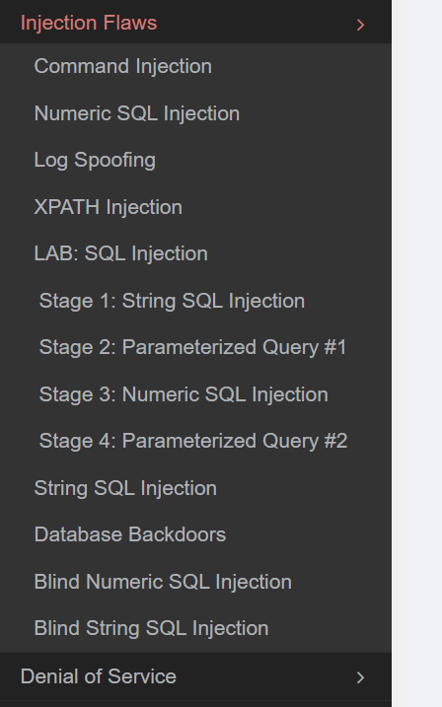

Slide 4
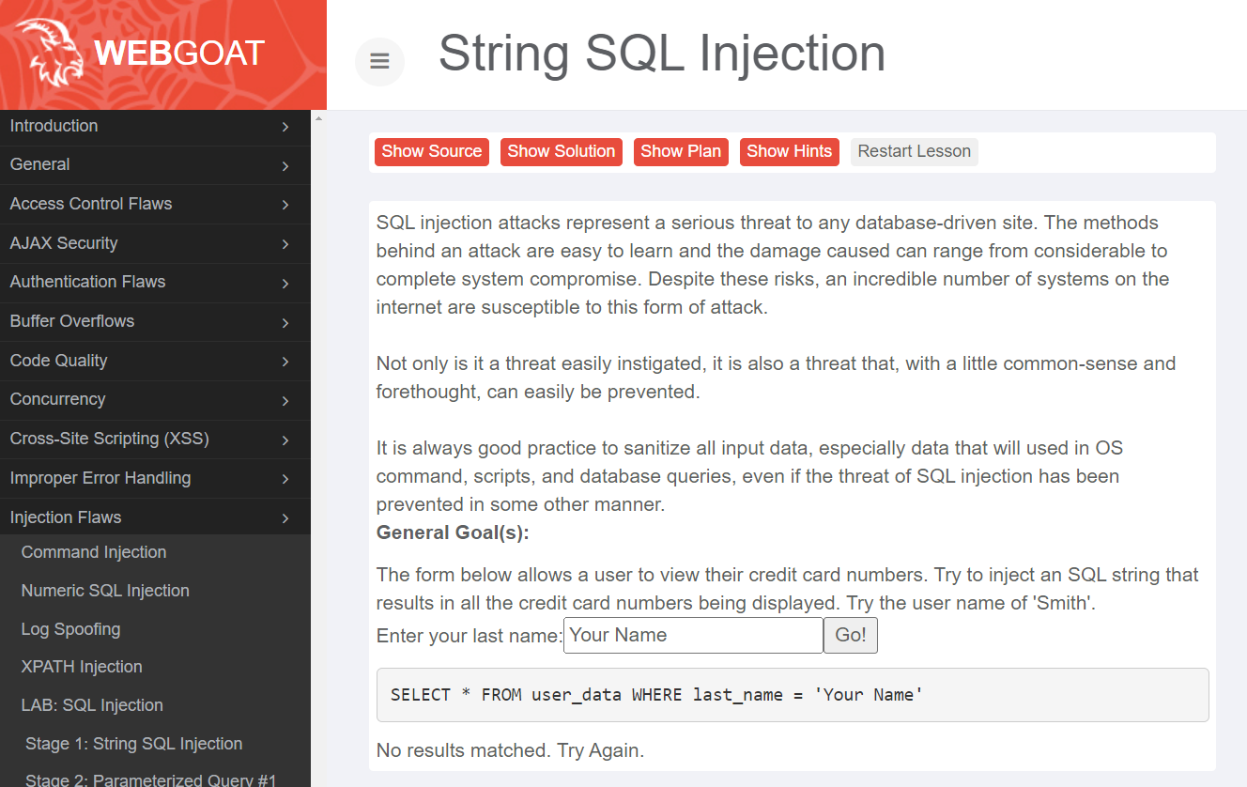

Slide 5
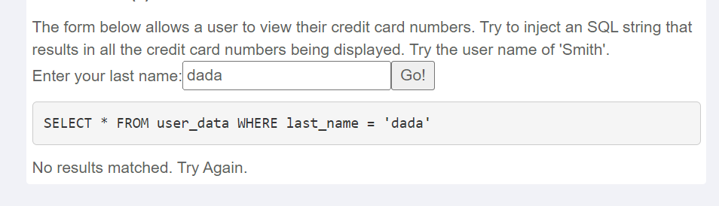

Slide 6
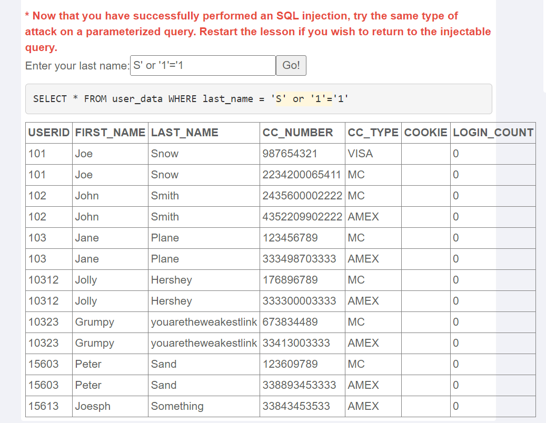

Slide 7
SELECT * FROM user_data WHERE last_name = ‘ '
SELECT *
FROM user_data
WHERE last_name = ‘ '

Slide 8
SELECT * FROM user_data WHERE last_name = 'S' or '1'='1'
SELECT *
FROM user_data
WHERE last_name = ‘ S' or '1'='1'

Slide 9
SELECT * FROM user_data WHERE last_name = 'S' or '1'='1'
SELECT *
FROM user_data
WHERE last_name = ‘ S' or '1'='1'

Slide 10
SELECT *
FROM user_data

