Slide 2
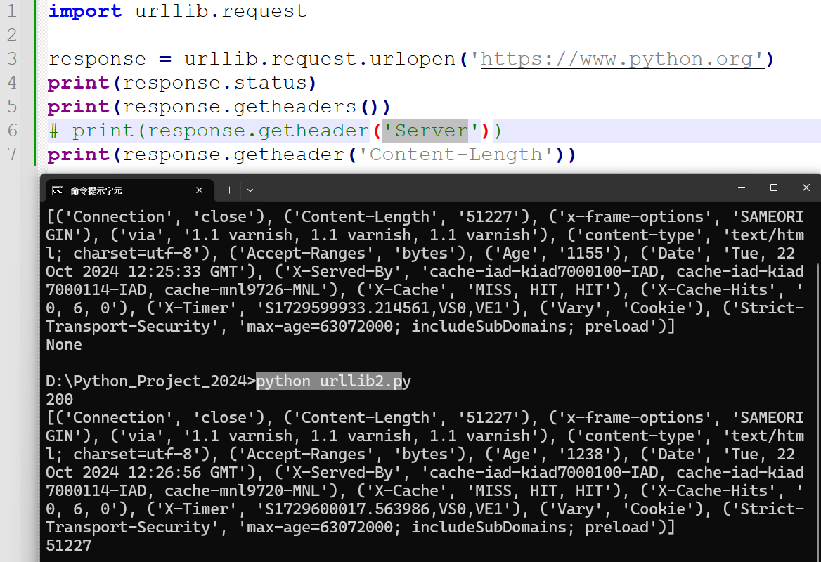
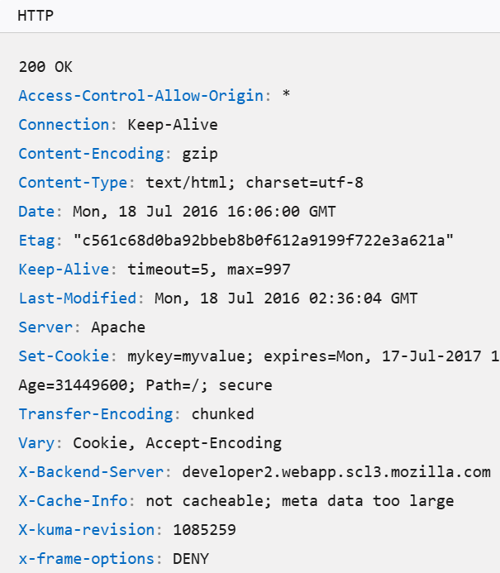
Response header
https://developer.mozilla.org/en-US/docs/Glossary/Response_header

Slide 3
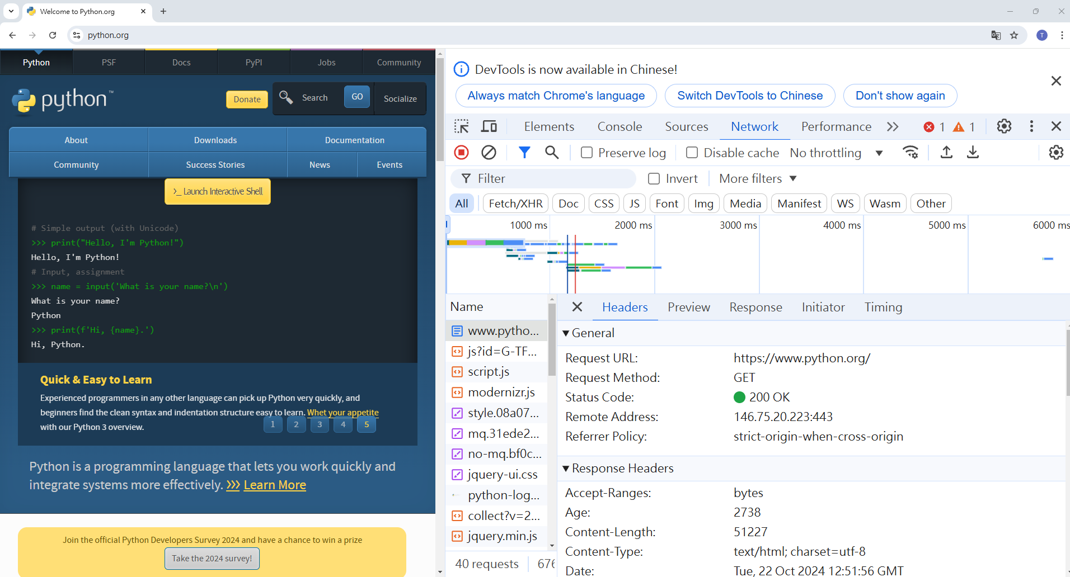
開啟chrome 開發人員工具 == > F12

