Slide 1
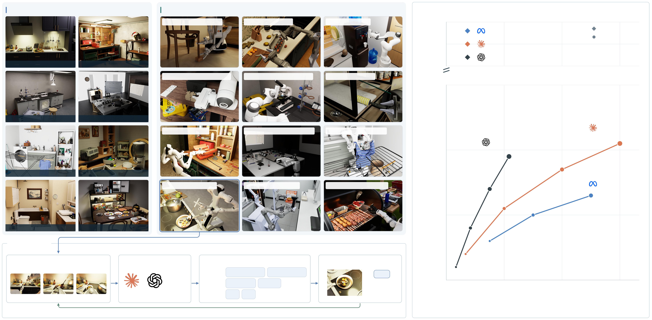
39 Scenes
5,000+ Objects · 60+ Behaviors
294 Tasks
4 Embodiments
Level the chair using a wooden block
Pack the eggs into the carton
Fill the cup with cold water
70%
Muse
Reference
Opus
RoboWild
65%
Astra
Kitchen
Workshop
60%
Assemble the mouse standees on the desk
Switch objectives on the microscope turret
Remove fur with the lint roller
15%
Laboratory
Conference room
Opus
Take tools from the toolbox
Align the projected image using both hands
Gather the shirt from the drying rack
Astra
10%
Laundry
Pet care
Overall task success
Stir-fry the shrimp with a spatula
Scan the barcode on the package
Flip the steak with the barbecue tongs
Muse
5%
Bathroom
Dining room
Agent harness
Model input
Models
Tool calls / action code
Simulation
Task: Stir-fry the shrimp until cooked.
...
Perception
get_scene_state
get_robot_state
step
Planning
plan_motion
solve_ik
Apply action
0%
Update state
0
60K
120K
180K
Head
Left wrist
Right wrist
Claude
GPT
Action
step
done
Continue until the goal is reached
Output tokens / task
Next observations · update history H(t+1) · repeat

