Slide 1
Getting started with Unity & Github
Gibson Ch 16-19

Slide 2

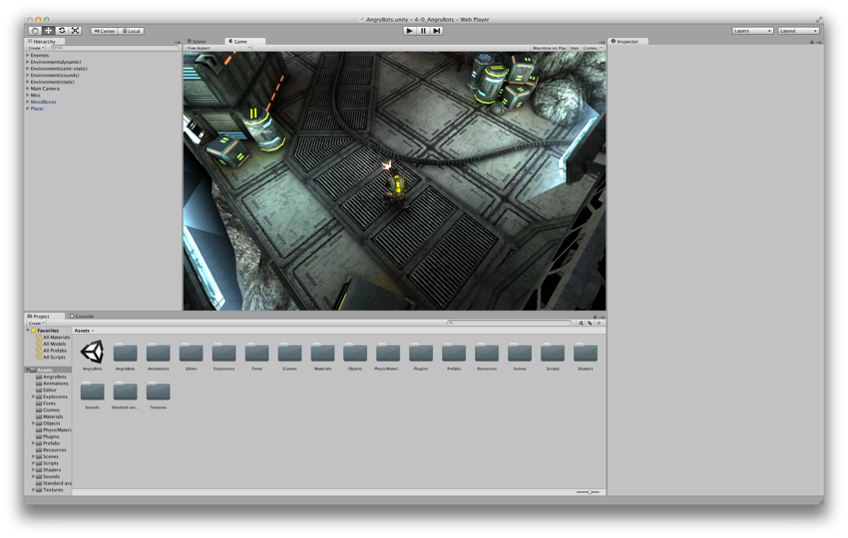
The Unity Demo Project: AngryBots
The Unity window when it opens for the first time
2

Slide 3
The Unity Demo Project: AngryBots
AngryBots Controls
Movement is controlled by WASD or Arrow Keys
The gun aims at your mouse pointer
Press the left mouse button to fire
Environmental awareness
Standing next to a circular door will cause it to open
Standing next to some computers will change the wires leading from them from red to green and unlock doors
3

Slide 4
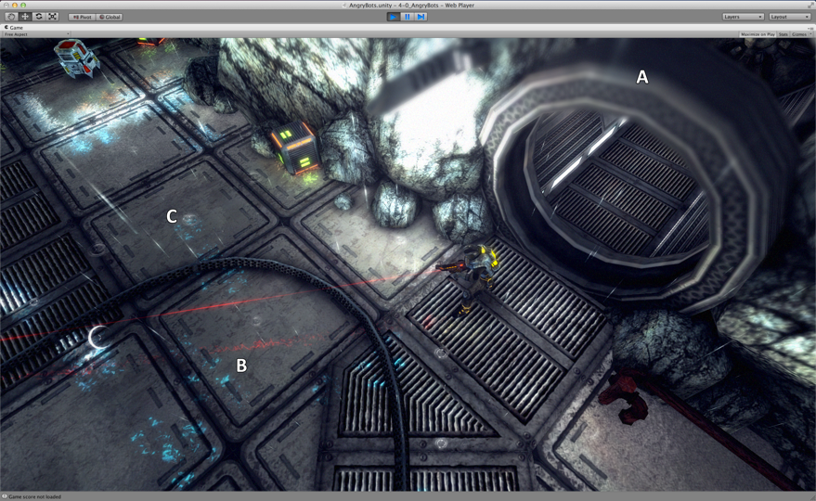
Unity Features Shown in AngryBots
Shaders
A: Depth of field shader (Unity Pro only)
B: Reflections (Unity Pro only)
C: Animated texture (raindrops)
4

Slide 5
Unity Features Shown in AngryBots
Shaders
A: Depth of field shader (Unity Pro only)
B: Reflections (Unity Pro only)
C: Animated texture (raindrops)
Character rigging and animation
Animation blending allows the character to move in one direction while looking in another
Artificial Intelligence-based Pathing
Enemies will move around objects in a room to track down the player
5

Slide 6
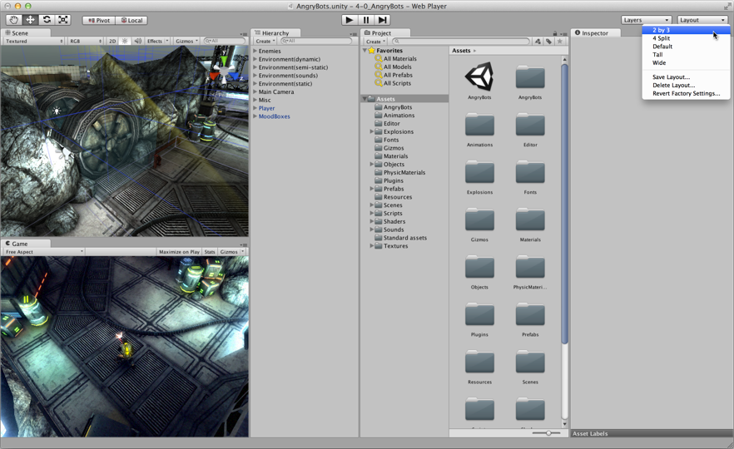
Setting Up the Unity Window Layout
6

Slide 7
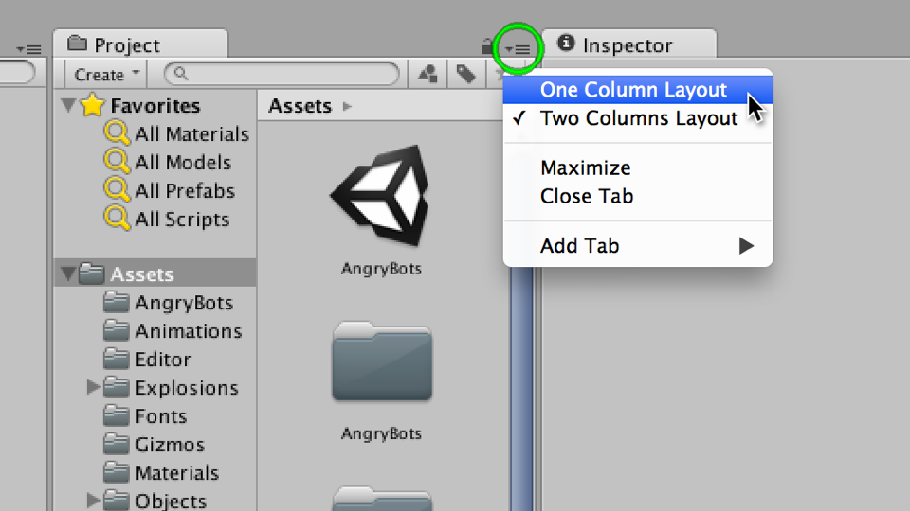
Setting Up the Unity Window Layout
Set the Project pane to One Column Layout
7

Slide 8
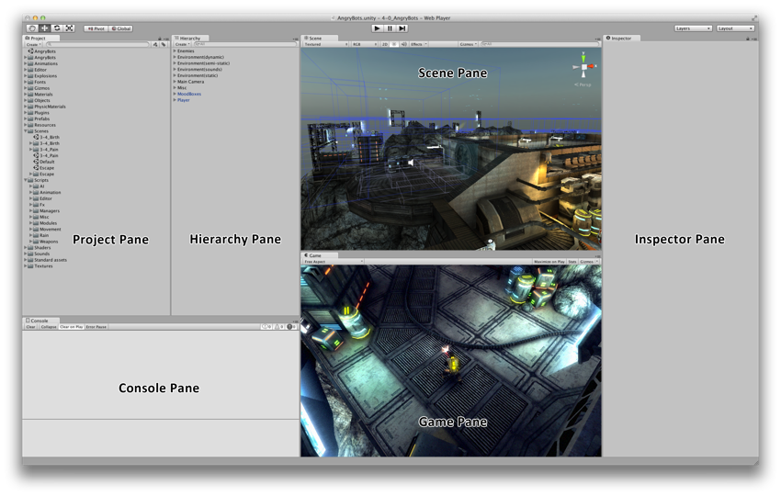
Understanding the Unity Window Panes
Scene Pane: Allows you to move around the 3D scene and select, move, rotate, and scale GameObjects.
8

Slide 9
Understanding the Unity Window Panes
Game Pane: Shows you a preview of the gameplay. Shows the view from the Main Camera in the scene.
9

Slide 10
Understanding the Unity Window Panes
Hierarchy Pane: A list of every GameObject in the scene. Maintains a hierarchy of parent and child GameObjects.
10

Slide 11
Understanding the Unity Window Panes
Project Pane: Collection of all assets in the Unity project: everything from models to C# code, images, and sounds.
11

Slide 12
Understanding the Unity Window Panes
Inspector Pane: Shows details of any selected asset. Allows you to edit the details of any GameObject.
12

Slide 13
Understanding the Unity Window Panes
Console Pane: Shows messages from Unity and from the C# scripts that you write. Used extensively in Chapter 18.
13

Slide 14
Dealing with C#...

Slide 15
Topics
The Features of C#
C# is a Compiled Language
C# is Managed Code
C# is Strongly Typed
C# is Function Based
C# is Object-Oriented
Reading and Understanding C# Syntax
15

Slide 16
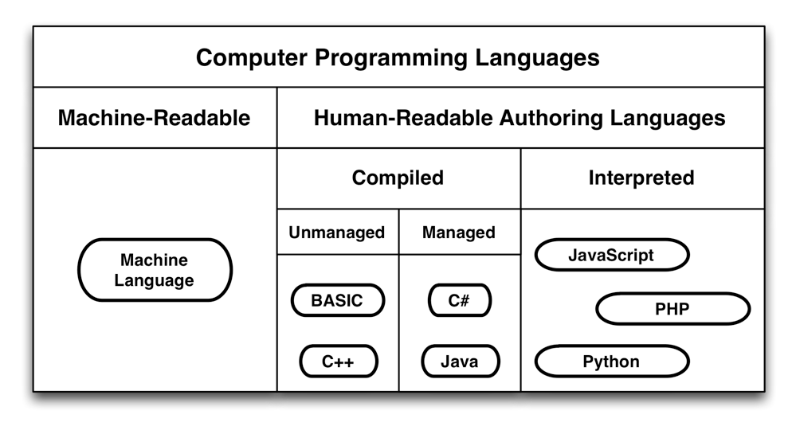
Understanding the Features of C#
Hierarchy of Computer Languages
16

Slide 17
Understanding the Features of C#
C# is Managed Code
C, C++ - must allocate and deallocate memory
In managed code, allocation and deallocation are handled automatically
This makes it less likely that you will accidentally claim all of the memory
17

Slide 18
VARIABLES IN COMPUTER LANGUAGES
A variable is a name that can hold a value
Variables in computer languages can Numbers
Words, sentences, paragraphs, novels…
Images, sounds, 3D models, animations…
Functions and methods
Classes and GameObjects
18

Slide 19
Understanding the Features of C#
C# is Strongly Typed
non-strongly typed
Here’s a box. Throw whatever you want in it…
strongly typed language
Custom ‘boxes’
Must put items in proper location
19

Slide 20
Understanding the Features of C#
C# is Function Based
Computer programs used to be just a series of commands
Functional languages allow the encapsulation of commands
"If you see a store on the way, please BuySomeMilk()."
The BuySomeMilk() function encapsulates the many actions involved in finding and purchasing milk.
20

Slide 21
Understanding the Features of C#
C# is Object-Oriented
Functions and data used to be separate
Object-oriented programming introduced classes
Classes combine functions and data into a single object
Variables in classes are called fields
Functions in classes are called methods
21

Slide 22
Reading and Understanding C# Syntax
C# statements have syntax rules
int x = 5;
Declares a variable named x of the type int
If a statement starts with a type, the second word of the statement becomes a new variable of that type
Defines the value of x to be 5
The = is used to assign values to variables
All C# statements end with a semicolon ( ; )
A semicolon is used because the period is already used in decimal numbers
22

Slide 23
Reading and Understanding C# Syntax
C# statements also have syntax rules
int x = 5;
int y = x * ( 3 + x );
Declares a variable named y of the type int
Adds 3 + x for a value of 8 (because x = 5)
Just as in algebra, order of operations follows parentheses first
Multiplies x * 8 for a value of 40 (5 * 8 = 40)
Defines the value of y to be 40
Ends with a semicolon ( ; )
23

Slide 24
Reading and Understanding C# Syntax
C# statements also have syntax rules
string greeting = "Hello World!";
Declares a variable named greeting of the type string
strings can hold a series of characters like a word or novel
Defines the value of greeting to be "Hello World!"
Anything between double quotes is a string literal, a value to be assigned to a string variable
Ends with a semicolon ( ; )
24

Slide 25
Reading and Understanding C# Syntax
C# statements also have syntax rules
string greeting = "Hello World!";
print( greeting );
Calls the function print()
When a function is called, it executes its actions
Passes the argument greeting into the function print()
Some functions take arguments: data that changes how the function acts
The print() function will print the string greeting to the Console pane in Unity
The Console pane will display "Hello World!"
Ends with a semicolon ( ; )
25

Slide 26
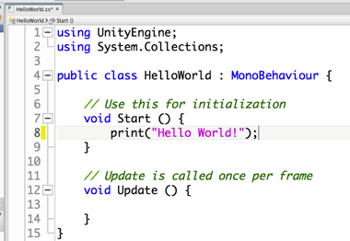
Hello World?
26

Slide 27
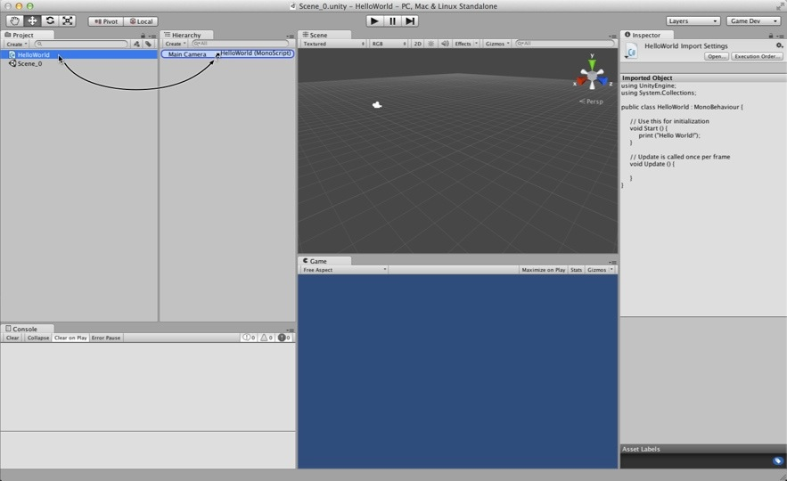
Attaching Scripts to GameObjects
To work in Unity, a C# script must be attached to a GameObject
27

Slide 28
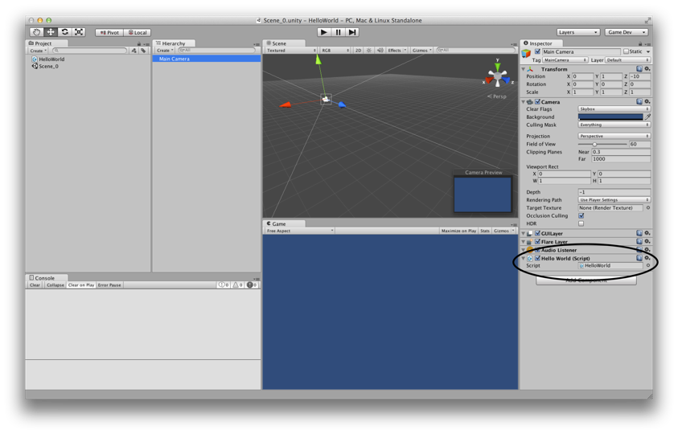
Attaching Scripts to GameObjects
This makes the script a component of the GameObject
28

Slide 29
Start() and Update()
You make use of Start() and Update() in the HelloWorld project
void Start() {…}
Called once
Called immediately before the first Update() is called
void Update() {…}
Called every frame
This can happen over 200 times per second!
void Awake() {…} (not used in HelloWorld, but important)
Called once
Called at the moment the GameObject is created
Guaranteed to be called before Start()
29

Slide 30
GameObject Prefabs and Instantiation
A prefab is a mold from which GameObject instances can be made
Created by dragging a GameObject from the Hierarchy pane into the Project pane
Can be assigned to a script variable in the Inspector pane
public GameObject gameObjectPrefab;
Then, an instance of the prefab can be created in code
Instantiate( gameObjectPrefab );
This is used in HelloWorld to create thousands of instances of a Cube GameObject prefab
30

Slide 31
The HelloWorld Project
Output "Hello World!" to the Console pane
Once using Start()
Many times using Update()
Create a Cube prefab that reacts to gravity & physics
Instantiate an instance of the Cube prefab
Once using Start()
Many times using Update()
This will create a cascade of thousands of Cube instances
Over other physically-modeled objects
31

Slide 32
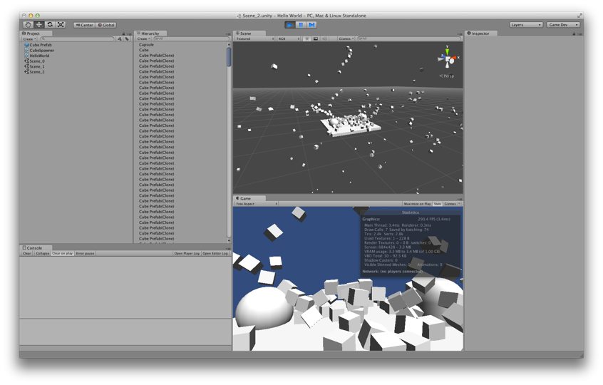
The HelloWorld Project
The final HelloWorld scene
32

Slide 33
VARIABLES AND COMPONENTS
CHAPTER 19
33

Slide 34
Variables in C#
Quick recap:
A variable is a named container for data
Variables in C# are typed, so they can only hold one type of data
Variables need to be declared to be used
Assigning a value to a variable is called defining the variable
A literal is a value that is entered into your code and can be assigned to a variable
The 5 above is an integer literal
string literals are surrounded by double quotes: "Hello World!"
float literals are followed by an f: 3.14f
34

Slide 35
Important C# Variable Types
Core C# variable types start with a lowercase character
bool - A 1-bit True or False Value
bool verified = true;
int – whole number –2,147,483,648 and 2,147,483,647
int nonFractionalNumber = 12345;
float - A 32-bit Decimal Number
float notPreciselyOneThird = 1.0f / 3.0f;
Char - A 16-bit Character (Unicode)
char theLetterA = 'A';
35

Slide 36
Important C# Variable Types
Core C# variable types start with a lowercase character
String - A Series of 16-bit Characters
string theFirstLineOfHamlet = "Who's there?";
char theCharW = theFirstLineOfHamlet[0];
char questionMark = theFirstLineOfHamlet[11];
int len = theFirstLineOfHamlet.Length;
Class - A Collection of Functions and Data
Creates a new variable type
Everything between the braces { } is part of the class
36

Slide 37
C# Naming Conventions
Use camelCase for almost everything
Variable names start with lowercase:
thisVariable anotherVariable bob
Function names start with uppercase:
ThatFunction() Start() Update()
Class names start with uppercase:
SomeClass GameObject HeroShip
Private variables start with underscore:
_privateVariable _hiddenVariable
Static variables use SNAKE_CASE:
STATIC_VAR NUM_INSTANCES
37

Slide 38
Important Unity Variable Types
Because they are classes, important Unity variable types all start with an uppercase character
Vector3
Color
Quaternion
Mathf
Screen
SystemInfo
GameObject
38

Slide 39
Important Unity Variable Types
Vector3 – A collection of 3 floats
Used for position of objects in 3D
Vector3 vec = new Vector3( 3, 4, 0 );
Instance variables and functions
vec.x – The x component of the vector
vec.y – The y component of the vector
vec.z – The z component of the vector
vec.magnitude – The length of the vector
vec.Normalize() – New Vector3 in the same direction at unit length
Static class variables and functions
Vector3.zero – Shorthand for new Vector3( 0, 0, 0 );
Vector3.Dot( vA, vB ); – Dot product of vA and vB
39

Slide 40
Important Unity Variable Types
Color – A color with transparency information
4 floats for red, green, blue, and alpha (all between 0 and 1)
Color col = new Color( 0.5f, 0.5f, 0, 1f );
Color col = new Color( 1f, 0f, 0f ); // Alpha is optional
In the Unity color picker, the RGBA values are in the range 0–255. These are then mapped to 0–1f.
Instance variables and functions
col.r – The red component of the vector
col.g – The green component of the vector
col.b – The blue component of the vector
col.a – The alpha component of the vector
40

Slide 41
Important Unity Variable Types
Color – A color with transparency information
Static class variables and functions
// Primary Colors: Red, Green, and Blue
Color.red = new Color(1, 0, 0, 1); // Solid red
Color.green = new Color(0, 1, 0, 1); // Solid green
Color.blue = new Color(0, 0, 1, 1); // Solid blue
// Secondary Colors: Cyan, Magenta, and Yellow
Color.cyan = new Color(0, 1, 1, 1); // Cyan, a bright greenish blue
Color.magenta = new Color(1, 0, 1, 1); // Magenta, a pinkish purple
Color.yellow = new Color(1, 0.92f, 0.016f, 1); // A nice-looking yellow
// As you can imagine, a standard yellow would be new Color(1,1,0,1), but
// in Unity's opinion, this color looks better.
// Black, White, and Clear
Color.black = new Color(0, 0, 0, 1); // Solid black
Color.white = new Color(1, 1, 1, 1); // Solid white
Color.gray = new Color(0.5f, 0.5f, 0.5f, 1) // Gray
Color.grey = new Color(0.5f, 0.5f, 0.5f, 1) // British spelling of gray
Color.clear = new Color(0, 0, 0, 0); // Completely transparent
41

Slide 42
Important Unity Variable Types
Quaternion – Rotation information
Based on three imaginary numbers and a scalar
So, everyone uses Euler angles (e.g., x, y, z) to input rotation
Quaternion up45Deg = Quaternion.Euler( -45, 0, 0 );
In Euler (pronounced "oiler") angles, x, y, & z are rotations about those respective axes
Quaternions are much better for interpolation and calculations than Euler angles
They also avoid Gimbal Lock (where two Euler axes align)
Instance variables and functions
up45Deg.eulerAngles – A Vector3 of the Euler rotations
42

Slide 43
Important Unity Variable Types
Mathf – A collection of static math functions
Static class variables and functions
Mathf.Sin(x); // Computes the sine of x
Mathf.Cos(x); // .Tan(), .Asin(), .Acos(), & .Atan() also available
Mathf.Atan2( y, x ); // Gives you the angle to rotate around the z-axis to // change something facing along the x-axis to face // instead toward the point x, y.
print(Mathf.PI); // 3.141593; the ratio of circumference to diameter
Mathf.Min( 2, 3, 1 );// 1, the smallest of the numbers (float or int)
Mathf.Max( 2, 3, 1 );// 3, the largest of the numbers (float or int)
Mathf.Round( 1.75f );// 2, rounds up or down to the nearest number
Mathf.Ceil( 1.75f ); // 2, rounds up to the next highest integer number
Mathf.Floor( 1.75f );// 1, rounds down to the next lowest integer number
Mathf.Abs( -25 ); // 25, the absolute value of -25
43

Slide 44
Important Unity Variable Types
Screen – Information about the display
Static class variables and functions
Screen.width // The width of the screen in pixels
Screen.height // The height of the screen in pixels
Screen.showCursor = false; // Hide the cursor
44

Slide 45
Important Unity Variable Types
SystemInfo – Information about the device/computer
Static class variables and functions
SystemInfo.operatingSystem // The width of the screen in pixels // e.g., Mac OS X 10.9.3
SystemInfo.systemMemorySize // Amount of RAM
SystemInfo.supportsAccelerometer // Has accelerometer
SystemInfo.supportsGyroscope // Has gyroscope
45

Slide 46
Important Unity Variable Types
GameObject – Base class for all objects in scenes
Composed of components
GameObject go = new GameObject("MyGO");
Always has a Transform component
Instance variables and functions
go.name // The name of the GameObject ("MyGO")
go.GetComponent<Transform>() // The Transform component
go.transform // A shortcut to the Transform component
go.SetActive(false) // Make this GameObject inactive
go.name // The name of the GameObject ("MyGO")
GetComponent<>() is a generic method that can be used to access any component attached to a GameObject
46

Slide 47
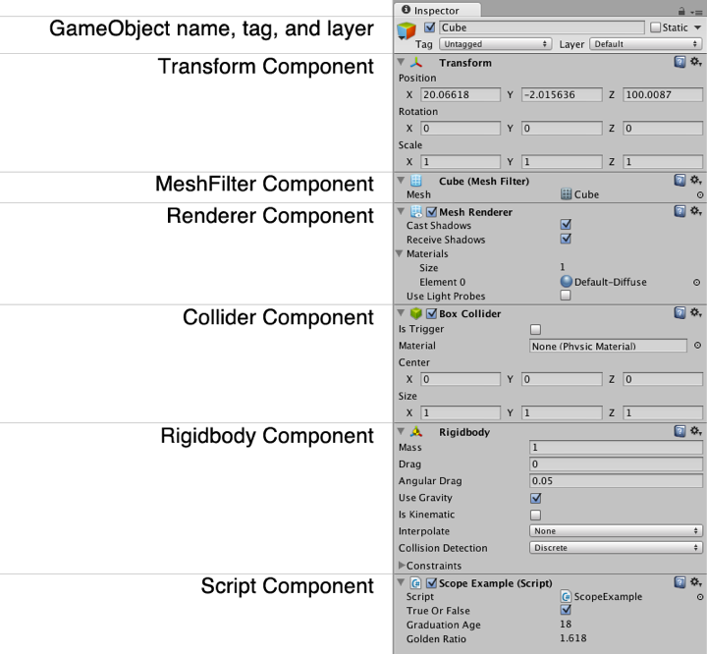
Unity GameObject Components
GameObjects are composed of Components
47

Slide 48
Unity GameObject Components
Transform component
Controls position, rotation, and scale
Transform tr = go.GetComponent<Transform>();
Also controls hierarchy of objects in the scene
tr.parent // The parent of this transform in the hierarchy
Children can be iterated over with a foreach loop
foreach (Transform tChild in tr) {…}
Instance variables and functions
tr.position // The position in world coordinates
tr.localPosition // The position relative to its parent
tr.rotation // The rotation in world coordinates
tr.localScale // The scale (always in local coordinates)
48

Slide 49
Unity GameObject Components
MeshFilter component
The model that you see
MeshFilter mf = go.GetComponent<MeshFilter>();
Attaches a 3D model to a GameObject
Is actually a 3D shell of the object (3D objects in games are hollow inside
This MeshFilter is rendered on screen by a MeshRenderer component
49

Slide 50
Unity GameObject Components
Renderer component
Draws the GameObject on screen
Renderer rend = go.GetComponent<Renderer>();
Usually, this is a MeshRenderer
Renderer is the superclass for MeshRenderer
So, Renderer is almost always used in code
Combines the MeshFilter with a Material (which contains various Textures and a Shader)
50

Slide 51
Unity GameObject Components
Collider component
The physical presence of the GameObejct
Collider coll = go.GetComponent<Collider>();
There are four types of collider (in order of complexity)
Sphere Collider – The fastest type. A ball or sphere.
Capsule Collider – A pipe with spheres at each end. 2nd fastest.
Box Collider – A rectangular solid. Useful for crates, cars, torsos, etc.
Mesh Collider – Collider formed from a MeshFilter. Much slower!
Only convex Mesh Collider can collide with other Mesh Colliders
Much, much slower than the other three types
Unity physics are performed by the NVIDIA PhysX engine
Colliders will not move without a Rigidbody component
51

Slide 52
Unity GameObject Components
Rigidbody component
The physical simulation of the GameObject
Rigidbody rigid = go.GetComponent<Rigidbody>();
Handles velocity, bounciness, friction, gravity, etc.
Updates every FixedUpdate()
This is exactly 50 times per second
If Rigidbody isKinematic == true, the collider will move, but position will not change automatically due to velocity
rigid.isKinematic = true; // rigid will not move on its own
Colliders will not move without a Rigidbody component
52

Slide 53
Unity GameObject Components
(Script) components
Any C# class that you write
HelloWorld hw = go.GetComponent<HelloWorld>();
Because C# scripts are handled as components, several can be attached to the same GameObject
This enables more object-oriented programming
You'll see several examples throughout the book
Public fields in your scripts will appear as editable fields in the Unity Inspector
However, Unity will often alter the names of these fields a bit
The class name ScopeExample becomes Scope Example (Script).
The variable trueOrFalse becomes True Or False.
The variable graduationAge becomes Graduation Age.
The variable goldenRatio becomes Golden Ratio.
53

