Slide 1
CHEST PNEUMONIA X-RAY IMAGES USING DEEP LEARNING
Guided By:
S.GANAPATHY
Presented By:
ANSHU KUMARI

Slide 2
CONTENTS
ABSTRACT
INTRODUCTION
TYPES OF PNEUMONIA X-RAY IMAGES
PROBLEM STATEMENT
ALGORITHM
LITERATURE REVIEW
CONCLUSION
REFERENCE

Slide 3
ABSTRACT
This study propose a convolutional neural network(CNN) model trained from scratch to classify and detect the presence of pneumonia from a collection of chest X-ray image samples.
We will constructed a convolutional neural network model from scratch to extract features from a given chest X-ray image and classify it to determine if a person is infected with pneumonia.
Our main focus is to Comparatively analyze different existing deep learning and machine learning technique in order to find out the most appropriate method that will support the large dataset with good accuracy of prediction.
Chest X-ray (CXR) is one of the most used imaging techniques for detection and diagnosis Pulmonary diseases.

Slide 4
INTRODUCTION
Pneumonia is a lung infection, which can be caused by either bacteria or viruses.
Pneumonia disease is a pulmonary inflammatory condition that leads to an average of 4 million annual deaths, of which majority of around 75% are children.
It evidently prevails in poor regions such as remote Asian areas and sub-Saharan Africa.
The biggest challenge these regions face is the lack of field deployable diagnostic tools that can rapidly and accurately detect the disease at low-cost.
One major concern in detecting pneumonia is that doctors can over diagnose the disease. Physicians occasionally make the diagnosis without considering canonical signs or symptoms.

Slide 5
INTRODUCTION COND.
Statistics shows that there is an increase in pneumonia diagnosis but little evidence on the decrease of morbidity and mortality rate from pneumonia.
This is mostly due to pneumonia having no standard definitions in terms of signs and symptoms.
Some patients do simply have fever and cough and healthcare professionals misdiagnose them to already having pneumonia.
This causes patients to not receive the necessary and appropriate treatment which puts them more at risk of making their illnesses more severe.
They may also highly likely spend too much on medicine and medical procedures that they do not need.

Slide 6
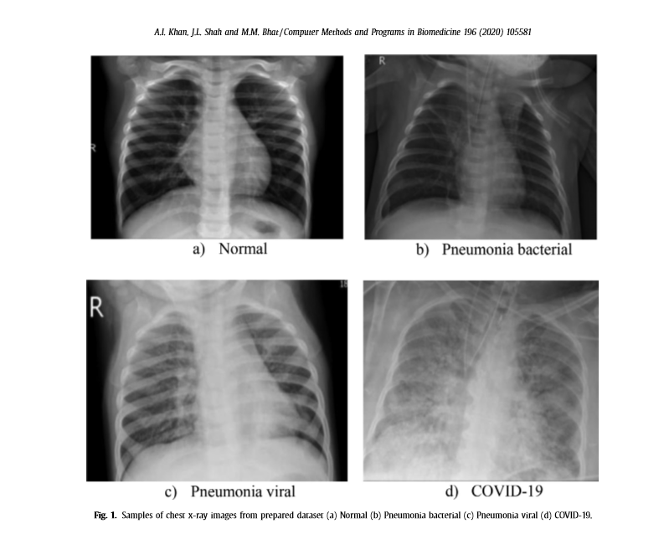
TYPES OF PNEUMONIA X-RAY IMAGES

Slide 7
PROBLEM STATEMENT
Build an algorithm to automatically identify whether a patient is suffering from pneumonia or not by looking at chest X-ray images.
The algorithm had to be extremely accurate because lives of people is at stake.
The dataset can be downloaded from the kaggle website.
Will use Environment and tools:-
scikit-learn
keras
numpy
pandas
matplotlib

Slide 8
ALGORITHM
A Convolutional Neural Network (CNN) is a Deep Learning algorithm which can take in an input image, assign importance to various aspects in the image and be able to differentiate one from the other.
The convolutional neural network is a specialized type of neural network model designed for working with two-dimensional image data, although they can be used with one-dimensional and three-dimensional data.
CNN image classifications takes an input image, process it and classify it under certain categories. Computers sees an input image as array of pixels and it depends on the image resolution. Based on the image resolution, it will see h x w x d( h = Height, w = Width, d = Dimension ).

Slide 9
LITERATURE REVIEW
There are several issues in the Pediatric Chest X-ray dataset under study, as follow that lead the models to learn undesirable patterns.
The main objective of present researches is to classify a certain x-ray image at a fast rate which is achieved in this study because of the formulation of bottleneck layers.
Lung infections are usually presented with white patches which do not have specific borders and have lower contrast as compared to other tissues, so convolution operation instead of detecting the pattern of consolidation learns to detect shapes with sharp edges in the images such as ribs, spine, heart, shoulder, etc.
Based from related researches, artificial intelligence and machine learning are the most looked-upon methodologies to accurately classify and identify health issues especially with regards to the diagnosis of pneumonia.

Slide 10
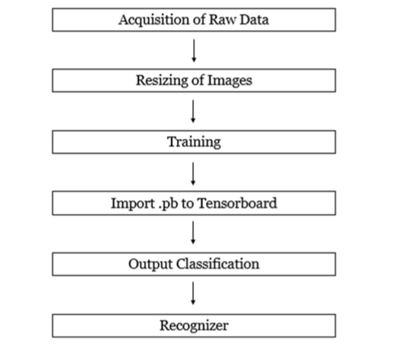
The step-by step processes to attain the needed classification results starting from the input.

Slide 11
CONCLUSION
In this paper we have reviewed about CNN deep learning algorithms for the prediction of chest(pneumonia) x-ray images. Our main focus is to find out the most suitable algorithm that can predict the occurrences of chest x-ray more effectively. This paper provides the all necessary information to the beginners who want to analyze the machine learning algorithms to gain the base of deep learning.

Slide 12
REFERENCE
[1]Tobias, R. R. N., De Jesus, L. C. M., Mital, M. E. G., Lauguico, S. C., Guillermo, M. A., Sybingco, E., ... & Dadios, E. P. (2020, October). CNN-based Deep Learning Model for Chest X-ray Health Classification Using TensorFlow. In 2020 RIVF International Conference on Computing and Communication Technologies (RIVF) (pp. 1-6). IEEE.
[2]Behzadi-khormouji, H., Rostami, H., Salehi, S., Derakhshande-Rishehri, T., Masoumi, M., Salemi, S., ... & Batouli, A. (2020). Deep learning, reusable and problem-based architectures for detection of consolidation on chest X-ray images. Computer methods and programs in biomedicine, 185, 105162.
[3]Souza, J. C., Diniz, J. O. B., Ferreira, J. L., da Silva, G. L. F., Silva, A. C., & de Paiva, A. C.
(2019). An automatic method for lung segmentation and reconstruction in chest X-ray using deep neural networks. Computer methods and programs in biomedicine, 177, 285-296.
[4]Khan, A. I., Shah, J. L., & Bhat, M. M. (2020). Coronet: A deep neural network for detection and diagnosis of COVID-19 from chest x-ray images. Computer Methods and Programs in Biomedicine, 105581.

Slide 13
THANK YOU

