Slide 1
Employee Data Analysis using Excel
STUDENT NAME: NIVETHA P
REGISTER NO :312208435
DEPARTMENT :B.COM GENARAL
COLLEGE : CHELLAMMAL WOMANS COLLAGE

Slide 2
PROJECT TITLE
Employee Performance Analysis using Excel

Slide 3



AGENDA
Problem Statement
Project Overview
End Users
Our Solution and Proposition
Dataset Description
Modelling Approach
Results and Discussion
Conclusion
3/21/2024 Annual Review

Slide 4





PROBLEM STATEMENT
ITDIENTFY THE PROBLEM
PUT THE PROBLEM INTO CONTEXT
FIND THE ROOT CAUSE
DESCRIBE YOUR IDEAL OUTCOME
PROPOSE A SOLUTION AND OUTLINE ITS BENEFITS

Slide 5

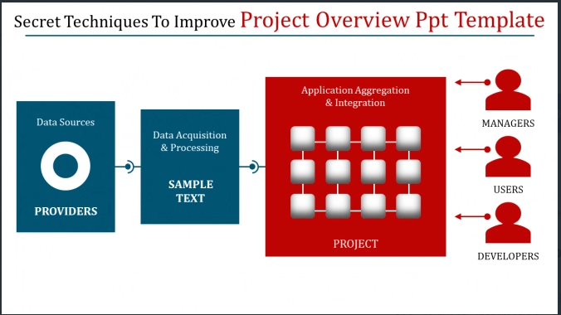
PROJECT OVERVIEW
.

Slide 6

WHO ARE THE END USERS?
Senior Executives
H R MANAGER
Performance Analysts
END USERS
Data Aalysts etc.
Training and Development Teams
Team Leaders

Slide 7
OUR SOLUTION AND ITS VALUE PROPOSITION
Filtering: Enhanced data accuracy by isolating relevant subsets, which improved focus on specific performance metrics and streamlined analysis.
Slicer: Enabled interactive data exploration by providing dynamic filtering options, allowing users to easily segment and analyse data across different dimensions.
Pivot Table: Summarized large datasets effectively by aggregating and reorganizing data, facilitating in-depth analysis and insight into key performance indicators.
Graph: Visualized data trends and patterns through charts, making complex information more accessible and actionable for stakeholders.

Slide 8
Dataset Description
Employee dataset | - Naan Mudhalvan Dashboard
Total Features | - 26
Features Used | - 9
Employee ID | - Number
Name | - Text
Gender | - Male and Female
Employee type | - Full time, part time, contract
Employee status | - Active
Employee Rating | - Number
Business Unit | - department

Slide 9
THE '' WOW'' IN OUR SOLUTION
Male employees have
achieved the similar results
and have also given
exceeding performance
in various sectors
accordingly
10

Slide 10
THE "WOW" IN OUR SOLUTION
About more than 100
Female employees in all
the departments have fully
met the performance
expectations and about
15-20 of employees in
each department have
exceeded the
expectation
9
9
3/21/2024 Review

Slide 11
Data Sources and Cleaning
Data was extracted from the NM dashboard for comprehensive analysis.
Cleaned data to remove inconsistencies and duplicates.
Ensured accuracy and completeness for reliable analysis.
Key Metrics and Dimensions
Defined dimensions like departments and job roles for detailed analysis.
Ensured metrics align with organizational performance goals.
Pivot Table Structure
Created pivot tables to summarize and analyse large data sets.
Organized data by dimensions like time periods and employee groups.
Enabled dynamic filtering for in-depth performance insights.
Types of Visualizations
Developed charts and graphs to illustrate performance trends.
Used bar charts for departmental comparisons and line graphs for trends over time.
Applied heat maps to highlight areas of high and low performance.
MODELLING
11

Slide 12
RESULTS
13
13

Slide 13
conclusion
WITH THE PERFORMANCE BEING SHOWN THAT MORE THAN OR EQUAL TO 100 EMPLOYEES IN BOTH MALE AND FEMALE(EACH DEPARTMENT ) HAVE FULLY MET THE PERFORMANCE EXPECTATION AND LESS THAN OR EQUAL TO 20 EMPLOYEES IN EACH DEPARTMENT BEING EXCEEDING THE EXPECTAION THE REST ARE TAKEN AS ''PIP'' AND ''NEEDS IMPROVEMENT''.
PIP < 15 IN EACH DEPARTMENT
NEEDS IMPROVEMENT
< 25 IN EACH DEPARTMENT
THESE NUMBER OF EMPLOYEES MIGHT NEED EXTRA MOTIVATION / TRAINING / PRACTICE ON EFFICIENT PERFORMANCE .

