Slide 1
Threads

Slide 2

Cost of a Memory
For x86 CPU, the thread’s context uses about 700 bytes of memory.
For x64 the context is about 1,240 bytes of memory.
For IA64 CPUs, the context is about 2,500 bytes of memory

Slide 3

Cost of a Thread
200,000 cycles to create a thread
100,000 to destroy one
context switch costs 2,000–8,000 cycles
Notes:
according to Joe Duffy, it cost approximately

Slide 4

Total Threads
A 32-bit process has 2 GB.
After Win32 DLLs load, the CLR DLLs load, the native heap and the managed heap is allocated, there is approximately 1.5 GB left.
Each thread requires more than 1 MB of memory for its user-mode stack and thread environment block (TEB)
The most threads you can get in a 32-bit process is about 1,360.
Notes:
Attempting to create more threads than this will result in an OutOfMemoryException being thrown.

Slide 5

A 64-bit process offers 8 terabytes of address space, so you could theoretically create hundreds of thousands of threads.
Notes:
If you think that your application needs hundreds or thousands of threads, there is something seriously wrong with the architecture of your application and the way that it’s using threads.

Slide 6

What is the Ideal Number of Threads ?
Notes:
The ideal number of threads to have is equal to the number of CPUs in the machine
I just can’t resist sharing with you another demonstration of how bad this situation is. Try this: Open Notepad.exe
and use Task Manager to see how many threads are in it. Then select Notepad’s File Open menu item to display
the common File Open dialog box. Once the dialog box appears, look at Task Manager to see how many new
threads just got created. On my machine, 22 additional threads are created just by displaying this dialog box! In
fact, every application that uses the common File Open or File Save dialog box will get many additional threads
created inside it that sit idle most of the time. A lot of these threads aren’t even destroyed when the dialog box is
closed.
If you have more threads than CPUs, then when the time-slice(quantum) expires, context switching is introduced and performance deteriorates

Slide 7

Notes:
Creating and destroying threads is an expensive operation; however having too many threads and not enough work is not ideal either, as it increases system memory utilization and context-switch overhead.

Slide 8

A thread pool has two functions:
It maintains a queue of work to be done
a collection of threads which execute work from the queue

Slide 9
When should you create Thread ?

Slide 10

When To Create Thread
You require a thread to have a particular priority. Changing priority is not recommended for thread’s in Thread pool.

Slide 11

When To Create Thread
You have tasks that cause the thread to block for long periods of time. The thread pool has a maximum number of threads, so a large number of blocked thread pool threads might prevent tasks from starting.

Slide 12

When To Create Thread
You need to have a stable identity associated with the thread, or to dedicate a thread to a task.

Slide 13
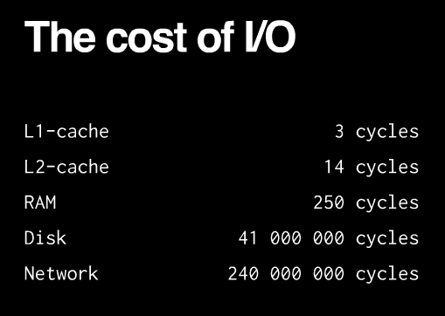

Slide 14
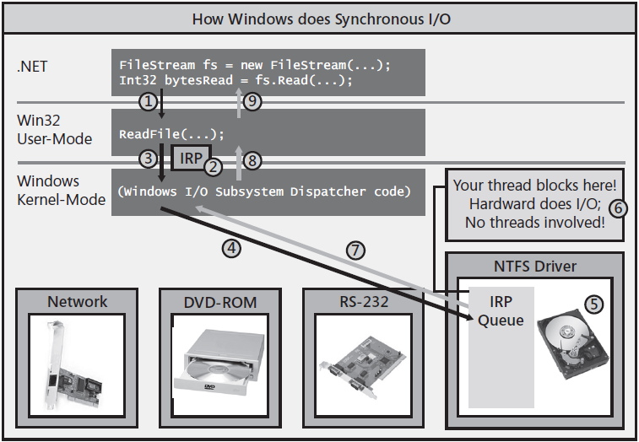

Slide 15
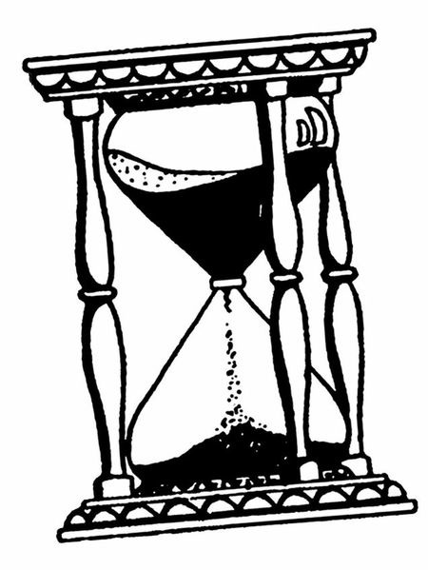
All synchronous I/O operations suspend the calling thread while the underlying hardware (disk-drive, network interface card, etc.) performs the work.
Notes:
There are two types of input/output (I/O) synchronization: synchronous I/O and asynchronous I/O. Asynchronous I/O is also referred to as overlapped I/O.

Slide 16

When performing asynchronous I/O-bound operations, you have a device driver doing the work for you and no threads are required.
Notes:
With NIO2 Java has stepped up its support for this mode with its
AsynchronousChannel API.For instance, if you print a Microsoft Word document, a thread runs the spooler, but you can edit the document while it is printing. These actions are actually overlapping computing operations with I/O operations. When performing an asynchronous compute-bound operation, it can execute using other threads.

Slide 17
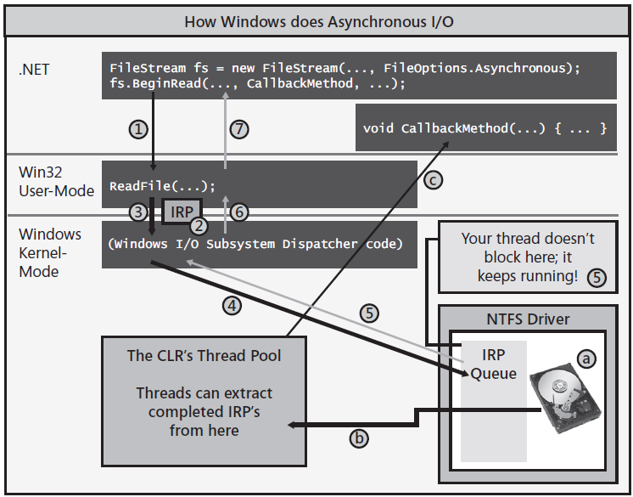
Notes:
To read data from the file, I now call BeginRead instead of Read. Like Read, BeginRead calls
Win32’s ReadFile function (#1). ReadFile allocates its IRP, initializes it just like it did in the
synchronous scenario (#2), and then passes it down to the Windows kernel (#3). Windows
adds the IRP to the hard disk driver’s IRP queue (#4), but now, instead of blocking your
thread, your thread is allowed to return to your code; your thread immediately returns from
its call to BeginRead (#5, #6, and #7). Now, of course, the IRP has not necessarily been processed
yet, so you cannot have code after BeginRead that attempts to access the bytes in the
passed-in Byte[].
Now you might ask, when and how do you process the data that will ultimately be read?
Well, when you call BeginRead, you pass it the name of a callback method as an argument
(CallbackMethod in my example). The delegate referring to your callback method is effectively
passed inside the IRP all the way down to the device driver. When the hardware device
completes processing the IRP (a), it will queue the IRP’s delegate into the CLR’s thread pool
(b). Sometime in the future, a thread pool thread will extract the completed IRP and invoke
your callback method (c).1 So now you know when the operation has completed, and inside
this method, you can safely access the data inside the Byte[].

Slide 18

Lock-free updates
x = x * 10;

Slide 19
Atomic Operation
data ++;
Load from RAM into CPU register
Increment CPU register
Store from CPU register into RAM.
Notes:
An operation during which a processor can simultaneously read a location and write it in the same bus operation. This prevents any other processor orI/O device from writing or reading memory until the operation is complete.
so an atomic operation must be performed entirely or not performed at all.
An atomic operation is a sequence of one or more machine instructions that are executed sequentially, without interruption. By default, any sequence of two or more machine instructions isn't atomic since the operating system may suspend the execution of the current sequence of operations in favor of another task. If you want to ensure that a sequence of operations is atomic you must use some form of locking or other types of synchronization. Without that, the only guarantee you have is that a single machine instruction is always atomic -- the CPU will not interrupt a single instruction in the middle. We can conclude from that minimal guarantee that if you can prove that your compiler translates a certain C++ statement into a single machine instruction, that C++ statement is naturally atomic meaning, the programmer doesn't have to use explicit locking to enforce the atomic execution of that statement.

Slide 20
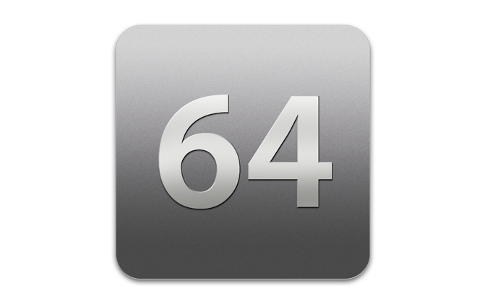
Reading and writing 64-bit fields is non atomic on 32-bit environments because it requires two separate instructions: one for each 32-bit memory location.

Slide 21
Lock-free updates
Take a “snapshot” of x into a local variable
Calculate the new value
Write the calculated value back if the snapshot is still up-to-date using Interlocked.CompareExchange
If the snapshot was stale, spin and return to step 1

Slide 22

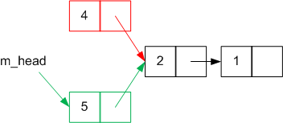
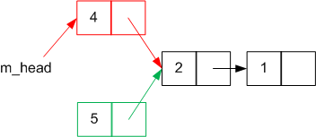
Adding a item to stack
Create a new Node object to hold the new value
Setting the node's m_next variable to point to the current head node
Changing m_head to point to the newly-created node.
Thread 1, cycle 1 ,
executes 1,2
Thread 2, cycle 2 ,
executes 1,2,3
Thread 1, cycle 3 ,
executes 3
Notes:
The node successfully pushed by Thread 2 has disappeared from the stack.

Slide 23
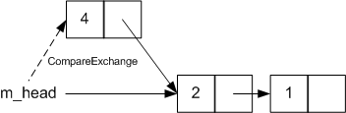
Adding a item to Concurrent Stack
public void Push(T item)
{
Node node = new Node(item); //step 1
do {
node.m_next = m_head; //step 2
} while (
Interlocked.CompareExchange(ref m_head, node, node.m_next) != node.m_next); //step 3
}
Perform step 3 only if the head hasn't changed in the meantime. If it has been changed, then go back to step 2 to use the updated head node as the value of m_next.
Notes:
what we want to do isThis has eliminated the race condition we had between steps 2 and 3. Only if the head hasn't been changed is the new node pushed onto the stack as the new head. This loop repeats until CompareExchange successfully sets the head to the new node.
Performing atomic operations
So, what underlying aspects of the system let us perform these operations atomically?
Object references are atomic This lets us take an atomic snapshot of the current state simply by storing the value of m_head in a local variable; m_head will always be pointing at a valid node (or null), it won't be 'half-changed'.
Interlocked.CompareExchange is atomic This ensures the state-check-and-switch won't be afflicted by race conditions with other threads.
m_head is a volatile variable m_head is marked as volatile. This means that any changes to that variable by one thread are instantly visible to all other threads on the system; there's no caching to get in the way. Any threads that are attempting to modify m_head will be forced to try again, and they won't overwrite the changes already made.

Slide 24
Approaches to Parallelism
Task parallelism
Data parallelism

Slide 25

Actor pattern
var c = new ActionBlock<int>(i =>
{
Process(i);
});
for(int i = 0; i < 5; i++)
{
c.Post(i);
}
ActionBlock<int>
Message Queue
Process(4);
Process(0);
Process(1);
Process(2);
Process(3);
4
0
1
2
3

Slide 26
static void Main()
{
bool complete = false;
var t = new Thread(() =>
{
int i=0;
while (!complete)
i++;
Console.Write(i);
});
t.Start();
Thread.Sleep(1000);
complete = true;
t.Join();
}
Notes:
This program never terminates because the complete variable is cached in a CPU register.

Slide 27
class Foo
{
int _answer;
bool _complete;
void A()
{
_answer = 123;
_complete = true;
}
void B()
{
if(_complete)
{
Console.WriteLine (_ answer);
}
}
}

Slide 28
class Foo
{
int _answer;
bool _complete;
void A()
{
_answer = 123;
_complete = true; //← instructions could get reordered causing B to write “0”
}
void B()
{
if (_complete)
Console.WriteLine (_answer);
}
}
Notes:
compilers/CPU could translate the code in such a way as to reverse the two lines of code

Slide 29
static void Main()
{
bool complete = false;
var t = new Thread(() =>
{
int i=0;
while (!complete)
{
Thread.MemoryBarrier();
i++;
}
Console.Write(i);
});
t.Start();
Thread.Sleep(1000);
complete = true;
t.Join();
}
run it with optimizations enabled and Release Mode
Notes:
Forces any earlier program order (the way it was written) loads and stores to be completed before the call to MemoryBarrier And it also forces any later program-order loads and stores to be completed after the call

Slide 30
The deprecated Suspend and Resume methods have two modes: dangerous and useless!
Notes:
If a thread holding a lock on a critical resource is suspended, the whole application can deadlock.

Slide 31
Do not abort a thread. Implement a cooperative cancellation pattern

Slide 32
Construct | Crossprocess? | Overhead*
lock (Monitor.Enter / Monitor.Exit) |  | 20ns
Mutex | Yes | 1000ns
Semaphore | Yes | 1000ns
* as measured on an Intel Core i7 860.

