Slide 1
Money Matters: A Personal Finance Management App
Team members:
Devashri M- 439C190AB51D29EBB714828BE97B8C2B
Swetha S - 5D0265D08D058438FB947C5A965BDE8E
Selvarani K – 294D1332579B6D298F745A218CE53B0C
Paranjothi S -3C8B0B3DB874CB0B21049F9EE80092E5

Slide 2
introduction
Personal finance management is the process of planning and budgeting for how your money is saved or spent. Managing your personal finances involves setting financial goals, such as saving for retirement, and working hard to achieve them. The first step in managing your money is to determine your long-term goal.
BUDGETING: the strategic process of budgeting, saving, and spending with purpose. It involves setting clear financial goals, such as retirement savings, and diligently working towards them.

Slide 3

Understanding Personal Finance
Personal ﬁnance encompasses budgeting, saving, investing, and planning for future expenses. By mastering these components, you can ensure ﬁnancial stability and reach your long-term goals. A ﬁnance app simpliﬁes this process by providing a clear overview of your ﬁnancial situation.

Slide 4
Beneﬁts of Budgeting
Budgeting allows you to track expenses, allocate resources effectively, and prepare for emergencies. A personal ﬁnance app enables you to visualize your spending habits, making it easier to identify areas for improvement and save more money.
The strategic process of budgeting, saving, and spending with purpose. It involves setting clear financial goals, such as retirement savings, and diligently working towards them.

Slide 5

Key Features of Finance Apps
Most personal ﬁnance apps offer features like expense tracking, budget creation, and ﬁnancial goal setting. These tools can help you stay organized and accountable, ultimately leading to better ﬁnancial decisions and improved money management.

Slide 6

Tracking Expenses Easily
With a personal ﬁnance app, you can automatically track your expenses by linking your bank accounts. This feature eliminates the need for manual entry, allowing you to gain real-time insights into your spending habits and make informed adjustments.

Slide 7

Creating a Budget
Creating a budget is essential for managing your ﬁnances. A personal ﬁnance app simpliﬁes this process by offering budget templates and suggestions based on your spending patterns, helping you allocate funds effectively and stay within your limits.

Slide 8
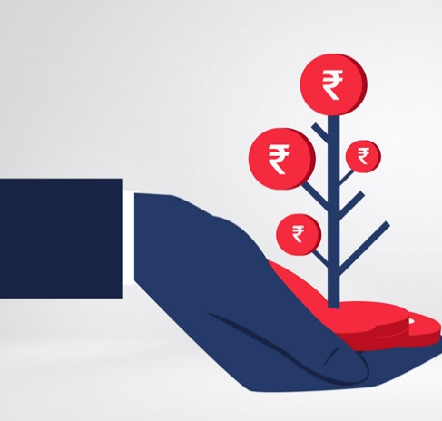
Investing Wisely
Many personal ﬁnance apps also offer investment tracking features. By monitoring your investments, you can make informed decisions about where to allocate your money, helping you grow your wealth and achieve ﬁnancial independence.

Slide 9

Conclusion: Take Control
In conclusion, a personal ﬁnance management app can signiﬁcantly transform your budgeting experience. By leveraging its features, you can gain better control over your ﬁnances, make informed decisions, and ultimately achieve your ﬁnancial goals. Start your journey to ﬁnancial mastery today!

Slide 10
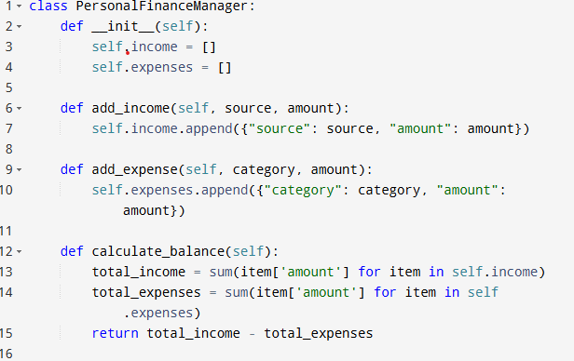
coding

Slide 11
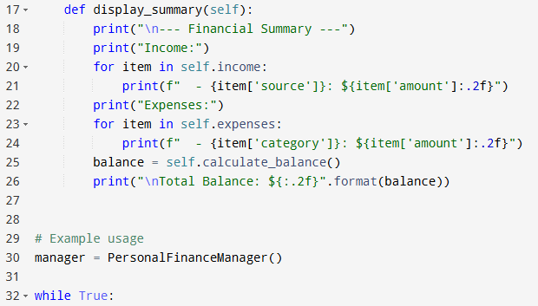

Slide 12
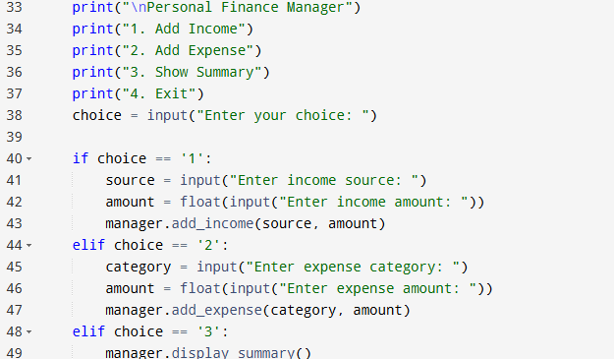

Slide 13
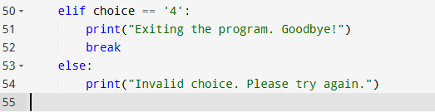

Slide 14
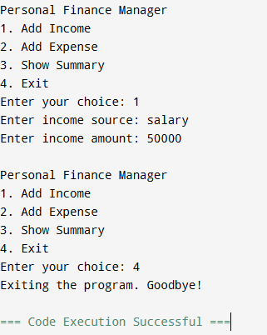
Output :

Slide 15
Thank you…..!
"The key to money is to
stay invested."

