Slide 1
PRESENTATION INSTRUCTIONS PRIOR TO PRESENTING, YOU WILL NEED TO CUSTOMIZE THIS PRESENTATION.
FIRST SAVE THIS POWERPOINT DOCUMENT TO YOUR COMPUTER AS THE ABOUT THE SALE PRESENTATION THIS WILL ENSURE YOUR CUSTOMIZATION SAVES FOR FUTURE PRESENTATIONS .
The slides in this Post Listing Presentation are placed in the recommended order in which they should be presented.
This sign will alert you that the slide needs to be customized with information specific to you, your company and/or your local market. Once you have inserted your information on the slide, please delete this slide and all instruction boxes on the slides.

Slide 2
Customize the page with Name and address
About The Sale of Your House
Name
Address
Listed: (Insert list date list price)
Add Your
Company DBA

Slide 3
Marketing exposure…
THE MARKETING PLAN
Strategies to target prospective buyers and the results.
Add Your
Company DBA

Slide 4

Since We Listed Your House…
(add newspaper/magazine and date of advertisement)
(add newspaper/magazine and date of advertisement)
(add newspaper/magazine and date of advertisement)
(add newspaper/magazine and date of advertisement)
(add newspaper/magazine and date of advertisement)
Add Your
Company DBA

Slide 5

Since We Listed Your House
www.coldwellbanker.com
<insert local website URL>
<insert company website URL>
This slide will allow you to customize the page with your local Website presence.
Add Your
Company DBA

Slide 6
Since We Listed Your House
Open Houses Held
Open Houses Promoted
Date:
Date:
Date
Websites:
Mailings:
Print Advertising:
eMarketing:
Social Media:
This slide will allow you to customize the page with your open house activity. If you choose to distribute your open house via crest, paste the following addresses under Websites :
Frontdoor.com
Homes.com
HomeFinder.com
Smarter Agent
Trulia.com
USAA
Yahoo Real Estate
Zillow.com
Add Your
Company DBA

Slide 7
Since We Listed Your House
Mailings:
Postcard notifications to xx neighbors announcing the listing of your house
eMails:
eCard notification to xx agents announcing the listing of your house
Social Media: Posts or Tweets to Sphere of Influence
Other Marketing Efforts:
Caravan showcasing your house to xx agents
This slide will allow you to customize the page with your direct mail and other marketing efforts.
Add Your
Company DBA

Slide 8
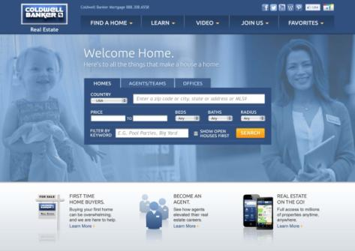
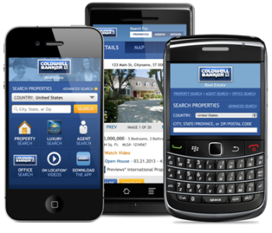
Since We Listed Your House
This slide will allow you to customize the page with your leads activity and results.
Virtual Visits:
xx virtual visits on
www.coldwellbanker.com
xx virtual visits on
<insert local website URL>
xx virtual visits on
<insert company website URL>
Add Your
Company DBA

Slide 9

Since We Listed Your House
This slide will allow you to customize the page with your leads activity and results.
Internet Leads:
X Internet leads received from all websites
Showings:
We physically showed your house X times
Offers:
We received X offers on your house
Add Your
Company DBA

Slide 10

Local market conditions
Add Your
Company DBA

Slide 11
Since We Listed Your House
Customize with new listings on market
These competing listings have come on the market:
123 Main Street, Any Town, …listing price
456 Main Street, Any Town, …listing price
789 Main Street, Any Town, …listing price
101 Main Street, Any Town, …listing price
112 Main Street, Any Town, …listing price
131 Main Street, Any Town, …listing price
Add Your
Company DBA

Slide 12

Since We Listed Your House
Customize with new listings on market
These competing listings have sold:
1. 123 Main Street, Any Town, …listing price
## Days On Market
456 Main Street, Any Town, …listing price
## Days On Market
789 Main Street, Any Town, …listing price
## Days On Market
Add Your
Company DBA

Slide 13
Since We Listed Your House
Customize with new listings on market
These competing listings have NOT sold:
1. 123 Main Street, Any Town, …listing price
## Days On Market
456 Main Street, Any Town, …listing price
## Days On Market
789 Main Street, Any Town, …listing price
## Days On Market
Add Your
Company DBA
Notes:
Let’s take a look at homes that did not sell. These houses are also comparable to yours, and show what price ranges failed to move.

Slide 14
You Need to Know
A successful sale results when the demands of the market match the needs of the seller…
Our marketing has exposed your house to the largest buyer base possible…
The market is indicating that your house does not compete with others in its present price range…
Add Your
Company DBA

Slide 15

Customize with your recommendations
You Need to Know
As your agent my recommendations are:
Price adjustment to $new price.
Offer buyers incentives of $####. (Mortgage BuyDown)
Adopt the Coldwell Banker HomeBuyer Ready Program
Remove your house from the market until a more advantageous time to procure your buyer.
Add Your
Company DBA

Slide 16

Customize with your recommendations
Thank You
I will be here for you providing honest, full-service assistance in the disposition of your house.
<insert Agent Name>
Add Your
Company DBA

Slide 17

©2013 Coldwell Banker Real Estate LLC. A Realogy Company. All Rights Reserved. Coldwell Banker Real Estate LLC fully supports the principles of the Fair Housing Act and the Equal Opportunity Act. Each Office is Independently Owned and Operated. Coldwell Banker® and the Coldwell Banker Logo are registered service marks owned by Coldwell Banker Real Estate LLC. Each agent and broker is responsible for complying with any consumer disclosure laws or regulations.
ENTER YOUR COMPANY DBA HERE

