Slide 1
Recommendation System
Based on Hybrid Model
Name | Workload
Dapeng Jin | Implement an algorithm to compute similarity used in collaborative filtering model, and write related reports. Finished format design of the report.
Haoyang Zhang | Propose the hybrid model, split and preprocess datasets, implement content based model, and write related reports.
Kunpeng Song | Implement latent factorizing model, and wirte related reports.
Xueyu Wu | Implement collaborative filtering model with initialized weights, implement hybrid model, and write related reports. Finetune the whole model.
Notes:
We implement a hybrid model to recommend movies
---
We test our system using MovieLens Datasets

Slide 2
Recommendation System
Movie
Based on Hybrid Model
Using MovieLens Datasets
https://grouplens.org/datasets/movielens/latest/
Notes:
We test our system using MovieLens Datasets
---
The detail of this data set is shown below

Slide 3
Datasets
Using MovieLens Datasets
Using
MovieLens Datasets
MovieLens
Datasets

Slide 4
Datasets
ratings.csv
(userId, movieId, rating, timestamp)
movies.csv
(movieId, title, genres)
tags.csv
(userId, movieId, tag, timestamp)
links.csv
(movieId, imdbId, tmdbId)
Notes:
The detail of this data set is shown below
---
We mainly use rating related data and some content related data

Slide 5
Datasets
ratings.csv
rating
rating
timestamp
timestamp
(userId, movieId, , )
movies.csv
genres
genres
(movieId, title, )
tags.csv
tag
tag
(userId, movieId, , timestamp)
links.csv
(movieId, imdbId, tmdbId)
Notes:
We mainly use rating related data and some content related data to recommend
---
But how? How can we use these data to recommend movies

Slide 6
Formalization of
Recommendation System
Using MovieLens Datasets
Notes:
How we can use these data to recommend movies
---
For example, we have a rating dataset

Slide 7
Formalization of
Formalization
of
Recommendation System
Using MovieLens Datasets

Slide 8
Formalization
 | Avengers: Endgame | Avengers: Infinity War | Avengers: Age of Ultron | The Avengers | Love, Death & Robots | Rick and Morty | Black Mirror | Westworld | Fate/Stay Night: Heaven's Feel | Sword Art Online: Ordinal Scale
Alice |  | 5 | 5 | 5 |  |  |  |  | 2
Bob |  |  |  |  |  | 5 | 4 | 5
Charlie |  | 1 | 3 | 3 | 5 | 4 | 5
David |  |  | 4 | 4 | 4 | 5 |  | 5
Eve | 5 | 4 |  |  | 2 |  | 2 | 1 |  | 1
Frank | 4 |  | 4 |  | 1 | 2 | 1 | 1 | 4 | 5
Notes:
For example, we have a rating dataset, our goal is to fill the blanks
---
Let’s consider this unknown rating

Slide 9
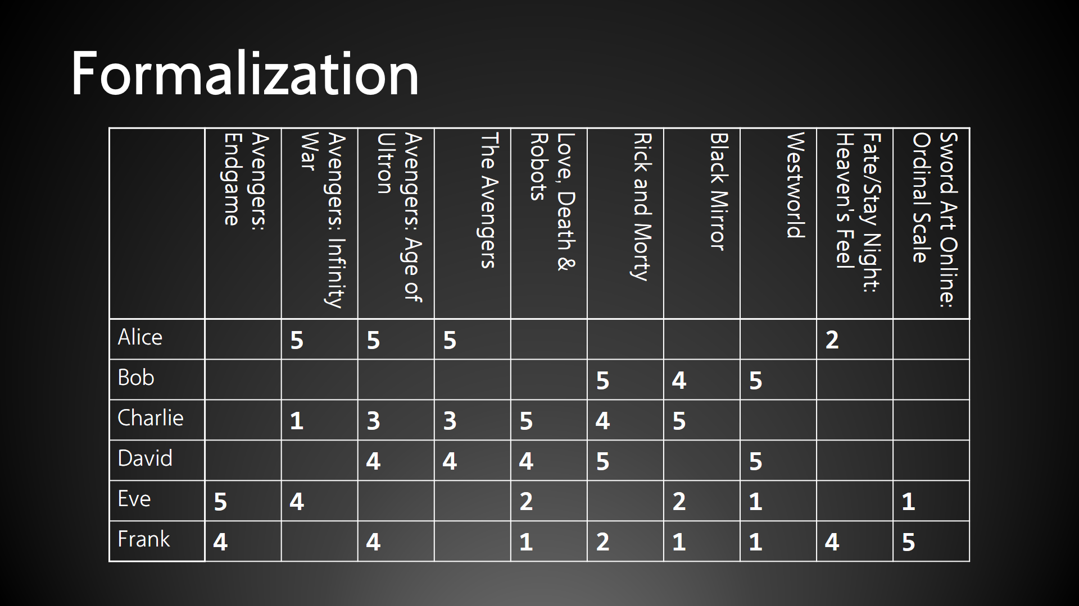
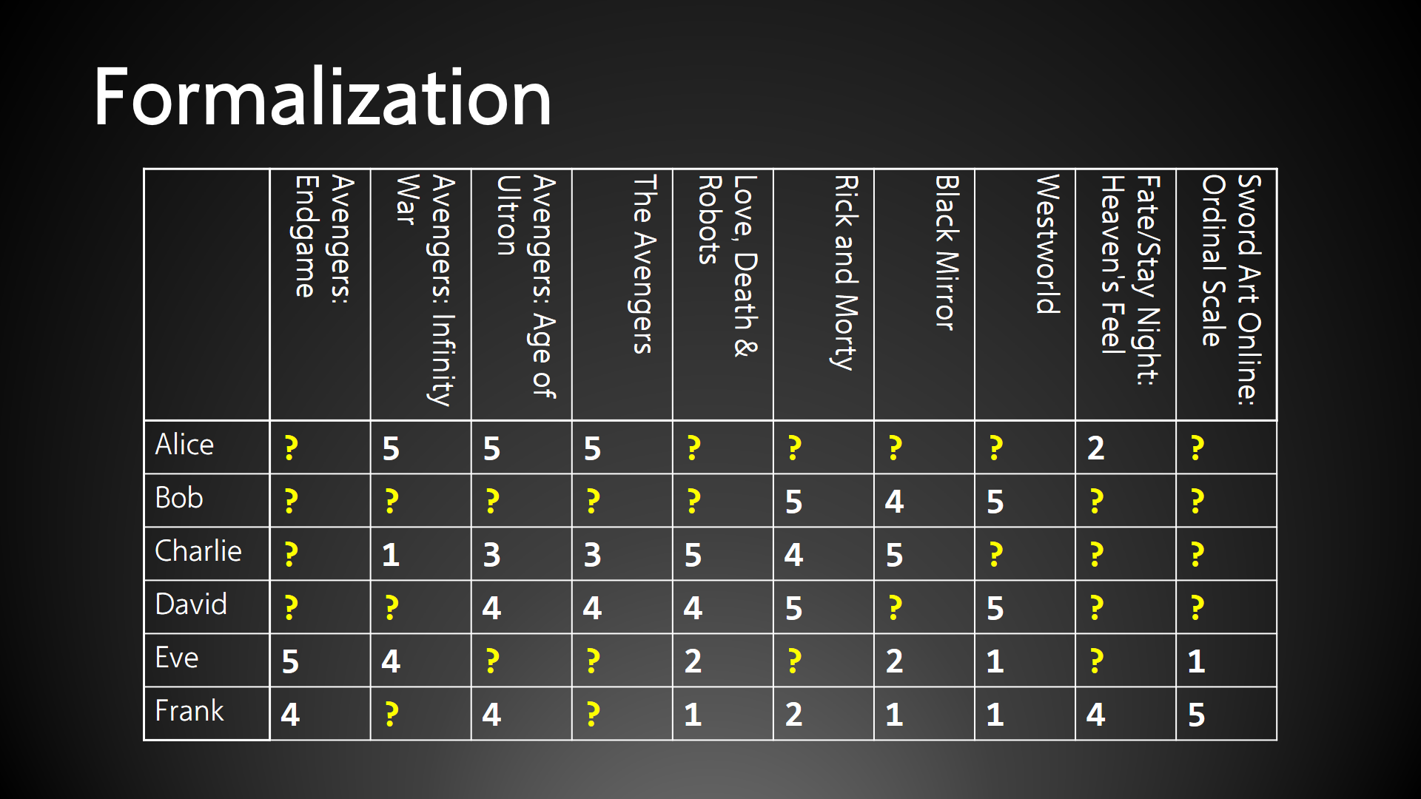
Notes:
--
For example, we are trying to fill this upper left corner

Slide 10
Formalization
 | Avengers: Endgame | Avengers: Infinity War | Avengers: Age of Ultron | The Avengers | Love, Death & Robots | Rick and Morty | Black Mirror | Westworld | Fate/Stay Night: Heaven's Feel | Sword Art Online: Ordinal Scale
Alice | ? | 5 | 5 | 5 |  |  |  |  | 2
Bob |  |  |  |  |  | 5 | 4 | 5
Charlie |  | 1 | 3 | 3 | 5 | 4 | 5
David |  |  | 4 | 4 | 4 | 5 |  | 5
Eve | 5 | 4 |  |  | 2 |  | 2 | 1 |  | 1
Frank | 4 |  | 4 |  | 1 | 2 | 1 | 1 | 4 | 5
Notes:
Let’s consider this unknown rating. What do you think it should be?
---
It should be high

Slide 11
Formalization
 | Avengers: Endgame | Avengers: Infinity War | Avengers: Age of Ultron | The Avengers | Love, Death & Robots | Rick and Morty | Black Mirror | Westworld | Fate/Stay Night: Heaven's Feel | Sword Art Online: Ordinal Scale
Alice | ? | 5 | 5 | 5 |  |  |  |  | 2
Bob |  |  |  |  |  | 5 | 4 | 5
Charlie |  | 1 | 3 | 3 | 5 | 4 | 5
David |  |  | 4 | 4 | 4 | 5 |  | 5
Eve | 5 | 4 |  |  | 2 |  | 2 | 1 |  | 1
Frank | 4 |  | 4 |  | 1 | 2 | 1 | 1 | 4 | 5
Notes:
It should be high because she rated previous 3 episodes high, she is a fan of Marvel
Therefore, we can use our prior knowledge to find correlated columns, and use this information to recommend
---
But what if we don’t have this prior knowledge?

Slide 12
Formalization
 | Avengers: Endgame | Avengers: Infinity War | Avengers: Age of Ultron | The Avengers | Love, Death & Robots | Rick and Morty | Black Mirror | Westworld | Fate/Stay Night: Heaven's Feel | Sword Art Online: Ordinal Scale
Alice |  | 5 | 5 | 5 |  |  |  |  | 2
Bob |  |  |  |  | ? | 5 | 4 | 5
Charlie |  | 1 | 3 | 3 | 5 | 4 | 5
David |  |  | 4 | 4 | 4 | 5 |  | 5
Eve | 5 | 4 |  |  | 2 |  | 2 | 1 |  | 1
Frank | 4 |  | 4 |  | 1 | 2 | 1 | 1 | 4 | 5
Notes:
Consider this ratings

Slide 13
Formalization
 | Avengers: Endgame | Avengers: Infinity War | Avengers: Age of Ultron | The Avengers | Love, Death & Robots | Rick and Morty | Black Mirror | Westworld | Fate/Stay Night: Heaven's Feel | Sword Art Online: Ordinal Scale
Alice |  | 5 | 5 | 5 |  |  |  |  | 2
Bob |  |  |  |  | ? | 5 | 4 | 5
Charlie |  | 1 | 3 | 3 | 5 | 4 | 5
David |  |  | 4 | 4 | 4 | 5 |  | 5
Eve | 5 | 4 |  |  | 2 |  | 2 | 1 |  | 1
Frank | 4 |  | 4 |  | 1 | 2 | 1 | 1 | 4 | 5
Notes:
We can still find correlated columns based on the given data
Because ratings in these columns are similar for each user
We can claim these movies are similar
---
Furthermore, we can also fill the other 3 blanks

Slide 14
Formalization
 | Avengers: Endgame | Avengers: Infinity War | Avengers: Age of Ultron | The Avengers | Love, Death & Robots | Rick and Morty | Black Mirror | Westworld | Fate/Stay Night: Heaven's Feel | Sword Art Online: Ordinal Scale
Alice |  | 5 | 5 | 5 |  |  |  |  | 2
Bob |  |  |  |  | ? | 5 | 4 | 5
Charlie |  | 1 | 3 | 3 | 5 | 4 | 5 | ?
David |  |  | 4 | 4 | 4 | 5 | ? | 5
Eve | 5 | 4 |  |  | 2 | ? | 2 | 1 |  | 1
Frank | 4 |  | 4 |  | 1 | 2 | 1 | 1 | 4 | 5
Notes:
Furthermore, we can also fill the other 3 blanks
---
More generally, consider this dataset as a matrix

Slide 15
Formalization
? | 5 | 5 | 5 | ? | ? | ? | ? | 2 | ?
? | ? | ? | ? | ? | 5 | 4 | 5 | ? | ?
? | 1 | 3 | 3 | 5 | 4 | 5 | ? | ? | ?
? | ? | 4 | 4 | 4 | 5 | ? | 5 | ? | ?
5 | 4 | ? | ? | 2 | ? | 2 | 1 | ? | 1
4 | ? | 4 | ? | 1 | 2 | 1 | 1 | 4 | 5

Slide 16
Formalization
? | 5 | 5 | 5 | ? | ? | ? | ? | 2 | ?
? | ? | ? | ? | ? | 5 | 4 | 5 | ? | ?
? | 1 | 3 | 3 | 5 | 4 | 5 | ? | ? | ?
? | ? | 4 | 4 | 4 | 5 | ? | 5 | ? | ?
5 | 4 | ? | ? | 2 | ? | 2 | 1 | ? | 1
4 | ? | 4 | ? | 1 | 2 | 1 | 1 | 4 | 5
Matrix rank is limited
Highly correlated
Notes:
More generally, consider this dataset as a matrix
Entries are highly correlated. Namely, Matrix rank
---

Slide 17
Formalization
Matrix rank is limited
Matrix rank is limited

Slide 18



Formalization
1. Matrix rank is limited
2. $r_{ix}=μ_{x}+f(i, x)$
$f(i, x)$: interaction between user $x$ and movie $i$
$μ_{x}$: baseline ratings of user $x$
Notes:
Critical generous mentioned by group 1
Some users are strict. Their ratings are always below 4 stars
Others maybe usually rates movies highly
--
Namely, users’ tastes and movies’ features

Slide 19



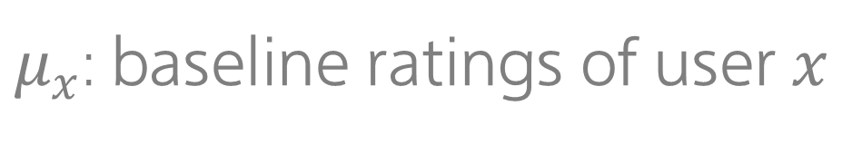
Formalization
1. Matrix rank is limited
2. $r_{ix}=μ_{x}+f(i, x)$
tastes
features
user $x$
and
movie $i$
$f(i, x)$: interaction between user $x$ and movie $i$
$f(i, x)$: interaction between
$μ_{x}$: baseline ratings of user $x$
$μ_{x}$: baseline ratings of user $x$

Slide 20


Formalization
1. Matrix rank is limited
2. $r_{ix}=μ_{x}+f(i, x)$
3. $f(i, x)$ is constant in terms of time
$μ_{x}$: baseline ratings of user $x$
$μ_{x}$: baseline ratings of user $x$
Notes:
Baseline maybe changes over time. Maybe because of the development of movie industry

Slide 21

Formalization
1. Matrix rank is limited
2. $r_{ix}=μ_{x}+f(i, x)$
3. $f(i, x)$ is constant in terms of time
$$μ_{x}=μ(t)+b_{x}$$

Slide 22

Formalization
1. Matrix rank is limited
2. $r_{ix}=μ_{x}+f(i, x)$
3. $f(i, x)$ is constant in terms of time
$$μ_{x}=μ(t)+b_{x}$$
4. $μ(t)$ is slowly changed in terms of time
Notes:
--
Given these mathematical formalization, we can construct our recommending system

Slide 23
Model
Recommendation System
Based on Hybrid Model
Based on Hybrid
Model

Slide 24
Model

Slide 25
Model

Slide 26
Model
Content Based Model
Bias Decomposition
Global Ave.
User Ave.
Item Ave.
TF-IDF
Item Profiles
User Profiles
User-Item Interaction
Item-Item Collaborative Filtering
Latent Factor Decomposition
Cosine Similarity
Interpolation Weights
Latent Factor Matrices
Similarity Matrix
Score Matrix
Score Matrix
Regression Networks
Final Result
Notes:
Our model is based on CB, CF, LF, and we use a regression function to combine them

Slide 27
Model
Content Based Model
Bias Decomposition
Global Ave.
User Ave.
Item Ave.
TF-IDF
Item Profiles
User Profiles
User-Item Interaction
Item-Item Collaborative Filtering
Latent Factor Decomposition
Cosine Similarity
Interpolation Weights
Latent Factor Matrices
Similarity Matrix
Score Matrix
Score Matrix
Regression Networks
Final Result

Slide 28
Model
Content Based Model
Content Based
Model
Content Based Model
Bias Decomposition
Global Ave.
User Ave.
Item Ave.
TF-IDF
Item Profiles
User Profiles
User-Item Interaction
Item-Item Collaborative Filtering
Latent Factor Decomposition
Cosine Similarity
Interpolation Weights
Latent Factor Matrices
Similarity Matrix
Score Matrix
Score Matrix
Regression Networks
Final Result

Slide 29


Content Based Model
movies.csv: (movieId, title, genres)
movies.csv:
(movieId, genres)
(movieId, title, genres)
$$TF_{ij}=\frac{f_{ij}}{\max_{k}{f_{kj}}}$$
TF-IDF: (movieId, movieProfile)
$$IDF_{i}=\frac{N}{n_{i}}$$

Slide 30





Content Based Model
movies.csv: (movieId, genres)
TF-IDF: (movieId, movieProfile)
ratings.csv: (userId, movieId, rating, timestamp)
ratings.csv:
timestamp
(userId, movieId, rating, )
$$p_{x}=\sum_{i∈H_{x}}{r_{xi}p_{i}}$$
$$r_{x}\sim N(μ_{x}, σ_{x}^{2})$$
$H_{x}$:
movies by user $x$
$H_{x}$: Highly rated movies by user $x$
Highly rated
Notes:
Weighted average to compute user profile

Slide 31
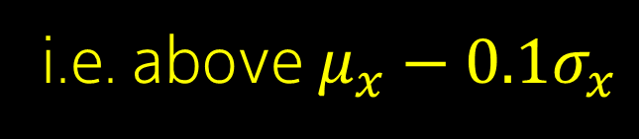
Content Based Model
movies.csv: (movieId, genres)
TF-IDF: (movieId, movieProfile)
ratings.csv:
timestamp
(userId, movieId, rating, )
weighted average: (userId, userProfile)
$$p_{x}=\sum_{i∈H_{x}}{r_{xi}p_{i}}$$
$$r_{x}\sim N(μ_{x}, σ_{x}^{2})$$
$H_{x}$:
Highest 54%
movies by user $x$
i.e. above $μ_{x}−0.1σ_{x}$

Slide 32

Content Based Model
movies.csv: (movieId, genres)
TF-IDF: (movieId, movieProfile)
ratings.csv: (userId, movieId, rating, timestamp)
weighted average: (userId, userProfile)
$$sim\left(p_{x}, p_{i}\right)=cos\left(p_{x}, p_{i}\right)=\frac{p_{x}^{T}p_{i}}{\left\|p_{x}\right\|\left\|p_{i}\right\|}$$
cosine similarity: (userId, movieId, similarity)

Slide 33
Content Based Model
Collaborative Filtering Model
Content Based
Collaborative Filtering
Model
Model
movies.csv: (movieId, genres)
TF-IDF: (movieId, movieProfile)
ratings.csv: (userId, movieId, rating, timestamp)
weighted average: (userId, userProfile)
cosine similarity: (userId, movieId, similarity)

Slide 34

Collaborative Filtering Model
ratings.csv: (userId, movieId, rating, timestamp)
ratings.csv: (userId, movieId, rating, timestamp)
$$s\left(i,j\right)=\frac{\sum_{s∈S_{ij}}{\left(r_{is}−\overline{r_{i}}\right)\left(r_{js}−\overline{r_{j}}\right)}}{\sqrt{\sum_{s∈S_{ij}}{{\left(r_{is}−\overline{r_{i}}\right)}^{2}}}\sqrt{\sum_{s∈S_{ij}}{{\left(r_{js}−\overline{r_{j}}\right)}^{2}}}}$$
Pearson correlation: (movie1, movie2, similarity)
Notes:
Pearson correlation

Slide 35





Collaborative Filtering Model
ratings.csv: (userId, movieId, rating, timestamp)
Pearson correlation: (movie1, movie2, similarity)
$${\hat{r}}_{xi}=b_{xi}+\sum_{\left.j∈N(i;x\right)}{s_{ij}⋅\left(r_{xj}−b_{xj}\right)}$$
$${\hat{r}}_{xi}=b_{xi}+\sum_{\left.j∈N(i;x\right)}{w_{ij}}$$
$$⋅\left(r_{xj}−b_{xj}\right)$$
$$w_{ij}←s_{ij}$$
$$L=\sum_{x,i}{{\left({\hat{r}}_{xi}−r_{xi}\right)}^{2}+{λ\left\|w\right\|}^{2}}$$
Notes:
Interpolation weights

Slide 36
Collaborative Filtering Model
ratings.csv: (userId, movieId, rating, timestamp)
Pearson correlation: (movie1, movie2, similarity)
$${\hat{r}}_{xi}=b_{xi}+\sum_{\left.j∈N(i;x\right)}{w_{ij}}$$
SGD: (userId, movieId, rating)
$$⋅\left(r_{xj}−b_{xj}\right)$$
$$w_{ij}←s_{ij}$$
$$L=\sum_{x,i}{{\left({\hat{r}}_{xi}−r_{xi}\right)}^{2}+{λ\left\|w\right\|}^{2}}$$
Stochastic Gradient Decent

Slide 37
Latent Factor Model
Collaborative Filtering
Model
Latent Factor
Model
ratings.csv: (userId, movieId, rating, timestamp)
Pearson correlation: (movie1, movie2, similarity)
SGD: (userId, movieId, rating)

Slide 38

Latent Factor Model
ratings.csv: (userId, movieId, rating, timestamp)
ratings.csv: (userId, movieId, rating, timestamp)
$${\hat{r}}_{xi}={b_{xi}+p}_{x}{⋅q}_{i}=b_{xi}+\sum_{f}{p_{xf}⋅q_{if}}$$

Slide 39

Latent Factor Model
ratings.csv: (userId, movieId, rating, timestamp)
$${\hat{r}}_{xi}={b_{xi}+p}_{x}{⋅q}_{i}=b_{xi}+\sum_{f}{p_{xf}⋅q_{if}}$$
SGD: (userId, movieId, rating)
$$L=\sum_{x,i}{{\left({\hat{r}}_{xi}−r_{xi}\right)}^{2}+λ_{1}{\left\|p\right\|}^{2}+{λ_{2}\left\|q\right\|}^{2}}$$
Stochastic Gradient Decent

Slide 40
Latent Factor Model
Model Combination
Model
Combination
Latent Factor
Model
ratings.csv: (userId, movieId, rating, timestamp)
SGD: (userId, movieId, rating)

Slide 41


Model Combination
CB: (userId, movieId, genreSim, tagSim)
CF: (userId, movieId, CFRating)
LF: (userId, movieId, LFRating)
$${\hat{r}}_{xi}=\sum_{k}{{w_{k}\hat{r}}_{xik}}$$
$$L=\sum_{x,i}{{\left({\hat{r}}_{xi}−r_{xi}\right)}^{2}+λ{\left\|w\right\|}^{2}}$$
Linear Regression: (userId, movieId, rating)
Stochastic Gradient Decent
Notes:
For simplicity, we use a linear regression
Notice that we might face overfitting when we use stochastic gradient decent
Therefore, we use cross validation to avoid it

Slide 42
Preprocessing
:
Splitting Dataset
Preprocessing

Slide 43
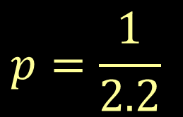
Preprocessing
:
Splitting Dataset
$$p=\frac{1}{2.2}$$

Slide 44
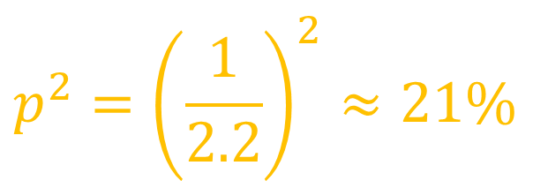
Preprocessing
:
Splitting Dataset
$$p=\frac{1}{2.2}$$
$$p^{2}={\left(\frac{1}{2.2}\right)}^{2}≈21\%$$

Slide 45


Preprocessing
:
Splitting Dataset
$$1−p^{2}≈79\%$$
$$p^{2}={\left(\frac{1}{2.2}\right)}^{2}≈21\%$$
Double check training set
$$p^{2}={\left(\frac{1}{2.2}\right)}^{2}≈21\%$$

Slide 46
Preprocessing
:
Splitting Dataset
$$1−p^{2}≈79\%$$
Double check training set
$$p^{2}={\left(\frac{1}{2.2}\right)}^{2}≈21\%$$

Slide 47

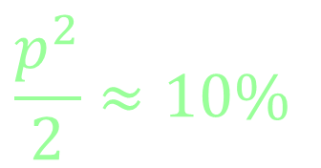
Preprocessing
:
Splitting Dataset
$$1−p^{2}≈79\%$$
Double check training set
$$\frac{p^{2}}{2}≈10\%$$
$$\frac{p^{2}}{2}≈10\%$$

Slide 48
Preprocessing
:
Time Regression
Splitting Dataset
$$1−p^{2}≈79\%$$
Double check training set
$$\frac{p^{2}}{2}≈10\%$$
$$\frac{p^{2}}{2}≈10\%$$

Slide 49





Preprocessing
:
Time Regression
$μ(t)$ is slowly changed in terms of time
linearly
$$μ=kt+b$$
$$k=\frac{\sum{\left(t−\overline{t}\right)}\left(μ−\overline{μ}\right)}{\sum{{\left(t−\overline{t}\right)}^{2}}}$$
$$r_{ix}^{′}=r_{ix}−μ(t)$$
$$b=\overline{μ}−k\overline{t}$$

Slide 50

Preprocessing
:
Baseline
Time Regression
$μ(t)$ is slowly changed in terms of time
linearly
$$r_{ix}^{′}=r_{ix}−μ(t)$$
$$μ=kt+b$$
$$k=\frac{\sum{\left(t−\overline{t}\right)}\left(μ−\overline{μ}\right)}{\sum{{\left(t−\overline{t}\right)}^{2}}}$$
$$r_{ix}^{′}=r_{ix}−μ(t)$$
$$b=\overline{μ}−k\overline{t}$$

Slide 51
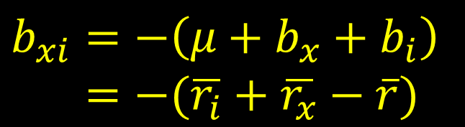






Preprocessing
:
Baseline
$$r_{ix}^{′}=r_{ix}−μ(t)$$
$$r_{xi}^{′}=μ+b_{x}+b_{i}+r_{xi}^{′′}$$
$$μ=\overline{r}$$
$$r_{xi}^{′′}=b_{xi}+r_{xi}^{′}$$
$$b_{i}=\overline{r_{i}}−μ$$
$$b_{xi}=−\left(μ+b_{x}+b_{i}\right) \\ =−(\overline{r_{i}}+\overline{r_{x}}−\overline{r})$$
$$b_{x}=\overline{r_{x}}−μ$$

Slide 52
Recommendation System
Based on Hybrid Model
Name | Workload
Dapeng Jin | Implement an algorithm to compute similarity used in collaborative filtering model, and write related reports. Finished format design of the report.
Haoyang Zhang | Propose the hybrid model, split and preprocess datasets, implement content based model, and write related reports.
Kunpeng Song | Implement latent factorizing model, and wirte related reports.
Xueyu Wu | Implement collaborative filtering model with initialized weights, implement hybrid model, and write related reports. Finetune the whole model.

Slide 53
Formalization
 | Avengers: Endgame | Avengers: Infinity War | Avengers: Age of Ultron | The Avengers | Love, Death & Robots | Rick and Morty | Black Mirror | Westworld | Fate/Stay Night: Heaven's Feel | Sword Art Online: Ordinal Scale
Alice |  | 5 | 5 | 5 |  |  |  |  | 2
Bob |  |  |  |  |  | 5 | 4 | 5
Charlie |  | 1 | 3 | 3 | 5 | 4 | 5
David |  |  | 4 | 4 | 4 | 5 |  | 5
Eve | 5 | 4 |  |  | 2 |  | 2 | 1 |  | 1
Frank | 4 |  | 4 |  | 1 | 2 | 1 | 1 | 4 | 5

Slide 54
Formalization
 | Avengers: Endgame | Avengers: Infinity War | Avengers: Age of Ultron | The Avengers | Love, Death & Robots | Rick and Morty | Black Mirror | Westworld | Fate/Stay Night: Heaven's Feel | Sword Art Online: Ordinal Scale
Alice | ? | 5 | 5 | 5 | ? | ? | ? | ? | 2 | ?
Bob | ? | ? | ? | ? | ? | 5 | 4 | 5 | ? | ?
Charlie | ? | 1 | 3 | 3 | 5 | 4 | 5 | ? | ? | ?
David | ? | ? | 4 | 4 | 4 | 5 | ? | 5 | ? | ?
Eve | 5 | 4 | ? | ? | 2 | ? | 2 | 1 | ? | 1
Frank | 4 | ? | 4 | ? | 1 | 2 | 1 | 1 | 4 | 5

