Slide 1
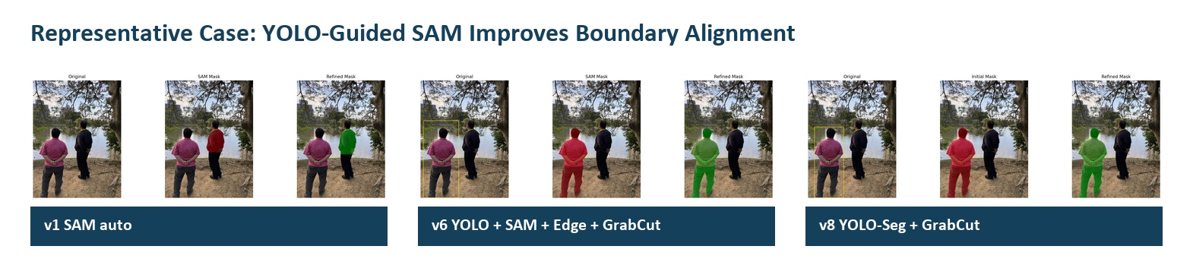
Artificial Intelligence Applications | Final Project
Multi-Model Boundary Refinement for Person Segmentation
SAM + YOLO + Canny Edge Scoring + GrabCut
12
8
0.8855
selected test images
experiment versions
best mean edge alignment

Slide 2
Problem and Objective
The project improves person mask boundaries without training a new neural network.
Problem
Objective
- SAM automatic masks can select imperfect target regions.
- Use YOLO to localize the person region.
- YOLO-Seg direct masks are not detailed enough on this small dataset.
- Use SAM to generate the segmentation mask.
- The output boundary needs to better follow visible person edges.
- Use Canny and GrabCut to evaluate and refine the boundary.
Scope: preliminary course project; final accuracy still needs ground-truth masks for IoU and Dice.

Slide 3
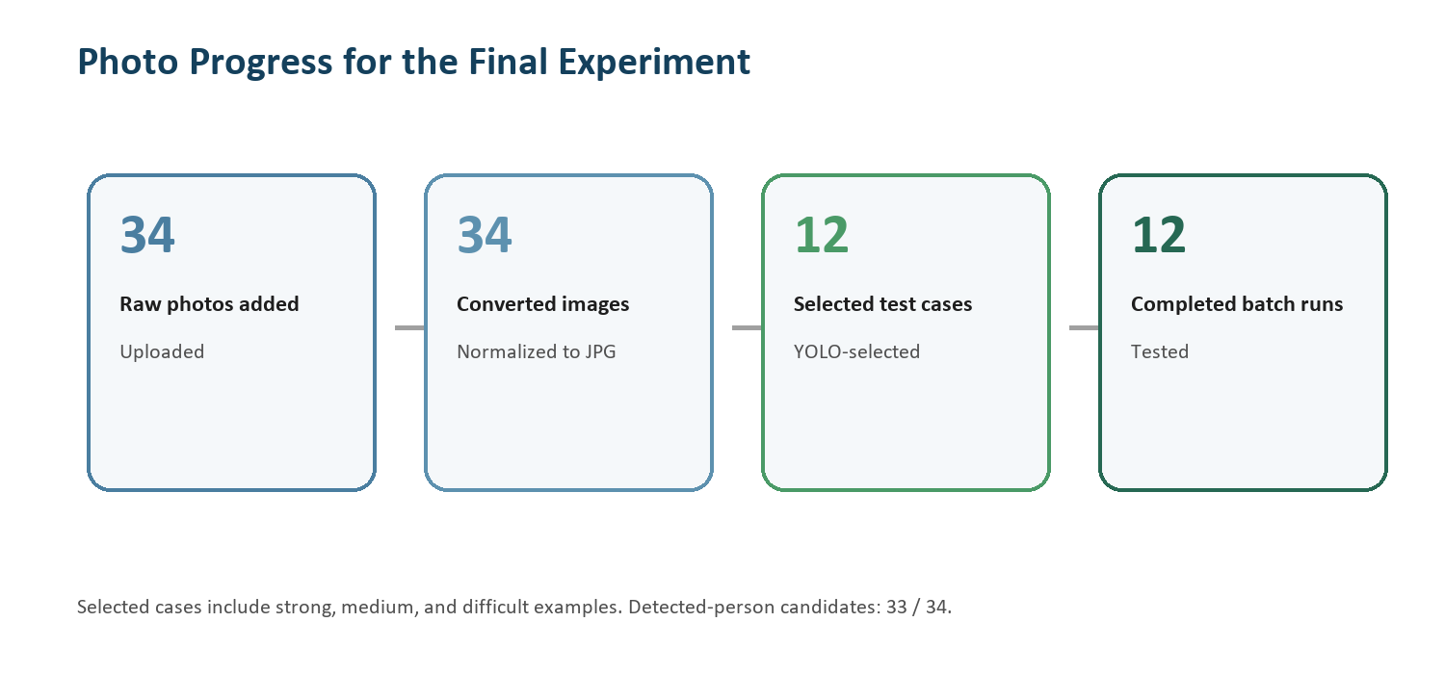
Methodology / Block Diagram
The final method is a hybrid pipeline, not a new model architecture.
1
2
3
4
5
Input image
YOLO box
SAM mask
Edge map
GrabCut
Selected person photo
Detect target person
Box-prompted segmentation
Canny boundary check
Foreground refinement
Dataset flow
- 34 uploaded raw photos were converted into a consistent test format.
- 12 suitable images were selected for final testing.
- All selected images were evaluated with the same batch pipeline.

Slide 4
Code Implementation
The deliverable includes runnable scripts, model weights, selected images, and batch outputs.
Core segmentation
Experiment runner
- sam_boundary_refinement.py
- run_experiment_versions.py
- SAM mask generation, edge scoring, GrabCut refinement
- runs v1-v8 model combinations
Batch test
Data preparation
- run_batch_test_images.py
- prepare_test_images.py
- evaluates all selected images consistently
- normalizes uploaded photos into test inputs
The final_finale package also includes model weights, selected test images, full batch outputs, and citation files.

Slide 5
Experiment Versions
Each version combines a different segmentation, localization, and refinement strategy.
Version
Modules
Mean
Role
v1
SAM auto + Canny + GrabCut
0.8708
baseline
v2
SAM auto + edge refine + GrabCut
0.8666
baseline variant
v5
YOLO box + SAM + GrabCut
0.8422
YOLO-guided
v6
YOLO box + SAM + edge refine + GrabCut
0.8855
best result
v7
YOLO-Seg direct + edge refine
0.5768
weak direct mask
v8
YOLO-Seg + GrabCut
0.7918
post-processing helps
v3/v4
Manual box versions
skipped
manual prompts needed

Slide 6
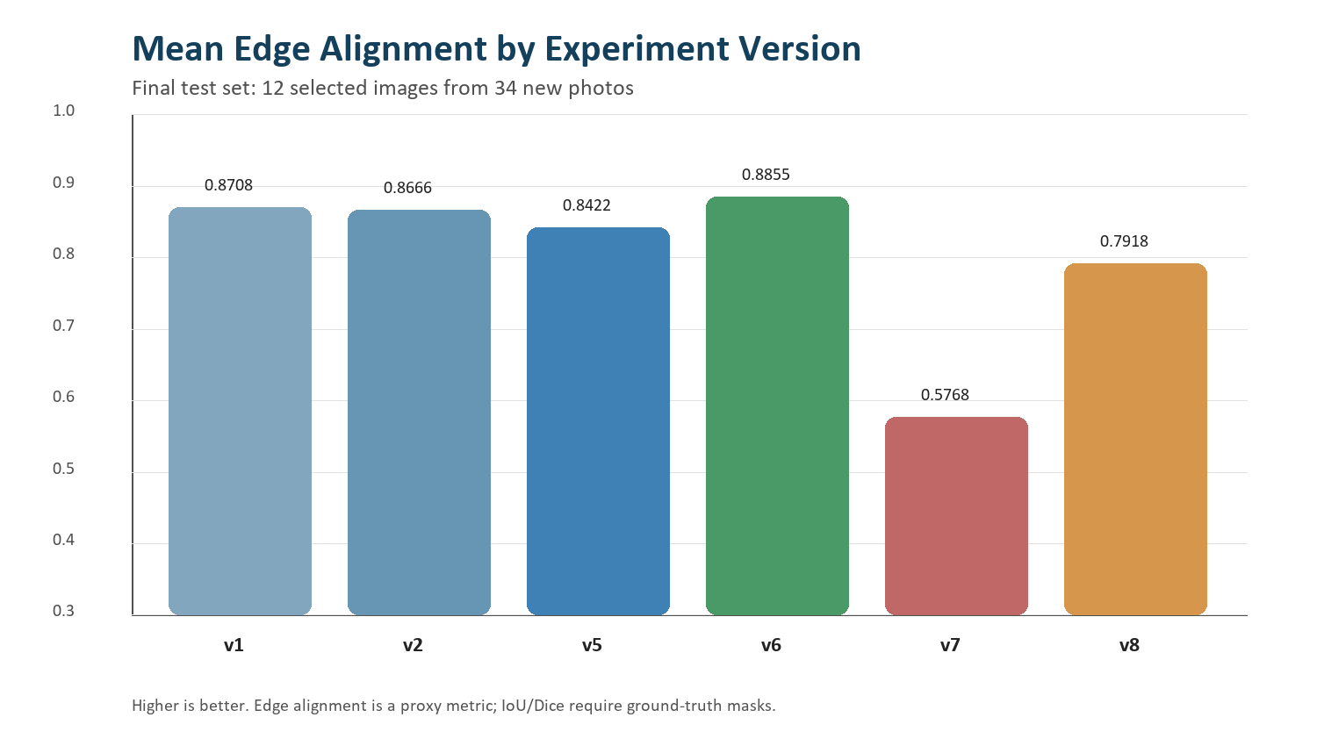
Quantitative Results
v6 achieved the highest mean edge alignment on the selected 12-image test set.
0.8855
v6 best mean score
0.7518
v6 minimum score
Interpretation
- YOLO guidance improves target focus.
- Edge refinement stabilizes the guided pipeline.
- GrabCut improves YOLO-Seg from v7 to v8.
Edge alignment is a proxy metric. A complete final evaluation should add ground-truth masks and report IoU/Dice.

Slide 7
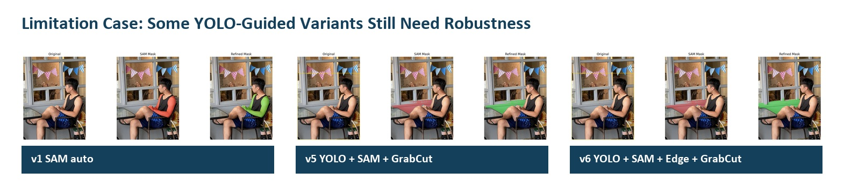
Visual Results and Limitations
The modified model improves many boundaries, but failure cases remain.
Representative case
Current limitations
- The dataset is small and self-collected.
- No ground-truth mask is available yet.
- Large person regions can still cause unstable masks.
- Edge alignment does not fully replace IoU or Dice.
Limitation case

Slide 8
Conclusion and References
The final result is a practical multi-model pipeline for preliminary person boundary refinement.
Final claim: YOLO-guided SAM with edge refinement and GrabCut is the best tested version in the current 12-image preliminary experiment.
Main references
Future work
- Kirillov et al. (2023): Segment Anything
- Create 5-10 ground-truth masks.
- Terven & Cordova-Esparza (2023): YOLO review
- Report IoU and Dice scores.
- Gaus et al. (2024): SAM prompt evaluation
- Test more difficult backgrounds and poses.
- Rother et al. (2004): GrabCut
- Canny (1986): edge detection
- Compare with stronger segmentation baselines.

