Slide 1
Rough Version | Final Project
Multi-Model Boundary Refinement for Person Segmentation
Goal: improve person mask boundary quality using existing models.
12
8
0.8855
selected final test images
tested model versions
best mean edge alignment

Slide 2
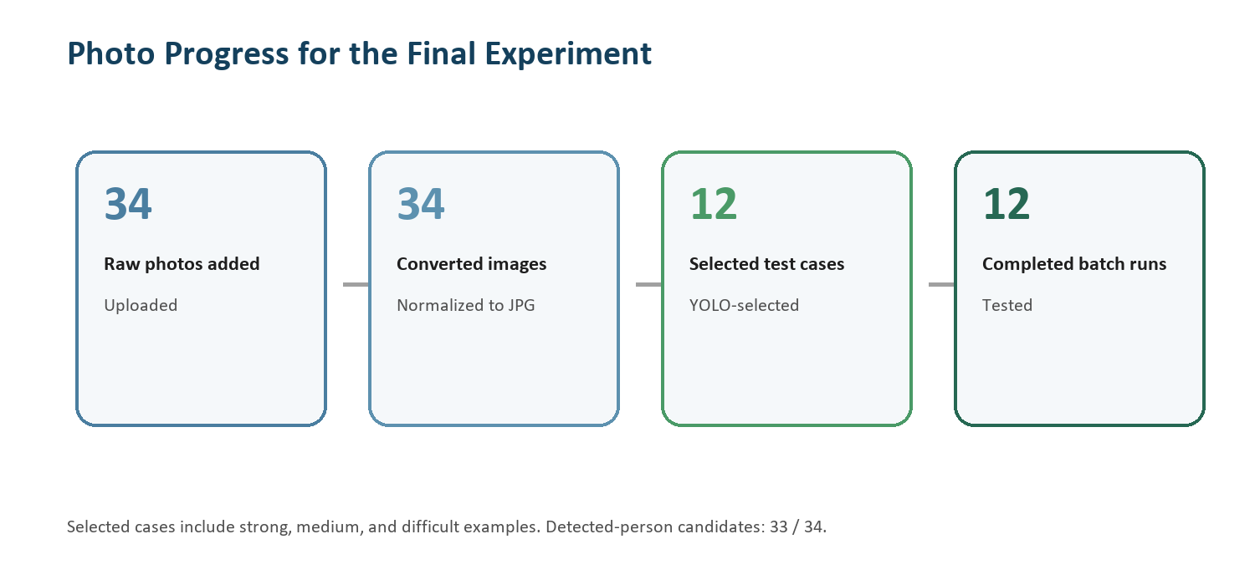
Method
YOLO localizes the person. SAM creates the mask. Edges and GrabCut refine the boundary.
1
2
3
4
5
Input
YOLO
SAM
Canny
GrabCut
person photo
person box
box-prompted mask
edge signal
mask cleanup
- No new model training.
- Compare model combinations.
- Use edge alignment as preliminary metric.

Slide 3
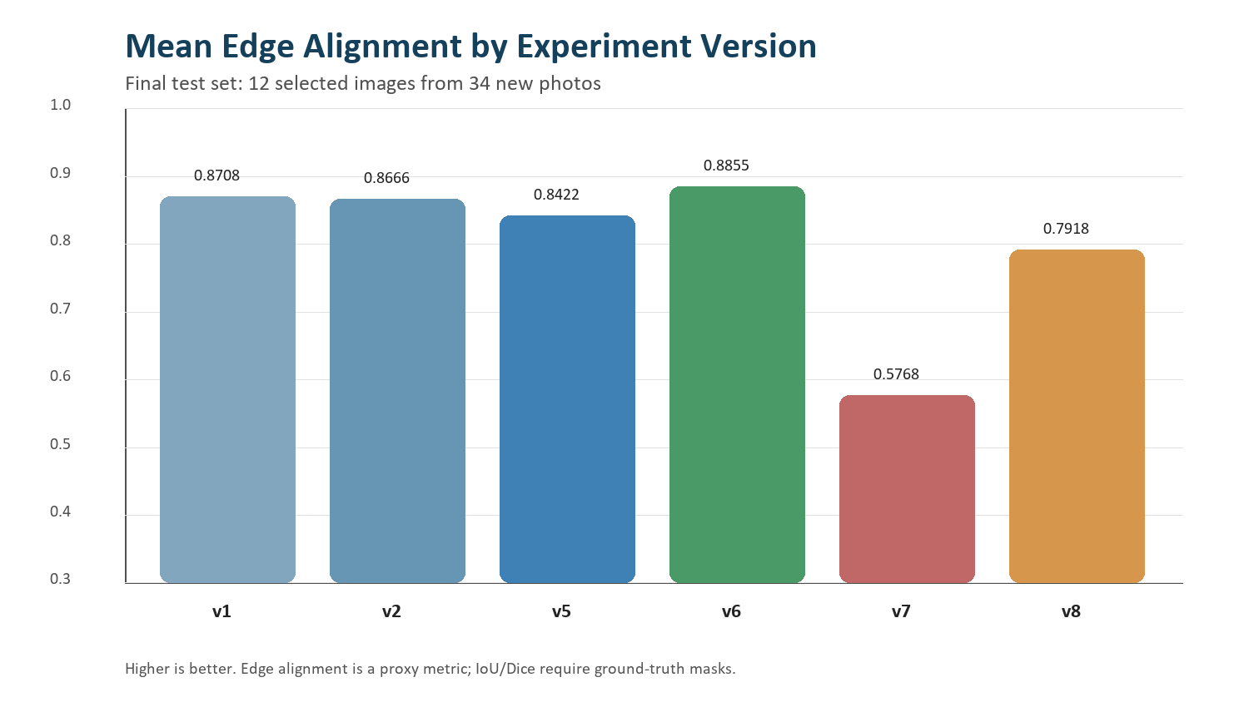
Main Result
v6 is the best current version on the selected 12-image test set.
v6
YOLO + SAM + Edge + GrabCut
0.8855
highest mean edge alignment
0.5768
YOLO-Seg direct baseline

Slide 4
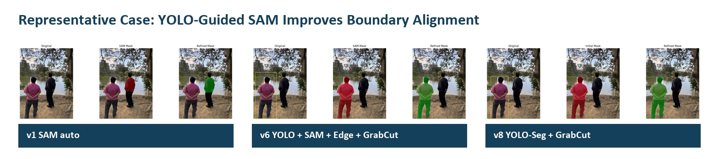
Conclusion
YOLO-guided SAM is useful, but the result is still preliminary.
Takeaway
- YOLO helps SAM focus on the person.
- GrabCut improves some masks.
- Need ground-truth masks for IoU/Dice.

