Slide 1
NLP Pretrained Models
Pre-trained models in Natural Language Processing (NLP) are models that are pre-trained on large-scale text data. They can learn general language knowledge and patterns and can be applied to a variety of NLP tasks to improve performance.
— VADER
— Word2Vec

Slide 2
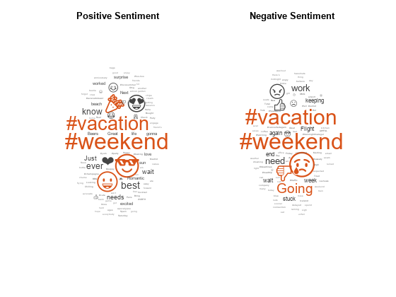
VADER Model
Principle：
VADER mainly relies on a pre-constructed sentiment dictionary for sentiment analysis. This dictionary contains a large number of words and their pre-labeled sentiment tendencies (positive, negative or neutral) and sentiment intensity values.
Implementation：
VADER will perform word segmentation on the input text, and then match each word with the words in the sentiment dictionary to calculate a sentiment score between -1 and 1, which reflects the sentiment tendency and intensity. This score is usually a value between -1 and 1, where a score close to 1 indicates a strong positive sentiment, and a score close to -1 indicates a strong negative sentiment.

Slide 3
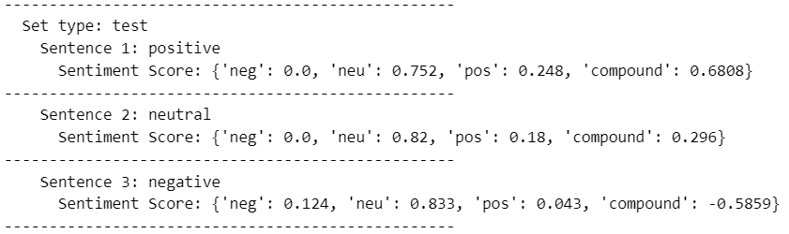
VADER -Model Implementation
First, create a VADER sentiment analyzer instance through analyzer = SentimentIntensityAnalyzer() for subsequent sentiment analysis of sentences to obtain sentiment scores;
Then traverse the data from the outer layer (language) to the inner layer (training set), and extract the tokenized data (tokenized_data) and the original unsegmented data (original_data);
For each segmented sentence, use the previously created analyzer to obtain the sentiment score through analyzer.polarity_scores(sent) and add the score to the sentiment_scores list;
Finally, aggregate the result dictionaries of each dataset type into a dictionary with the language as the key, and finally return this dictionary containing all languages and the sentiment analysis results of each dataset type.

Slide 4
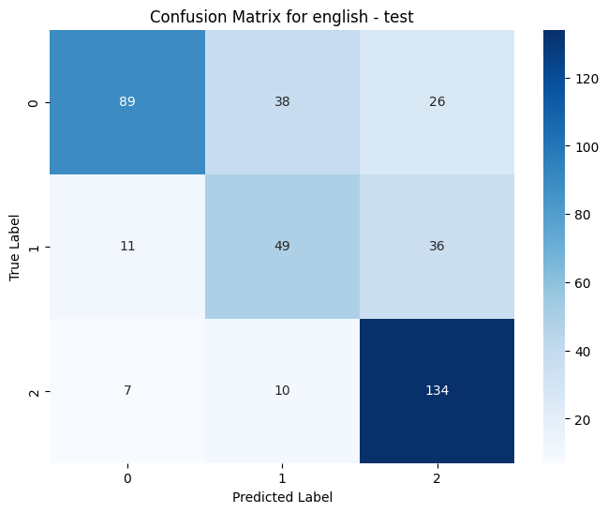
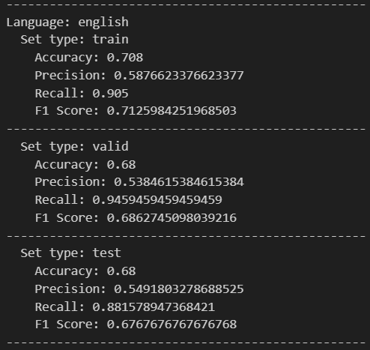
CADER - Visualization and Effect Evaluation
Effect Evaluation ：
Visualization ：
Accuracy：Measures the proportion of samples correctly predicted by the model in the total number of samples, reflecting the overall prediction accuracy of the model.
Precision：Among the samples predicted as positive cases, the proportion of true positive cases, reflecting the precision of the model's prediction of positive cases.
Recall：Among the samples that are actually positive cases, the proportion correctly predicted as positive cases by the model, reflecting the model's ability to capture positive cases.
F1：Comprehensively considers precision and recall, and is the harmonic mean of the two, used to comprehensively evaluate the balanced performance of the model in predicting positive and negative cases.
This is the confusion matrix made based on the training results of the VADER model and applied on the test set. It can be seen that the accuracy of the model is relatively high on the English test set.

Slide 5
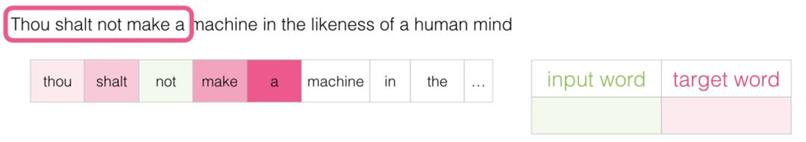
Word2Vec Model
A classic word vector model developed by Google, which learns the distributed representation of words through a neural network and can capture the semantic relationships between words. For example, semantically similar words are closer in the vector space.

Slide 6
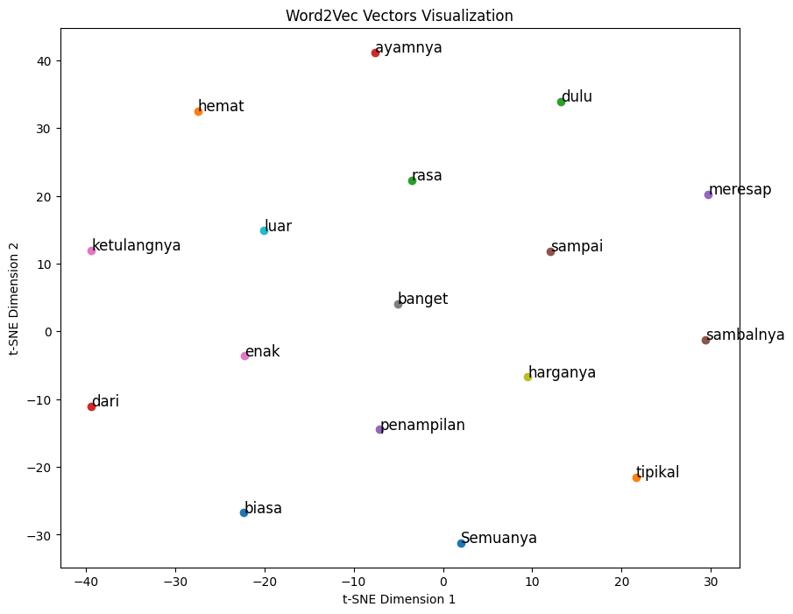
Word2vec - Model Implementation
Training Model：
Similar to training VADER, first traverse the data of each language from the outer layer to the inner layer, and use these sentence data for model training. After training, a good Word2Vec model is returned; When using it, only need to obtain the word vector corresponding to each word through the word vector dictionary of the model according to the given word list "words" and return it in the form of a list.
Visualization ：
I selected the word vectors of some words, and in the trained Word2Vec model, obtained the word vectors corresponding to these words. After dimensionality reduction through t-SNE, a scatter plot (right figure) can be made.

