Slide 1

WorkShare
Empowering Compensation with Blockchain Technology
Benedek Robert - George
Supervisor
Conf, Dr. Craciun Mihai Florin Gabriel

Slide 2
CONTENTS
History – evolution of money
Introduction – solution
Challenges
Functionality
Summary

Slide 3
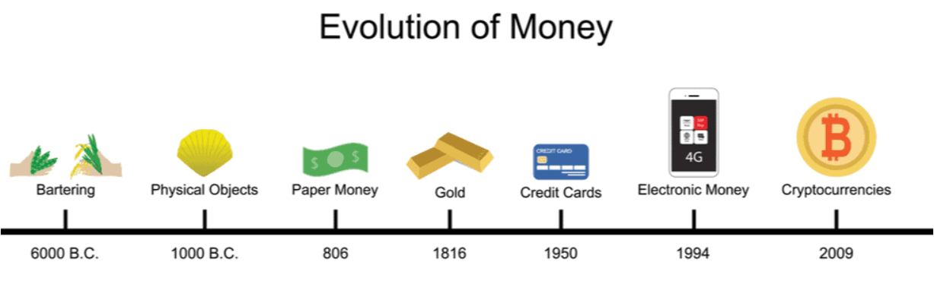
TRADING & INVESTING
Evolution is not a destination but a continuous journey, where adaptation and innovation pave the path to progress.

Slide 4
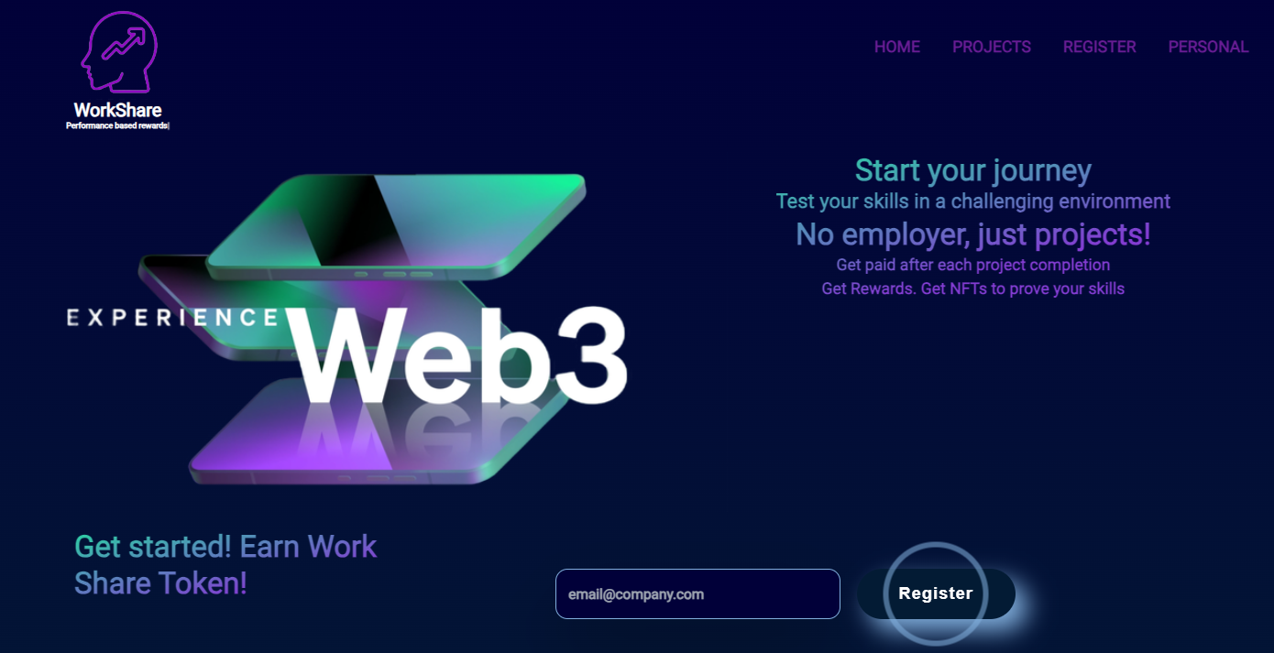
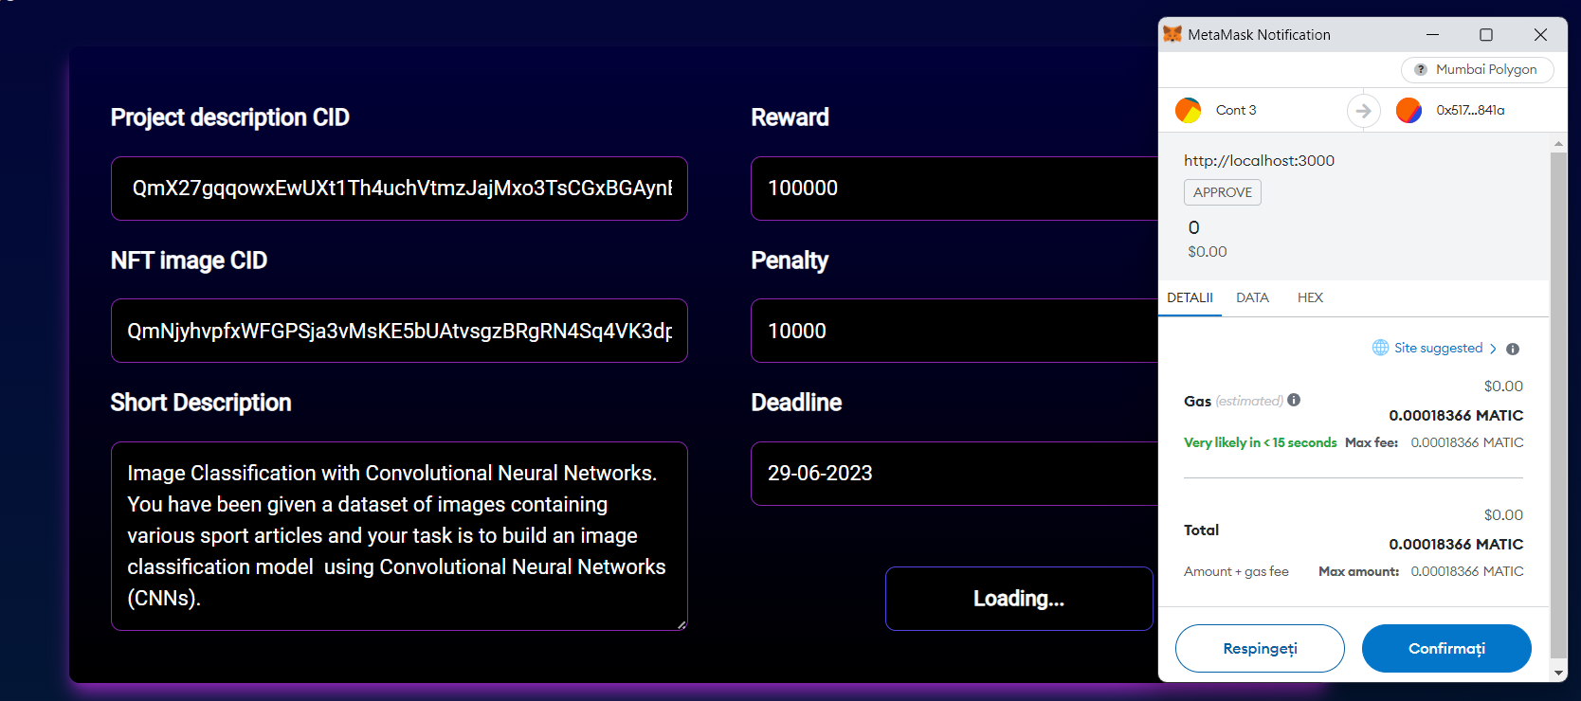
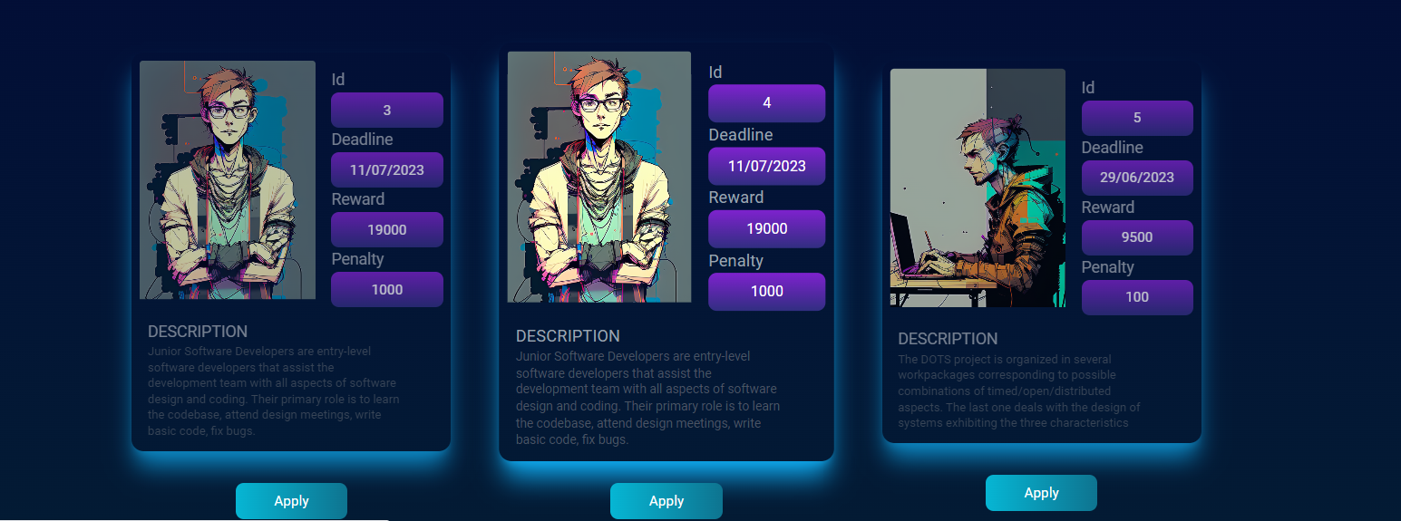
WorkShare
Scalability issues
Transactions cost
Tax relief

Slide 5
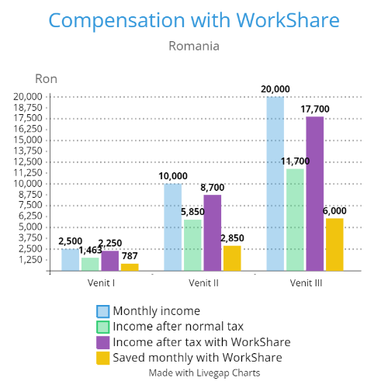
Normal VS. WorkShare

Slide 6

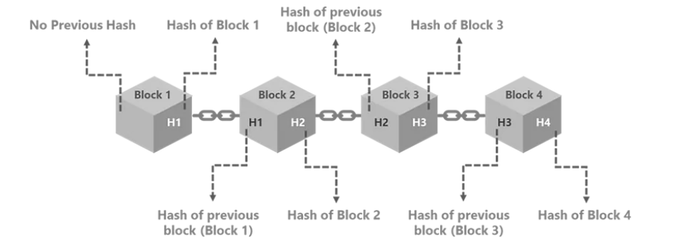
Blockchain
Distributed ledger
Sha-256
Network nodes
Consensus protocol
Public blockchain

Slide 7

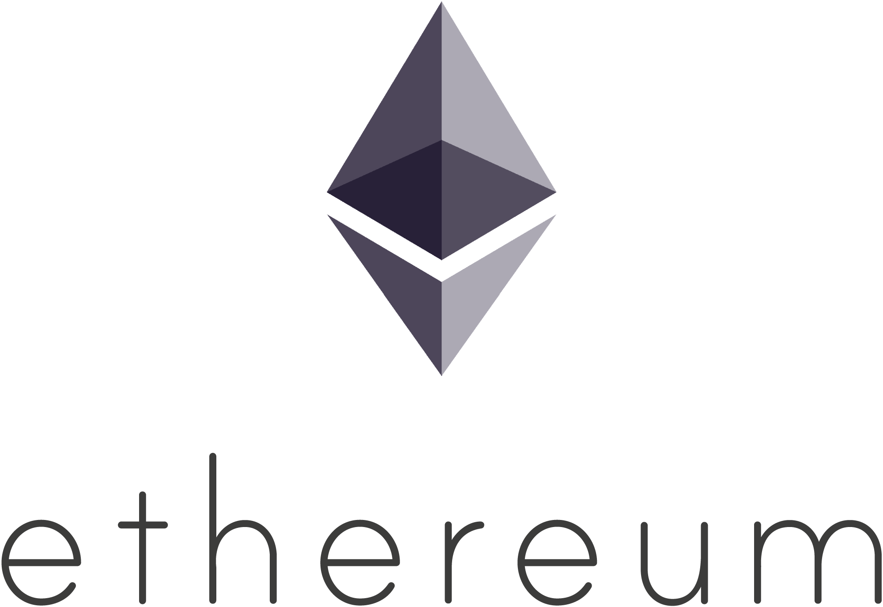
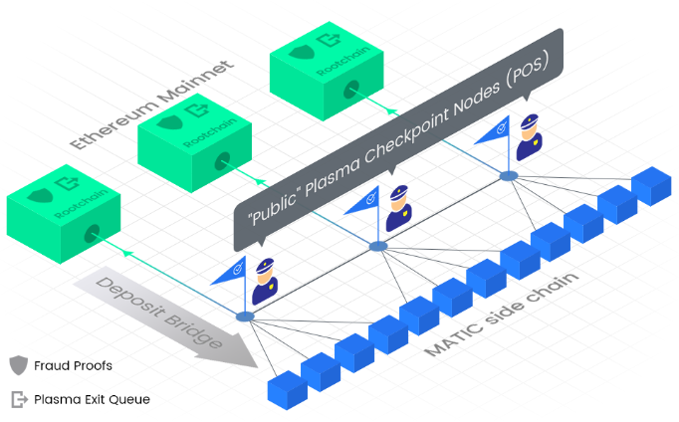

Ethereum - Polygon
Ethereum
Polygon
Decentralized apps
Smart Contracts
Solidity
Gas
OpenZeppelin library
Layer 2
Sidechain
Fast
Low fees

Slide 8


Proposed approach for Company management with freelancers
Regular company issues
Hard to scale
Bank transfers
Big employee taxes
Lack of motivation for employees
Boring projects
WorkShare solution
Global talent pool
Companies can scale
Instant payments
NFT proof

Slide 9
How
Payment
Utility
Security
NFT
Motivation
Instant payments on completion of a project in WorkShare Tokens through a smart contract .
- These tokens can be later sold for Matic.
- In a future version, users are going to be able to sell them for stablecoins .
- Smart contracts are self executing programs that automate the actions required in an code written agreement.
Each NFT has traits that describe the skills proved by the developer in previous projects.
Developers are paid based on the results rather than on the time. So the sooner they finish the task, the better.

Slide 10
Challenges
Technology related issues
Review system
Adoption
High gas fees
Legal and regulatory
Polygon
Upgradable contracts

Slide 11
Am invatat ca a detine Bitcoin e ca si cum ai avea un fragment din viitoR
Sergiu Manea - CEO BCR

Slide 12
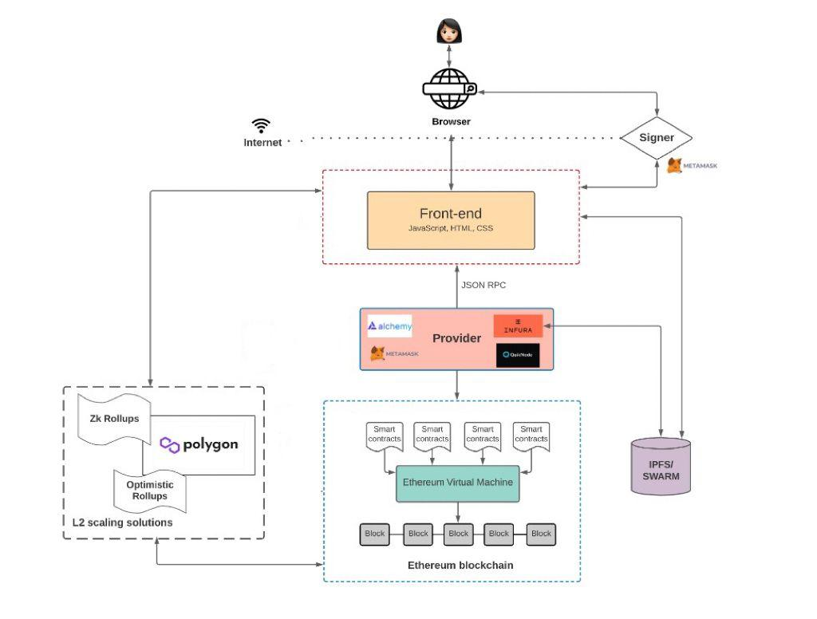
Technical architecture and components

Slide 13
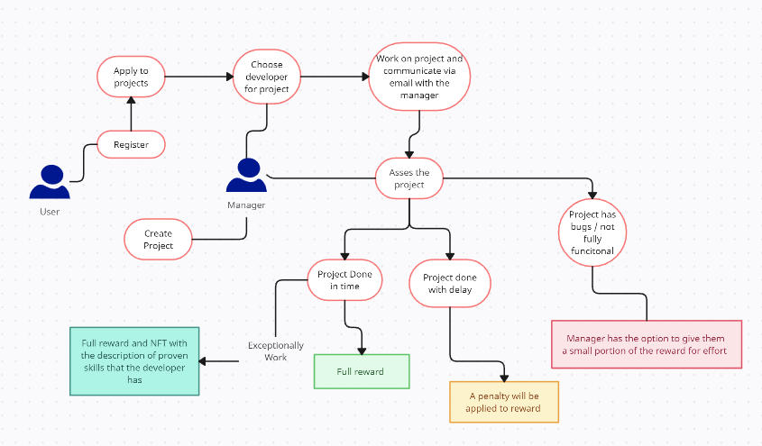
Application flow

Slide 14
SUMMARY
In conclusion, the exploration of WorkShare has demonstrated its effectiveness
in revolutionizing project management and compensation. The application’s ability to leverage blockchain technology, smart contracts, and a global talent pool has addressed critical challenges, enabling companies to allocate resources efficiently and the posibility of stimulating growth in the digital economy.

Slide 15
THANK YOU
Benedek Robert - George
robert.benedek@stud.ubbcluj.ro
www.WorkShare.com

