Slide 1

INFORMATION VISUALIZATION FINAL PROJECT
NYC Airbnb
Market Explorer
Visualizing spatial and temporal patterns in NYC Airbnb performance using an interactive multi-view dashboard.
Joyce Fu (jf5456)
NYU Tandon School of Engineering
NYC Airbnb Market Explorer / 1
Notes:
Hi, today I will present my project on exploring NYC Airbnb market patterns using interactive visualization. The goal is to transform Airbnb performance records into an interactive visual analytics system.

Slide 2
Problem & Motivation
Airbnb market behavior is multidimensional and difficult to understand with static summaries.
Price
+
Demand
+
Location
+
Time
Why static charts are not enough
Key analytical questions
Visualization goal
Tables and one-off charts flatten spatial and temporal variation into a few averages.
Where is revenue concentrated? How does performance change over time? How do room types differ?
Build an interactive system that supports exploration instead of only displaying aggregate statistics.
NYC Airbnb Market Explorer / 2
Notes:
The Airbnb market involves multiple dimensions, including price, demand, location, room type, and time. Traditional static charts cannot effectively reveal these relationships, so this project uses interactive visualization to support exploration.

Slide 3
Dataset
Monthly NYC Airbnb performance data from Kaggle, covering 2021–2026.
35,157
975
872
161
monthly observations
unique listings
unique hosts
ZIP code areas
Key Variables
Why visualization is needed
Location: latitude, longitude, ZIP code
The dataset combines spatial, temporal, categorical, and quantitative variables. Meaningful interpretation requires comparing multiple dimensions together.
Time: monthly records
Performance: revenue, occupancy, ADR, RevPAR
Categories: room type, property type
NYC Airbnb Market Explorer / 3
Notes:
The dataset comes from Kaggle and contains monthly Airbnb performance records from 2021 to 2026. After preprocessing, it contains over 35,000 observations with spatial, temporal, and categorical variables.

Slide 4
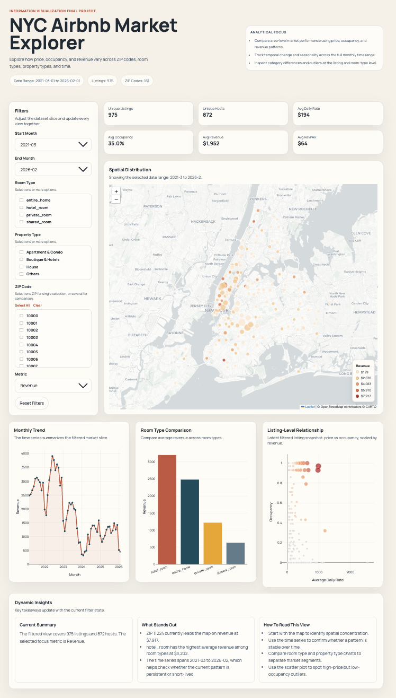
System Overview
A coordinated multi-view dashboard for spatial,
temporal, and categorical analysis.
Coordinated views
The dashboard integrates map, trend, bar, and listing-level relationship views in one interface.
Interactive filters
Users can adjust time range, room type, property type, ZIP code, and metric to update the dashboard.
Analysis workflow
Start with the map, compare categories, inspect temporal patterns, then use insights to interpret market behavior.
NYC Airbnb Market Explorer / 4
Notes:
This slide shows the full dashboard interface. It integrates multiple coordinated views with filters and dynamic summary sections, allowing users to explore different market slices.

Slide 5
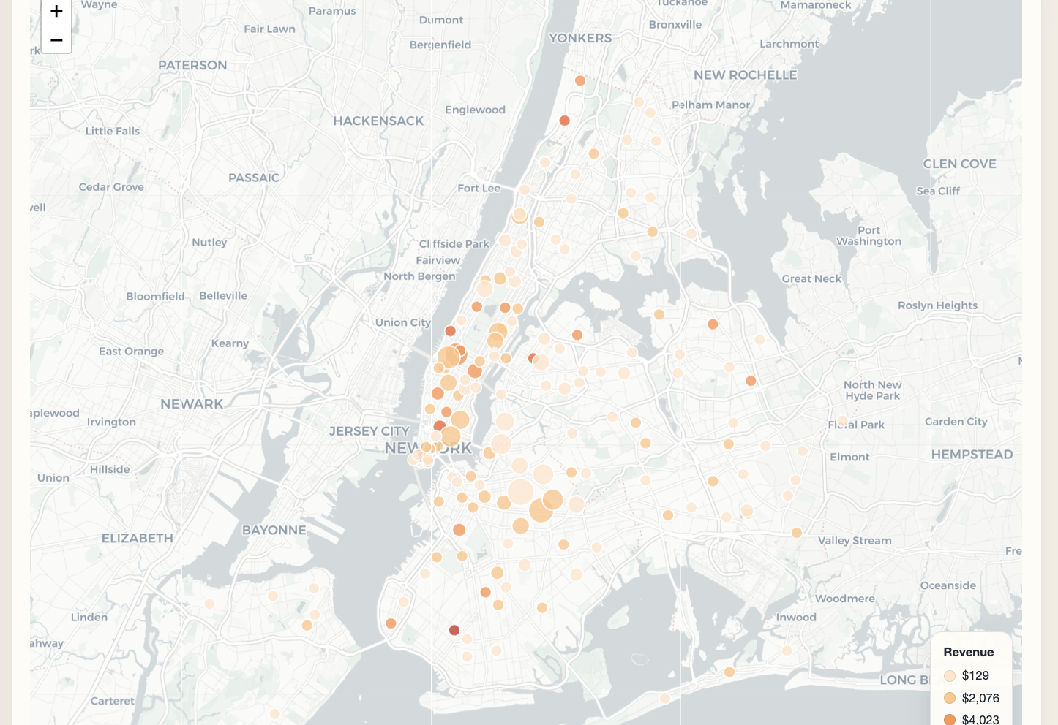
Spatial Distribution
Revenue is concentrated in selected ZIP-code areas instead of being evenly distributed.
Key Takeaway
Bubble size reflects revenue
Color intensity highlights stronger areas
High-revenue ZIP codes cluster in limited locations
Insight
Location plays a major role in earning potential, so Airbnb performance should be evaluated at the local submarket level.
NYC Airbnb Market Explorer / 5
Notes:
The map shows the spatial distribution of revenue. Revenue is not evenly distributed across New York City. Instead, higher-revenue areas are concentrated in certain ZIP codes, especially around central locations.

Slide 6
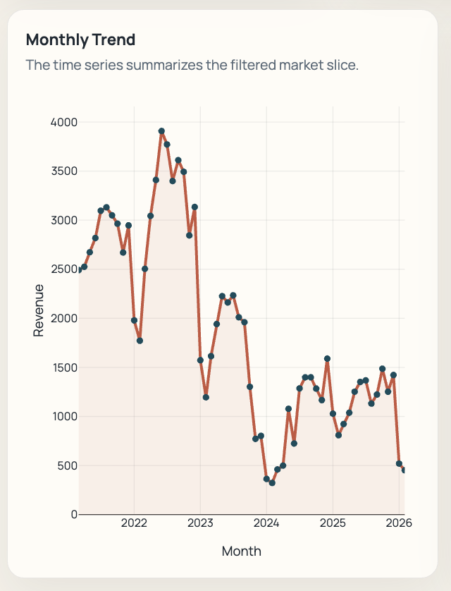
Temporal Trend
Monthly revenue changes substantially over the full data period.
What the chart shows
Revenue peaks around 2022
Strong decline through 2023–2024
Partial recovery afterward
Performance is not stable over time
Insight
Temporal context matters: a single average would hide major market fluctuations across the 2021–2026 period.
NYC Airbnb Market Explorer / 6
Notes:
This chart shows monthly revenue over time. We can see a strong peak around 2022, followed by a large decline in 2023 and 2024, then some partial recovery. This makes temporal context important.

Slide 7
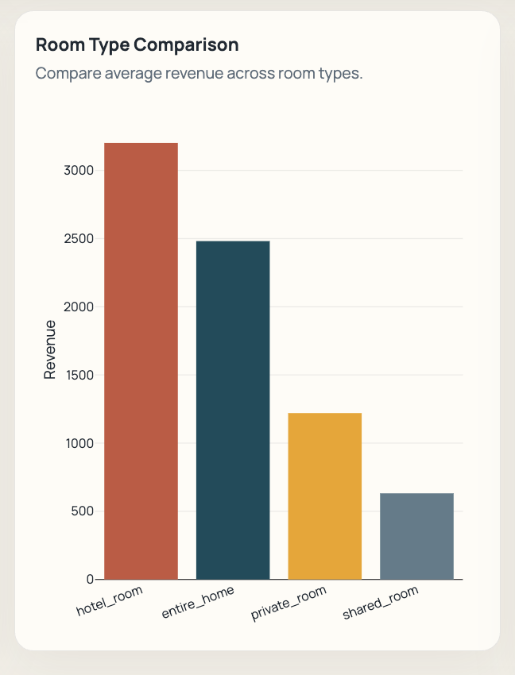
Room Type Comparison
Revenue differs substantially across accommodation formats.
Category Pattern
Hotel rooms have the highest average revenue
Entire homes also perform strongly
Private rooms are lower
Shared rooms have the lowest revenue
Interpretation
Listing category affects market performance, so revenue should not be interpreted only at the city-wide average level.
NYC Airbnb Market Explorer / 7
Notes:
The room type comparison shows clear category differences. Hotel rooms and entire homes generate higher revenue, while private and shared rooms have lower average revenue.

Slide 8
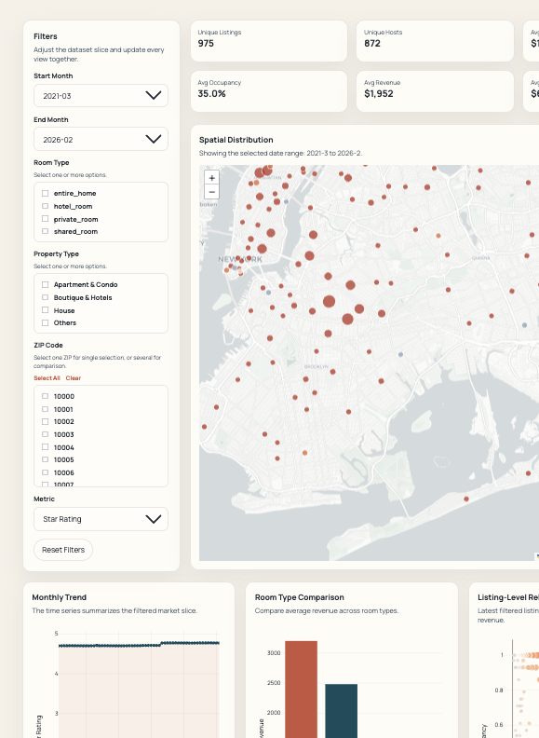
Interaction & User Experience
Filters support exploratory analysis across space, time, and categories.
Interactive Controls
Date range filtering
Room type and property type selection
ZIP code filtering
Metric switching
Dynamic updates across charts
UX refinement
The final dashboard emphasizes a larger spatial view, clearer legend, multi-select filters, and a lighter basemap for readability.
NYC Airbnb Market Explorer / 8
Notes:
The dashboard supports interaction through date range filters, room type and property type filters, ZIP code selection, and metric selection. These controls update the visualizations dynamically.

Slide 9
Key Insights
The coordinated views turn raw records into interpretable market patterns.
1. Spatial concentration
2. Temporal variation
3. Category differences
Airbnb revenue is concentrated in a limited subset of ZIP-code areas rather than evenly distributed across NYC.
Market performance fluctuates significantly over time, with a strong peak around 2022 and lower levels afterward.
Room type strongly affects average revenue, with hotel rooms and entire homes outperforming other categories.
Takeaway
Airbnb performance should be interpreted through location, time, and listing category together — not through a single overall average.
NYC Airbnb Market Explorer / 9
Notes:
The three main insights are spatial concentration, temporal variation, and category differences. Together, they show that Airbnb performance depends on multiple dimensions.

Slide 10
Contributions & Live Demo
A working visual analytics system for exploring NYC Airbnb performance.
Core Contributions
Demo Flow
Cleaned and processed multi-year dataset workflow
Overview → filter room type → change time range → inspect map and trend → reset
Interactive multi-view dashboard
Spatial, temporal, and category-level insight generation
Live Demo URL
Deployed system for browser-based access
https://nyc-airbnb-market-explorer.vercel.app/
Thank you!
NYC Airbnb Market Explorer / 10
Notes:
This project contributes a working visual analytics system based on a real-world dataset. In the demo, I will show the overview, filter by room type, change the time range, and explain how the coordinated views support analysis.

