Slide 1





TRAFFIC MANAGEMENT SYSTEM
Team : R.DURAIRAGAVAN
& ragavanjr26@gmail.com
Guide: P. Raja, (Master Trainer, Edunet Foundation)
Disclaimer: The content is curated for educational purposes only.
Notes:
Slides: Prepare a short slide deck (10-12 slides) summarizing the project objectives, methodology, and key results.

Slide 2
OUTLINE
Abstract of the Project
Problem Statement
Proposed Solution
System Architecture
Live Demo of the Project
Embedded Video of Project
Conclusion
Future Scope

Slide 3
Abstract
A traffic management system is a sophisticated, integrated system that strives to promote safety, improve traffic flow, and boost overall transportation system effectiveness. To gather and analyse real-time data regarding traffic conditions, it depends on cutting-edge technology like sensors, cameras, and communication networks. Using traffic lights, road signs, and other traffic control equipment, this data is utilised to control traffic flow and to give drivers real-time information on accidents, traffic congestion, and other problems.
Reducing traffic jams, boosting safety, and improving the performance of the transportation system as a whole are the main objectives of a traffic management system. The technology can assist in cutting commute times, lowering fuel consumption and emissions, and improving general quality of life for city dwellers by streamlining traffic and easing congestion. The device can also aid in lowering the chance of accidents and other occurrences by giving drivers real-time traffic information, hence improving safety and security on the roadways.

Slide 4
Problem Statement
The problem of traffic congestion in numerous cities has grown dramatically during the last several years. The advancement of civilization, as well as the widespread use of vehicles, has resulted in an increasing transportation requirement for infrastructure, which is notably connected with network congestion. However, the availability of various transport infrastructure has slowed mobility expansion. Congestion difficulties are connected with increased late issues, vehicle operation costs, including fuel consumption, pollution emissions, and stress caused by cars interfering with traffic flow on the road, particularly when traffic numbers reach a certain level. The majority of people are stuck in traffic in cities, and congestion occurs when demand exceeds road capacity. Several factors have contributed to the traffic congestion. The majority ofthem were designed to limit road capacity at a certain place or over a specific distance, such as when parking is done on a specific lane of road or when the number of cars is raised. Traffic signals have also dominated traffic congestion, and even when there is little or no traffic on the road, the traffic light still displays the same sort of traffic time, forcing traffic in the other lanes to rise and congestion to worsen. As a result, ambulances, police cars, and fire trucks may arrive late at their destinations.

Slide 5
Proposed Solution
Traffic Prediction Models Traffic prediction models are models that forecast traffic conditions using techniques trained to extract relevant information from historical or real-time data about traffic flow, congestion levels, commute times, etc. and use it to generate accurate and reliable predictions. AI finds wide application in this area, and can be used to create and better understand the phenomenon of traffic forecasting.
Machine Learning Models Machine learning models or algorithms are trained using historical databases to learn and identify patterns between the variables that impact traffic flow. The algorithms are then used to automatically detect and adapt to these patterns, if experienced in real-time. One of the primary benefits of using a machine learning model is that it can be used to analyze data of increased complexity and non-linear relationships between variables to generate predictions of enhanced accuracy.

Slide 6
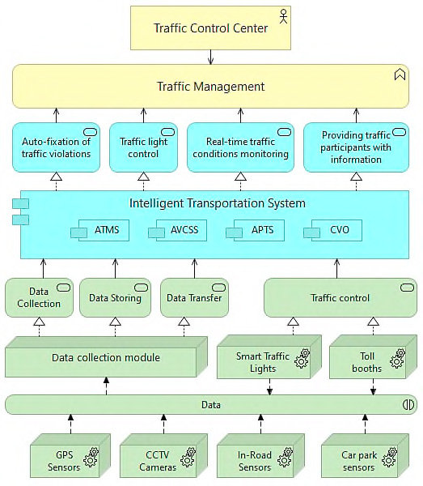
System Architecture

Slide 7
Conclusion
The Traffic Management AI project has demonstrated the potential of using artificial intelligence to optimize traffic flow and reduce congestion in urban environments. By analyzing real-time traffic data from various sensors and utilizing machine learning algorithms, the system was able to dynamically adjust traffic signal timings, predict congestion patterns, and suggest optimal routes for vehicles. This not only improved travel times but also contributed to reducing emissions and enhancing overall road safety.The implementation of this system showed a significant reduction in average vehicle delays at intersections and a smoother flow of traffic during peak hours. Additionally, the AI's predictive capabilities enabled better management of unexpected events such as accidents or road closures, ensuring minimal disruption to the traffic network.However, the project also faced several challenges, including data integration from diverse sources, the need for large-scale deployment across multiple cities, and addressing privacy concerns related to real-time tracking. Moreover, the system's effectiveness is closely tied to the quality of the data it receives, making the accuracy and timeliness of data crucial to its success.In conclusion, AI-powered traffic management systems hold great promise for modern cities.

Slide 8
Future Scope
The future of AI in traffic is alive with possibilities, each one more impressive than the last.
One of the most important future trends is smart cities, and how intelligent traffic management can be juxtaposed with urban planning hierarchies in order to build smarter, greener cities.
The core concept of smart cities relies heavily on data-oriented decision making. A city is typically composed of many simultaneously occurring systems - road traffic, rail and water-based transportation, infrastructure, parking facilities, etc. In order to effectively coordinate every individual cog, it is essential to have access to consistent, reliable data and be able to perform speedy analysis on it.
With the help of AI and machine learning, large volumes of data can be analyzed and used to anticipate future events

Slide 9
Thank you!
Notes:
thank you very much for joining this PPT, keep learning.
9

