Slide 1
Mediator Design Pattern
Budurlean Andrei, Astalus Adrian, Arsene Gina-Teodora

Slide 2
What is mediator ?
Mediator is a behavioral design pattern that lets you reduce chaotic dependencies between objects. The pattern restricts direct communications between the objects and forces them to collaborate only via a mediator object.
It mainly consists of a function acting as a type of link between different classes.

Slide 3
The main problem
When you have a bigger application, many different objects may need to communicate with each other. By having this logic implemented inside the objects, the code will be extremely hard to update, due to the way other objects handle it.
These objects will also become harder to use in other parts of the application, making you choose between using all or none of them.

Slide 4
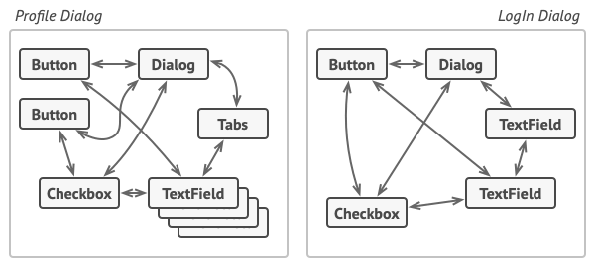
Example with problem solved by Mediator
Relations between elements of the user interface can become chaotic as the application evolves.

Slide 5
Solution
The Mediator is a class that consolidates all direct communication between multiple objects instead of them communicating with each other.
They will basically call functions from the mediator while the mediator sends the relevant information to all other objects that should receive it.

Slide 6
Example
Let’s say you want to create an application that handles sending and receiving messages to and from a list of users.
Without the mediator, each user would have to contain a list of users and manually call a function from each user sending them the message.
With the mediator, the user only has to call the mediator method and the receiving of messages and list of users can be handled by the mediator.

Slide 7
Example implementation in java
public interface ChatMediator {
public void sendMessage(String msg, User user);
void addUser(User user);
}
This interface is used to tell the users what the mediator can do.

Slide 8
public abstract class User {
protected ChatMediator mediator;
protected String name;
public User(ChatMediator med, String name){
this.mediator=med;
this.name=name;
}
public abstract void send(String msg);
public abstract void receive(String msg);
}
Each user will contain a reference to the mediator implementation.

Slide 9
public class ChatMediatorImpl implements ChatMediator {
private List<User> users;
public ChatMediatorImpl(){
this.users=new ArrayList<>();
}
public void addUser(User user){
this.users.add(user);
}
public void sendMessage(String msg, User user) {
for(User u : this.users)
if(u != user)
u.receive(msg);
}
}
The mediator contains the list of users.
The addUser method adds a user to the list.
The sendMessage sends the message to all other users, besides the one sending the message.

Slide 10
public class UserImpl extends User {
public UserImpl(ChatMediator med, String name) {
super(med, name);
}
public void send(String msg){
mediator.sendMessage(msg, this);
}
public void receive(String msg) {
System.out.println(this.name+": Received Message: "+msg);
}
}
The users have 2 methods:
The send method calls the mediator and tells it to handle sending the message to all other users.
The receive method is called by the mediator when the user receives a message

Slide 11
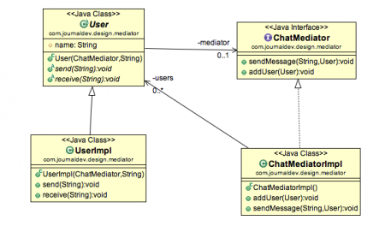

Slide 12
Applicability
The Mediator pattern should be used when:
it becomes hard to change some of the classes because they are too tightly coupled to other classes.
you can’t reuse a component in a different program because of it’s dependencies.
get to the point of creating multiple subclasses just to reuse a subset of basic behaviors in different contexts.

Slide 13
Pros and cons
Pros:
enforces Single Responsibility and Open/Closed Principles.
can reduce coupling between various components.
can help reuse individual components with ease.
Cons:
can lead to the Mediator becoming a God Object (anti-pattern referring to an object having too many objects and methods)

Slide 14
References
[1] https://refactoring.guru/design-patterns/mediator
[2] https://www.digitalocean.com/community/tutorials/mediator-design-pattern-java
[3] https://www.baeldung.com/java-mediator-pattern

