Slide 1
ClassQuiz
An open-source quiz platform
for our company events
Hackathon proposal for Deutsche Telekom
Created by Mawoka and the ClassQuiz contributors
01
Notes:
Suggested time: 20 seconds
I would like to propose ClassQuiz for our internal events. It is an existing open-source project, created by Mawoka and its contributors. I found it while looking for a tool that fits our need, and we made some small interface changes for our use.
Sources and attribution
https://github.com/mawoka-myblock/ClassQuiz
https://github.com/mawoka-myblock/ClassQuiz/blob/711bdde7a7dcd2d217cfc75dbbbb2592a78582d3/README.md
Code review scope: local checkout at 711bdde7a7dcd2d217cfc75dbbbb2592a78582d3, including existing local changes. Checked 29 September 2026.

Slide 2
The need and my contribution
Our event need
What I brought to the hackathon
We do not have Kahoot available.
Our current alternative has been unreliable.
Found a suitable open-source project.
We simplified the UI, including removing “Why choose ClassQuiz”.
The proposal is to evaluate ClassQuiz for an internal pilot.
02
Notes:
Suggested time: 35 seconds
At events, a quiz gives people an easy way to participate. We do not have Kahoot available, and our current internal alternative has been unreliable. My contribution is finding an existing solution that appears to cover the need, then helping make it more suitable for us. We removed some promotional clutter. The underlying quiz platform and its features belong to the original project.
Sources and attribution
Business need and contribution: presenter’s account in this conversation.
UI changes: local frontend/src/routes/+page.svelte and existing Git diff.
https://github.com/mawoka-myblock/ClassQuiz
Code review scope: local checkout at 711bdde7a7dcd2d217cfc75dbbbb2592a78582d3, including existing local changes. Checked 29 September 2026.

Slide 3
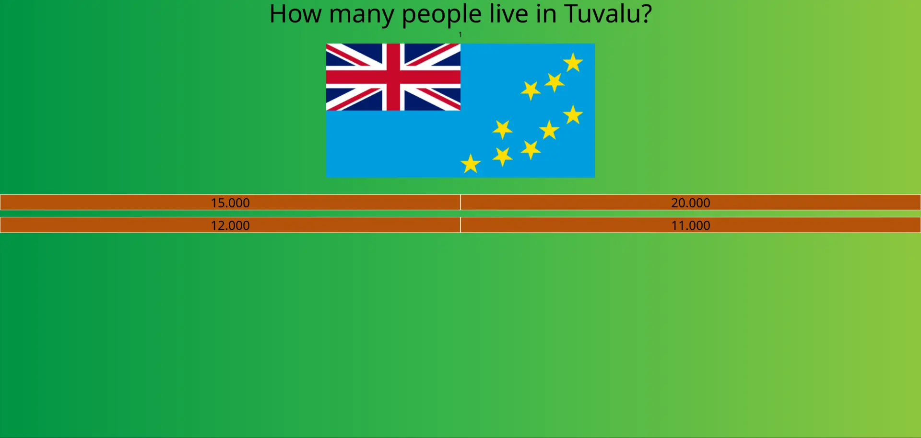
A familiar live quiz experience
1 Prepare
The host creates a quiz
and starts a session.
2 Join
Participants open a browser
and enter the game PIN.
3 Play
Answer questions and
see the results together.
Live demo: https://quiz.911bob.dev
Demo setup: no 2FA configured, no SMTP/email verification.
03
Notes:
Suggested time: 50 seconds
I already have a demonstration running at quiz.911bob.dev. The host prepares a quiz, participants join in a browser using a game PIN, and everyone sees the results. The current demo has no 2FA configured and no SMTP service or email verification. Those are demo choices. A company developer would configure the authentication and services we want for a corporate deployment. This original ClassQuiz screenshot shows the play experience, and I can demonstrate the running site.
Details for questions
Optional demo: replace this explanation with a rehearsed 45–60 second demonstration. Have the quiz and host session ready before presenting. Keep this slide as the fallback. Do not claim large-event capacity or reliability from a short demo. Standard PIN-based participation is separate from host/account SSO. The presenter reports no 2FA configured in the demonstration. SMTP is absent and email verification is skipped in the local deployment configuration. Do not state that SMTP is required for 2FA: ClassQuiz includes authenticator-based TOTP, which does not use SMTP. The public demo is not a company deployment.
Sources
https://github.com/mawoka-myblock/ClassQuiz/blob/711bdde7a7dcd2d217cfc75dbbbb2592a78582d3/README.md
https://github.com/mawoka-myblock/ClassQuiz/blob/711bdde7a7dcd2d217cfc75dbbbb2592a78582d3/frontend/src/lib/play/join.svelte
https://github.com/mawoka-myblock/ClassQuiz/blob/711bdde7a7dcd2d217cfc75dbbbb2592a78582d3/frontend/src/lib/assets/landing_new/select_org.webp
https://quiz.911bob.dev
https://github.com/mawoka-myblock/ClassQuiz/blob/711bdde7a7dcd2d217cfc75dbbbb2592a78582d3/classquiz/routers/users/twofa.py
Demo 2FA configuration: presenter’s statement. SMTP/email-verification configuration: local deploy/README.md and deploy/compose.yaml.
Reviewed 29 September 2026.

Slide 4
MPL 2.0 permits company use
We can use, self-host and modify ClassQuiz
for internal company events.
Within the organization
If we distribute it outside
Internal modifications do not have to be published publicly.
Provide the covered source, including changes, to recipients under MPL terms.
Preserve license and copyright notices. Hosting and support still have a cost.
04
Notes:
Suggested time: 40 seconds
ClassQuiz uses the Mozilla Public License 2.0. Mozilla explicitly allows companies to use the software and make private modifications. For use inside the organization, those changes do not need public release. If we distribute covered software outside the organization, source-sharing and notice obligations apply. This makes internal deployment possible without buying a ClassQuiz software license, while infrastructure and maintenance still need resources.
Detail for questions
MPL is file-level copyleft. New independent files are not automatically MPL-covered. Server execution alone is not distribution, but browser-delivered HTML, CSS and JavaScript count as delivered code. External guests or a publicly accessible deployment therefore need a distribution review. Ask the company’s open-source/legal process to confirm organizational boundaries, dependencies and any external rollout. MPL does not provide trademark rights or an enterprise support commitment. Removing promotional UI is permitted, but retain source license notices. This summarizes the cited terms, not a company legal approval.
Sources and attribution
https://github.com/mawoka-myblock/ClassQuiz/blob/711bdde7a7dcd2d217cfc75dbbbb2592a78582d3/LICENSE
https://www.mozilla.org/en-US/MPL/2.0/
https://www.mozilla.org/en-US/MPL/2.0/FAQ/#using-and-distributing-software-under-the-license
https://www.mozilla.org/en-US/MPL/2.0/FAQ/#other-common-questions
Code review scope: local checkout at 711bdde7a7dcd2d217cfc75dbbbb2592a78582d3, including existing local changes. Checked 29 September 2026.

Slide 5
Entra ID sign-in needs integration work
The foundation exists: OpenID Connect
Custom OpenID login
Adaptation and testing
ClassQuiz supports it. Microsoft Entra ID uses the same standard for SSO.
This version assumes identity fields that Entra does not always guarantee.
SSO means using the company sign-in. It still needs IT configuration and validation.
05
Notes:
Suggested time: 45 seconds
There is a useful foundation for company login. ClassQuiz has a configurable OpenID Connect integration, and Entra ID supports that standard for single sign-on. However, I would not describe this version as having ready-to-use Entra support. Its login code makes some assumptions about the identity data it receives. A developer needs to adapt those assumptions and test the flow with our tenant. IT would also register the application and decide who can access it.
Detail for questions
Code inspection, not a tenant test: Userinfo.sub is a uuid.UUID and later uses .hex, whereas Microsoft documents sub as an opaque string. The model also requires email_verified, email and other fields, plus a refresh_token in the outer response. These are not all guaranteed by a default Entra OIDC response. Configure a tenant-specific app and validate stable identity mapping, missing claims, registration/account linking and sessions. Do not replace validation with blindly trusted email values. Entra SSO for quiz creators does not automatically restrict PIN-based participant access or every route. No internal Entra access was available for validation.
Sources and attribution
https://classquiz.de/docs/self-host
https://github.com/mawoka-myblock/ClassQuiz/blob/711bdde7a7dcd2d217cfc75dbbbb2592a78582d3/classquiz/oauth/custom.py
https://github.com/mawoka-myblock/ClassQuiz/blob/711bdde7a7dcd2d217cfc75dbbbb2592a78582d3/classquiz/oauth/init_oauth.py
https://learn.microsoft.com/en-us/entra/identity-platform/v2-protocols-oidc
https://learn.microsoft.com/en-us/entra/identity-platform/id-token-claims-reference
Code review scope: local checkout at 711bdde7a7dcd2d217cfc75dbbbb2592a78582d3, including existing local changes. Checked 29 September 2026.

Slide 6
The technology in plain language
Part | What it does | Technology
Browser interface | Shows the quiz editor and participant screens | SvelteKit / TypeScript Tailwind CSS
Quiz engine | Runs the game and exchanges live answers | Python / FastAPI Socket.IO
Data services | Save quizzes and accounts, hold session state and search content | PostgreSQL / Valkey Meilisearch
Hosting | Runs the services and serves images over a secure connection | Docker Compose File or S3 storage / HTTPS
IT operates a group of services on approved company infrastructure.
06
Notes:
Suggested time: 35 seconds
You can think of it as a website with a game engine behind it. SvelteKit builds the screens people use. Python and FastAPI run the application, with Socket.IO keeping the quiz live. Separate services store the quizzes, hold session state and support search. Docker Compose packages the services so IT can run them together on suitable company infrastructure. Participants only need a browser.
Detail for questions
Repository evidence: frontend/package.json, Pipfile, classquiz code and docker-compose.yml. The current local deployment uses PostgreSQL, Valkey (Redis-compatible), Meilisearch, a background worker, SeaweedFS S3-compatible storage and an Nginx gateway. Upstream also supports local file storage and uses Caddy in its example stack. Do not imply that the prototype topology is the only supported corporate architecture, or that Docker makes production operations automatic.
Sources and attribution
https://github.com/mawoka-myblock/ClassQuiz/blob/711bdde7a7dcd2d217cfc75dbbbb2592a78582d3/README.md
https://github.com/mawoka-myblock/ClassQuiz/blob/711bdde7a7dcd2d217cfc75dbbbb2592a78582d3/frontend/package.json
https://github.com/mawoka-myblock/ClassQuiz/blob/711bdde7a7dcd2d217cfc75dbbbb2592a78582d3/Pipfile
https://github.com/mawoka-myblock/ClassQuiz/blob/711bdde7a7dcd2d217cfc75dbbbb2592a78582d3/docker-compose.yml
Local deploy/compose.yaml (prototype-specific configuration).
Code review scope: local checkout at 711bdde7a7dcd2d217cfc75dbbbb2592a78582d3, including existing local changes. Checked 29 September 2026.

Slide 7
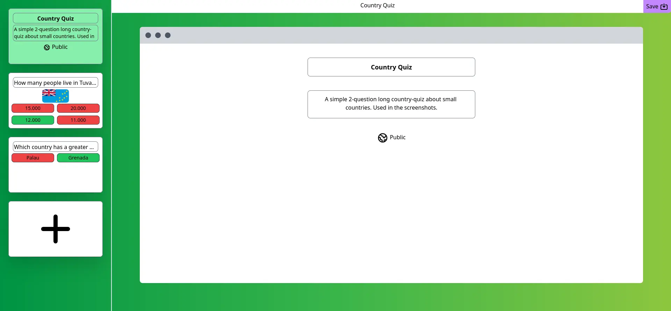
A Telekom theme is feasible
Basic recolor
A modest frontend task. Shared Svelte components and Tailwind/CSS styles provide a starting point.
Complete theme
Review every screen. Some colors live in individual components. Check dark mode and contrast too.
Original project styling
Magenta for branding. Keep answer and status colors meaningful.
07
Notes:
Suggested time: 40 seconds
A magenta theme looks achievable. The frontend uses reusable Svelte components and shared CSS, so a developer can change the main backgrounds, navigation and buttons without rebuilding the quiz engine. It is more specific than editing a single HTML page: some colors are also set inside individual screens. A consistent result means checking the editor, host view and participant view, including dark mode. The answer colors should still help people distinguish choices and results.
Detail for questions
Effort is an engineering assessment, not a time estimate or completed theme. Shared styles are in frontend/src/app.css, layout colors in frontend/src/routes/+layout.svelte, and shared components under frontend/src/lib. Direct utility classes and literal colors are scattered across components. The current Tailwind 4 setup uses CSS imports and utilities, so do not promise that editing the legacy tailwind.config.cjs alone will theme the app. Establish semantic brand styles, replace decorative hard-coded colors, then rebuild and review. The presentation uses a magenta-inspired design, not an official Deutsche Telekom template or an approved app rebrand.
Sources and attribution
https://github.com/mawoka-myblock/ClassQuiz/blob/711bdde7a7dcd2d217cfc75dbbbb2592a78582d3/frontend/src/app.css
https://github.com/mawoka-myblock/ClassQuiz/blob/711bdde7a7dcd2d217cfc75dbbbb2592a78582d3/frontend/src/routes/+layout.svelte
https://github.com/mawoka-myblock/ClassQuiz/blob/711bdde7a7dcd2d217cfc75dbbbb2592a78582d3/frontend/package.json
https://github.com/mawoka-myblock/ClassQuiz/blob/711bdde7a7dcd2d217cfc75dbbbb2592a78582d3/frontend/src/lib/navbar.svelte
https://github.com/mawoka-myblock/ClassQuiz/blob/711bdde7a7dcd2d217cfc75dbbbb2592a78582d3/frontend/src/lib/assets/landing_new/edit_org.webp
Code review scope: local checkout at 711bdde7a7dcd2d217cfc75dbbbb2592a78582d3, including existing local changes. Checked 29 September 2026.

Slide 8
Company deployment needs an IT owner
Infrastructure and data
Identity and access
Hosting, DNS/HTTPS, database, live-session and search services, S3 storage.
Entra application setup, integration fixes and access rules.
Operations
Pilot validation
Secrets, backups, monitoring, updates and SMTP if email features are needed.
Test a realistic event size, reconnects and recovery.
I need an IT partner with access to company hosting, DNS and Entra ID.
08
Notes:
Suggested time: 40 seconds
The demo is already available, but company deployment needs a developer or platform team with internal permissions. Beyond authentication and an S3 storage endpoint, they need hosting, DNS and HTTPS, the database and supporting services. They also need to manage secrets, backups, monitoring and updates. Email features would need SMTP. Before wider use, we should test the event size we expect, including reconnects and recovery, and name someone to support it.
Details for questions
Docker Compose is a useful starting point. Production preparation remains a moderate integration and operations task, with effort depending on internal approvals and infrastructure. The local prototype notes do not configure external OAuth or scheduled backups. Do not imply company deployment, Entra testing or capacity testing has already happened. The public demo address is included at the presenter’s request. Credentials and private infrastructure details remain excluded. See the final appendix for the full deployment checklist.
Sources
https://classquiz.de/docs/self-host
https://github.com/mawoka-myblock/ClassQuiz/blob/711bdde7a7dcd2d217cfc75dbbbb2592a78582d3/docker-compose.yml
Presenter’s access constraints in this conversation.
Local deploy/README.md and deploy/compose.yaml.
Reviewed 29 September 2026.

Slide 9
Proposal: one internal pilot
Use one real event to decide
whether ClassQuiz fits.
An IT partner and approved hosting
A short quiz with a representative group
A review of reliability and hosting effort
Build on the existing project, with clear ownership for company use.
09
Notes:
Suggested time: 25 seconds
My proposal is one internal pilot with an IT partner. We can try a short quiz with a representative group, check whether hosting is practical and see how the tool behaves during the event. If the pilot meets our needs, we can decide whether to adopt it more broadly. The value is using an existing project to solve a company problem, with clear ownership for the work that remains.
Sources and attribution
Proposed next step, not an approved plan.
Code review scope: local checkout at 711bdde7a7dcd2d217cfc75dbbbb2592a78582d3, including existing local changes. Checked 29 September 2026.

Slide 10
Appendix: Entra integration details
Configuration already exists
Developer review required
Custom provider settings, discovery URL, client ID/secret and a login callback.
Subject ID format, missing identity fields, account linking and token response validation.
IT must configure the tenant
Acceptance checks
Register the app, allow the redirect URI and apply appropriate access policy.
First sign-in and repeat sign-in, logout, denied access and player access boundaries.
10
Notes:
Use only for questions. The integration path exists, but tenant compatibility has not been demonstrated.
Detail for questions
Settings: CUSTOM_OPENID_PROVIDER__CLIENT_ID, CUSTOM_OPENID_PROVIDER__CLIENT_SECRET, CUSTOM_OPENID_PROVIDER__SERVER_METADATA_URL and CUSTOM_OPENID_PROVIDER__SCOPES. Default scopes: openid email profile. Frontend: VITE_CUSTOM_OAUTH_NAME. Callback: https://<company-host>/api/v1/users/oauth/custom/auth. A tenant-specific Microsoft v2 discovery URL is https://login.microsoftonline.com/<tenant-id>/v2.0/.well-known/openid-configuration. Current Python models require sub as uuid.UUID, email_verified and refresh_token. Microsoft documents sub as a string and email as not guaranteed. A standard response can fail validation. A developer must choose safe claim mapping and account lifecycle behavior. Do not assume automatic role provisioning, tenant restriction or single logout from generic OIDC support.
Sources and attribution
https://classquiz.de/docs/self-host
https://github.com/mawoka-myblock/ClassQuiz/blob/711bdde7a7dcd2d217cfc75dbbbb2592a78582d3/classquiz/oauth/custom.py
https://github.com/mawoka-myblock/ClassQuiz/blob/711bdde7a7dcd2d217cfc75dbbbb2592a78582d3/classquiz/oauth/init_oauth.py
https://github.com/mawoka-myblock/ClassQuiz/blob/711bdde7a7dcd2d217cfc75dbbbb2592a78582d3/classquiz/config.py
https://learn.microsoft.com/en-us/entra/identity-platform/v2-protocols-oidc
https://learn.microsoft.com/en-us/entra/identity-platform/id-token-claims-reference
Code review scope: local checkout at 711bdde7a7dcd2d217cfc75dbbbb2592a78582d3, including existing local changes. Checked 29 September 2026.

Slide 11
Appendix: likely questions
Is it free for company use?
Must we publish our changes?
The MPL grants use rights without a royalty. Hosting and maintenance still cost time and money.
Internal changes can stay private. External distribution triggers obligations for MPL-covered code.
Is reliability proven for us?
How much work is the branding?
No company-scale result yet. The pilot should establish our event capacity and recovery needs.
A basic recolor is relatively small. Consistent branding across all screens requires review.
11
Notes:
Use these answers if questions come up after the pitch.
Detail for questions
License scope: keep source notices and track local patches. External browser-delivered assets count as distribution. Independent files need not automatically become MPL-licensed. Company legal/open-source review should cover relevant entities, dependencies and external access. No total deployment cost, developer-day estimate or tested player capacity is available. Source revision and existing local deployment changes are documented in the walkthrough.
Sources and attribution
https://www.mozilla.org/en-US/MPL/2.0/
https://www.mozilla.org/en-US/MPL/2.0/FAQ/
https://github.com/mawoka-myblock/ClassQuiz/blob/711bdde7a7dcd2d217cfc75dbbbb2592a78582d3/frontend/src/app.css
https://github.com/mawoka-myblock/ClassQuiz/blob/711bdde7a7dcd2d217cfc75dbbbb2592a78582d3/frontend/src/routes/+layout.svelte
Reliability and effort statements are explicit limitations/assessments, not measured results.
Code review scope: local checkout at 711bdde7a7dcd2d217cfc75dbbbb2592a78582d3, including existing local changes. Checked 29 September 2026.

Slide 12
Appendix: company deployment checklist
Area | What the company team needs to provide
Hosting and network | Approved VM or container platform, DNS, TLS/HTTPS, reverse proxy with WebSocket support and network rules
Application and data | Frontend, API and worker, PostgreSQL, Valkey, Meilisearch, persistent data and S3-compatible storage with a bucket
Identity and email | Entra integration and access policy, MFA policy, secrets, SMTP/sender setup if verification or password reset is used
Operations | Backups and restore tests, monitoring/logs, patching, release/rollback process and a named support owner
Company acceptance | Privacy/retention and open-source review, brand checks, realistic event capacity, reconnect and recovery testing
IT selects optional external integrations and verifies supported service versions.
12
Notes:
This is the handoff checklist for the company developer or platform team. Authentication and storage are only part of the deployment.
Detail for questions
Core services: frontend, API, worker, PostgreSQL, Redis-compatible Valkey, Meilisearch, and persistent media storage. The company can supply managed equivalents where compatible. S3 requires an endpoint, bucket, credentials with appropriate permissions, connectivity, and a browser-accessible media URL. The local prototype has an additional S3 public-URL patch that is separate from the minimal UI fork and must be evaluated if that storage topology is reused. Configure DNS, TLS, reverse proxy routing for the app/API/Socket.IO, upload size limits and timeouts. Store application signing keys and database/storage/identity credentials outside Git. Define access for hosts and participants, including any guest policy. Add SMTP and an approved sender only if local account email verification, password resets or notifications are needed. Authenticator-based TOTP does not require SMTP. Evaluate version support and dependency updates, perform database migrations, establish backup/restore and release rollback, and assign support ownership. Optional integrations such as CAPTCHA, image search and analytics are choices, not mandatory requirements for basic quiz play.
Sources and attribution
https://classquiz.de/docs/self-host
https://github.com/mawoka-myblock/ClassQuiz/blob/711bdde7a7dcd2d217cfc75dbbbb2592a78582d3/docker-compose.yml
https://github.com/mawoka-myblock/ClassQuiz/blob/711bdde7a7dcd2d217cfc75dbbbb2592a78582d3/classquiz/config.py
https://github.com/mawoka-myblock/ClassQuiz/blob/711bdde7a7dcd2d217cfc75dbbbb2592a78582d3/classquiz/routers/users/twofa.py
Local deploy/README.md and deploy/compose.yaml.
Deployment requirements also include engineering recommendations for an internally operated service.
Code review scope: local checkout at 711bdde7a7dcd2d217cfc75dbbbb2592a78582d3, including existing local changes. Checked 29 September 2026.

