Slide 1
Software engineering
V - Object Design - Design Patterns
5th Seminar

Slide 2
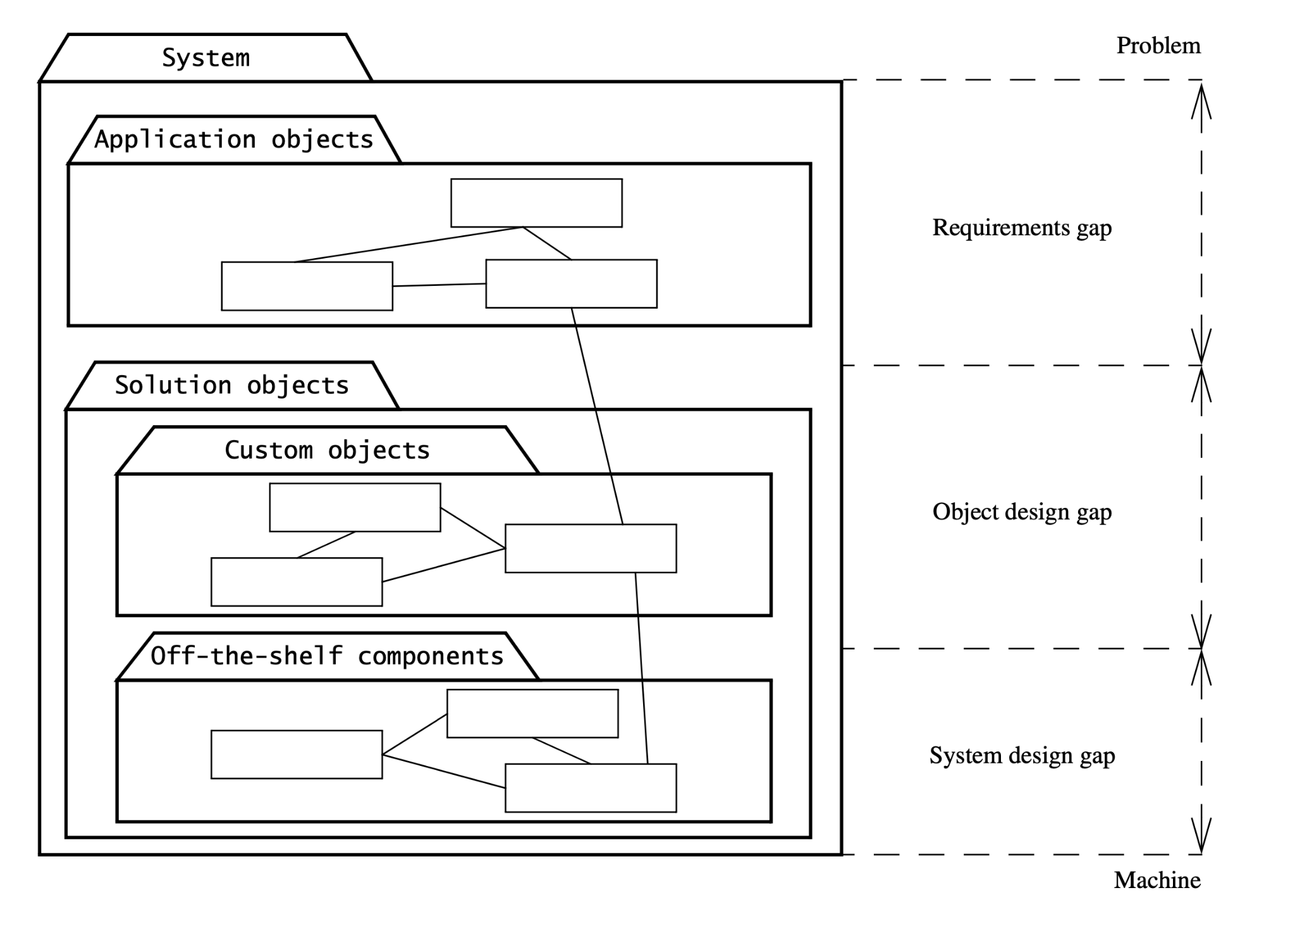
Object design - Intro
Analysis -> System Design -> Object design

Slide 3
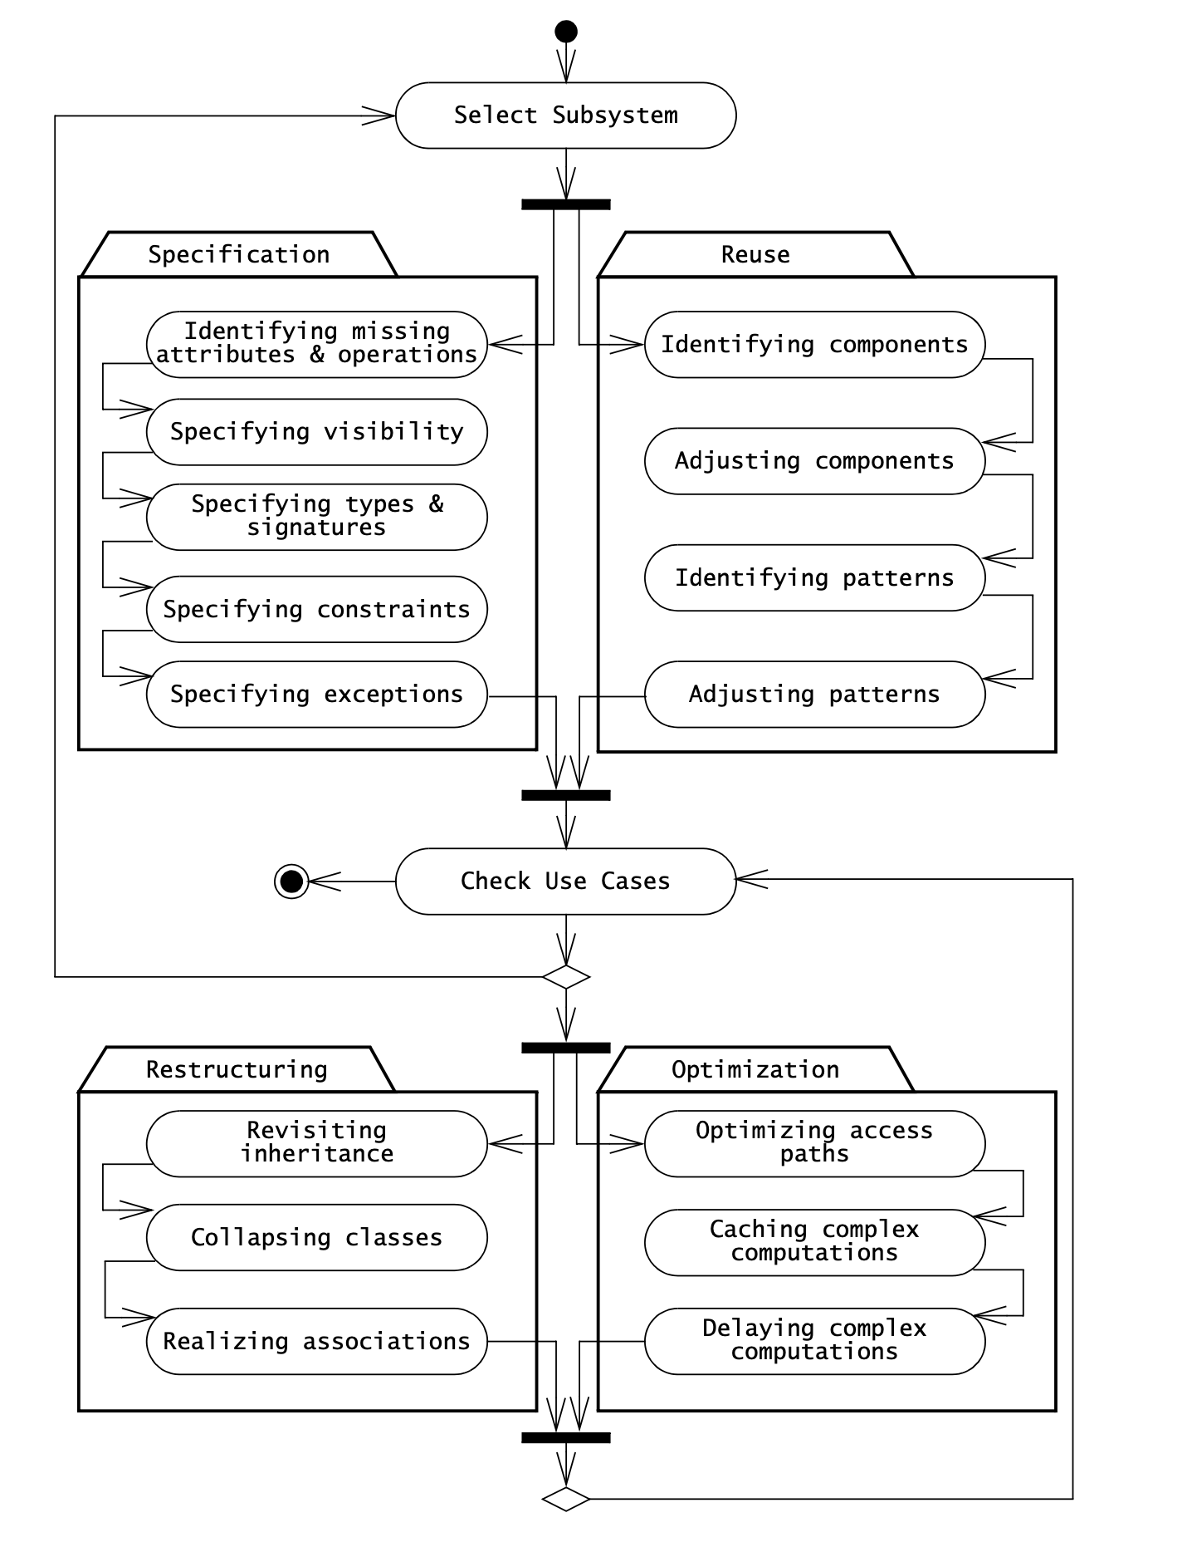
Object design - Activities
Reuse
Service Specification
Object Model Restructuring
Object Model Optimization

Slide 4
SOLID Principles
S - Single responsibility principle Issue and Fix
O - Open/closed principle Issue and Fix
L - Liskov substitution principle Issue and Fix
I - Interface segregation principle Issue and Fix
D - Dependency inversion principle Issue and Fix
Dependency injection - (Check java - Spring)

Slide 5
Design Patterns
A design pattern has four elements:
1. A name that uniquely identifies the pattern from other patterns.
2. A problem description that describes the situations in which the pattern can be used. Problems addressed by design patterns are usually the realization of modifiability and extensibility design goals and nonfunctional requirements.
3. A solution stated as a set of collaborating classes and interfaces.
4. A set of consequences that describes the trade-offs and alternatives to be considered with respect to the design goals being addressed.
Types of patterns:
Creational patterns provide object creation mechanisms that increase flexibility and reuse of existing code.
Structural patterns explain how to assemble objects and classes into larger structures, while keeping the structures flexible and efficient.
Behavioral patterns take care of effective communication and the assignment of responsibilities between objects.
System design and object design - paradox

Slide 6
Design Patterns - Singleton
Single instance of a class
A single class which is responsible to create an object while making sure that only single object gets created..
The singleton pattern is used to limit creation of a class to only one object. This is beneficial when one (and only one) object is needed to coordinate actions across the system. There are several examples of where only a single instance of a class should exist, including caches, thread pools, and registries.
Examples:
Notes:
Bridge is a structural design pattern that lets you split a large class or a set of closely related classes into two separate hierarchies—abstraction and implementation—which can be developed independently of each other.

Slide 7
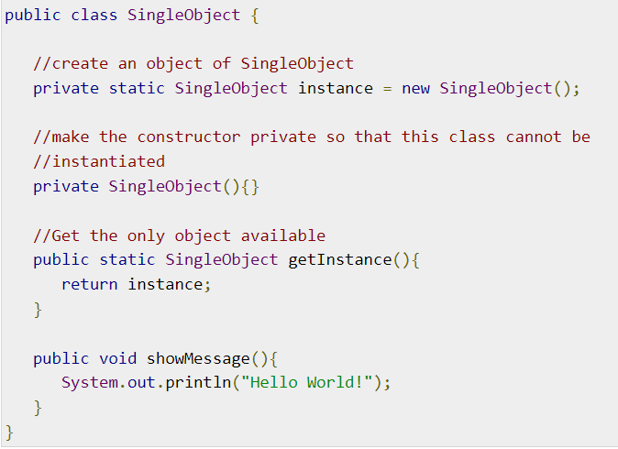
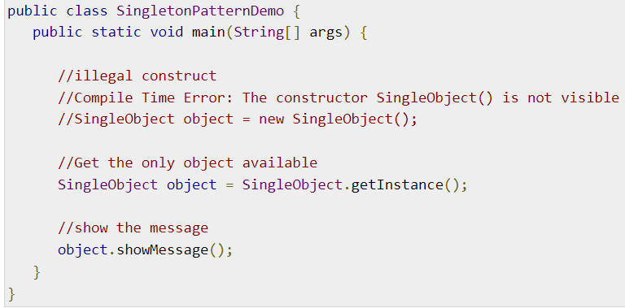
Singleton implementation

Slide 8
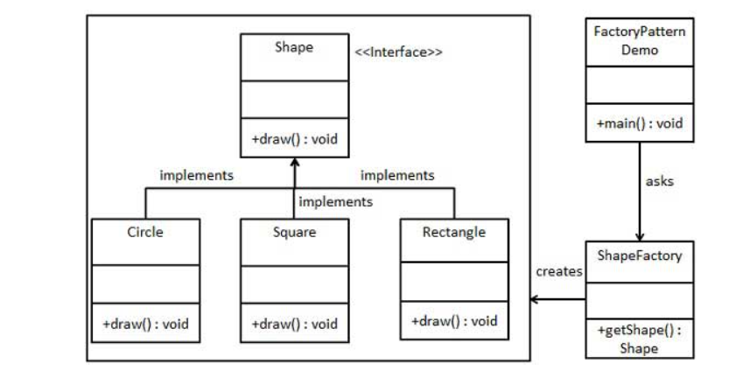
Factory
This type of design pattern comes under creational pattern as this pattern provides one of the best ways to create an object.

Slide 9
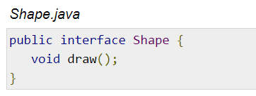
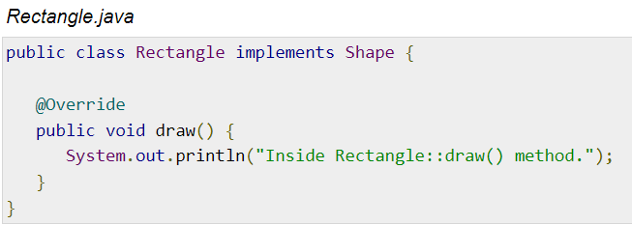
Factory

Slide 10
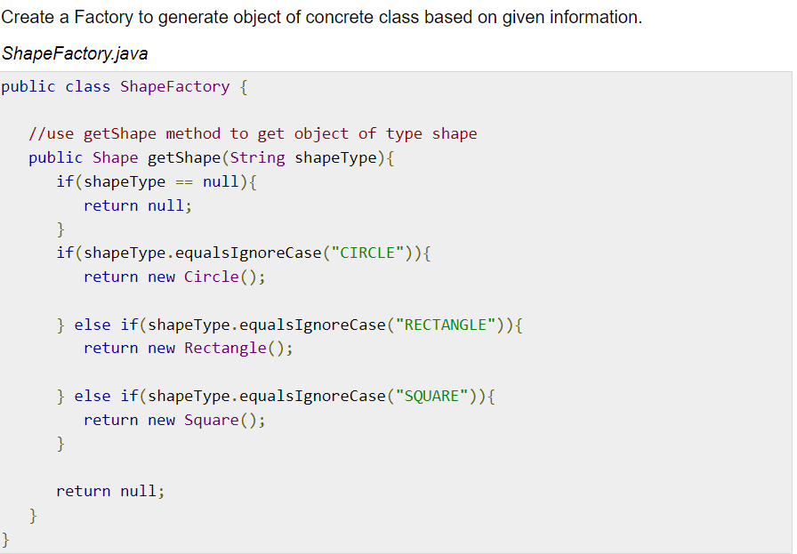
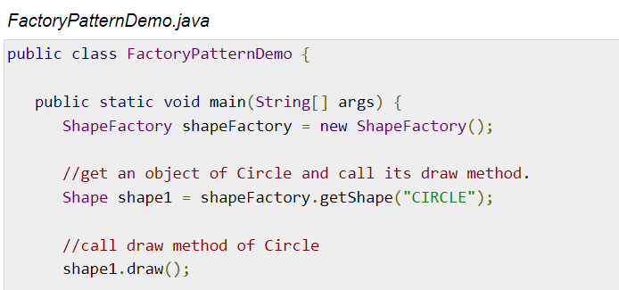

Slide 11
Observer Pattern
Observer pattern is used when there is one-to-many relationship between objects such as if one object is modified, its dependent objects are to be notified automatically.
Observer pattern falls under behavioural pattern category.
Implementation
Observer pattern uses three actor classes: Subject, Observer and Client.
Subject is an object having methods to attach and detach observers to a client object

Slide 12
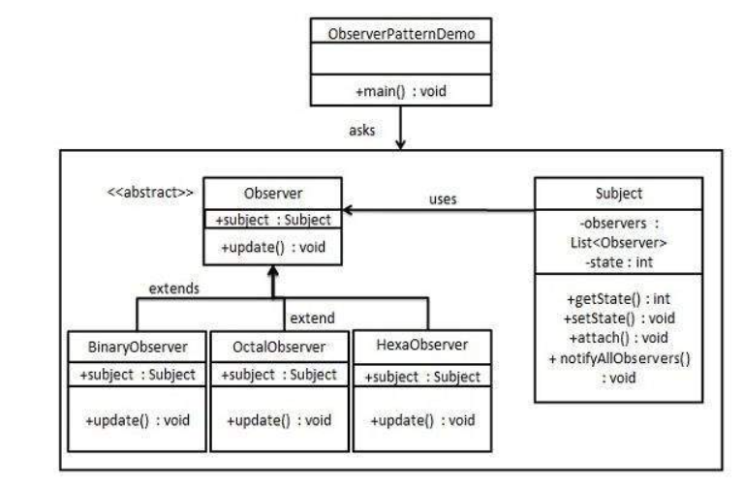
Observer pattern

Slide 13
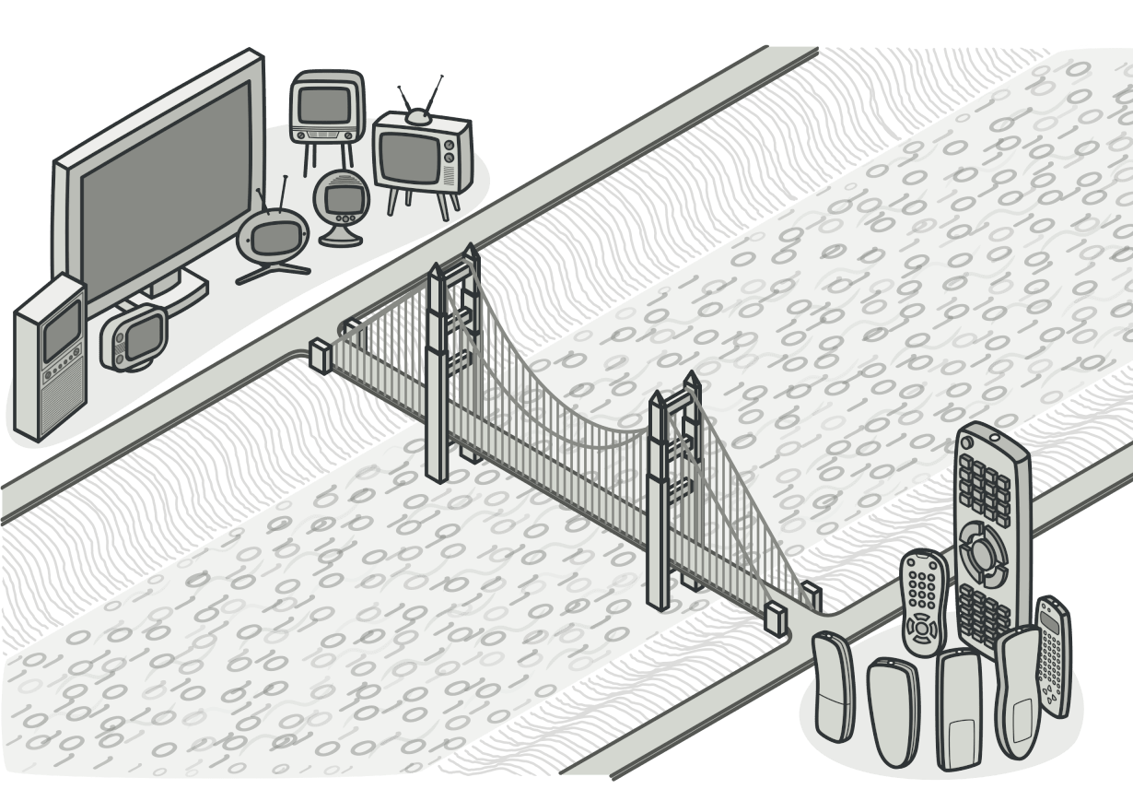
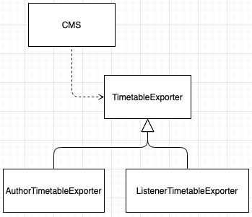
Design Patterns - Bridge Pattern
Encapsulating Data Stores with the Bridge Pattern
Anticipates: New vendor/technology/implementation.
lets you split a large class or a set of closely related classes into two separate hierarchies—abstraction and implementation—which can be developed independently of each other.
Problem: Conference timetable
Let’s say I, as a listener, am able to build my timetable for a conference(I am picking presentations from different sessions). As an author I’m able to see my timetable too. As author/listener I would like to export the presentations timetable:
to my calendar
Google calendar
Outlook(Microsoft)
to PDF, to print it - etc
start from here
Notes:
Bridge is a structural design pattern that lets you split a large class or a set of closely related classes into two separate hierarchies—abstraction and implementation—which can be developed independently of each other.

Slide 14
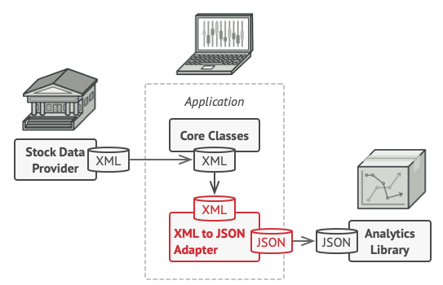
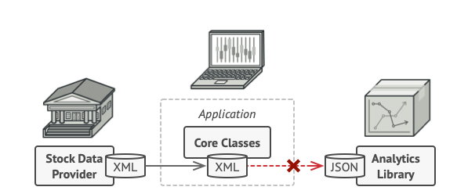
Design Patterns - Adapter Pattern
Encapsulating Legacy Components with the Adapter Pattern
Anticipates: New vendor/technology/implementation.
allows objects with incompatible interfaces to collaborate.
Problem: Imagine that you’re creating a stock market monitoring app. The app downloads the stock data from multiple sources in XML format and then displays nice-looking charts and diagrams for the user.
At some point, you decide to improve the app by integrating a smart 3rd-party analytics library. But there’s a catch: the analytics library only works with data in JSON format.

Slide 15
Design Patterns - Adapter Pattern
Encapsulating Legacy Components with the Adapter Pattern
Anticipates: New vendor/technology/implementation.
allows objects with incompatible interfaces to collaborate.
Problem: Imagine that you’re creating a stock market monitoring app. The app downloads the stock data from multiple sources in XML format and then displays nice-looking charts and diagrams for the user.
At some point, you decide to improve the app by integrating a smart 3rd-party analytics library. But there’s a catch: the analytics library only works with data in JSON format.

Slide 16
Design Patterns - Strategy Pattern
Encapsulating Context with the Strategy Pattern
Anticipates: New vendor/technology/implementation.
https://refactoring.guru/design-patterns/behavioral-patterns
Problem: Consider payments in our CMS app
Available in different countries
Needs to accept different currencies for the payment of the conference fee depending on the location of the user.
If the same user is accessing the CMS from another country, should be able to pay the fee in the local currency
Dealing with multiple currencies/payments from different countries will imply integrating multiple payment systems(according to the countries regulations).

Slide 17
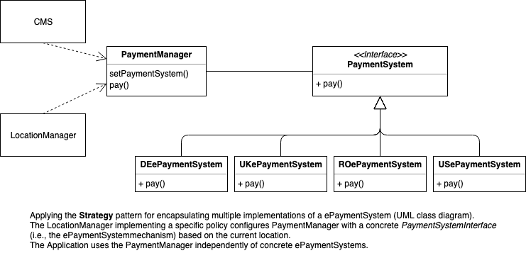
Strategy pattern example

Slide 18
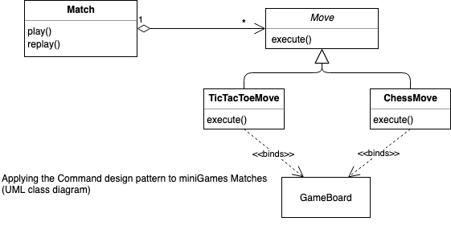
Design Patterns - Command Pattern
Encapsulating Control Flow with the Command Pattern
Anticipates: New functionality
Problem: New Mini-Miniclip :)
Online platform where you can play games like Chess/ TicTacToe etc
Record individual moves in order to be able to reply the games
Broad variety of games

Slide 19
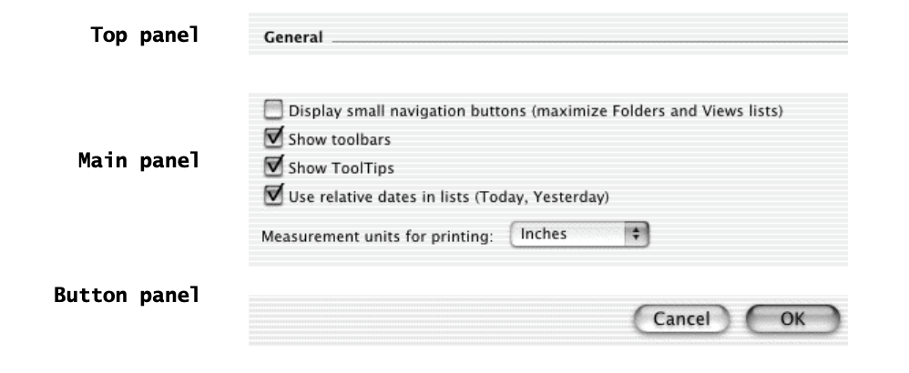
Design Patterns - Composite Pattern
Encapsulating Hierarchies with the Composite Design Pattern
Anticipates: New complexity of application domain
Problem: UI Toolkits (JavaFX) or HTML Content
Building blocks
inputting text
selecting and deselecting a check box
pushing a button
pulling down a menu
windows
widgets containers

Slide 20
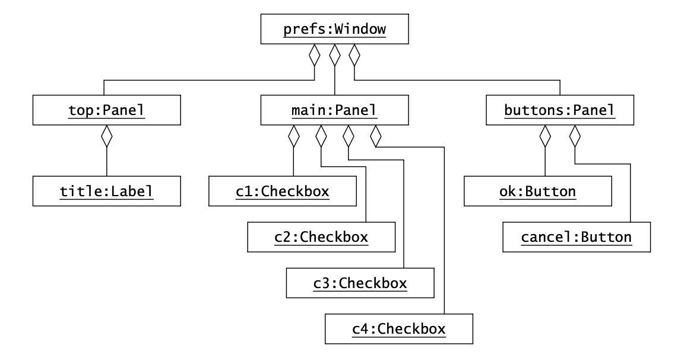
Design Patterns - Composite Pattern
Encapsulating Hierarchies with the Composite Design Pattern
Corresponding object diagram for the above UI snippet.

Slide 21
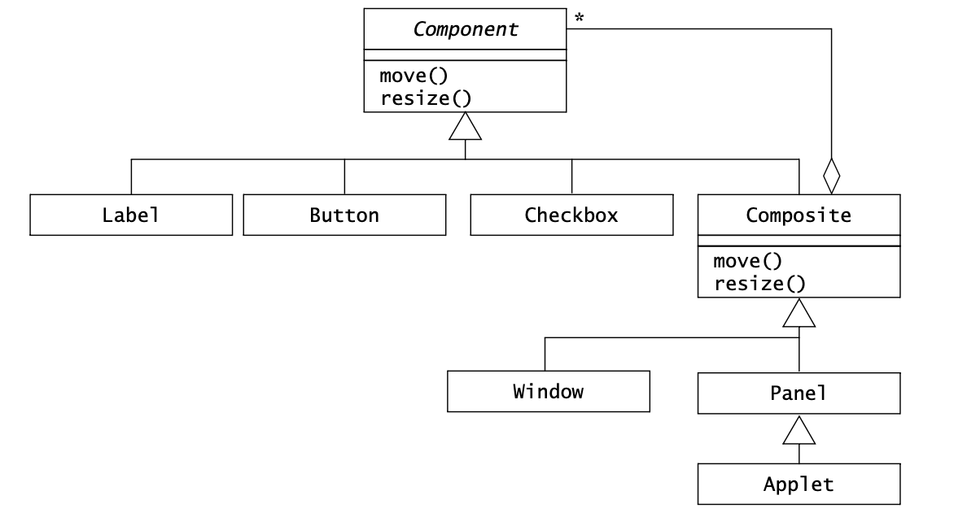
Design Patterns - Composite Pattern
Encapsulating Hierarchies with the Composite Design Pattern
Applying the Composite design pattern to user interface widgets (UML class diagram).

Slide 22
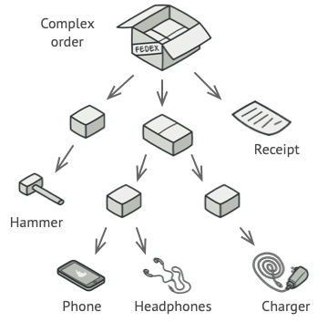
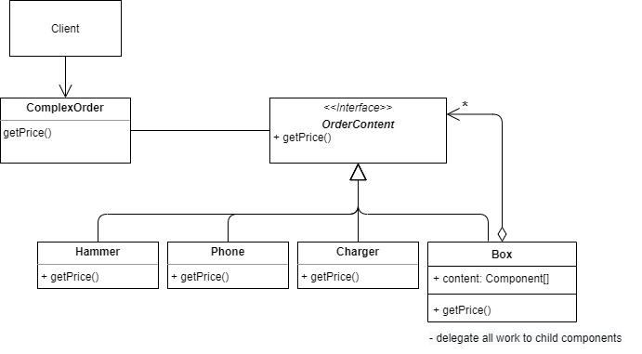

Slide 23
Q&A

Slide 24
Resources
SOLID examples
Object-Oriented Software Engineering;Using UML, Patterns, and Java™; Third Edition - Bernd Bruegge & Allen H. Dutoit
https://www.tutorialspoint.com/

