Slide 1
NYC HOUSING PRICES
Predict housing prices in New York City with additional features around broad economic factors such as unemployment and income.
By Toral Shah
Maria Wolf
Sam Wunderlich

Slide 2
REASON
Global pandemic affecting housing markets in and around NYC.
To learn if any correlation between COVID and these prices.
Lag time and volatility between COVID cases and housing market.
Additional features such as unemployment and income gave us better data to get a longitudinal view of data.

Slide 3
DATA
Data Source
Database

Slide 4
Data Source
Income Data - www.irs.gov
Unemployment Data - www.bls.go
Scraping Housing Data – from online sources of Zillow – sale price, sale date, sqft, # of bedrooms, # of bathrooms and zip code

Slide 5
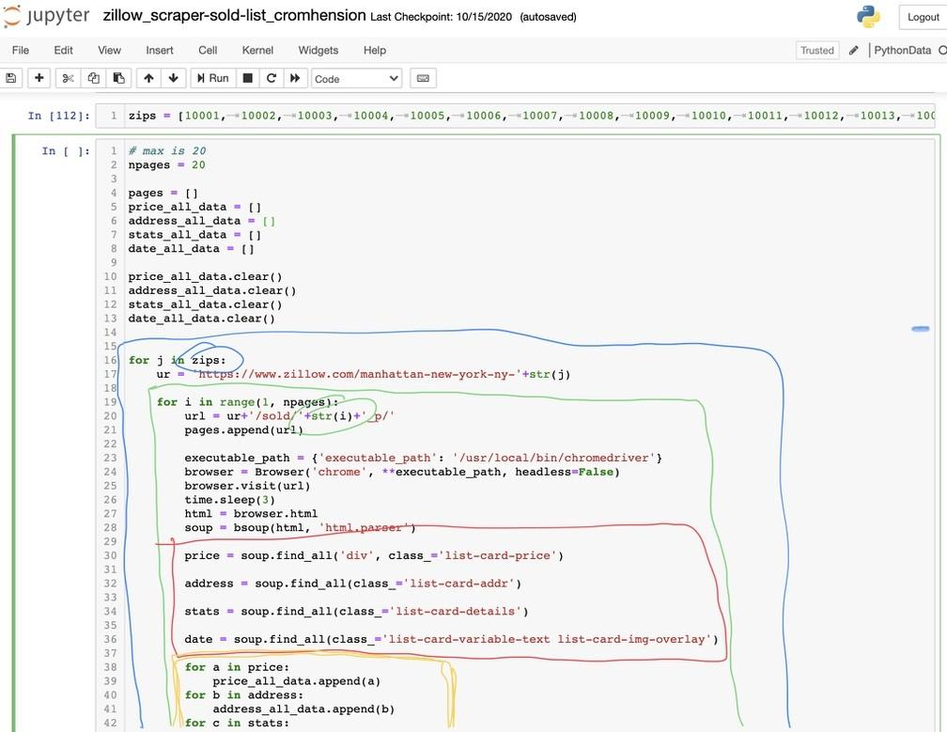
Jupyter Notebook

Slide 6
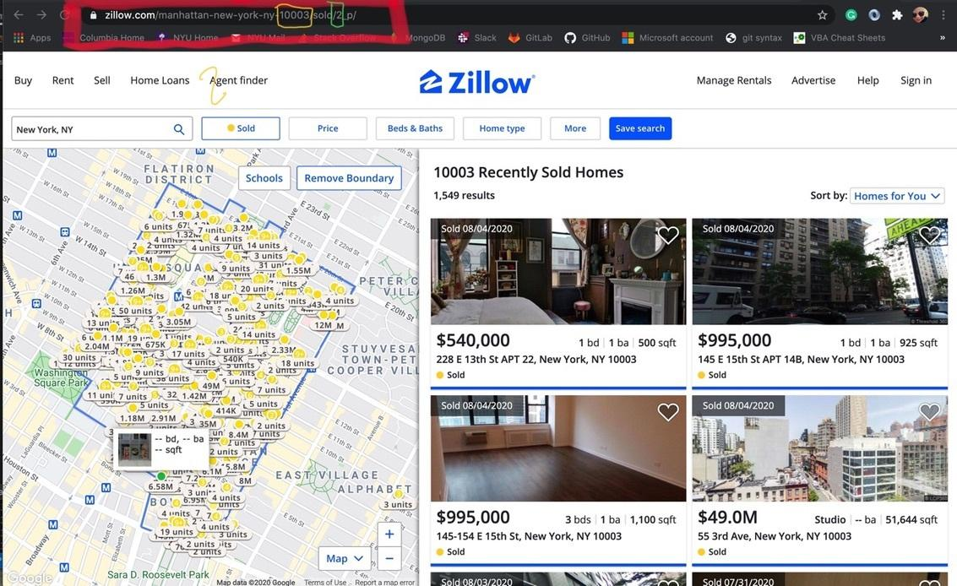
URL builder

Slide 7
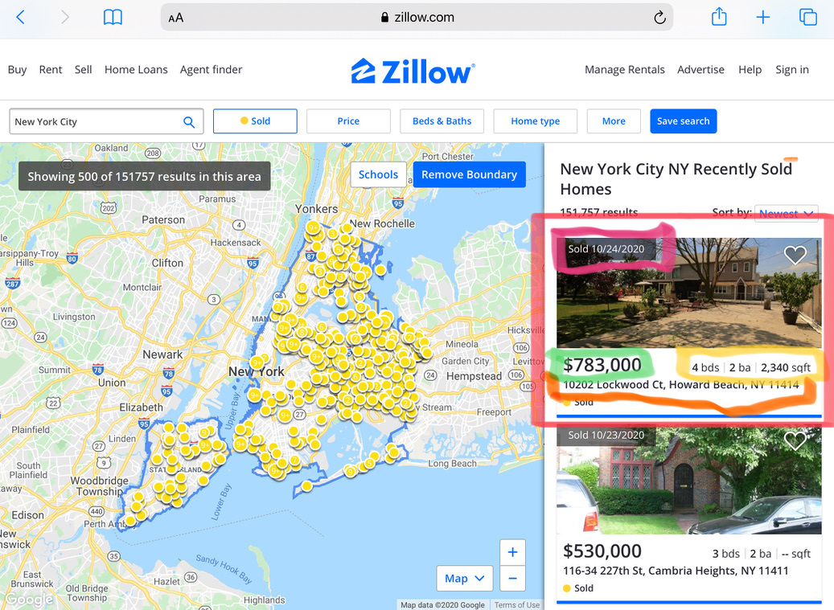
Page Data

Slide 8
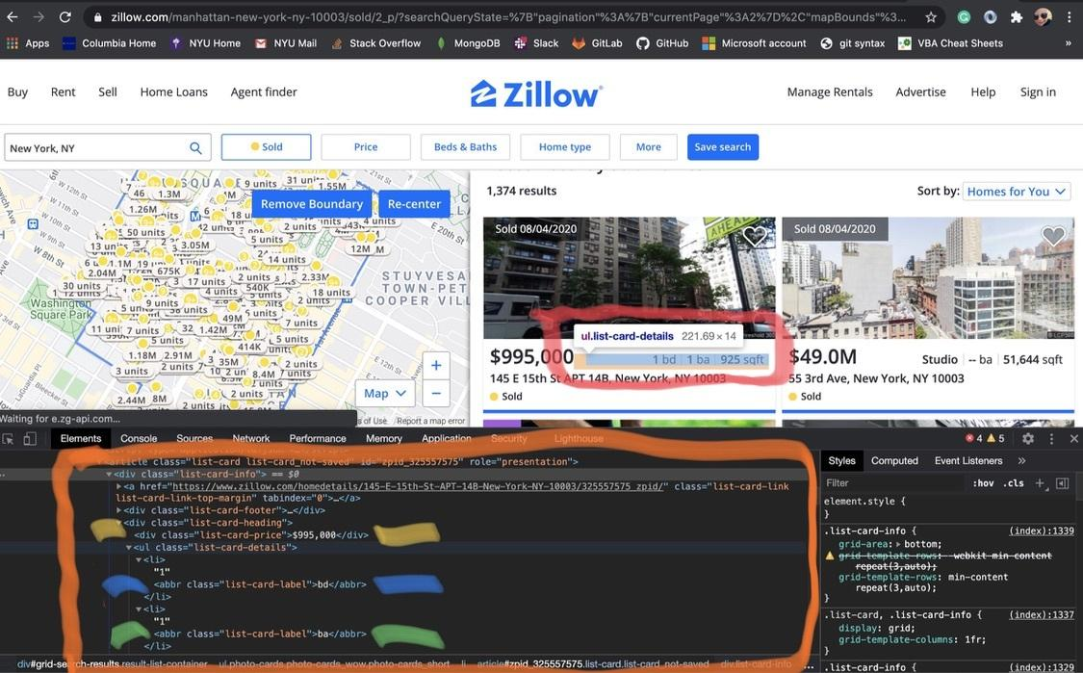
Details of
‘List Card’

Slide 9
Database
PgAdmin database
Table 1 – Housing Data
Table 2 – Transition table zipcode to boro
Table 3 - Income
Table 4 - Unemployment

Slide 10
ML MODEL
Data Pre- Processing
Split data into training and testing
Model Choice

Slide 11
Data Pre-Processing
Data Selection
Zillow scraping, IRS, Unemployment
Shortcomings: data missing zip code level
Workaround – translated data into zip code by boro
Redundancy in data

Slide 12
Data Pre-Processing
Data Processing
Data formatting, cleaning and sampling
Dropped null values
Data type conversions
Bucketing data
Dropped outliers

Slide 13
Data Transformation
One hot encoder – converted category columns - Zip code, bed and bath
Merged new df with old ones and deleted old df to relieve memory use.

Slide 14
Split Data
Data was split into training and test sets.
Used transformed scaled data
Prediction : y – variable dependent variable is Price
Independent variables – X – all other categories such as income, unemployment, # bed, # bath and sqft.
Data is split into X_train, X_test, y_train and y_test

Slide 15
Model Choice
Used Linear Regression Model and Random Forest Classifier Model.
Since our prediction – Price is a continuous variable, we used regression model instead of classification model where the target variable has only two possible values.
Random Forest required large memory sources than Linear model so we decided to try that model.
Our Mean squared error was identicle for both models – 0.74

Slide 16
Visual EDA around Full Dataset

Slide 17
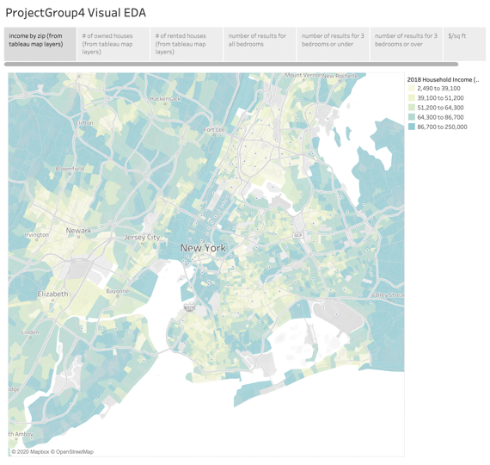

Slide 18
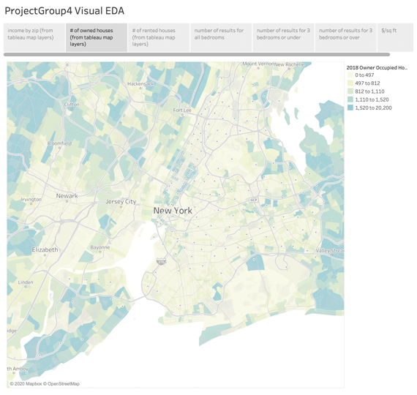

Slide 19
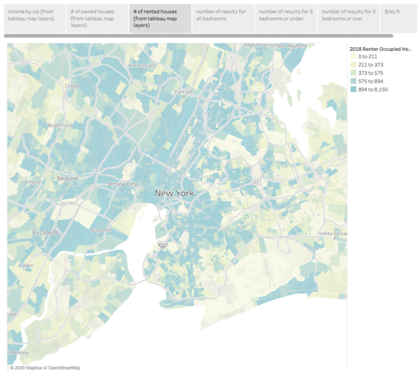

Slide 20
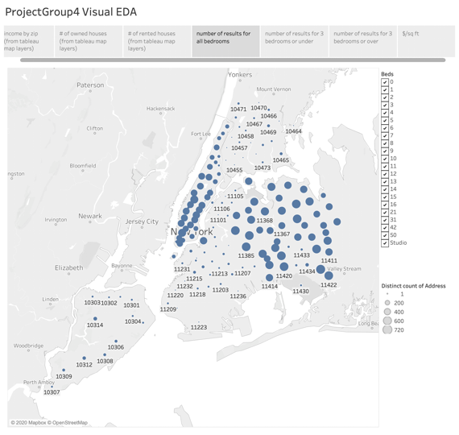

Slide 21
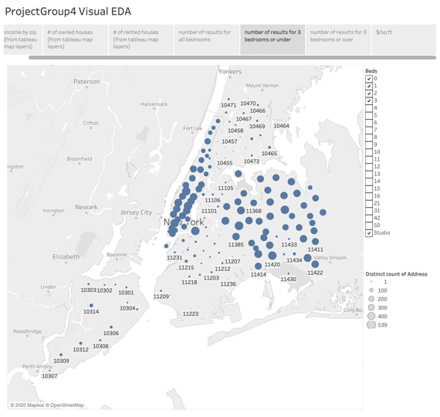

Slide 22
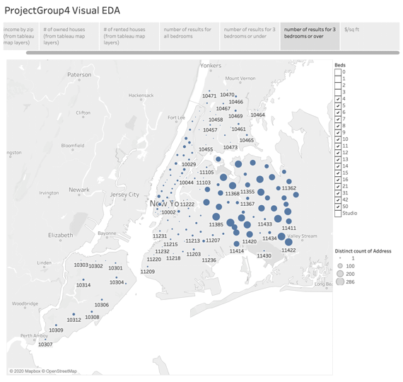

Slide 23
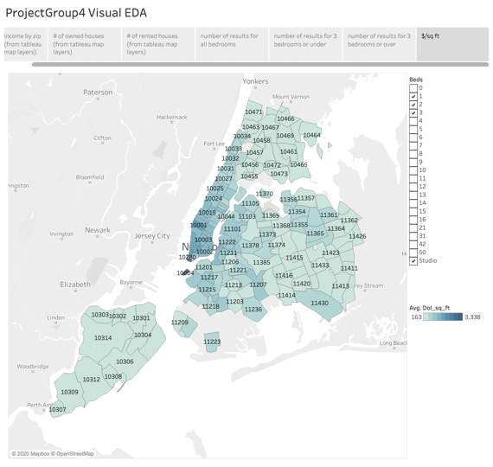

Slide 24
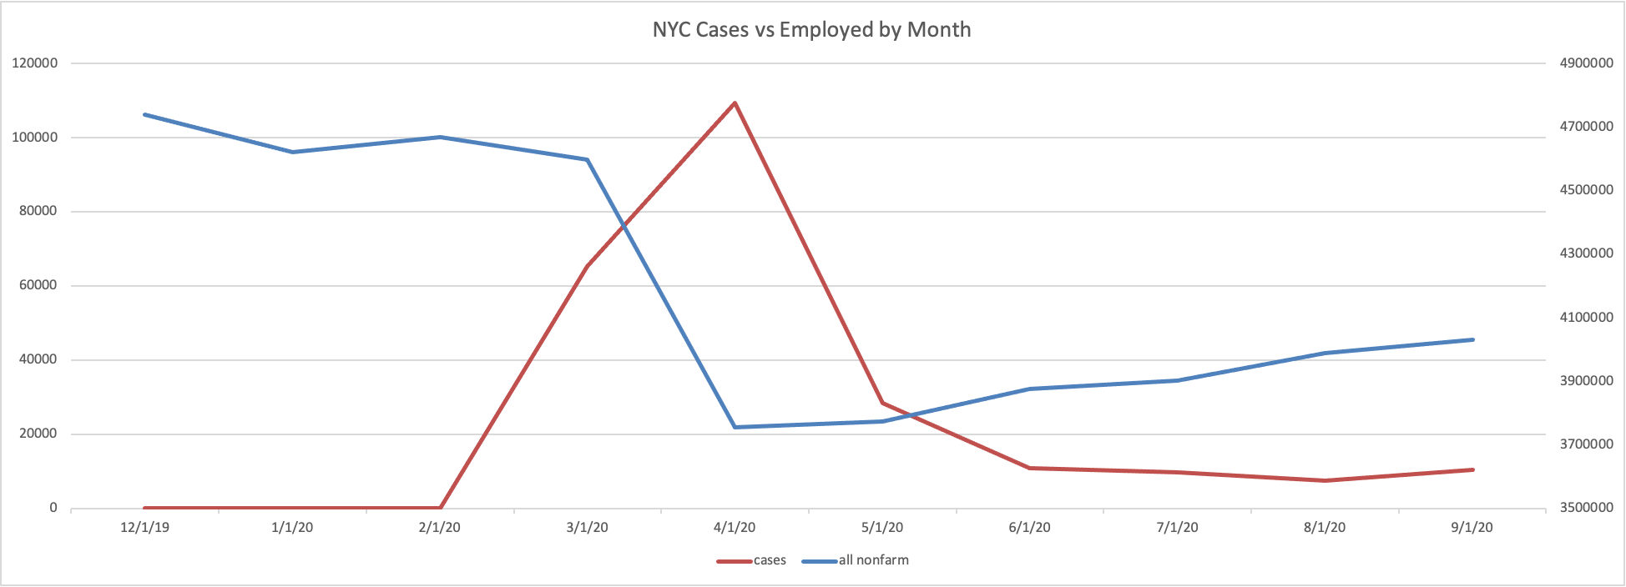
Total non-farm Employment Numbers vs NYC COVID Cases. AKA - why we added unemployment rate to the model.

Slide 25
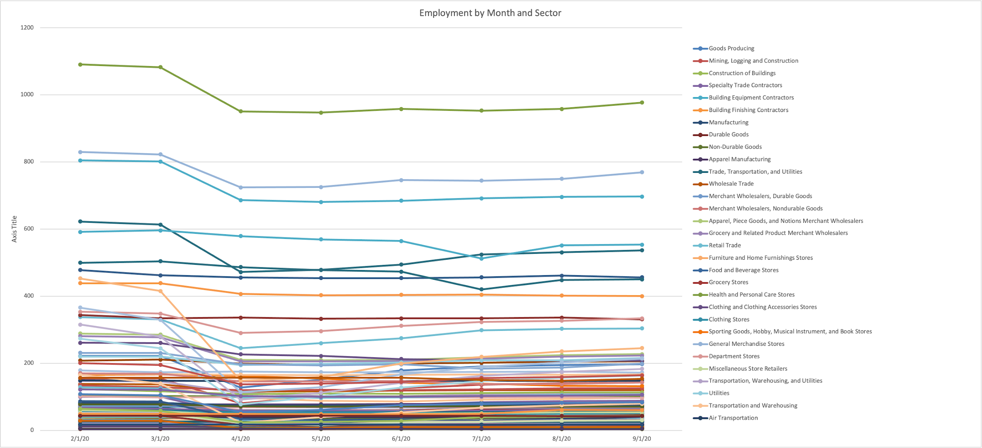
Nyc Employment numbers by Sector. AKA why we added income to the model.

Slide 26
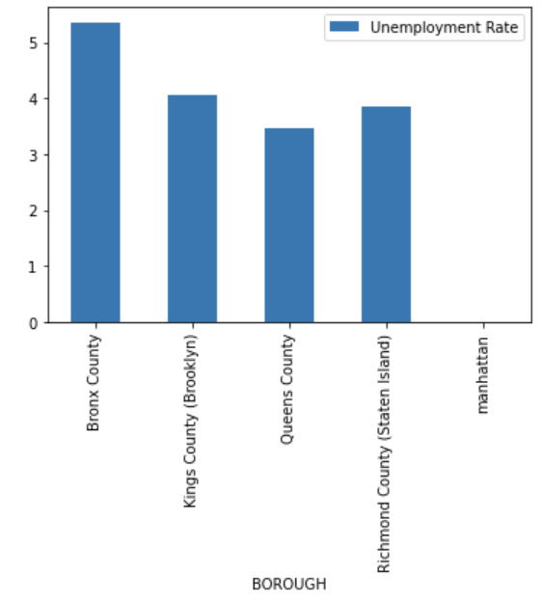
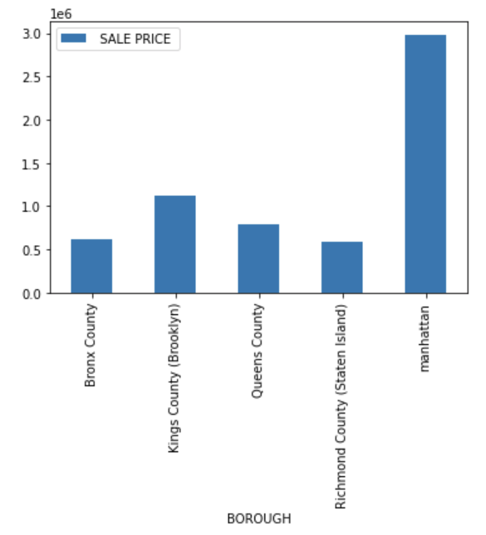
Unemployment rate and Sale price per Borough

Slide 27
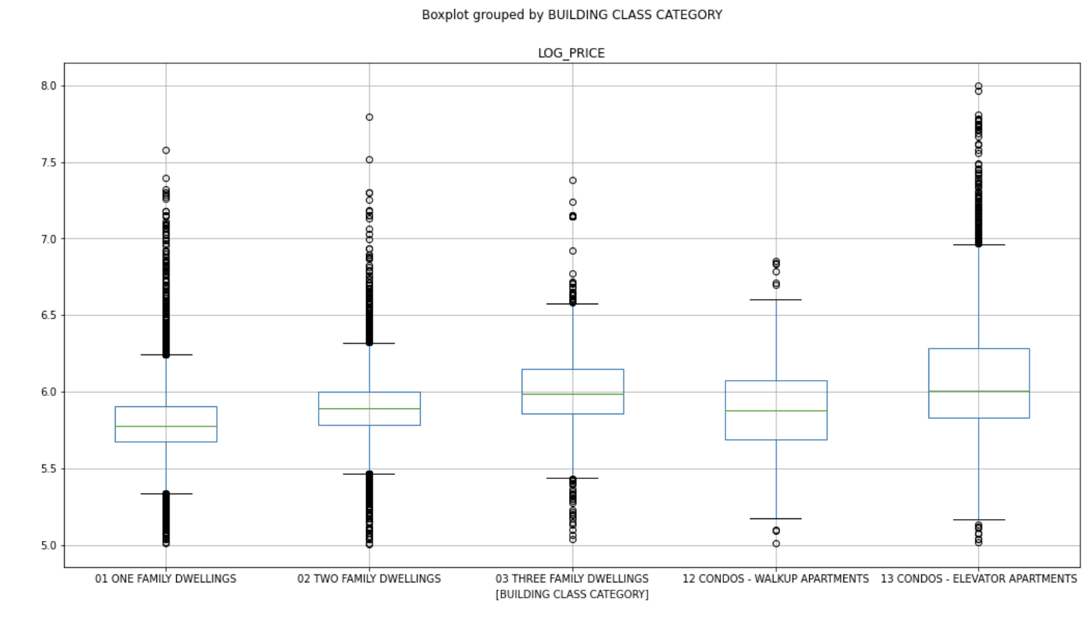
Boxplot prices and type of the building

Slide 28
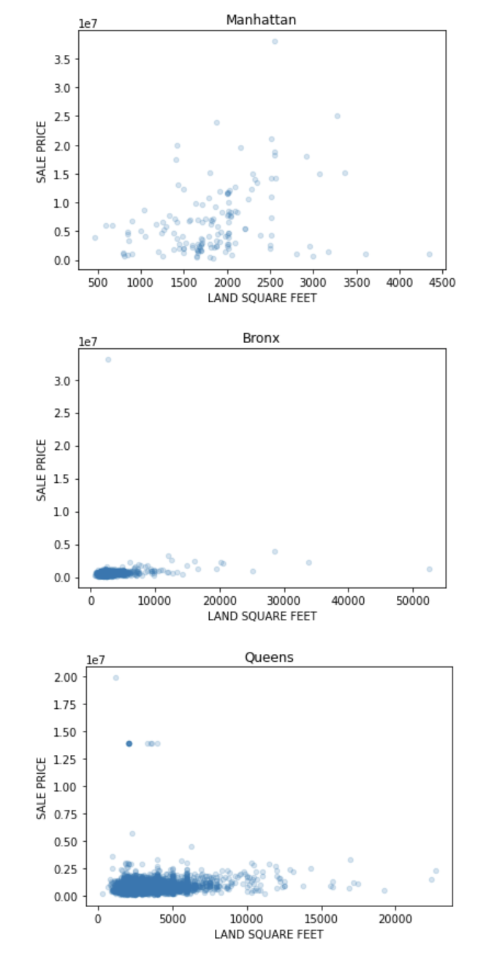
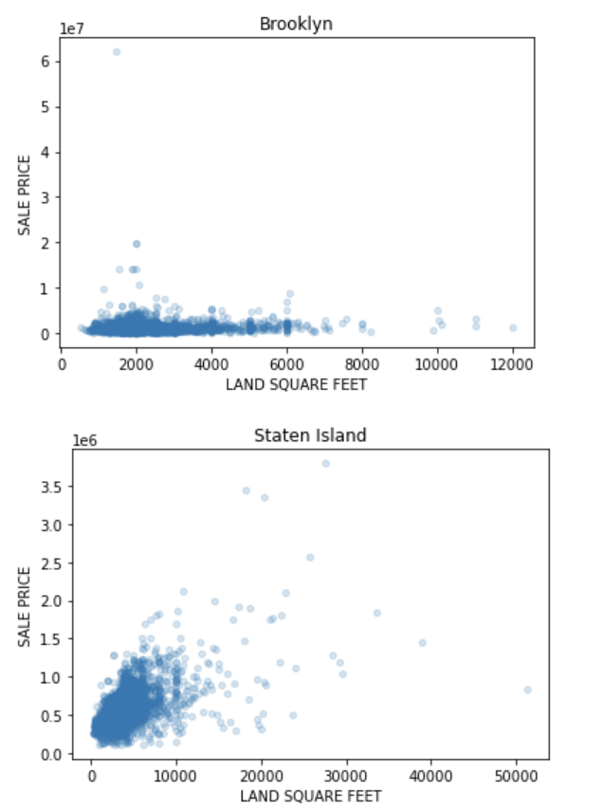
Scatter plots for boroughs

Slide 29
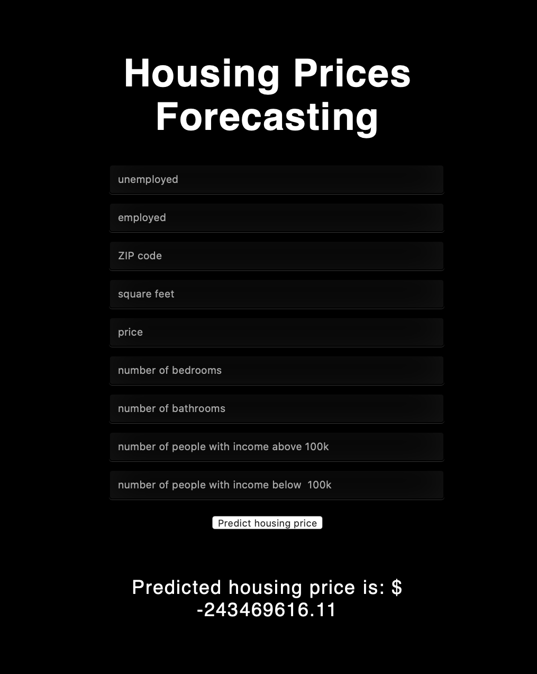
Flask app

Slide 30
Conclusion
… to be made...

