Slide 1

Introduction to neural networks
erhtjhtyhy
Marieme ngom
Assistant Computer Scientist,
ALCF, MCS
October 8, 2024

Slide 2
Objectives of this session
Introduce fundamental concepts of deep learning through hands-on activities,
Give you the necessary background for the more advanced topics in the coming weeks.
Last week:
We worked through a linear regression problem to predict the sale price of a house.
Input: above ground square feet
Output: sale price
Function type: linear
Loss function: mean squared error
Optimization algorithm: stochastic gradient descent.
This week:
We will work on a classification problem with the MNIST dataset.

Slide 3
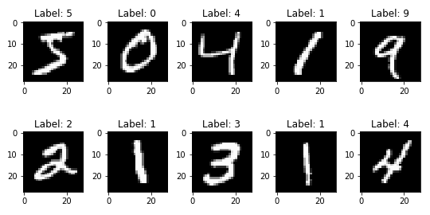
The dataset
The MNIST dataset contains thousands of examples of handwritten numbers, with each digit labeled 0-9.

Slide 4
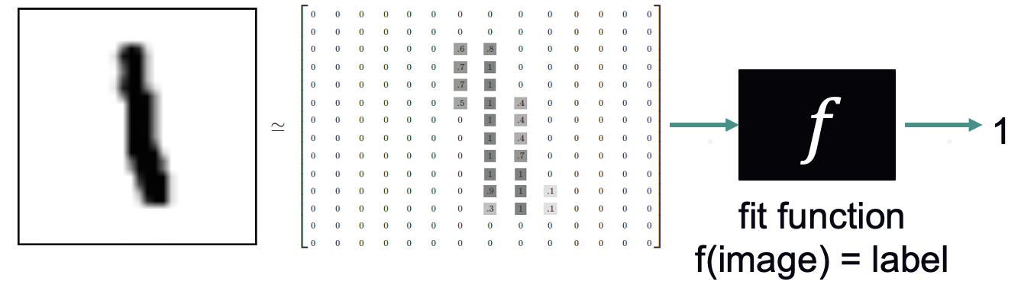
The task: Classification
Types of ML algorithms:
Supervised: learning from labeled data where the correct output is known.
Unsupervised: learning patterns from data without labeled outputs.
Semi-Supervised: Combines a small amount of labeled data with a large amount of unlabeled data to improve learning.
Classification: a supervised learning task where the goal is to predict the categorical label of an input based on its features, by assigning it to one of two or more predefined classes.
Example:

Slide 5
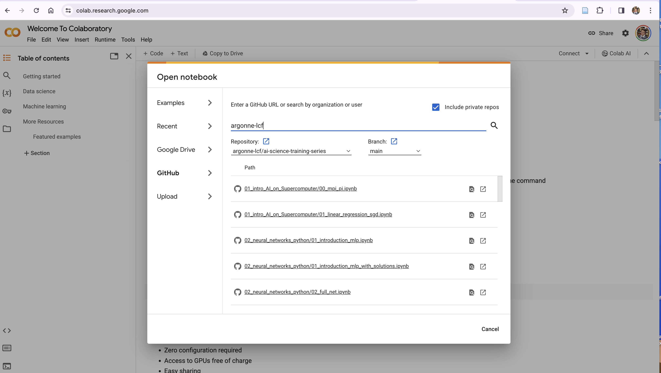
Google colab
.
Log into https://colab.research.google.com/
Go to File -> Open Notebook -> Github
Search for argonne-lcf and select argonne-lcf/ai-science-training-series
Pick 02_intro_neural_networks/01_introduction_mnist.ipynb.

