Slide 1
Distributed Database Systems
Autumn, 2017
Optimization of Distributed Queries
(Part 1/3)

Slide 2
Review: Query Decomposition
Four steps:
(1) normalization
(2) analysis
(3) elimination of redundancy
(4) rewriting

Slide 3
Review: Localization
Objective
Translate a query on global relation into algebra queries on physical fragment, and optimize the query by reduction.
[R: cond]
fragment conditions its tuples satisfy

Slide 4
Reduction for Hybrid Fragmentation
Example
EMP is vertically fragmented first, and then horizontally next.

Slide 5
Reduction for Hybrid Fragmentation
Combine all discussed three rules to reduce hybrid fragmentation.
Example
A query on EMP fragmented as above example.
SELECT ENAME
FROM EMP
WHERE ENO=“E5”

Slide 6
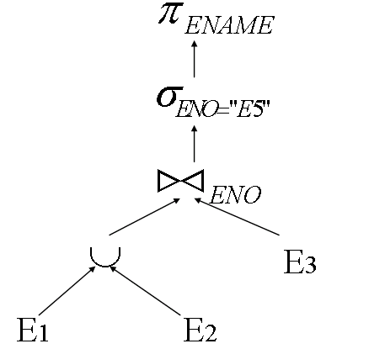
Reduction for Hybrid Fragmentation
Example
Generic query tree

Slide 7
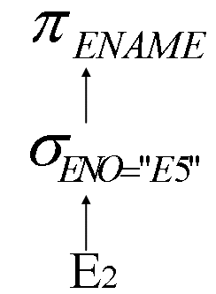
Reduction for Hybrid Fragmentation
Example
By rule 3, E3 is eliminated, and by rule 1, E1 is eliminated. The reduced query is

Slide 8
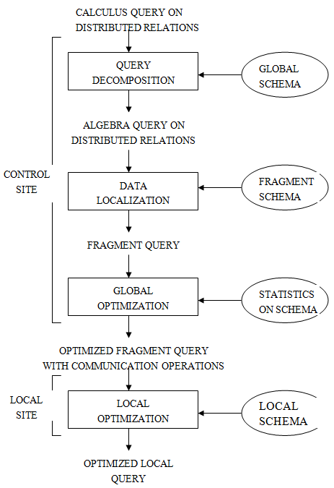
The last two layers of the laying scheme of last chapter

Slide 9
The query resulting from decomposition and localization can be executed in many ways by choosing different data transfer paths.
We need an optimizer to choose a strategy close to the optimal one.

Slide 10
Inputs to Query Optimizer
Objects to be optimized: time, space, etc. Let’s focus on time.

Slide 11
Overview of Query Optimization
Generate Query Plans
Estimate size of intermediate results
Estimate cost of plan
P1
P2
Pn
…
…
…
C1
C2
Cn
Estimate cost of plan

Slide 12
Cost Model
Two cost models used to optimize a query to
calculate the total time of the query for increasing throughput, or
calculate the response time for reducing query response time

Slide 13
Cost Model
Two cost models used to optimize a query to
calculate the total time of the query for increasing throughput, or
calculate the response time for reducing query response time

Slide 14
Cost Model
A general formula of total cost of time.
Total-cost =
C_{CPU} * number-of-instructions +
C_{I/O} * number-of-I/O’s +
C_{MSG} * number-of-messages +
C_{TR} * number-of-bytes-to-transfer

Slide 15
Cost Model
C_{CPU}, C_{I/O}, C_{MSG}, and C_{TR} are the unit cost for CPU time, I/O time, message passing, and data transfer.
Components of the model may weight differently depending on the type of the network. LAN cares all. But WAN cares the last two.

Slide 16
Cost Model
A general formula of response time.
Response-time =
Where total-cost_{i} is the total cost of one thread of the parallel executed query.

Slide 17
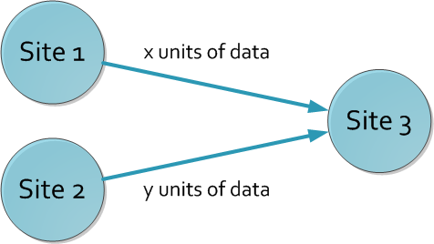
Cost Model
Example: cost of a query involving 3 sites by ignoring CPU and I/O times.

Slide 18
Cost Model
Total-time =
C_{MSG}* 2 + C_{TR} * (x+y)
Response-time =
max{(C_{MSG} + C_{TR}*x),(C_{MSG} + C_{TR}*y)}
The two times must be compromised.

Slide 19
Differences with centralized optimization
New strategies for some operations (semi-join, range-partitioning, sort,…)
Many ways to assign and schedule processors

Slide 20
Parallel/distributed sort
Input Options:
(a) relation R on single site/disk
(b) R fragmented/partitioned by
sort attribute
(c) R fragmented/partitioned by other attribute

Slide 21
Output (a) sorted R on single site/disk
(b), (c) fragments/partitions sorted
F1 F2 F3
5
...
12
...
19
...
6
...
15
20
10
21
50

Slide 22
Basic sort
R(K,…), sort on K
Fragmented on K Vector: ko, k1, … kn
ko
k1
7
11
27
10
20
3
17
22
14

Slide 23
Algorithm: each fragment sorted independently
If necessary, ship results

Slide 24
⇒ Same idea on different architectures
Shared nothing:
Shared memory: sorts F1 sorts F2
P1
P2
Net
F1
M
M
F2
P1
P2
F1
M
F2

Slide 25
Range partitioning sort
R(K,….), sort on K
R located at one or more site/disk, not fragmented on K
Solution: Range partition on K

Slide 26
Algorithm:
(a) Range partition on K
(b) Basic sort
Ra
Rb
R1
Local sort
R’1
ko
Result
R2
Local sort
R’2
k1
R3
Local sort
R’3

Slide 27
Selecting a good partition vector
7
Ra Rb Rc
...
31
...
10
...
52
8
12
11
15
4
14
11
32
17

Slide 28
Example
Each site sends to coordinator:
Min sort key
Max sort key
Number of tuples
Coordinator computes vector and distributes to sites
(also decides # of sites for local sorts)

Slide 29
Sample scenario:
Coordinator receives:
SA: Min=5 Max=10 # = 10 tuples
SB: Min=7 Max=17 # = 10 tuples

Slide 30
Sample scenario:
Coordinator receives:
SA: Min=5 Max=10 # = 10 tuples
SB: Min=7 Max=17 # = 10 tuples
Expected tuples:
5 10 15 20
ko?
2
1
[assuming we want to sort at 2 sites]

Slide 31
Expected tuples:
5 10 15 20
ko?
2
1
[assuming we want to sort at 2 sites]

Slide 32
Expected tuples:
5 10 15 20
ko?
2
1
[assuming we want to sort at 2 sites]
Expected tuples = Total tuples
with key < ko 2
2(ko - 5) + (ko - 7) = 10
3ko = 10 + 10 + 7 = 27
ko = 9

Slide 33
Variations
Send more info to coordinator
Partition vector for local site
Eg. Sa: 3 3 3 # tuples
5 6 8 10 local vector
- Histogram
5 6 7 8 9 10

Slide 34
⬄ More than one round
E.g.: (1) Sites send range and # tuples
(2) Coordinator returns “preliminary” vector Vo
(3) Sites tell coordinator how many tuples in each Vo range
(4) Coordinator computes final vector Vf

Slide 35
Parallel external sort-merge
Same as range-partition sort, except sort first
Ra
Rb
Local sort
Ra’
R1
ko
Result
Local sort
Rb’
R2
k1
In order
R3
Merge

Slide 36
Parallel/distributed Join
Input: Relations R, S
May or may not be partitioned
Output: R S
Result at one or more sites

Slide 37
Partitioned Join (Equi-join)
Local join
Ra
R1
S1
Sa
Rb
R2
S2
Sb
R3
S3
Sc
f(A)
Result
f(A)

Slide 38
Notes:
Same partition function f is used for both R and S (applied to join attribute)
f can be range or hash partitioning
Local join can be of any type
Various scheduling options e.g., (a) partition R; partition S; join (b) partition R; build local hash table for R; partition S and join

Slide 39
More notes:
We already know why part-join works:
R1 R2 R3 S1 S2 S3 R1 S1 R2 S2 R3 S3
Useful to give this type of join a name, because we may want to partition data to make partition-join possible
(especially in parallel DB system)
∪
⇒
∪
∪

Slide 40
Asymmetric fragment + replicate join
Local join
Ra
R1
S
Sa
Rb
R2
S
Sb
R3
S
f
partition
Result
union

Slide 41
Notes:
Can use any partition function f for R
(even round robin)
Can do any join — not just equi-join e.g.: R S
R.A < S.B

Slide 42
General fragment and replicate join
f1
partition n copies of each fragment
-> 3 fragments
Ra
R1
R1
Rb
R2
R2
R3
R3

Slide 43
 S is partitioned in similar fashion
R1
Result
S1
R1
S2
R2
S1
R2
S2
All nxm pairings of
R,S fragments
R3
S1
R3
S2

Slide 44
Notes:
Asymmetric F+R join is special case of general F+R
Asymmetric F+R may be good if S small
Works for non-equi-joins

Slide 45
Motivation for Map-Reduce
R1
Local sort
R’1
ko
Local sort
Result
R2
R’2
k1
R3
Local sort
R’3
process data
& partition
additional
processing

Slide 46
Another example: Asymmetric fragment + replicate join
Local join
Ra
R1
S
Sa
Rb
R2
S
Sb
R3
S
f
partition
Result
union
process data
& partition
additional
processing

Slide 47
Building Text Index - Part I
original Map-Reduce application....
FLUSHING
1
rat
(rat, 1)
(dog, 1)
(dog, 2)
(cat, 2)
(rat, 3)
(dog, 3)
(cat, 2)
(dog, 1)
(dog, 2)
(dog, 3)
(rat, 1)
(rat, 3)
Intermediate runs
Page stream
dog
2
dog
cat
rat
Disk
dog
3
Loading
Tokenizing
Sorting
Notes:
Spend some time explaining pieces of figure
Say that blue is buffer
What the three stages are
Mention that what is flushed to disk is the intermediate run
Different resources are used by diff stages of the process – (network, CPU, IO)
Hence obvious approach is to execute them simultaneously

Slide 48
Building Text Index - Part II
(cat, 2)
(dog, 1)
(dog, 2)
(dog, 3)
(rat, 1)
(rat, 3)
(ant, 5)
(cat, 2)
(cat, 4)
(dog, 1)
(dog, 2)
(dog, 3)
(dog, 4)
(dog, 5)
(eel, 6)
(rat, 1)
(rat, 3)
(ant: 2)
(cat: 2,4)
(dog: 1,2,3,4,5)
(eel: 6)
(rat: 1, 3)
Merge
Intermediate Runs
(ant, 5)
(cat, 4)
(dog, 4)
(dog, 5)
(eel, 6)
Final index
Notes:
Spend some time explaining pieces of figure
Say that blue is buffer
What the three stages are
Mention that what is flushed to disk is the intermediate run
Different resources are used by diff stages of the process – (network, CPU, IO)
Hence obvious approach is to execute them simultaneously

Slide 49
Generalizing: Map-Reduce
Map
FLUSHING
1
rat
(rat, 1)
(dog, 1)
(dog, 2)
(cat, 2)
(rat, 3)
(dog, 3)
(cat, 2)
(dog, 1)
(dog, 2)
(dog, 3)
(rat, 1)
(rat, 3)
Intermediate runs
Page stream
dog
2
dog
cat
rat
Disk
dog
3
Loading
Tokenizing
Sorting
Notes:
Spend some time explaining pieces of figure
Say that blue is buffer
What the three stages are
Mention that what is flushed to disk is the intermediate run
Different resources are used by diff stages of the process – (network, CPU, IO)
Hence obvious approach is to execute them simultaneously

Slide 50
Generalizing: Map-Reduce
(cat, 2)
(dog, 1)
(dog, 2)
(dog, 3)
(rat, 1)
(rat, 3)
(ant, 5)
(cat, 2)
(cat, 4)
(dog, 1)
(dog, 2)
(dog, 3)
(dog, 4)
(dog, 5)
(eel, 6)
(rat, 1)
(rat, 3)
(ant: 2)
(cat: 2,4)
(dog: 1,2,3,4,5)
(eel: 6)
(rat: 1, 3)
Merge
Intermediate Runs
(ant, 5)
(cat, 4)
(dog, 4)
(dog, 5)
(eel, 6)
Reduce
Final index
Notes:
Spend some time explaining pieces of figure
Say that blue is buffer
What the three stages are
Mention that what is flushed to disk is the intermediate run
Different resources are used by diff stages of the process – (network, CPU, IO)
Hence obvious approach is to execute them simultaneously

Slide 51
Semi-join
Goal: reduce communication traffic
R S ⇒ (R S) S or
R (S R) or
(R S) (S R)
A
A
A
A
A
A
A
A

Slide 52
Example: R S
A B A C
R S
2 a
3 x
10 b
10 y
25 c
15 z
30 d
25 w
32 x

Slide 53
Example: R S
A B A C
R S
2 a
3 x
10 b
10 y
25 c
15 z
30 d
25 w
32 x
ΠA R = [2,10,25,30]

Slide 54
Example: R S
A B A C
R S
2 a
3 x
10 b
10 y
Ans:
R S
25 c
15 z
30 d
25 w
32 x
ΠA R = [2,10,25,30]
A C
10 y
25 w
S R =

Slide 55
A B A C
R S
2 a
3 x
10 b
10 y
25 c
15 z
30 d
25 w
32 x
Computing transmitted data in example:
with semi-join R (S R):
T = 4 |A| +2 |A+C| + result
with join R S:
T = 4 |A+B| + result

Slide 56
A B A C
R S
2 a
3 x
10 b
10 y
25 c
15 z
30 d
25 w
32 x
Computing transmitted data in example:
with semi-join R (S R):
T = 4 |A| +2 |A+C| + result
with join R S:
T = 4 |A+B| + result
better if say
|B| is large

Slide 57
 In general:
Say R is smaller relation
(R S) S better than R S if
size (ΠA S) + size (R S) < size (R)
A
A
A
A

Slide 58
Similar comparisons for other semi-joins
Remember: only taking into account transmission cost

Slide 59
 Three way joins with semi-joins
Goal: R S T

Slide 60
 Three way joins with semi-joins
Goal: R S T
Option 1: R’ S’ T
where R’ = R S; S’ = S T

Slide 61
 Three way joins with semi-joins
Goal: R S T
Option 1: R’ S’ T
where R’ = R S; S’ = S T
Option 2: R’’ S’ T
where R’’ = R S’; S’ = S T

Slide 62
⬄ Many options!
⬄ Number of semi-join options is exponential in # of relations in join

Slide 63
Other parallel operations
Duplicate elimination
Sort first (in parallel) then eliminate duplicates in result
Partition tuples (range or hash) and eliminate locally
Aggregates
Partition by grouping attributes; compute aggregate locally

Slide 64
Example:
Ra
Rb
sum (sal) group by dept

Slide 65
Example:
Ra
Rb
sum (sal) group by dept

Slide 66
Example:
sum
Ra
Rb
sum
sum (sal) group by dept

Slide 67
Example:
less
data!
Ra
Rb
sum (sal) group by dept

Slide 68
Example:
less
data!
sum
Ra
Rb
sum
sum (sal) group by dept

Slide 69
Example:
less
data!
sum
sum
Ra
Rb
sum
sum
sum (sal) group by dept

Slide 70
Summary
Q
Basic Idea of Query Optimization
Generate query plans
Pick the one with minimum cost
In generating plans, keep goal in mind:
e.g.: Goal is parallelism in system with fast net, consider partitioning relation(s) first
e.g.: Goal is reduction of net traffic, consider semi-joins
min

