Slide 1
Distributed Database Systems
Autumn, 2007
Chapter 12 – Part 2 of 3
Distributed DBMS Reliability
Some parts of the slides are borrowed from Stanford CS347

Slide 2
Reliability
Correctness
Serializability
Atomicity
Persistence
Availability

Slide 3
Types of Failures
Processor failures
Halt, delay, restart, erratic execution
Storage failures
Volatile vs. non-volatile storage failures
Atomic write violations, transient errors, localized vs. global failures
Network failures
Lost message, out-of-order messages, partitions, bounded delay

Slide 4
Types of Failures
Unintended vs. malevolent failures
Single vs. multiple failures
Detectable vs. undetectable failures

Slide 5
Failure Models
Cannot protect against everything
Unlikely failures
E.g., flooding in the Sahara: Ten of the Strangest Data Center Outages [ goo.gl/DcQysr ]
Failures expensive to protect against
E.g., earthquakes

Slide 6
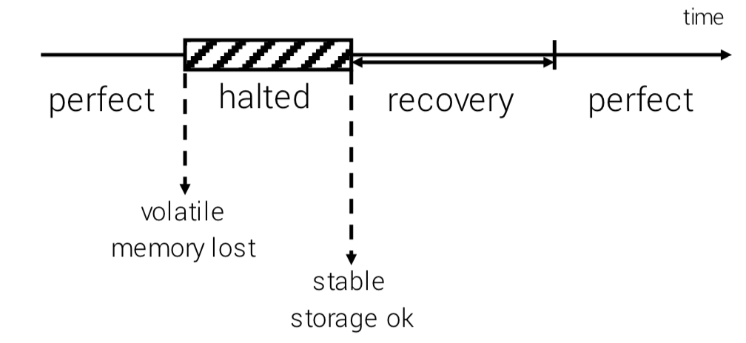
Node Models
Fail-Stop nodes

Slide 7
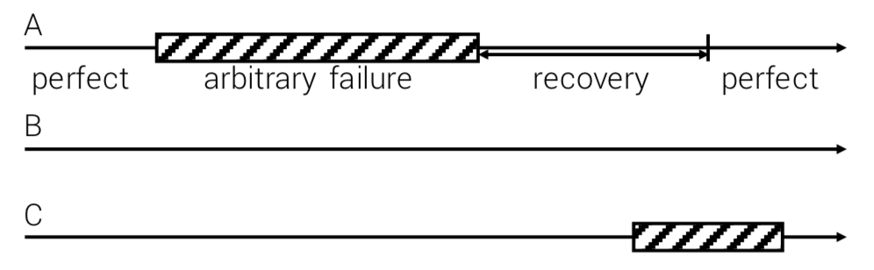
Node Models
Byzantine nodes
At any given time, at most some fraction (e.g., 1/2 or 1/3) of nodes are failing

Slide 8
Byzantine Generals' Problem
An agreement problem (described by Leslie Lamport, etc. )
A group of generals, each commanding a portion of the Byzantine army, encircle a city.
These generals wish to formulate a plan for attacking the city, e.g., attack or retreat.
Some generals may prefer to attack, while others prefer to retreat.

Slide 9
Byzantine Generals' Problem
An agreement problem (described by Leslie Lamport, etc. )
The important thing is that every general agree on a common decision, for a halfhearted attack by a few generals would become a rout, and would be worse than either a coordinated attack or a coordinated retreat.

Slide 10
Byzantine Generals' Problem
Example
Nine generals are voting, four of whom support attacking while four others are in favor of retreat
The ninth general may send a vote of retreat to those generals in favor of retreat, and a vote of attack to the rest
Those who received a retreat vote from the ninth general will retreat, while the rest will attack (which may lose the war)

Slide 11
Network Models
1. Reliable network
In order messages
No spontaneous messages
Timeout T_{D}
No response within T_{D} means destination is down (not paused)
No lost messages except due to node failures

Slide 12
Network Models
Variation of reliable network
Persistent messages If destination down, network will eventually deliver message
Simplifies node recovery, but inefficient
Not considered here

Slide 13
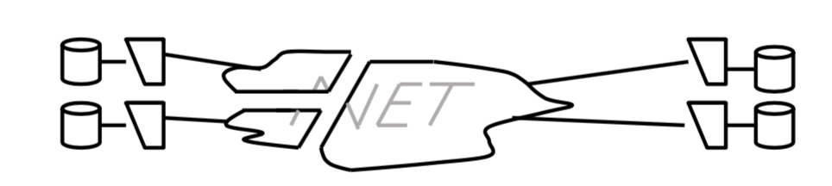
Network Models
2. Partitionable network In order messages No spontaneous messages
No timeout Nodes can have different views of the failures

Slide 14
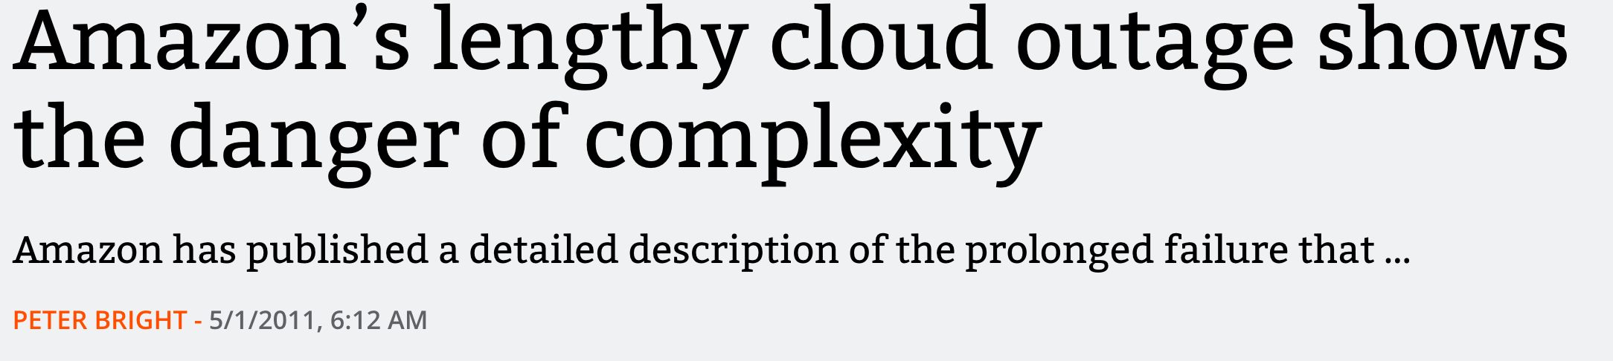
Case Study
https://arstechnica.com/information-technology/2011/04/amazons-lengthy-cloud-outage-shows-the-danger-of-complexity/
你觉得应该如何应对？

Slide 15
Scenarios
Reliable network
Fail-stop nodes No data replication (1)
Data replication (2)
Partitionable network
Fail-stop nodes (3)

Slide 16
Distributed Commit Problem

Slide 17
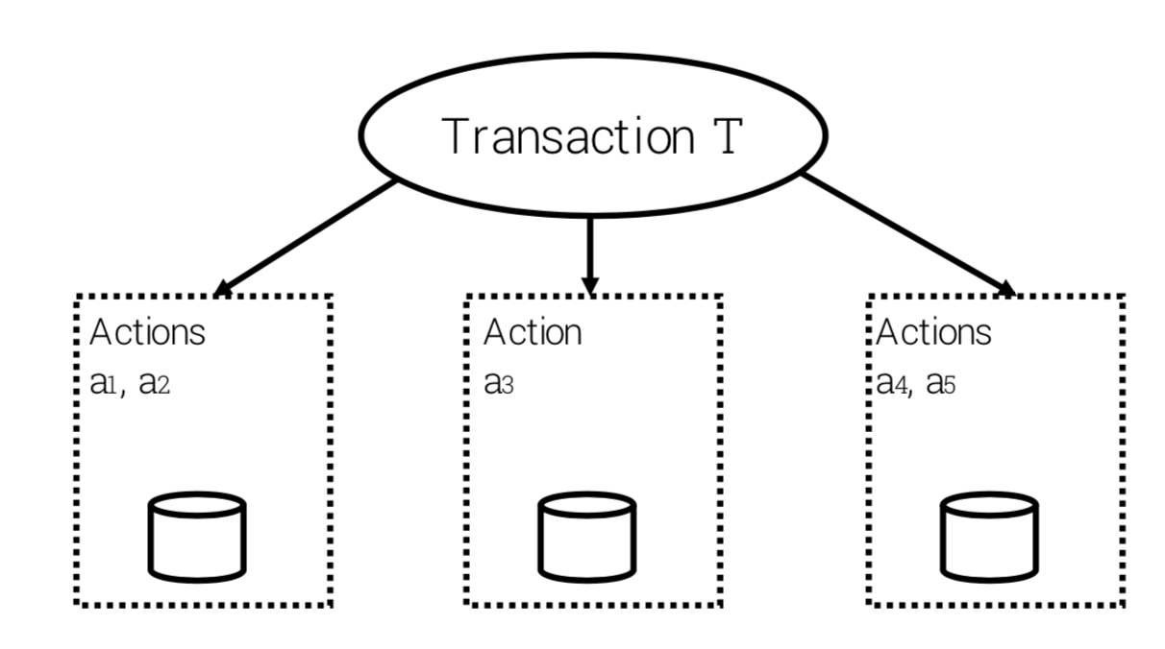
Distributed Commit Problem

Slide 18
Centralized Two-Phase Commit
2PC ensures the atomic commitment of distributed transaction.
2PC involves one coordinator at the originating site and more than one participant from other sites.

Slide 19
Phase I
The coordinator sends a message to all participants asking if they are ready to commit, and every participant answers if it's ready or not according to its own condition.

Slide 20
Phase 2
The coordinator makes the final decision global commit if all participants answer yes in phase 1, or global abort otherwise, and inform the decision to all participants. All participants take actions accordingly.

Slide 21
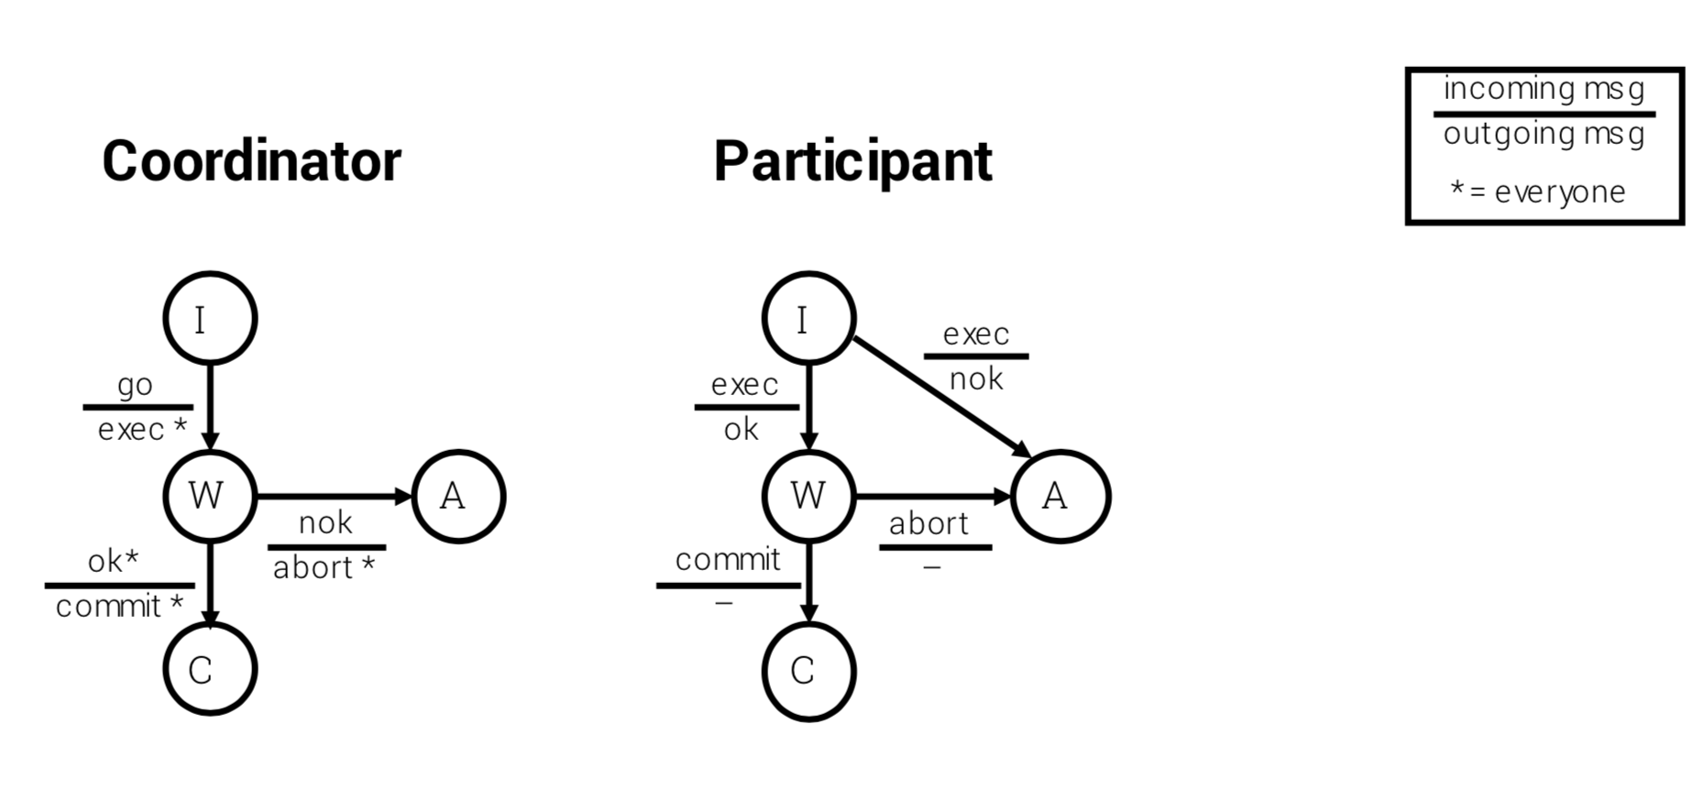
Centralized Two-Phase Commit

Slide 22
Centralized Two-Phase Commit
No lost messages (for now)
Reliable network Will discuss node failures next
When participant enters W state It must have acquired all resources It can only abort or commit if so instructed by the coordinator
Coordinator only enters C state if all participants are in W It is certain that all will eventually commit

Slide 23
Observations
A participant can unilaterally abort before he answers "yes".
Once a participant answers "yes", it must prepare for commit and cannot change its vote.
While a participant is READY, it can either to abort, or to commit, depending on the decision from the coordinator.
The global termination is commit if all participants vote "yes", or abort if any participant vote "no”.
The coordinator and participants may be in some waiting state, time-out method can be used to exit.

Slide 24
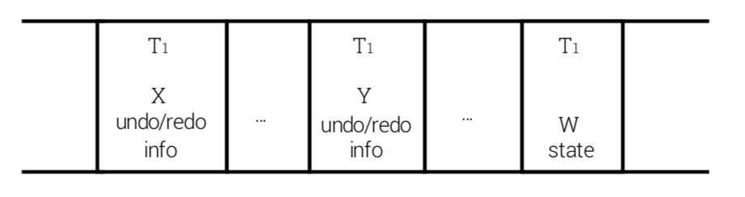
Handling Node Failures
At failing node
Coordinator and participant logs are used to reconstruct state before failure
Example: the failing node is a participant
Participant log contains W on recovery
How to perform the recovery?

Slide 25
Handling Node Failures
Example: the failing node is a participant
Participant log contains W on recovery
Recovery steps:
Notice that T1 is in W state
Obtain X, Y write locks (no read locks—why?)
Wait for message from coordinator (or ask about outcome)

Slide 26
Handling Node Failures
Other examples
No W record on log ⟹ abort T1
Have C record on log ⟹ finish T1

Slide 27
Handling Node Failures
At the protocol level
Add timeouts to cope with messages lost during failures
Add finish (F) state for coordinator
all done, can forget outcome

Slide 28
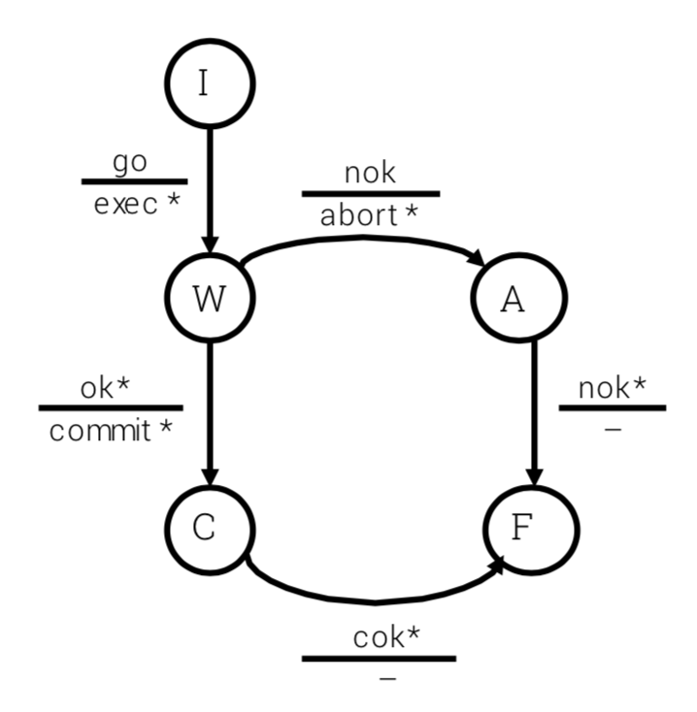
Coordinator
cok = committed ok

Slide 29
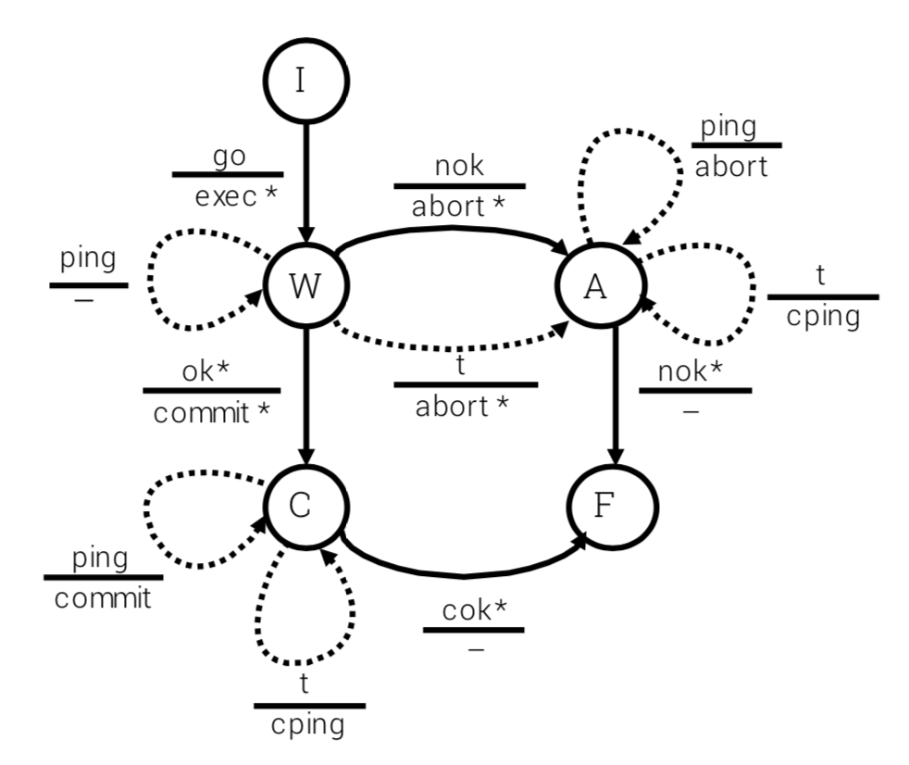
Coordinator
t = timeout
cping = coordinator ping

Slide 30
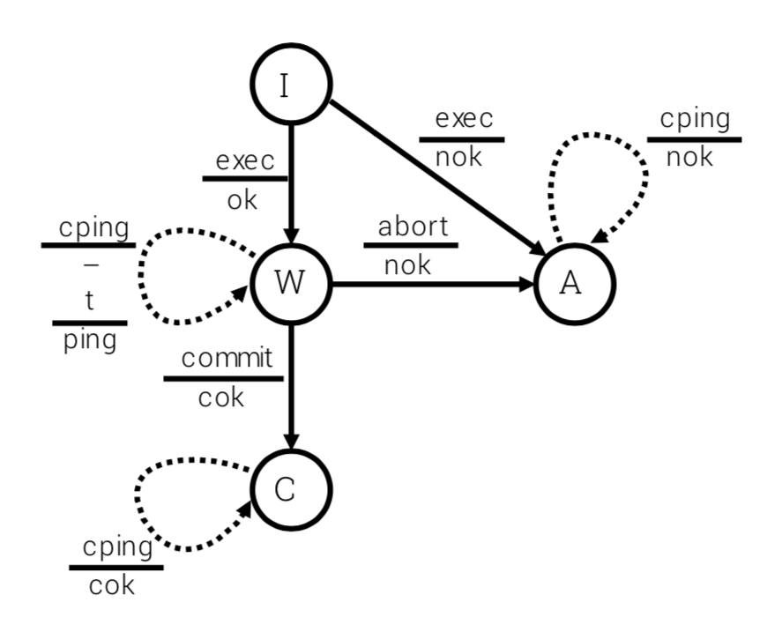
Participant
equivalent to finish state

Slide 31
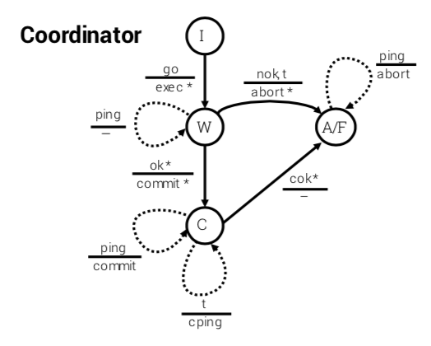
Presumed Abort Protocol
F and A states combined in coordinator
Saves persistent space (allows coordinator to forget sooner)
Whenever there is no information about the transaction's outcome, no commit, no abort, the outcome is abort.

Slide 32
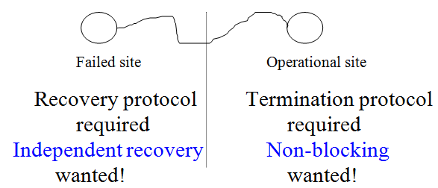
Problem with 2PC
2PC is designed for dealing with system crashes.
Failed site can properly recover without consulting other sites.
Operational site can properly terminate without waiting for the recovery of failed site.
Independent recovery and non-blocking protocols exist only for single-site failures.

Slide 33
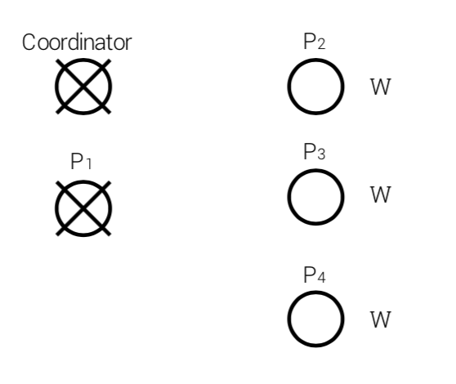
Problem with 2PC
2PC is inherently blocking !
Example 1
All participants are in W state →
it could safely be inferred that no commit had happened

Slide 34
Problem with 2PC
2PC is inherently blocking !
However, let us consider Example 2

Slide 35
2PC is blocking !
Case I
P1⟶ W
Coordinator sent commits
P1⟶ C
Case II
P1⟶ A
Operational participants P2, P3, P4 cannot properly terminate without waiting for the recovery of failed site.

