Slide 1
Distributed Database Systems
Autumn, 2018
Chapter 12 – Part 3 of 3
Distributed DBMS Reliability
Some parts of the slides are borrowed from Stanford CS347

Slide 2
Three-Phase Commit

Slide 3
Three-Phase Commit
Non-blocking commit protocol
Assumes that a failed node stays down forever
Key idea
Before committing the coordinator tells participants that everyone is OK

Slide 4
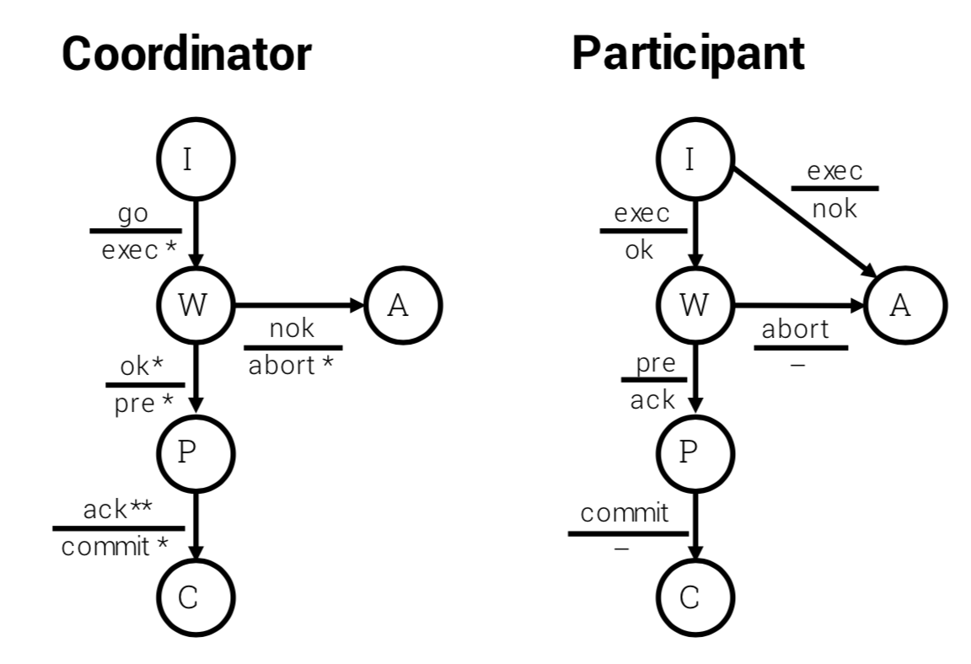
Three-Phase Commit
** = all non-failed nodes

Slide 5
3PC Recovery Rules
Termination protocol
Survivors try to complete transaction, based on their current states
Goal
If dead nodes committed or aborted, then survivors should not contradict; else survivors can do as they please

Slide 6
3PC Recovery Rules
Let { S1, S2, ..., Sn } be survivor nodes
If one or more Si = COMMIT ⟹ COMMIT T
If one or more Si = ABORT ⟹ ABORT T
If one or more Si = PRE-COMMIT ⟹ COMMIT T
T could not have aborted
If no Si = PRE-COMMIT (or COMMIT) ⟹ ABORT T
T could not have committed

Slide 7
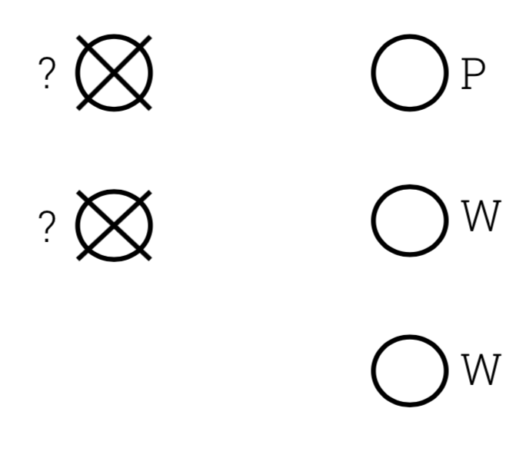
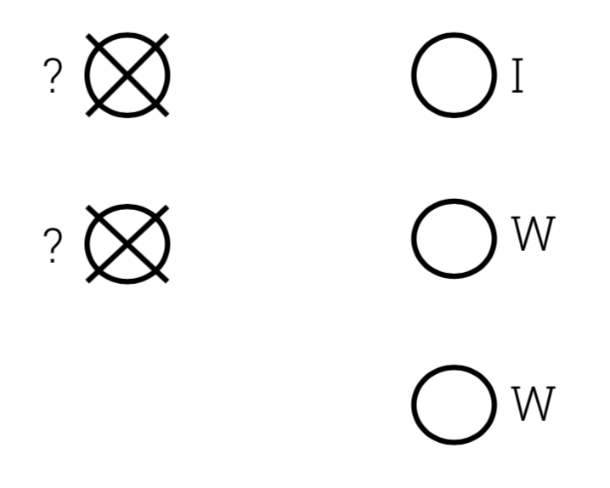
3PC Recovery Rules
Example 1
Example 2

Slide 8


3PC Recovery Rules
Example 3
Example 4

Slide 9
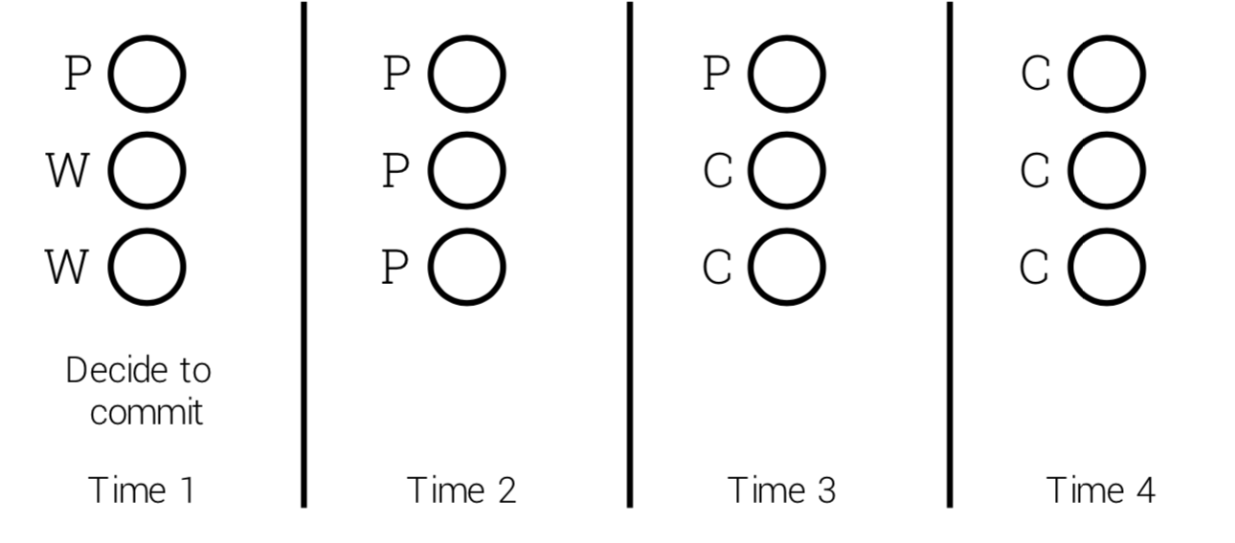
3PC Recovery Rules
Once survivors make decision, they must select new coordinator to continue 3PC

Slide 10
Observations
When survivors continue 3PC, failed nodes do not count

Slide 11
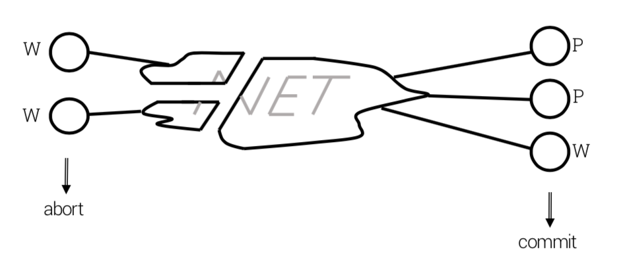
3PC Recovery Rules
3PC is unsafe with partitions

Slide 12
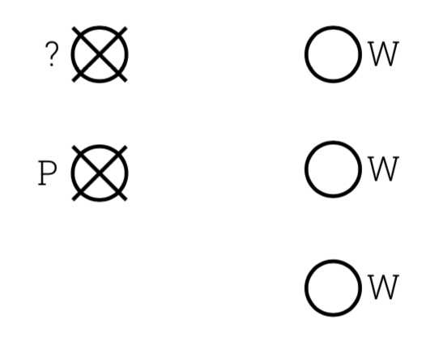
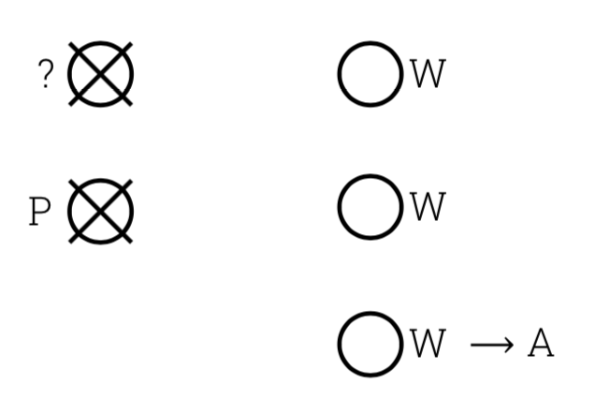
3PC Node Recovery
After node recovers from failure
Do not participate in termination protocol
Counter-example

Slide 13
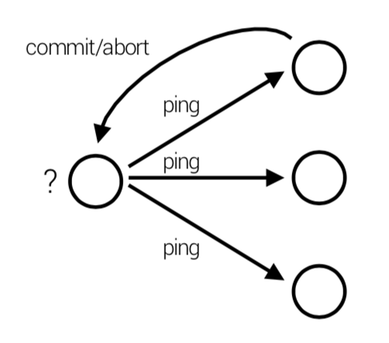
3PC Node Recovery
After node recovers from failure
Waits until receives commit or abort decision from another node
Waiting for commit or abort decision from others is ok Unless all nodes fail

Slide 14
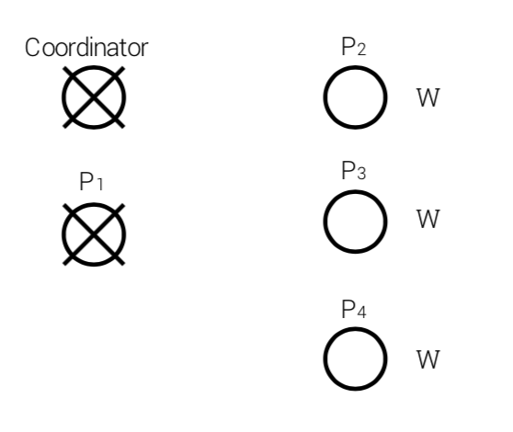
Review: Blocking Problem with 2PC
Participants P2, P3 and P4 are in W state
They have to wait for the command (Commit/Abort) from Coordinator, because they are not sure if other (failed) participants are synchronized.

Slide 15
Review: 3PC
** = all non-failed nodes
Add a new state P to synchronize ALL participants to commit

Slide 16
Review: 3PC Recovery Rules
Let { S1, S2, ..., Sn } be survivor nodes
If one or more Si = COMMIT ⟹ COMMIT T
Every participant is ready to commit
If one or more Si = PRE-COMMIT ⟹ COMMIT T
Every participant is ready to commit
If one or more Si = ABORT ⟹ ABORT T
At least one participant is not ready to commit
If no Si = PRE-COMMIT (or COMMIT) ⟹ ABORT T
The COMMIT is not synchronized among participants

Slide 17
Review: 3PC Recovery Rules
Once survivors make decision, they must select new coordinator to continue 3PC

Slide 18
Review: 3PC Node Recovery
After node recovers from failure
Waits until receives commit or abort decision from another node
Waiting for commit or abort decision from others is ok Unless all nodes fail

Slide 19
3PC Node Recovery
After node recovers from failure
Waiting for commit or abort decision from others is ok Unless all nodes fail
Two Solutions
A. Wait for all nodes to recover
B. Perform majority commit

Slide 20
3PC Node Recovery
A. Wait for all nodes to recover
Recovering node waits for either
1. Commit or abort decision from another node or
2. If all other nodes are up and recovering then 3PC can continue

Slide 21
3PC Node Recovery
B. Perform majority commit
Basic Idea
Want a gang of failed but recovered nodes to be able to terminate the transaction, even when the rest are still failing
Nodes are assigned votes, total is V
Majority is M ≥ round((V + 1) / 2)
To make state transitions, coordinator requires messages from nodes with a majority of votes

Slide 22
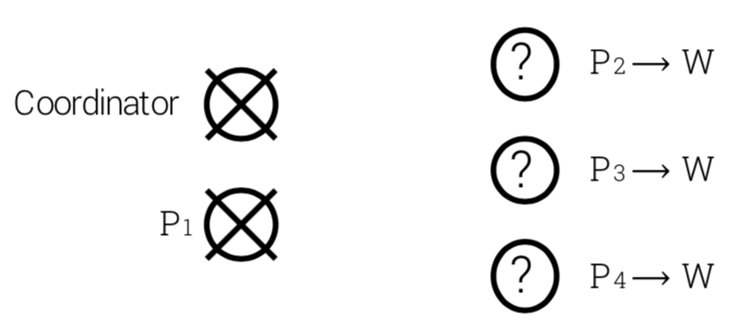
3PC with Majority Votes
Example 1
Nodes P2, P3, P4 enter W state and fail
When they recover, coordinator and P1 are down
Each node has one vote, V = 5, M ≥ 3

Slide 23
3PC with Majority Votes
Example 1
Nodes P2, P3, P4 enter W state and fail
When they recover, coordinator and P1 are down
Each node has one vote, V = 5, M ≥ 3
Since P2, P3, P4 have majority, they know coordinator could not have gone to P without at least one of their votes ⟹ T can be aborted

Slide 24
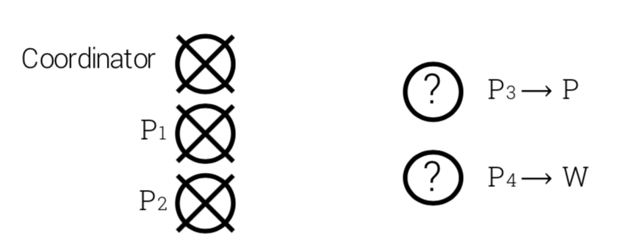
3PC with Majority Votes
Example 2
Nodes P3 and P4 enter P and W state, then fail
When they recover, coordinator, P1 and P2 are down
Each node has one vote, V = 5, M ≥ 3

Slide 25
3PC with Majority Votes
Example 2
Nodes P3 and P4 enter P and W state, then fail
When they recover, coordinator, P1 and P2 are down
Each node has one vote, V = 5, M ≥ 3
Nodes P3 and P4 have insufficient votes ⟹ they do nothing

Slide 26
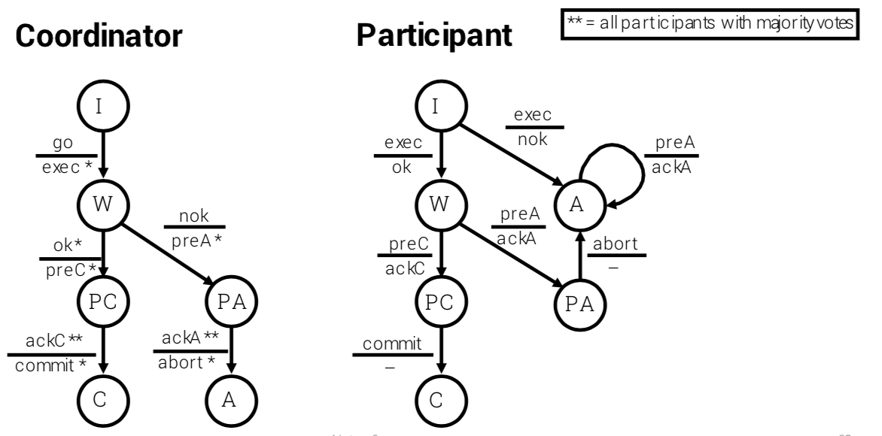
3PC with Majority Votes

Slide 27
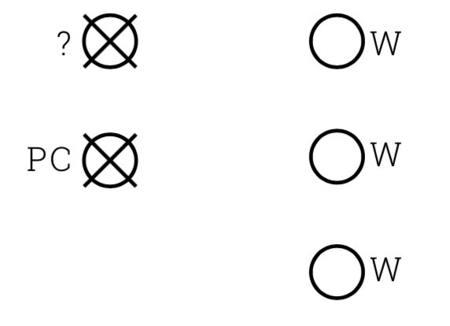
3PC with Majority Votes
Consider the following example

Slide 28
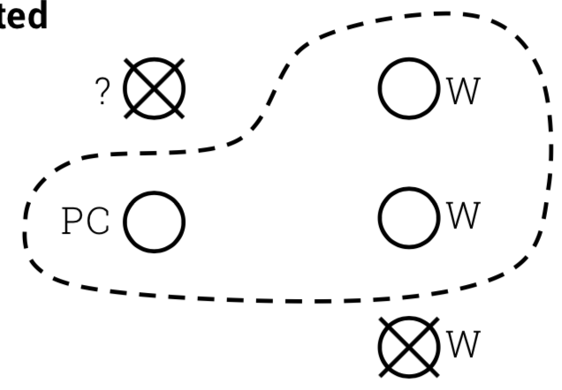
3PC with Majority Votes
Scenario 1
OK for all remaining nodes to enter PC and eventually commit
The transaction could not have aborted

Slide 29
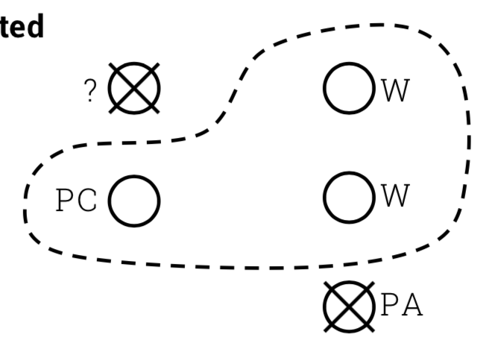
3PC with Majority Votes
Scenario 2
Same outcome as scenario I
Even though most recently failed node was in PA
The PA node will have to commit when it eventually recovers

Slide 30
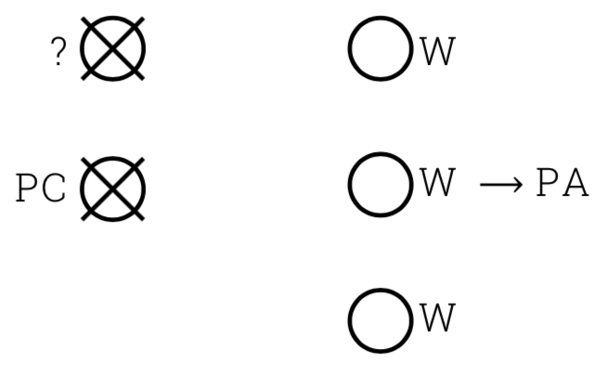
3PC with Majority Votes
Scenario 3
What is the outcome?
Remaining nodes initiated abort
some entered PA state

Slide 31
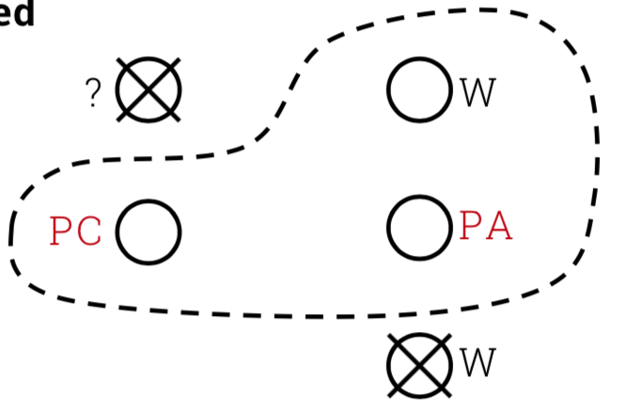
3PC with Majority Votes
Scenario 3
Cannot make a decision
The transaction could have committed or aborted

Slide 32
3PC with Majority Votes
Scenario 3
Will have to wait for either
Some node to recover in A or C
All nodes to recover and confirm that none were in A or C

Slide 33
3PC with Majority Votes
Summary for the above example
If survivors have majority and all states W ⟹ try to abort
If survivors have majority and states in { W, PC, C } ⟹ try to commit
If survivors have majority and states in { W, PA, A } ⟹ try to abort
Otherwise block

Slide 34
3PC Comparison
Basic 3PC
Only nodes that have not failed participate in decision
Any remaining subgroup can terminate (even one node)
If all nodes fail, must wait for all to recover

Slide 35
3PC Comparison
3PC with majority votes
A group of failed but recovering nodes can terminate transaction
Need majority to commit
Blocking protocol

Slide 36
3PC Logging
When a node recovers, it uses its log as usual to determine the status of each transaction
If commit logged ⟹ redo if necessary
If abort logged (or wait is missing) ⟹ rollback if necessary
If wait logged (or pre state ) ⟹Reclaim locks held by T before crash
Try to terminate T (with other nodes)

Slide 37
Reliablity Summary
Failure models
Nodes
Networks
Reliable network, fail-stop nodes, no replication
Two-phase commit (blocking)
Three-phase commit
Basic (non-blocking)
With majority votes (blocking)

Slide 38
Summary of Fundamental DDB Issues
Course objectives: study the fundamental issues of DDB. Topics covered
Chapter 1 Introduction
Chapter 4 Distributed DBMS Architecture
Transparency and data independence, the major goals of DBMS
ANSI/SPARC 3-level architecture
Components of DDBMS
User Processor at local site, plus Data Processor at remote site
Global directory

Slide 39
Chapter 5 Distributed DB Design
DDB design = Data fragmentation
Why
How
Correctness of fragmentation
Chapter 7 Overview of Query Processing
Problem
Objective
Complexity, characterization
Layers of query processing

Slide 40
Chapter 8 Optimization of Distributed Queries
Cost model
Centralized query optimization
INGRES
System R
Distributed query optimization
INGRES
System R*
Chapter 10 Introduction to Transaction Management
Properties of transactions: ACID
Formalization – partial order, or DAG
Termination of transactions

Slide 41
Chapter 11 Distributed Concurrency Control
Serializability theory
Locking-based algorithms
Basic
2PL
Strict 2PL
Timestamp-based algorithms
Basic
Conservative
Extremely conservative
Optimistic versus pessimistic

Slide 42
Chapter 12 Distributed DBMS Reliability
Reliability and types of failures
Local recovery protocols
Architecture and log file
Execution of LRM commands
Checkpoint
Distributed reliability protocols
2PC protocol
Termination protocols
Recovery protocols
3PC – a non-blocking protocols

Slide 43
Discussion Topics
MapReduce (Instructor)
December 6
Concurrence Control (Groups)
H-Store (VLDB 2007): Group A
Silo (SOSP 2013): Group B
December 13: 50 min per group
Self-Driving DBMS (Instructor)
December 20

Slide 44
Course Project
Release of Evaluation Info – Dec 13
Evaluation Document
Evaluation Data
Project Evaluation
Onsite Evaluation – Jan 3
Report Submission – Jan 6

