Slide 1
Distributed Database Systems
Autumn, 2007
Chapter 12 – Part 3 of 3
Distributed DBMS Reliability

Slide 2
12.1 Reliability Concepts And Measures
12.2 Failures And Fault Tolerance In Distributed Systems
12.3 Failures In Distributed DBMS
12.4 Local Reliability Protocols
12.5 Distributed Reliability Protocols

Slide 3
Dealing with Site Failures
Section 12.6

Slide 4
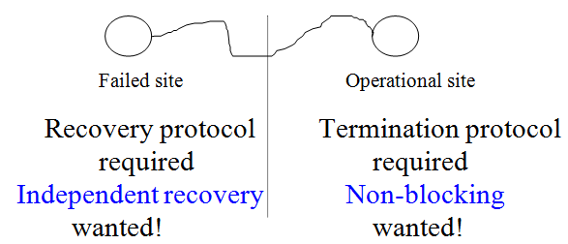
Problem with 2PC
2PC is designed for dealing with system crashes.
Failed site can properly recover without consulting other sites.
Operational site can properly terminate properly without waiting for the recovery of failed site.
Independent recovery and non-blocking protocols exist only for single-site failures.

Slide 5
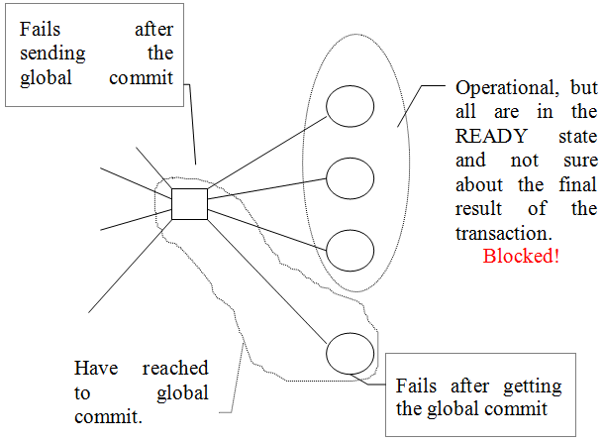
Problem with 2PC
2PC is inherently blocking !

Slide 6
Subsection 12.6.1 Termination and Recovery Protocols of 2PC

Slide 7
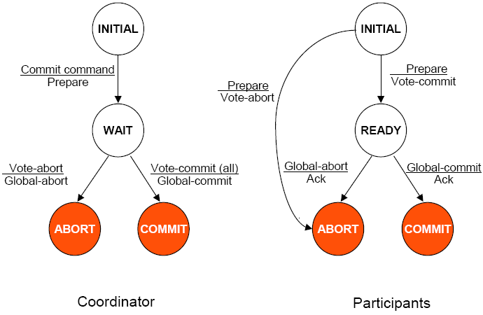
State transition in 2PC protocol

Slide 8
Coordinator time-outs
The coordinator can time-out in WAIT, ABORT, and COMMIT states.
WAIT
The coordinator is waiting for the local decisions from the participants.
Solution: the coordinator decides to globally abort the transaction by writing an abort record in the log, and sending a global abort to all participants

Slide 9
Coordinator time-outs
COMMIT or ABORT
The coordinator is not certain if the commit or abort procedures have been completed by the LRMs of all participants.
Solution: resend the "global-commit" or "global abort" to the site that have not acknowledged.

Slide 10
Participant time-outs
A participant can time-out in INITIAL or READY states.
INITIAL
The participant is waiting for a “prepare” message.
The coordinator must have failed in INITIAL state.
Solution: the participant unilaterally aborts the transaction. If the "prepare" message arrives later. It can be responded by
vote abort, or
just ignoring the message. This causes the time-out of the coordinator in the WAIT state (see the previous discussion for this case).

Slide 11
Participant time-outs
READY
The participant must have "voted commit" and therefore cannot change it and unilaterally abort it.
Solution: blocked until it can learn (from the coordinator or other participants) the ultimate fate of the transaction.
In centralized communication structure, a participant has to ask the coordinator for its decision. If the coordinator failed, the participant will remain blocked.

Slide 12
Can blocking problem be overcome?
No!
2PC is an inherently blocking protocol.

Slide 13
Course Summary
Course objectives: study the fundamental issues of DDB. Topics covered
Chapter 1 Introduction
Chapter 4 Distributed DBMS Architecture
Transparency and data independence, the major goals of DBMS
ANSI/SPARC 3-level architecture
Components of DDBMS
User Processor at local site, plus Data Processor at remote site
Global directory

Slide 14
Chapter 5 Distributed DB Design
DDB design = Data fragmentation
Why
How
Correctness of fragmentation
Chapter 7 Overview of Query Processing
Problem
Objective
Complexity, characterization
Layers of query processing

Slide 15
Chapter 8 Optimization of Distributed Queries
Cost model
Centralized query optimization
INGRES
System R
Distributed query optimization
INGRES
System R*
Chapter 10 Introduction to Transaction Management
Properties of transactions: ACID
Formalization – partial order, or DAG
Termination of transactions

Slide 16
Chapter 11 Distributed Concurrency Control
Serializability theory
Locking-based algorithms
Basic
2PL
Strict 2PL
Timestamp-based algorithms
Basic
Conservative
Extremely conservative
Optimistic versus pessimistic

Slide 17
Chapter 12 Distributed DBMS Reliability
Reliability and types of failures
Local recovery protocols
Architecture and log file
Execution of LRM commands
Checkpoint
Distributed reliability protocols
2PC protocol
Termination protocols
Recovery protocols
3PC – a non-blocking protocols

