Slide 1
Distributed Database Systems
Welcome!

Slide 2
Teaching Staff
Instructor: Ju Fan (范举)
Associate Professor
School of Information / DEKE Lab
Renmin University of China Email: fanj@ruc.edu.cn
Homepage: http://iir.ruc.edu.cn/~fanj/
Office: Room 500, Information Building

Slide 3
Course Name
Distributed
Database
Systems

Slide 4
Teaching language
English

Slide 5
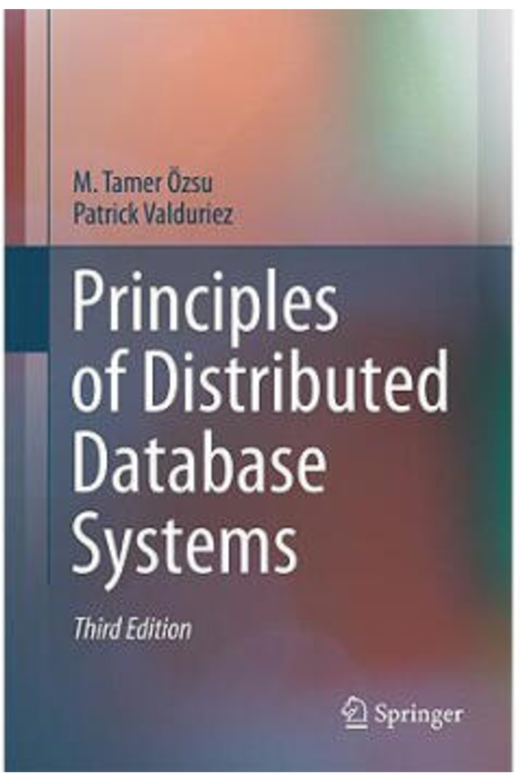

Textbook
Principles of Distributed Database Systems
(3nd Edition)
M. Tame Özsu
Patrick Valduriez
Springer, 2011
Price: RMB 73.30

Slide 6
Reference
Distributed Databases: Principles and Systems Ceri & Pelagatti McGraw-Hill, 1985
许多中文参考书

Slide 7
Prerequisite
Undergraduate database course
Computer networks

Slide 8
Contents- theory
No. | Chapter # | Title
1 | 1 | Introduction
2 | 3 | Distributed Database Design
3 | 6 | Overview of Query Processing
4 | 7 | Query Decomposition and Data Localization
5 | 8 | Optimization of Distributed Queries
6 | 10 | Introduction to Transaction Management
7 | 11 | Distributed Concurrency Control
8 | 12 | Distributed DBMS Reliability

Slide 9
Contents- systems
No. | Title
9 | MapReduce
10 | Distributed Column Store
11 | Spark
12 | Spanner

Slide 10
Contents- project
Design and implementation of a course project of DDBMS capable of
defining DDB
support of SQL
Teamwork of 3-4 members
To be evaluated by a benchmark of data and queries
Demo

Slide 11
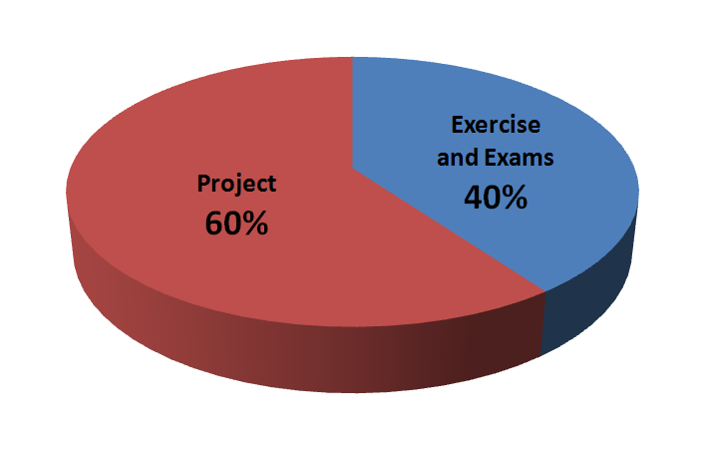
Evaluation

Slide 12
Course home page
https://github.com/fanju1984/ddb/wiki
On the home page you can
Get notifications
Download the latest courseware
Download other related materials

Slide 13
Why take this course?

Slide 14
History of DB Systems
1960’s
IBM IMS
DBTG network data model
1970’s
E. F. Codd RDB model
Pioneering systems: INGRES, System R
1980’s
Booming of RDBs
Federated, Multi-database
DDB
OODB

Slide 15
History of DB Systems
1990’s
Merge of RDB and OODB
Internet Fame
P2P model
2000’s
XML DB
Web data processing
Semantic Web
Data Integration

Slide 16
History of DB Systems
2010’s
NoSQL
NewSQL
More details in course 分布式系统与云计算（卢卫副教授）

Slide 17
Why study DDB
Reason 1: The fundamental principles for parallel & distributed data processing
Reason 2: Scientific training on

Slide 18
Why study DDB
Reason 1: The fundamental principles for parallel & distributed data processing
Reason 2: Scientific training on
basic concepts
problem formulation
identification of key technical issues
algorithm presentation
system level design and implementation

Slide 19
上届学生反馈……
都觉得有难度……
在编码的过程中遇到了许许多多的问题
总是会有莫名 其妙的 bug 困扰着你并消磨你的热情
项目伊始，我就预料到工作量可能比较大
为了这门课我贡献 了本学期四次熬夜中的两次，欣赏了人大独具特色的冬日星空
这门课真是一点也不“水”

Slide 20
上届学生反馈……
但都觉得收获很大！
我在这门课学习了分布式系统的知识、提升了coding能力、锻炼了团队合 作的能力
对分布式数据库实现上的难题有了进一步认识，也为之后实现规模更大的数据库奠定了 一些基础
选择上这 门课收益很大，对个人偏向分布式存储的专业方向也很有帮助
在与队员的合作过程当中，真正体会到了一起通宵战bug的快乐
总结一下，选这门课，值。
传承：清华大学周立柱教授DDB课

Slide 21
Friendly Reminding Messages from the Instructor

Slide 22
课程设计中应注意的问题
选课太多，疲于奔命，无暇顾忌
缺乏总体设计，系统划分不当，随意编程，接口混乱
设计目标很高，实现时想一步到位，指望一次成功
选择开发环境欠考虑
代码管理混乱，难以形成正确版本

Slide 23
实现时不考虑调试需求（例如反复建立表格，生成数据字典）
匆忙上马，反复折腾
各自为战，缺少交流
众人平等，没有核心
分工不均，事后抱怨

