Slide 1
Distributed Database Systems
Autumn, 2018
Discussion Topic
MapReduce
Some parts of the slides are borrowed from Stanford CS347

Slide 2
Motivation: Simple data processing
Distribution makes simple computations complex
Communication
Load balancing
Fault tolerance
Not all applications require relational data and transactions
What if we could automatically parallelize simple data processing?

Slide 3
Motivation for Map-Reduce
R1
Local sort
R’1
ko
Local sort
Result
R2
R’2
k1
R3
Local sort
R’3
process data
& partition
additional
processing

Slide 4
Another example: Asymmetric fragment + replicate join
Local join
Ra
R1
S
Sa
Rb
R2
S
Sb
R3
S
f
partition
Result
union
process data
& partition
additional
processing

Slide 5
Building Text Index - Part I
original Map-Reduce application....
FLUSHING
1
rat
(rat, 1)
(dog, 1)
(dog, 2)
(cat, 2)
(rat, 3)
(dog, 3)
(cat, 2)
(dog, 1)
(dog, 2)
(dog, 3)
(rat, 1)
(rat, 3)
Intermediate runs
Page stream
dog
2
dog
cat
rat
Disk
dog
3
Loading
Tokenizing
Sorting
Notes:
Spend some time explaining pieces of figure
Say that blue is buffer
What the three stages are
Mention that what is flushed to disk is the intermediate run
Different resources are used by diff stages of the process – (network, CPU, IO)
Hence obvious approach is to execute them simultaneously

Slide 6
Building Text Index - Part II
(cat, 2)
(dog, 1)
(dog, 2)
(dog, 3)
(rat, 1)
(rat, 3)
(ant, 5)
(cat, 2)
(cat, 4)
(dog, 1)
(dog, 2)
(dog, 3)
(dog, 4)
(dog, 5)
(eel, 6)
(rat, 1)
(rat, 3)
(ant: 2)
(cat: 2,4)
(dog: 1,2,3,4,5)
(eel: 6)
(rat: 1, 3)
Merge
Intermediate Runs
(ant, 5)
(cat, 4)
(dog, 4)
(dog, 5)
(eel, 6)
Final index
Notes:
Spend some time explaining pieces of figure
Say that blue is buffer
What the three stages are
Mention that what is flushed to disk is the intermediate run
Different resources are used by diff stages of the process – (network, CPU, IO)
Hence obvious approach is to execute them simultaneously

Slide 7
Generalizing: Map-Reduce
Map
FLUSHING
1
rat
(rat, 1)
(dog, 1)
(dog, 2)
(cat, 2)
(rat, 3)
(dog, 3)
(cat, 2)
(dog, 1)
(dog, 2)
(dog, 3)
(rat, 1)
(rat, 3)
Intermediate runs
Page stream
dog
2
dog
cat
rat
Disk
dog
3
Loading
Tokenizing
Sorting
Notes:
Spend some time explaining pieces of figure
Say that blue is buffer
What the three stages are
Mention that what is flushed to disk is the intermediate run
Different resources are used by diff stages of the process – (network, CPU, IO)
Hence obvious approach is to execute them simultaneously

Slide 8
Generalizing: Map-Reduce
(cat, 2)
(dog, 1)
(dog, 2)
(dog, 3)
(rat, 1)
(rat, 3)
(ant, 5)
(cat, 2)
(cat, 4)
(dog, 1)
(dog, 2)
(dog, 3)
(dog, 4)
(dog, 5)
(eel, 6)
(rat, 1)
(rat, 3)
(ant: 2)
(cat: 2,4)
(dog: 1,2,3,4,5)
(eel: 6)
(rat: 1, 3)
Merge
Intermediate Runs
(ant, 5)
(cat, 4)
(dog, 4)
(dog, 5)
(eel, 6)
Reduce
Final index
Notes:
Spend some time explaining pieces of figure
Say that blue is buffer
What the three stages are
Mention that what is flushed to disk is the intermediate run
Different resources are used by diff stages of the process – (network, CPU, IO)
Hence obvious approach is to execute them simultaneously

Slide 9
Computational Model
Input
D = { d1, d2, ..., dn }
M(di) ⟶ { [ k1, v1 ], [ k2, v2 ], ... }
R(ki, { values }) ⟶result
Let S = { [ k, v ] | [ k, v ] ∈ M(d) for some d ∈ D }
Let K = { k | [ k, v ] ∈ S, for any v }
Let G(k) = { v | [ k, v ] ∈ S }
Output: O = { [ k, r ] | k ∈ K, r = R(k, G(k)) }

Slide 10
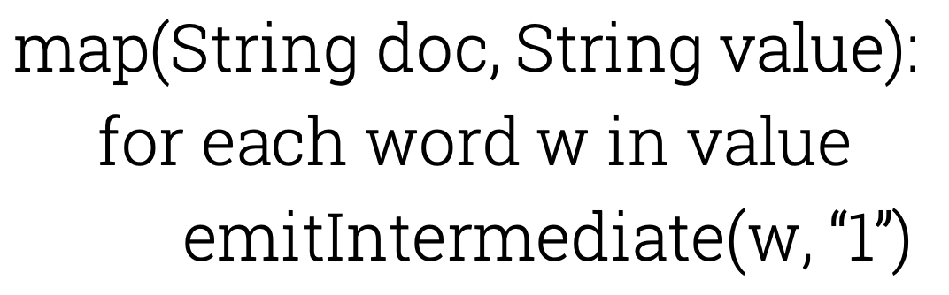
Example
Counting word occurrences
Example
map(doc, “cat dog cat bat dog”) emits[“cat”, “1”], [“dog”, “1”], [“cat”, “1”], [“bat”, “1”], [“dog”, “1”]

Slide 11
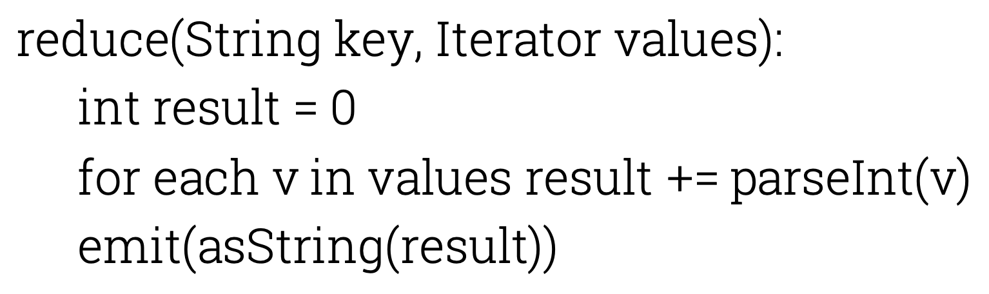
Example
Counting word occurrences
Example
reduce(“dog”, { “1”, “1”, “1”, “1” }) emits “4”

Slide 12
References
MapReduce: Simplified Data Processing on Large Clusters. J. Deanand S. Ghemawat, OSDI 2004
Pig Latin: A Not-So-Foreign Language for Data Processing. Olston etal, SIGMOD 2008

Slide 13
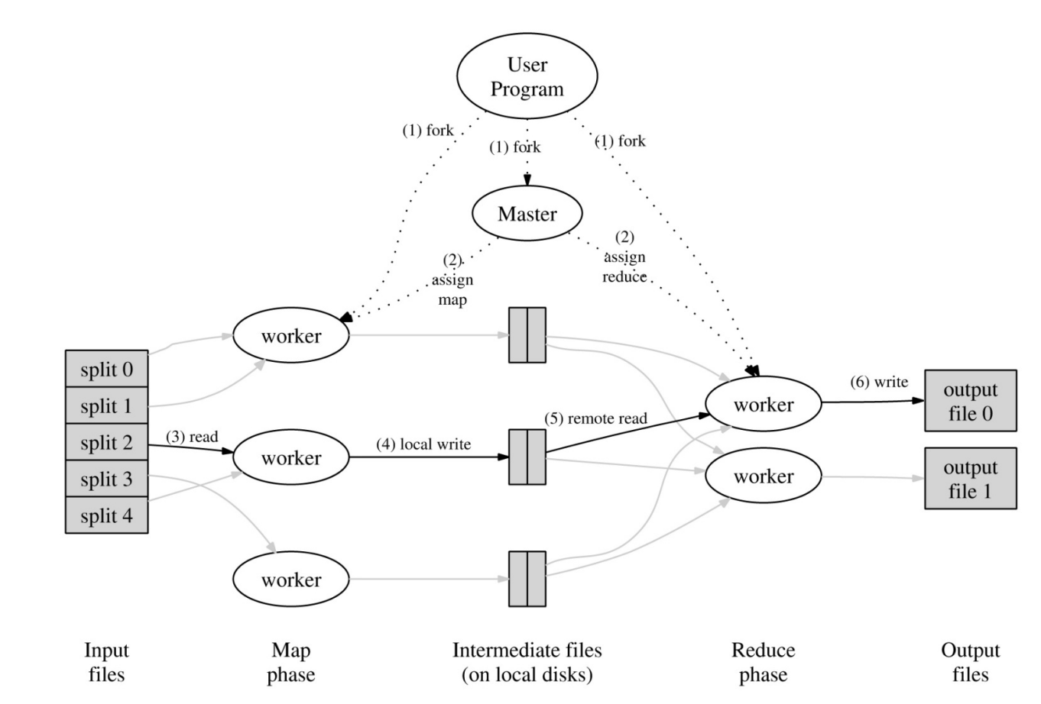
Processing Model

Slide 14
Processing Model
Can vary the number of mappers to tune performance
Reduce tasks bounded by number of intermediate files produced by each map worker

Slide 15
MapReduce Implementation
Combine function
File system
Partitions
Latency
Failures
Backup tasks
Ordering of results
Pipelines

Slide 16
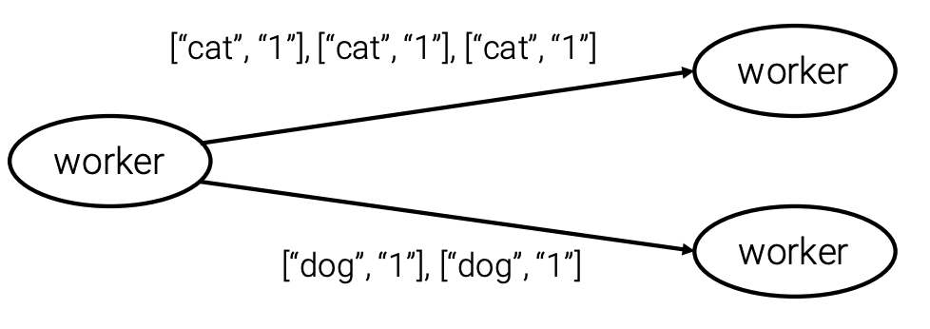
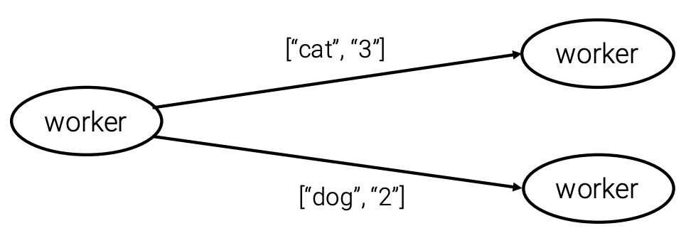
Combine Function
Combine is a local reduce step applied before distribution

Slide 17
File System
All data transfers are through a distributed filesystem
High-throughput network is essential
Map workers must be able to access any split of the input
Input is a distributed file
Reduce worker must be able to access local disks on map workers
Any worker must be able to write its part of the output
Output is left in a distributed file

Slide 18
File System

Slide 19
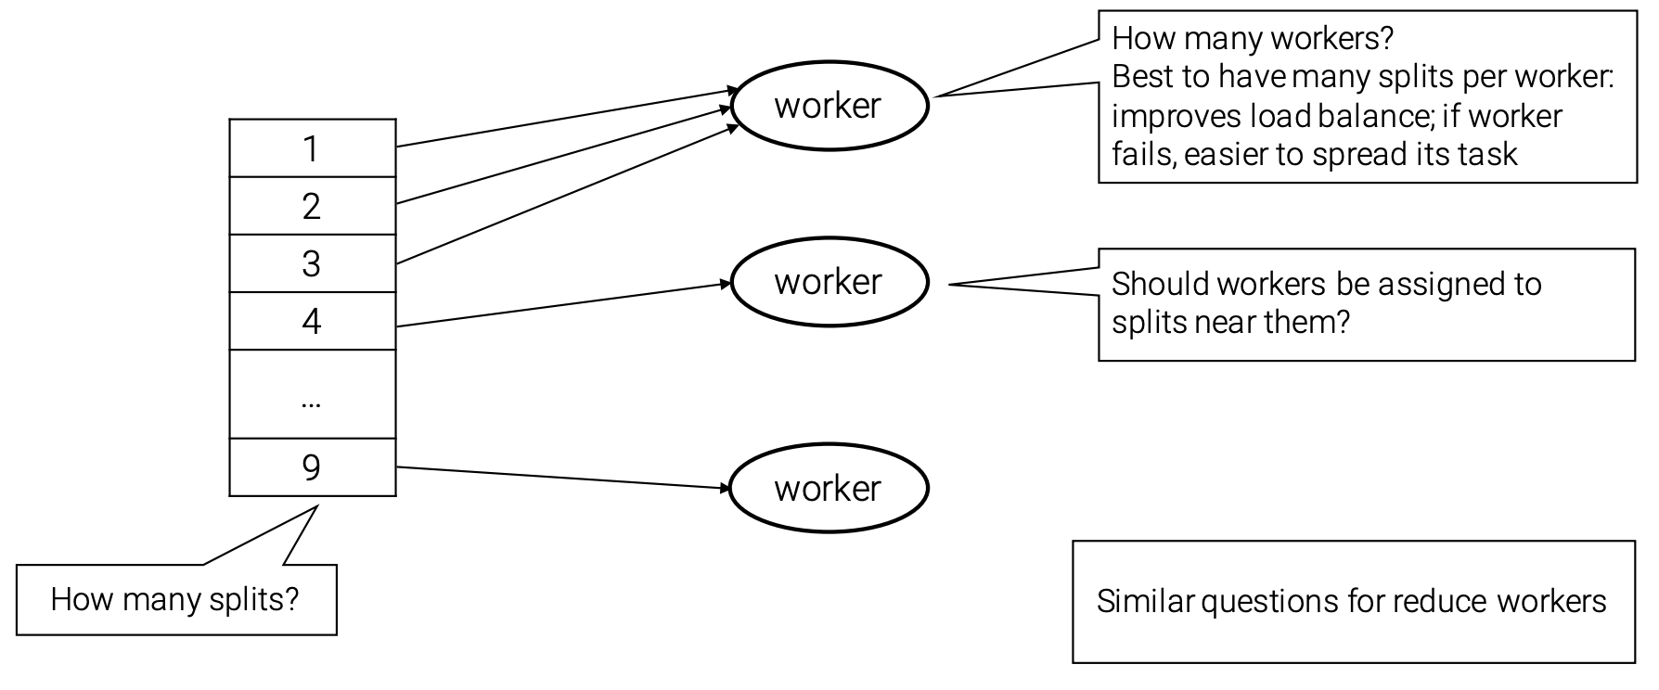
Partitions
How many splits and workers are best?

Slide 20
Latency
What takes time?
Reading the input
Mapping
Shuffling
Reducing
Map and reduce are separate phases
Latency determined by slowest task Reduce task (data) skew can significantly increase latency
Map and shuffle can overlap
Once some mappers are done, shuffle may commence

Slide 21
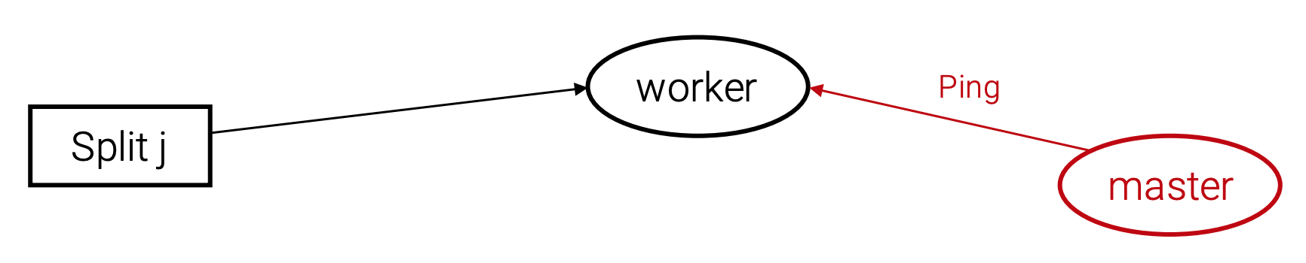
Failures
Distributed implementation should produce same output as a non-faulty sequential execution
General strategy
Master detects worker failures, gets task re-done by another worker

Slide 22
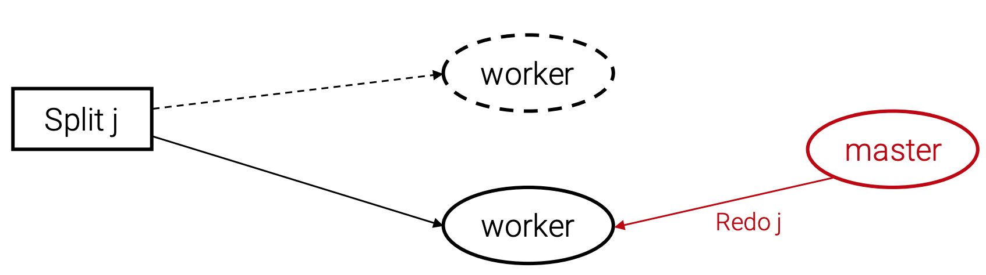
Failures
Distributed implementation should produce same output as a non-faulty sequential execution
General strategy
Master detects worker failures, gets task re-done by another worker

Slide 23
Backup Tasks
Stragglers are workers that take unusually long finish their tasks
They can delay overall completion
When overall processing is close to completion, the master may schedule backup execution for remaining tasks
Must be able to eliminate redundant results

Slide 24
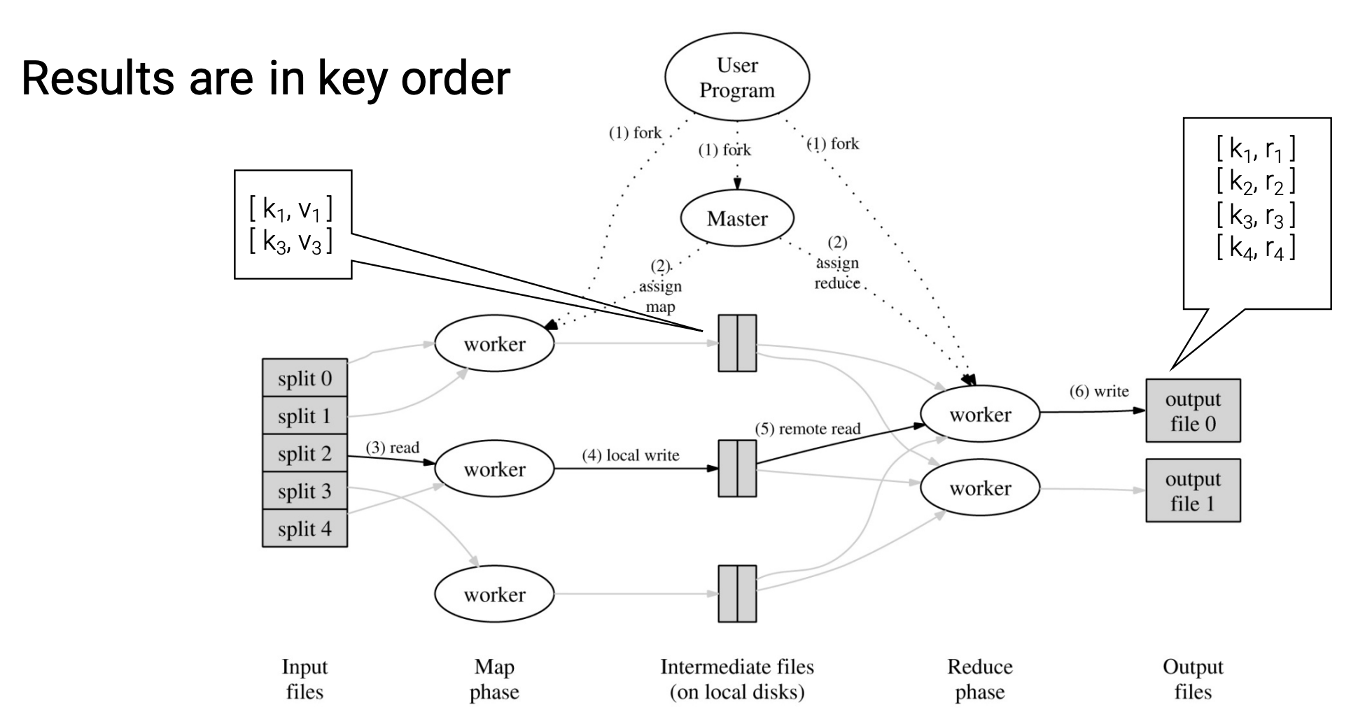
Ordering of Results

Slide 25
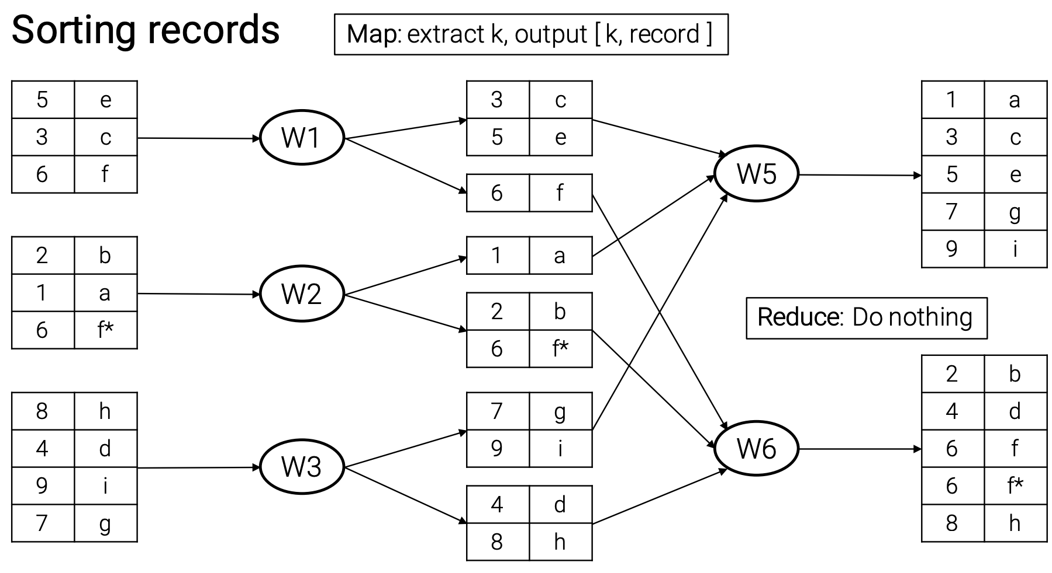
Example

Slide 26
Pipelines
The output of one MapReduce can become the input for another
Example
Identifying top-k terms
Stage 1: translate data to canonical form
Stage 2: term count
Stage 3: sort by frequency
Stage 4: extract top-k

Slide 27
MapReduce Implementations
Google MapReduce
Proprietary system
Hadoop
Open-source MapReduce framework
Also, a toolkit
HDFS: filesystem for Hadoop
HBase: database for Hadoop
Also, an ecosystem
Tools Recipes Developer community

Slide 28
MapReduce Advantages
Model easy to use, hides details of parallelization and fault recovery
Many problems can be expressed in the MapReduce framework
Scales to thousands of machines

Slide 29
MapReduce Disadvantages
1-input, 2-stage data flow is rigid, hard to adapt to other scenarios
Custom code is needed for even the most common operations
E.g., projections and filtering
The opaque nature of map/reduce functions impedes optimization

Slide 30
Questions
Can MapReduce support traditional database operators?
E.g., how can we perform joins?
Can MapReduce be made more declarative?

Slide 31
Supporting Database Operators
Simple idea
Each operator is a MapReduce stage
How to do?
Selection
Projection
Group by and aggregation

Slide 32
Joins
Reduce-side join
Shuffle puts all values for the same key at the same reducer
Mapper
Input: tuples from R; tuples from S
Output: [ join value, ( R|S, tuple ) ]
Reducer
Local join of all R tuples with all S tuples

Slide 33
Joins
Map-side join
Like a hash-join, but every mapper has a copy of the hash table
Mapper
Read hash table of R
Input: tuples of S
Output: tuples of S joined with tuples of R
Reducer
Pass through

Slide 34
Joins
Comparison
Reduce-side join shuffles all the data
Map-side join requires one table to be small
Semi-joins
One idea
Stage 1: Extract the join keys of R; reduce-side join with S
Stage 2: Map-side join result of stage 1 with R

Slide 35
Pig & Pig Latin
A layer on top of MapReduce (Hadoop)
Pig is the system
Pig Latin is the query language
Pig Latin is a hybrid between
High-level declarative query language in the spirit of SQL
Low-level procedural programming using MapReduce

Slide 36
Example
Data
Info about we pages: urls(url, category, score)
Problem
Find, for each sufficiently large category, the average score of high-scoring pages in that category

Slide 37
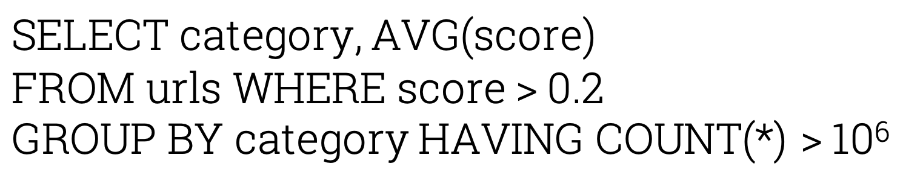
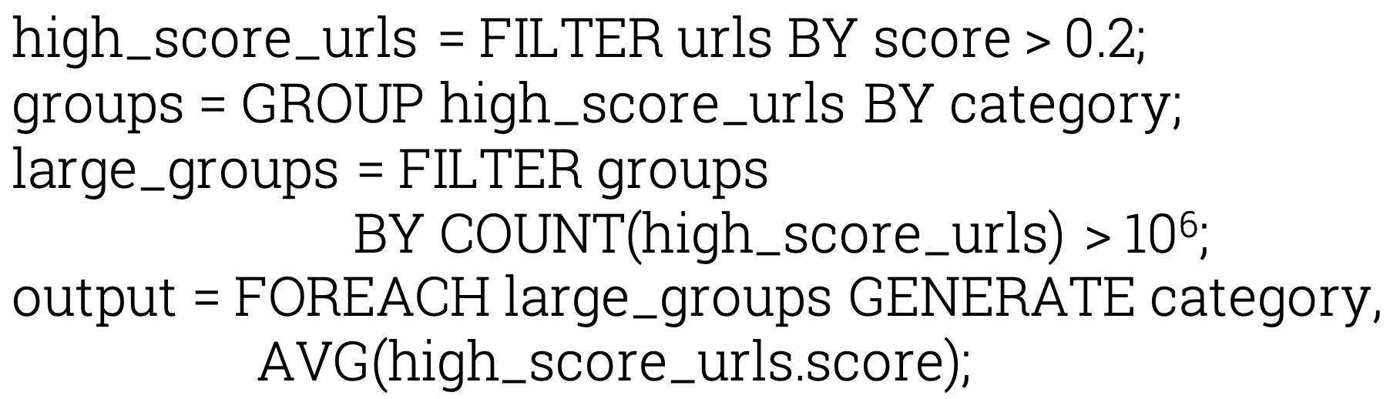
Example
SQL
Pig Latin

Slide 38
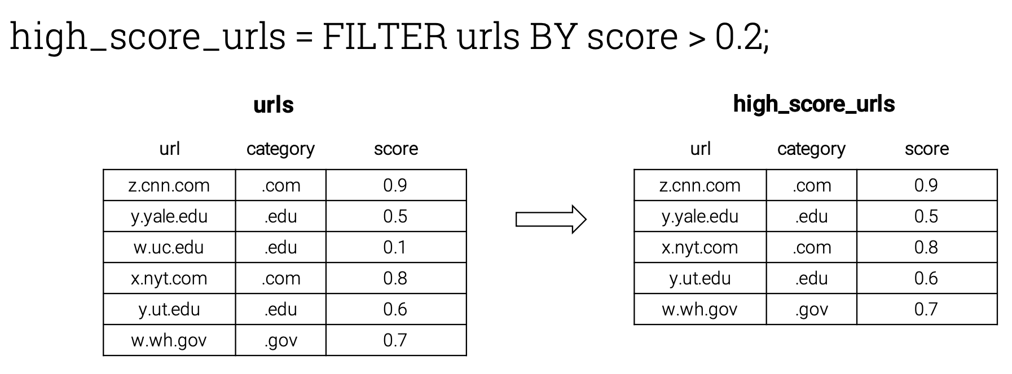
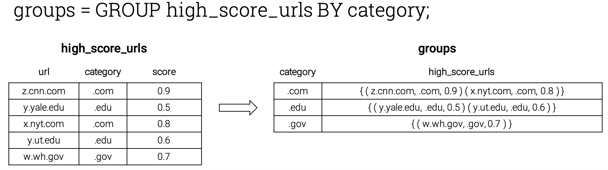
Example

Slide 39
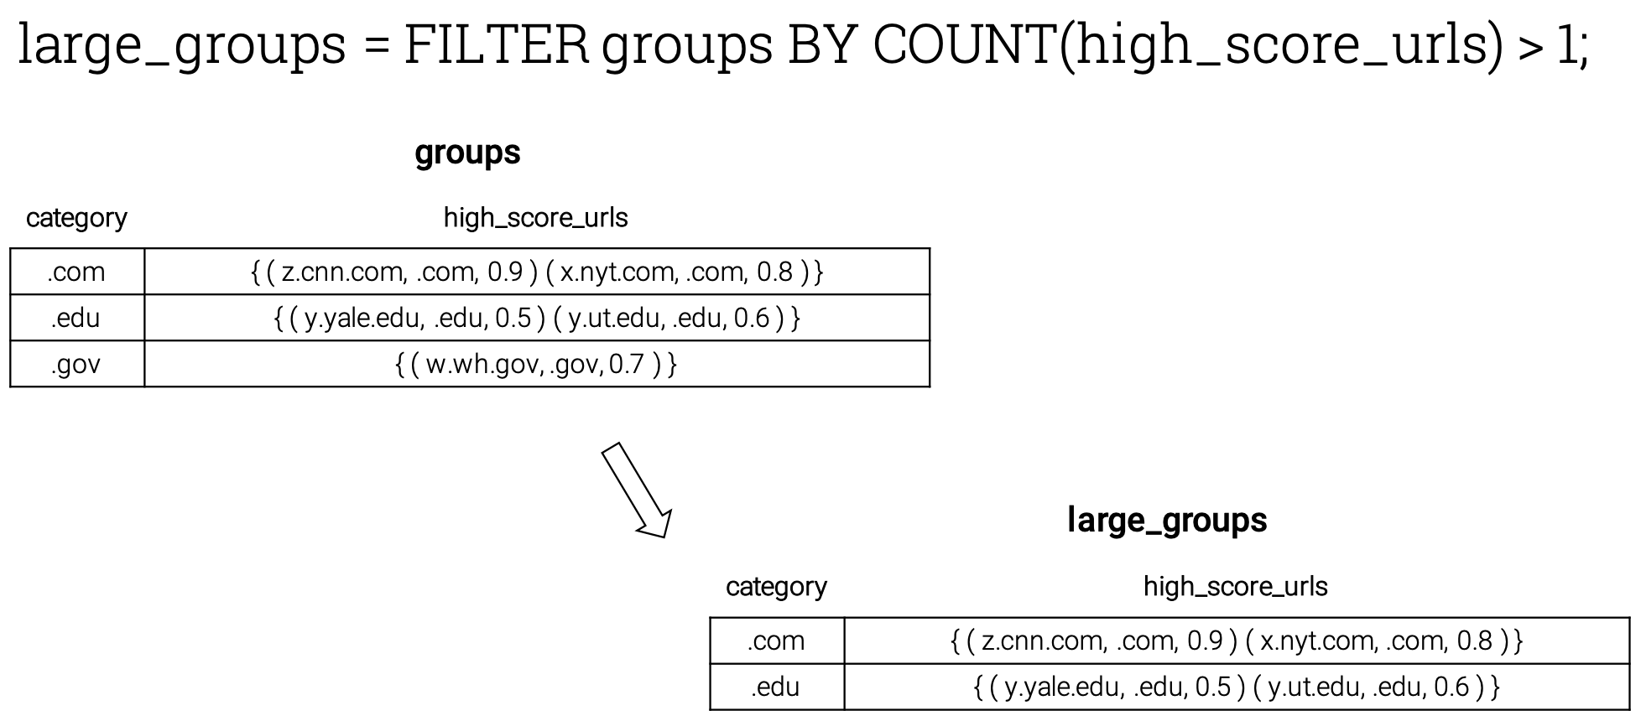
Example

Slide 40
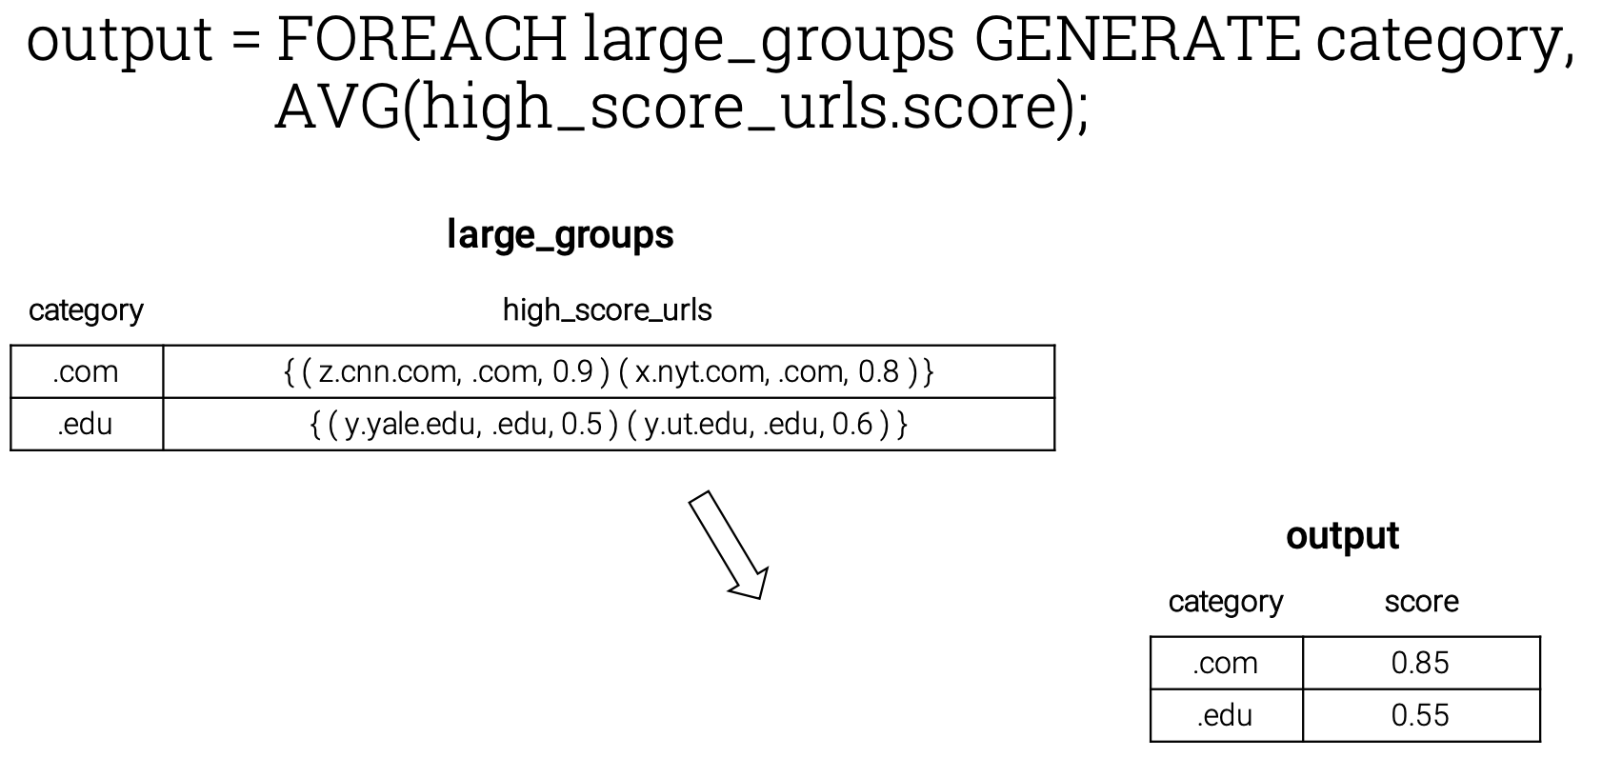
Example

Slide 41
Pig Features
Similar to specifying a query execution plan
Easy for developers to understand and control processing flow
Supports a flexible, fully nested data model Supports user-defined functions
Can operate over plain input files without any schema information
Provides debugging environment, useful for large data sets

Slide 42
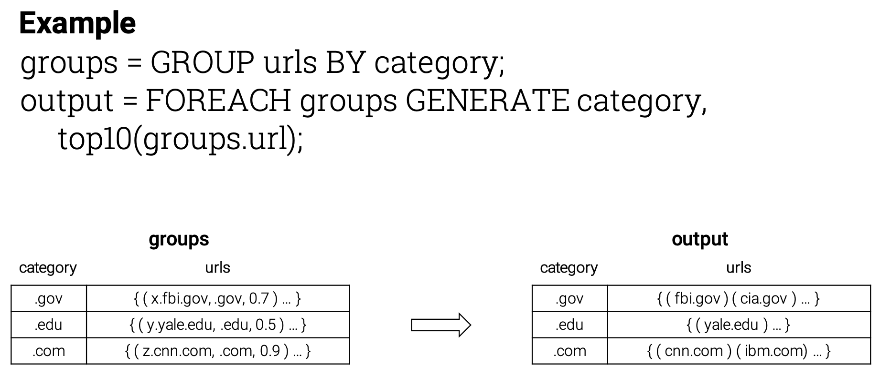
User Defined Functions

Slide 43
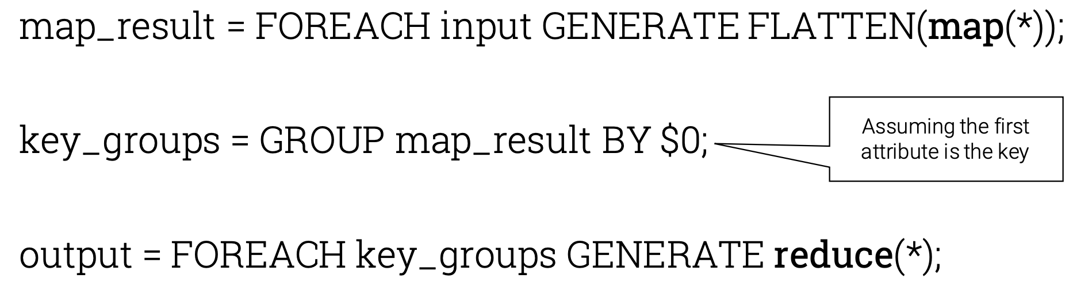
MapReduce in Pig Latin

Slide 44
Why Not Use a DBMS?
Many database systems are highly optimized
Loading data is hard (e.g., need schema)
May come with system overhead (e.g., transactions)
MapReduce is
Scalable
Easy to deploy/use/extend
Free
Suitable for diverse large, parallelizable computation E.g., building inverted indices or thumbnailing images

