Slide 1
DDBMS Midterm Report
By: Chai Mingke
Hong Yinhao
Shen Yunlong

Slide 2
System Design

Slide 3
Design Principles
Simple
Embedded
Flexible configuration

Slide 4
System Overview
Server + Client
Data Manager
Query Executor
Connector
RPC
Etcd
PG
Metadata Handler

Slide 5
Division of the work
Query Executor: 柴茗珂
Data Manager: 沈运龙
The others: 洪殷昊

Slide 6
Development Environment
Operating System: Not required
Language: Golang
IDE: Goland
DB: PostregSQL
MetaData & Statement storage: Etcd
Communication: RPC

Slide 7
Language: Golang
Advantage
Performance: similar to C++
Concurrency and channel: thread oriented, thread communicating without lock
Easy to learn: many aspects are similar to C and Java(grammar, built-in GC, etc.)
Type inference
Disadvantage
Error handling
Prohibit declaration of unused variables and import
Dispute
Specified code style
Dynamic link library not supported

Slide 8
Cluster Generating: Etcd
The reason we choose it: Etcd is written in Golang, so we can embed etcd in our code.

Slide 9
Communication: RPC
Protocol buffer is efficient
Choose gRPC with no reason

Slide 10
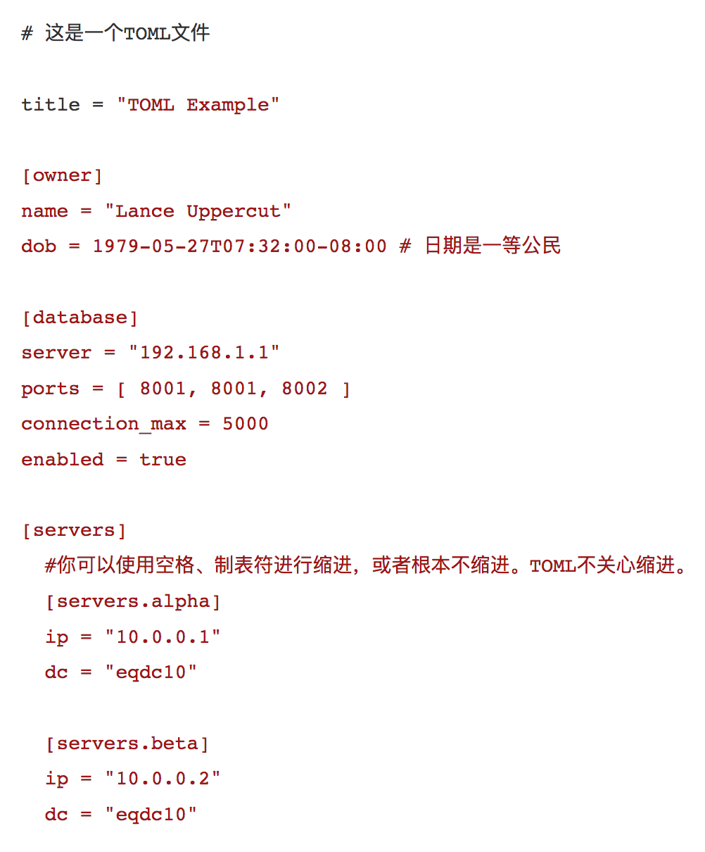
Configuration file language: TOML
TOML is designed to be unambiguously converted to a hash table
Easy to read and write
Golang's parsing of TOML is simple

Slide 11
Query Parser

Slide 12
Framework
Centralized query
Distributed query
Optimization

Slide 13
Ⅰ Centralized query
SQL parser
Analysis
Rewrite
SQL->Relational algebra tree
Detect semantic incorrect
Rewrite tree

Slide 14
SELECT ENAME
FROM PROJ, EMP, ASG
WHERE ASG.ENO=EMP.ENO
AND ASG.JNO=PROJ.JNO
AND ENAME<>“J.Doe”
AND PROJ.NAME=“CAD/CAM”
AND (DUR=12 OR DUR=24)
Projection
Table
Join
Select
SQL parser
GDD
Type incorrect : undefined relation, attribute, wrong type mapping etc.
Value incorrect : out of range, redundancy
Semantic incorrect (query graph)
Analysis

Slide 15
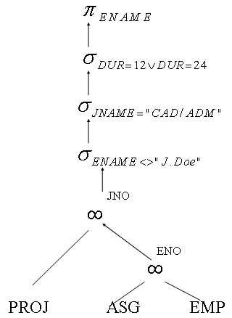
Rewrite
1.SQL->Relational algebra tree
Projection
Table
Join
Select
SELECT ENAME
FROM PROJ, EMP, ASG
WHERE ASG.ENO=EMP.ENO
AND ASG.JNO=PROJ.JNO
AND ENAME<>“J.Doe”
AND PROJ.NAME=“CAD/CAM”
AND (DUR=12 OR DUR=24)

Slide 16
Rewrite
Not connection
Multiple connections
2.Detect semantic incorrect
SELECT ENAME
FROM PROJ, EMP, ASG
WHERE ASG.ENO=EMP.ENO
AND ASG.JNO=PROJ.JNO
AND ENAME<>“J.Doe”
AND PROJ.NAME=“CAD/CAM”
AND (DUR=12 OR DUR=24)
ASG.X=EMP.X

Slide 17
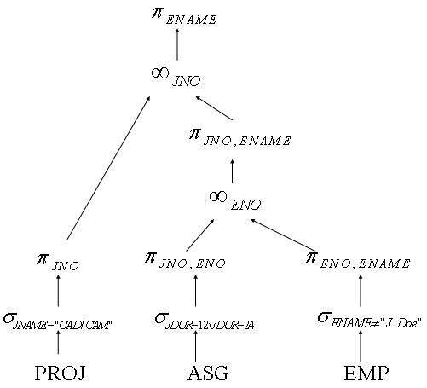
Rewrite
3. Rewrite tree
(1)Selection down
attribute parallel
(2) Projection down
root join
(3)Join up
GDD

Slide 18
Ⅱ Distributed query (fragments)
useless selections
Horizontal Fragmentation
useless joins
reduction
Vertical Fragmentation
useless joins

Slide 19
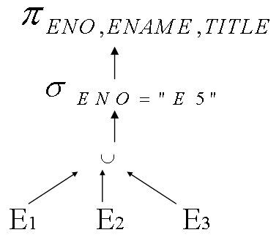
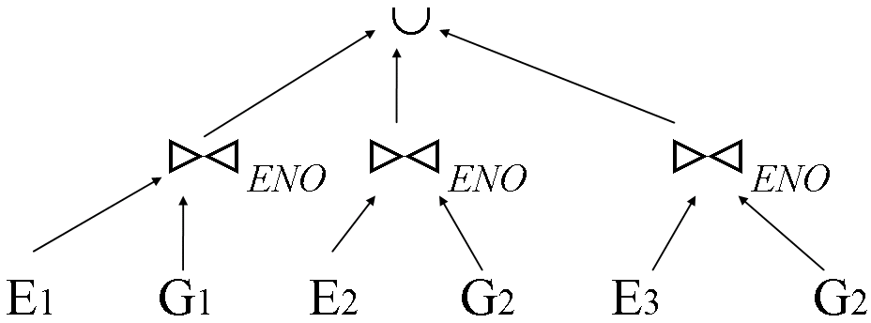
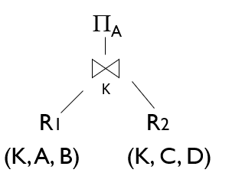
Horizontal Fragmentation (Union)
useless selections
useless joins
Out of range?
(1) Intersection of data range = NULL?
E1: ENO<=E3
E2: 3<ENO<=E6
E3: ENO>E6
(2) Join & Projection

Slide 20
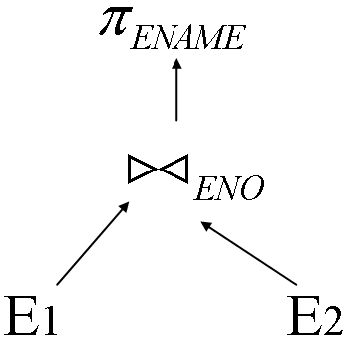
Vertical Fragmentation (Join)
useless joins

Slide 21
Ⅲ Optimization
Join(Partitioned join? Semi-join? Order?)
Data node & Join node

Slide 22
Data Manager

Slide 23
DataManager
Create commands
Drop commands
Insert commands
delete commands
Data Partion
Horizontal partition
Vertical partition
DDL
Prase
Local
Plan
Excute
Remote
ETCD
RPC

Slide 24
Partition
Hybrid Partition
Horizontal & Vertical
Partition principle
completeness
reconstruction

Slide 25
metadata
Schema informantion
name , attribution, datatype
statistic information
max/min value
number of rows
Partition information
describes which parts of which table are on which db

