Slide 1
Distributed Database Systems
Autumn, 2007
Chapter 12 – Part 2 of 3
Distributed DBMS Reliability

Slide 2
Reliability
Correctness
Serializability
Atomicity
Persistence
Availability

Slide 3
Types of Failures
Processor failures
Halt, delay, restart, erratic execution
Storage failures
Volatile vs. non-volatile storage failures
Atomic write violations, transient errors, localized vs. global failures
Network failures
Lost message, out-of-order messages, partitions, bounded delay

Slide 4
Types of Failures
Unintended vs. malevolent failures
Single vs. multiple failures
Detectable vs. undetectable failures

Slide 5
Failure Models
Cannot protect against everything
Unlikely failures
E.g., flooding in the Sahara: Ten of the Strangest Data Center Outages [ goo.gl/DcQysr ]
Failures expensive to protect against
E.g., earthquakes

Slide 6
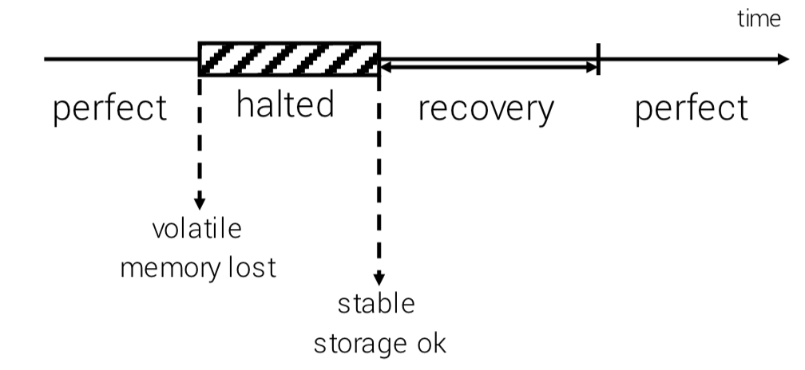
Node Models
Fail-Stop nodes

Slide 7
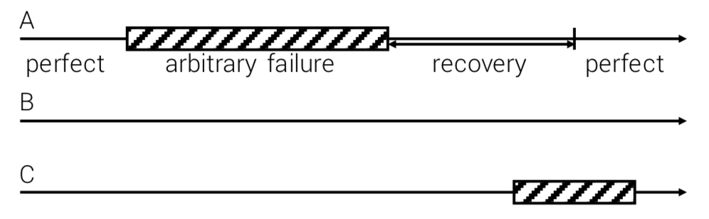
Node Models
Byzantine nodes
At any given time, at most some fraction (e.g., 1/2 or 1/3) of nodes are failing

Slide 8
Byzantine Generals' Problem
An agreement problem (described by Leslie Lamport, etc. )
A group of generals, each commanding a portion of the Byzantine army, encircle a city.
These generals wish to formulate a plan for attacking the city, e.g., attack or retreat.
Some generals may prefer to attack, while others prefer to retreat.

Slide 9
Byzantine Generals' Problem
An agreement problem (described by Leslie Lamport, etc. )
The important thing is that every general agree on a common decision, for a halfhearted attack by a few generals would become a rout, and would be worse than either a coordinated attack or a coordinated retreat.

Slide 10
Byzantine Generals' Problem
Example
Nine generals are voting, four of whom support attacking while four others are in favor of retreat
The ninth general may send a vote of retreat to those generals in favor of retreat, and a vote of attack to the rest
Those who received a retreat vote from the ninth general will retreat, while the rest will attack (which may lose the war)

Slide 11
Network Models
1. Reliable network
In order messages
No spontaneous messages
Timeout T_{D}
No response within T_{D} means destination is down (not paused)
No lost messages except due to node failures

Slide 12
Network Models
Variation of reliable network
Persistent messages If destination down, network will eventually deliver message
Simplifies node recovery, but inefficient
Not considered here

Slide 13
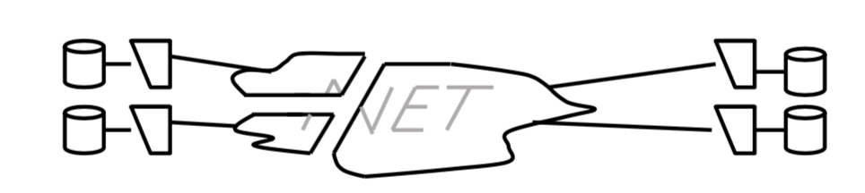
Network Models
2. Partitionable network In order messages No spontaneous messages
No timeout Nodes can have different views of the failures

Slide 14
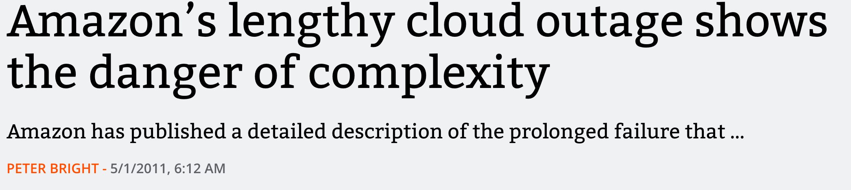
Case Study
https://arstechnica.com/information-technology/2011/04/amazons-lengthy-cloud-outage-shows-the-danger-of-complexity/
你觉得应该如何应对？

Slide 15
Scenarios
Reliable network
Fail-stop nodes No data replication (1)
Data replication (2)
Partitionable network
Fail-stop nodes (3)

Slide 16
Distributed Commit Problem

Slide 17
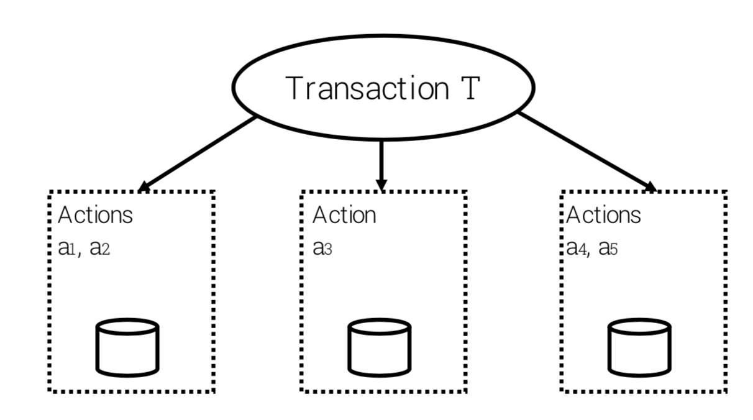
Distributed Commit Problem

Slide 18
Centralized Two-Phase Commit
2PC ensures the atomic commitment of distributed transaction.
2PC involves one coordinator at the originating site and more than one participant from other sites.

Slide 19
Phase I
The coordinator sends a message to all participants asking if they are ready to commit, and every participant answers if it's ready or not according to its own condition.

Slide 20
Phase 2
The coordinator makes the final decision global commit if all participants answer yes in phase 1, or global abort otherwise, and inform the decision to all participants. All participants take actions accordingly.

Slide 21
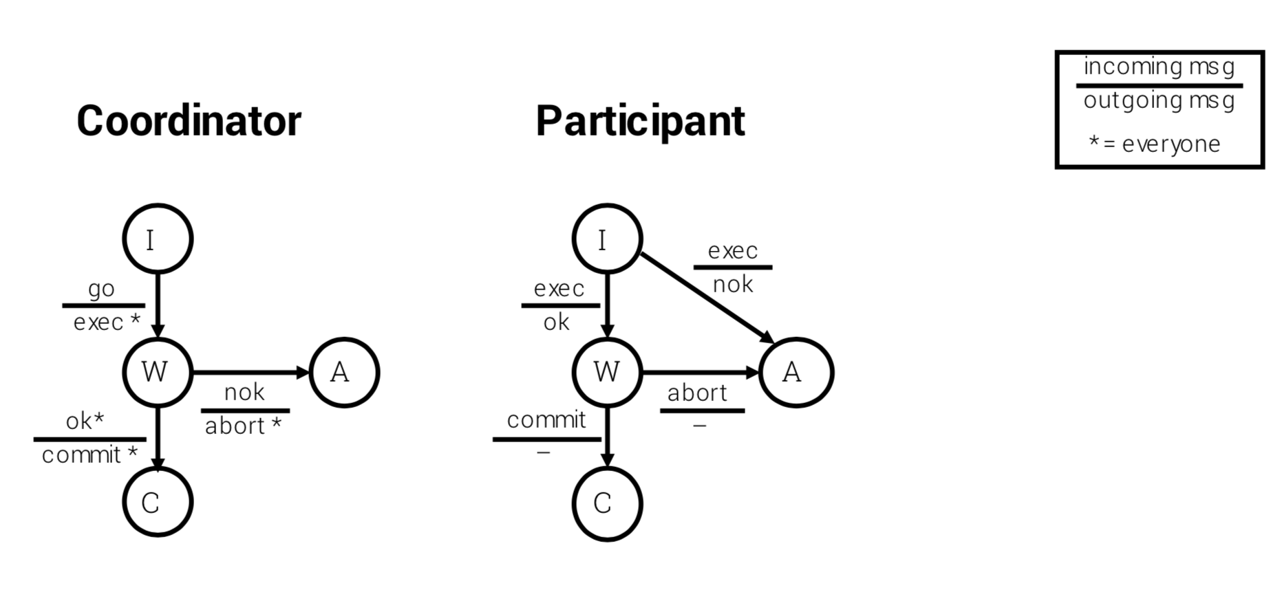
Centralized Two-Phase Commit

Slide 22
Centralized Two-Phase Commit
No lost messages (for now)
Reliable network Will discuss node failures next
When participant enters W state It must have acquired all resources It can only abort or commit if so instructed by the coordinator
Coordinator only enters C state if all participants are in W It is certain that all will eventually commit

