Slide 1

Network Intrusion Detection System based on Machine Learning
Shibo Sun

Slide 2



Agenda
Dataset
Tools & Library
Machine Learning Algorithms
Steps
Results & Conclusion

Slide 3




Introduction
An intrusion detection system (IDS) is a device or software application that monitors a network or systems for threat activity or policy violations.

Slide 4

Dataset
CSE-CIC-IDS2018 on AWS
A collaborative project between the Communications Security Establishment (CSE) & the Canadian Institute for Cybersecurity (CIC)
https://www.unb.ca/cic/datasets/ids-2018.html

Slide 5
Based on Amazon Web Services, which is a cloud computing platform.
B-profiles: to profile the abstract behavior of human interactions and generates naturalistic benign background traffic.
M-Profiles: to describe an attack scenario in an unambiguous manner.
Tuesday, November 30, 2021
Blockchain Technology
5
Notes:
B-profiles: Encapsulate the entity behaviors of users using various machine learning and statistical analysis techniques. The encapsulated features are distributions of packet sizes of a protocol, number of packets per flow, certain patterns in the payload, size of payload, and request time distribution of a protocol.
M-Profiles: Attempt to describe an attack scenario in an unambiguous manner. In the simplest case, humans can interpret these profiles and subsequently carry them out. Idealistically, autonomous agents along with compilers would be employed to interpret and execute these scenarios.

Slide 6
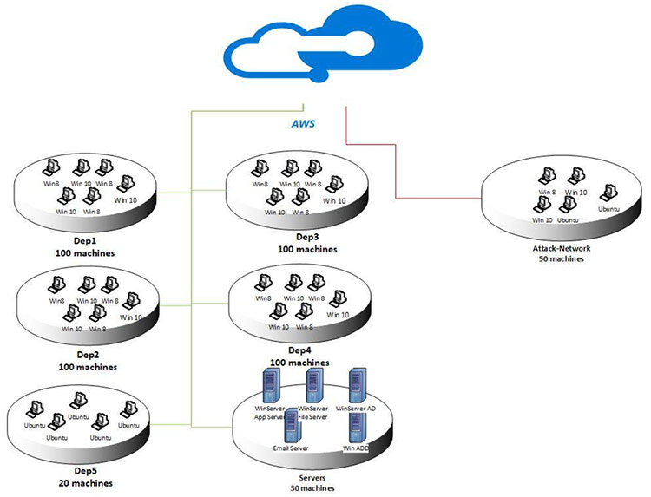
Network Topology

Slide 7
Tools & Library

Slide 8
Google Colab & PyCharm
Sklearn: Machine Learning Library
Numpy: Mathematical Operations
Pandas: Data Analysis
Matplotlib: Graphics and Visuality
Notes:
Scikit-learn is a free machine learning library for the Python programming language. It features various classification, regression and clustering algorithms.

Slide 9
Machine Learning Algorithms

Slide 10
Naive Bayes
QDA (Quadratic Discriminant Analysis)
Random Forest
ID3 (Iterative Dichotomiser 3)
AdaBoost (Adaptive Boosting)
MLP (Multi-Layer Perceptron)
Nearest Neighbors (KNN)
Tuesday, November 30, 2021
Blockchain Technology
10

Slide 11
Steps
1.1 Merge
1.2 Statistic information
1.3 Divide
1.4 Select features
2. Machine learning implementation

Slide 12
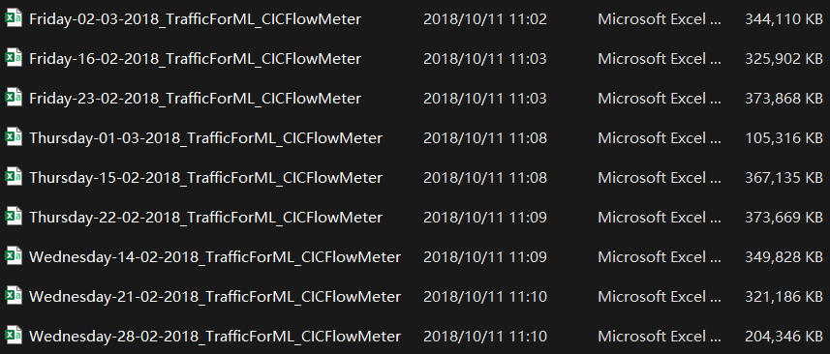
Merge
9 CSV files → “all_data.csv”
2.74 GB
80 columns
8284195 rows

Slide 13
Statistic information
Attack | Amount | Attack | Amount
Benign | 6112151 | DoS attacks-SlowHTTPTest | 139890
DDOS attack-HOIC | 686012 | DoS attacks-GoldenEye | 41508
DoS attacks-Hulk | 461912 | DoS attacks-Slowloris | 10990
Bot | 286191 | DDOS attack-LOIC-UDP | 1730
FTP-BruteForce | 193360 | Brute Force -Web | 611
SSH-Bruteforce | 187589 | Brute Force -XSS | 230
Infilteration | 161934 | SQL Injection | 87
Tuesday, November 30, 2021
Blockchain Technology
13
Notes:
Attack 26% Benign 74%

Slide 14
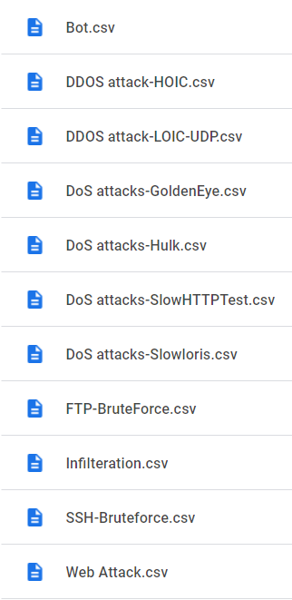
Divide
Tuesday, November 30, 2021
Blockchain Technology
14

Slide 15
Select features
a. Apply Random Forest algorithm to each attack file and get top 20 features for each attack.
b. Apply Random Forest algorithm to all_data.csv and get top 20 features for all data.
Tuesday, November 30, 2021
Blockchain Technology
15
Notes:
Random Forests are often used for feature selection in a data science workflow. The reason is because the tree-based strategies used by random forests naturally ranks by how well they improve the purity of the node. This mean decrease in impurity over all trees (called Gini impurity).
SHAP is a game theoretic approach to explain the output of any machine learning model. It connects optimal credit allocation with local explanations using the classic Shapley values from game theory and their related extensions.

Slide 17
Machine Learning implementation
1. Apply 7 machine learning algorithms 10 times to each attack file, using the top 4 features from 1.4.a and get the average accuracy precision recall and F1-score.
2. Apply 7 machine learning algorithms 10 times to all_data.csv, using the top 4 features for each attack from 1.4.a (4*11=44→15) and get the average accuracy precision recall and F1-score.
3. Apply 7 machine learning algorithms 10 times to all_data.csv, using the top 7 features from 1.4.b and get the average accuracy precision recall and F1-score.
Tuesday, November 30, 2021
Blockchain Technology
17

Slide 18
4. Find the optimal property list for Naive Bayes, QDA and MLP.
It is a kind of trial-and-error method
The feature list obtained from the file 1.4.b is placed in the machine learning algorithm to start with the highest importance score.
If the F-measure for each feature is equal to or greater than the highest value obtained, this property is added to the list. Otherwise, it is removed from the list.
As a result of the process, the program gives the highest F-measure obtained and the property list

Slide 19
5. Apply 7 machine learning algorithms 10 times to all_data.csv, using the top 7 features from 1.4.b for Random Forest, ID3, AdaBoost, and Nearest Neighbors, using the features from 2.4 for Naive Bayes, QDA and MLP, and get the average accuracy precision recall and F1-score for each algorithm.

Slide 20
Results & Conclusion

Slide 21
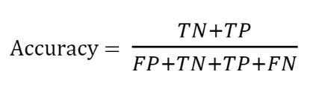
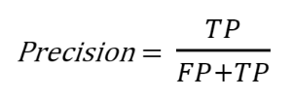
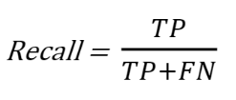
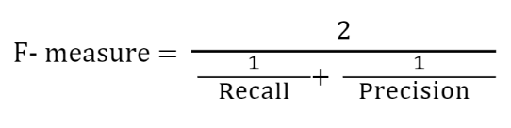
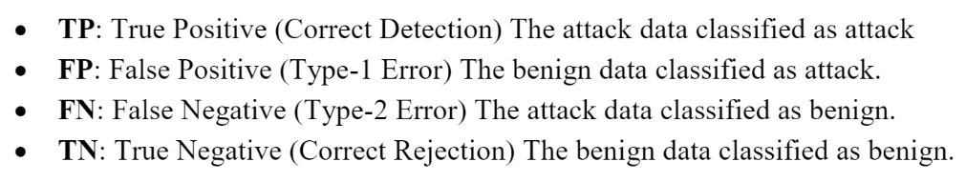
Evaluation
Notes:
Accuracy: The ratio of successfully categorized data to total data
Recall: The ratio of data classified as an attack to all attack data
Precision: The ratio of successful classified data as the attack to all data classified as the attack
F1-score: The harmonic-mean of sensitivity and precision.
This concept is used to express the overall success. So, in this study, when analyzing the results, it will be focused, especially on the F1-score.

Slide 22
F1-score | DDOS attack-HOIC | DoS attacks-Hulk | Bot | FTP-BruteForce | SSH-Bruteforce | Infilteration | DoS attacks-SlowHTTPTest | DoS attacks-GoldenEye | DoS attacks-Slowloris | DDOS attack-LOIC-UDP | Web Attack
Naive Bayes | 0.59 | 0.39 | 0.61 | 0.6 | 0.57 | 0.31 | 0.6 | 0.36 | 0.76 | 1 | 0.6
QDA | 0.65 | 0.75 | 0.82 | 0.23 | 0.74 | 0.33 | 0.41 | 0.54 | 0.6 | 0.23 | 0.78
Random Forest | 0.95 | 0.98 | 0.99 | 0.98 | 0.99 | 0.57 | 0.97 | 0.96 | 0.97 | 1 | 0.9
ID3 | 0.94 | 0.98 | 0.99 | 0.98 | 0.99 | 0.57 | 0.97 | 0.97 | 0.99 | 1 | 0.9
AdaBoost | 0.97 | 0.98 | 0.99 | 0.98 | 0.99 | 0.59 | 0.97 | 0.97 | 0.99 | 1 | 0.92
MLP | 0.81 | 0.92 | 0.97 | 0.98 | 0.77 | 0.49 | 0.93 | 0.44 | 0.51 | 0.96 | 0.67
Nearest Neighbors | 0.99 | 0.97 | 1.0 | 0.98 | 0.99 | 0.67 | 0.97 | 0.98 | 0.97 | 1 | 0.87

Slide 23
ML algorithm | Accuracy | Precision | Recall | F1-score
Naive Bayes | 0.37 | 0.63 | 0.57 | 0.35
QDA | 0.7 | 0.69 | 0.75 | 0.68
MLP | 0.81 | 0.86 | 0.64 | 0.64
Random Forest | 0.95 | 0.94 | 0.92 | 0.93
ID3 | 0.94 | 0.94 | 0.91 | 0.92
AdaBoost | 0.95 | 0.95 | 0.93 | 0.94
Nearest Neighbors | 0.94 | 0.94 | 0.91 | 0.92

Slide 24

Summary
Machine Learning can be applied to IDS.
Random Forest, ID3, AdaBoost and Nearest Neighbors perform better than other algorithms.

Slide 25


Thank You
Shibo Sun

