Slide 1

PROPOSITIONAL LOGIC
Syntactic Approach

Slide 2

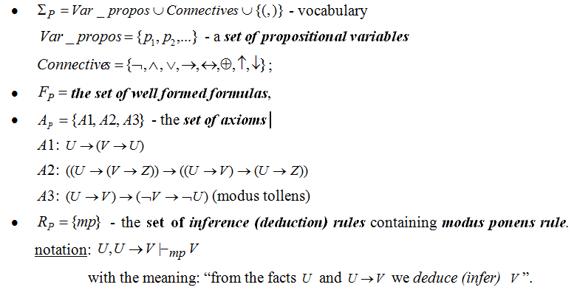
AXIOMATIC (FORMAL) SYSTEM:

Slide 3
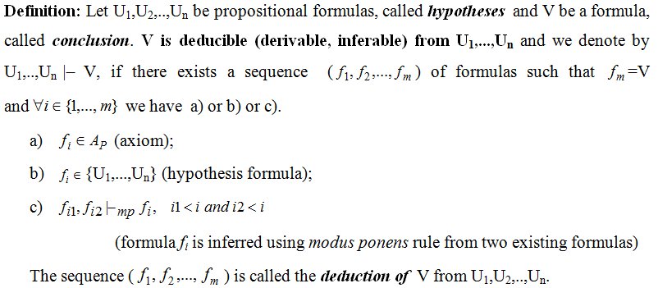

DEDUCTION

Slide 4
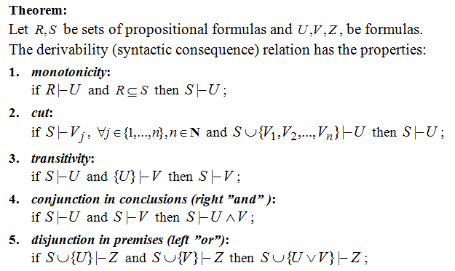
PROPERTIES OF DERIVABILITY RELATION

Slide 5
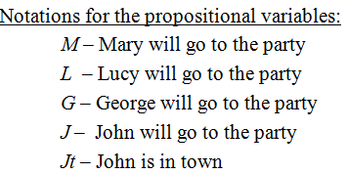
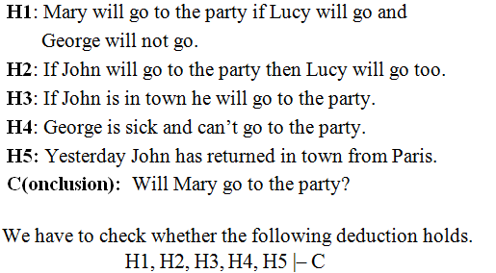
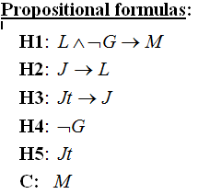
EXAMPLE 1 OF REASONING MODELING: PARTY

Slide 6





Slide 7



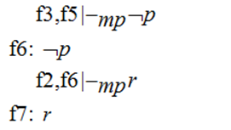
EXAMPLE 2

Slide 8
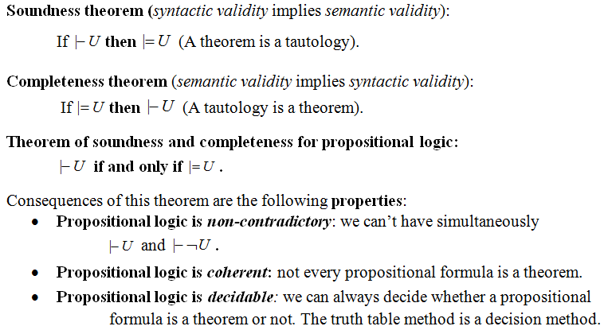
PROPERTIES OF PROPOSITIONAL LOGIC

Slide 9
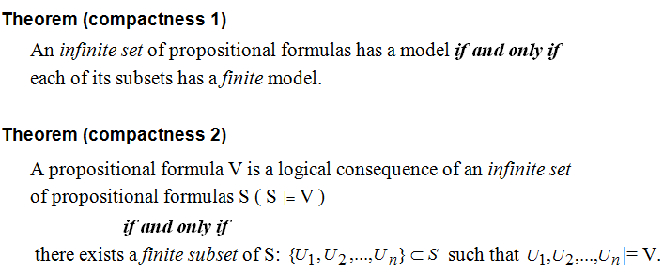
COMPACTNESS PROPERTY

Slide 10
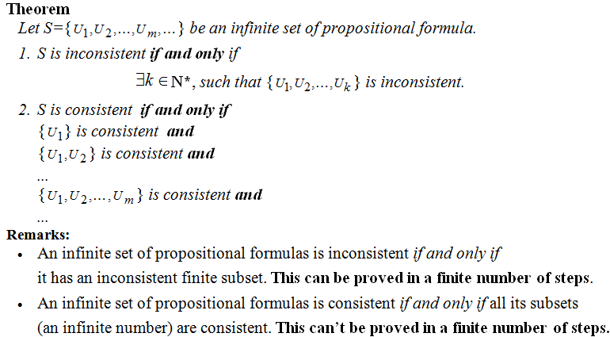
COMPACTNESS PROPERTY (CONTD.)

Slide 11
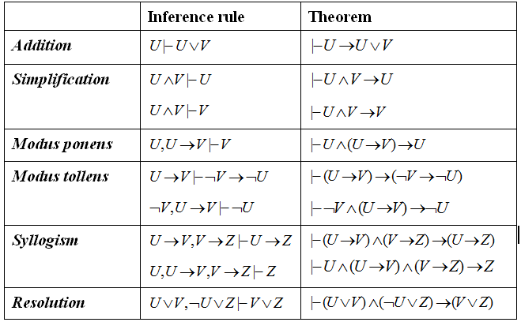
PROPOSITIONAL INFERENCE RULES

Slide 12










WHICH RULE OF INFERENCE IS USED IN EACH ARGUMENT BELOW?

Slide 13
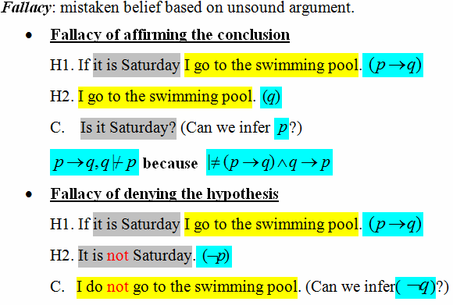
FALLACIES

Slide 14
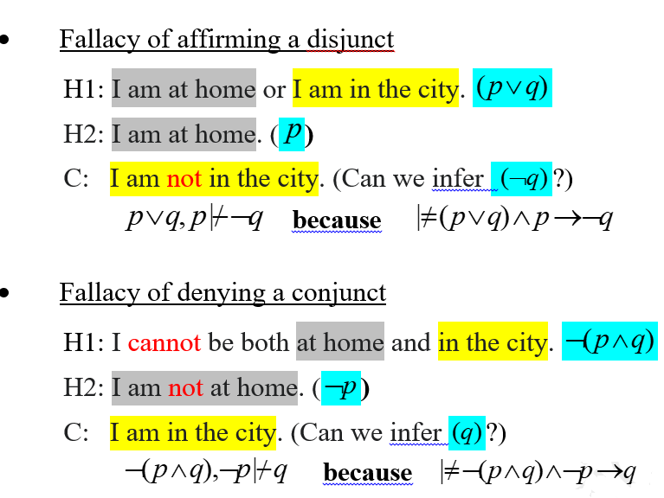
FALLACIES (contd.)

Slide 15
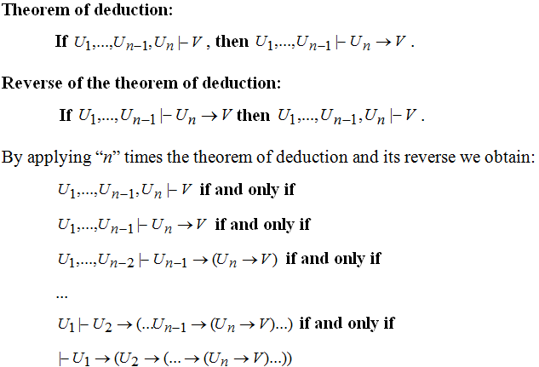
THEOREM OF DEDUCTION AND ITS REVERSE

Slide 16

Theorem of deduction - consequences

Slide 17

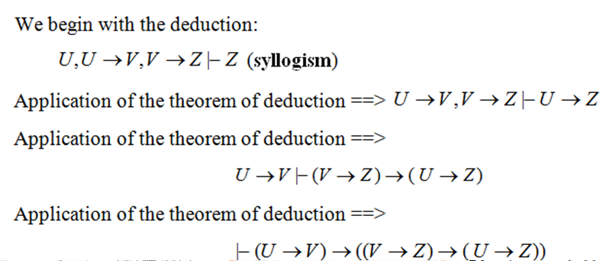
Proof

Slide 18



EXAMPLE 4 – THEOREM OF DEDUCTION

Slide 19
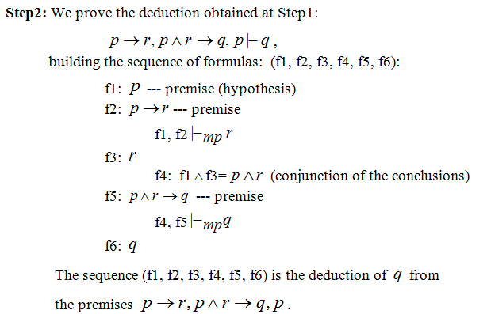
EXAMPLE 4 (CONTD.)

Slide 20






EXAMPLE 4 (CONTD.)

Slide 21
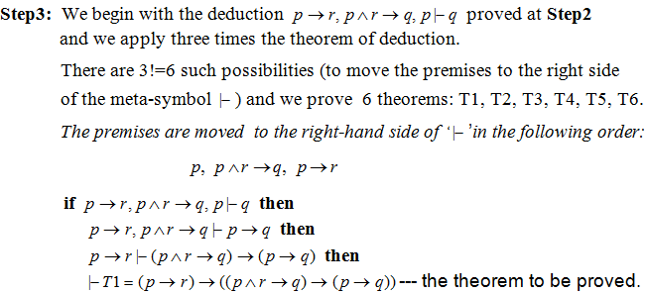
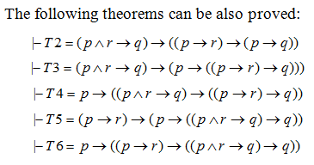
EXAMPLE 4 (CONTD.)

Slide 22
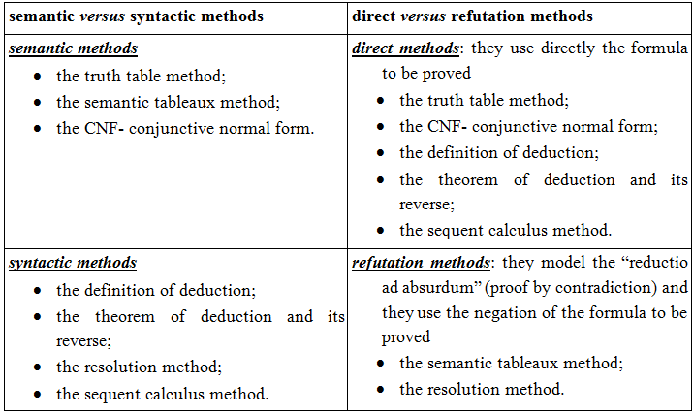
CLASSIFICATION OF PROOF METHODS

Slide 23
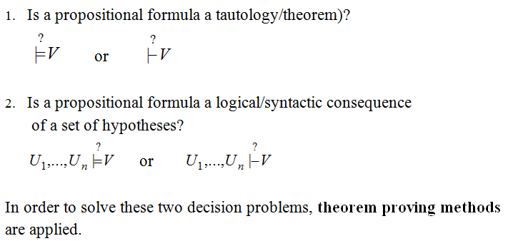
DECISION PROBLEMS IN PROPOSITIONAL LOGIC

