Slide 1

First-order (predicate) Logic

Slide 2
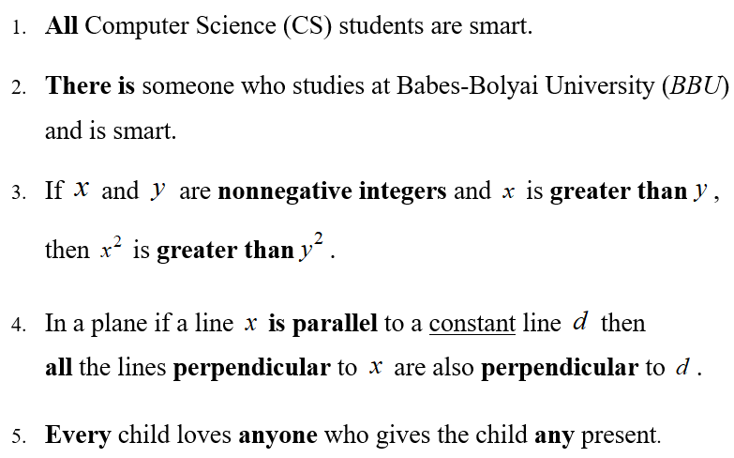
TRANSFORMATION OF NATURAL LANGUAGE SENTENCES INTO PREDICATE FORMULAS

Slide 3
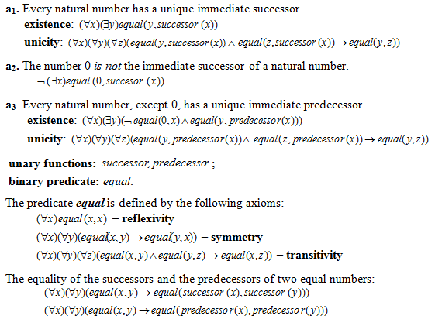
The axioms that define the natural numbers

Slide 4
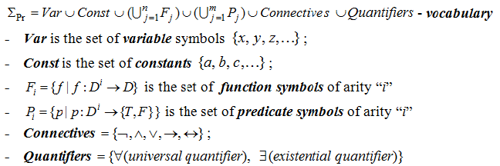
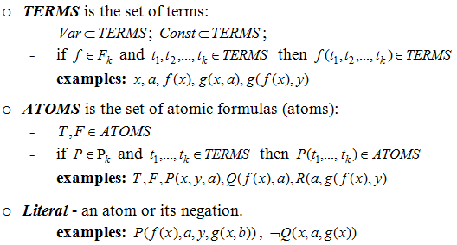
AXIOMATIC SYSTEM OF PREDICATE LOGIC

Slide 5
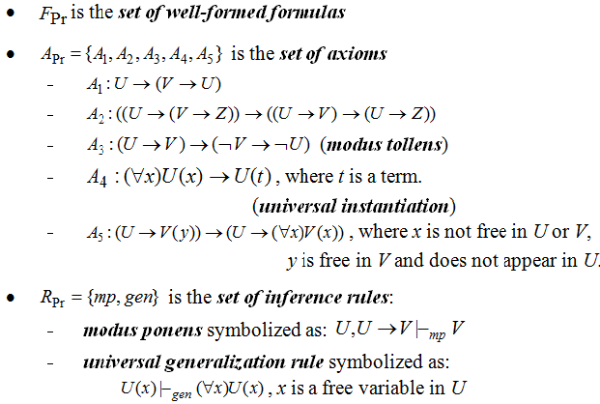
AXIOMATIC SYSTEM (CONTD.)

Slide 6
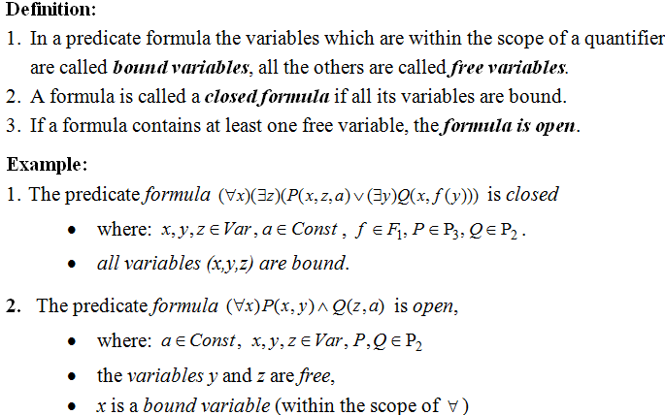
OPEN VERSUS CLOSED FORMULAS

Slide 7
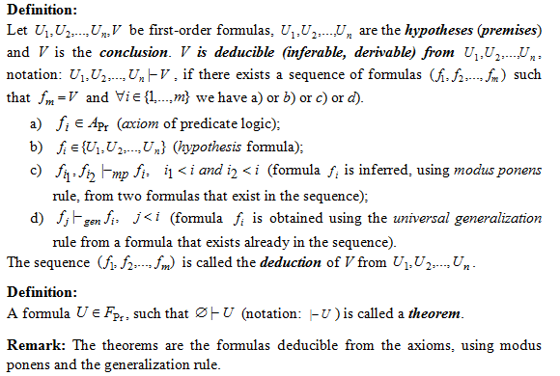
DEDUCTION IN FIRST-ORDER LOGIC

Slide 8
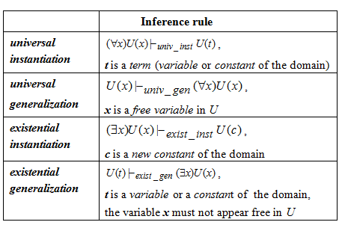
INFERENCE RULES IN FIRST-ORDER LOGIC

Slide 9
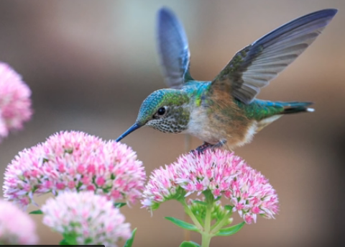
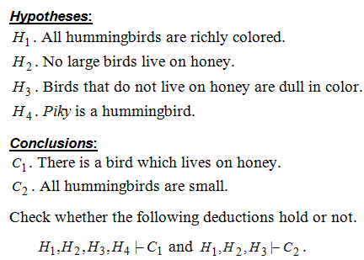
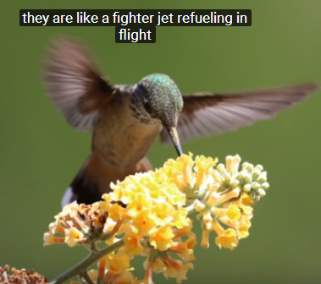
EXAMPLE 1 – MODELING REASONING

Slide 10





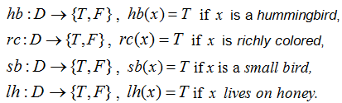

EXAMPLE 1 –MODELING REASONING (contd.)

Slide 11
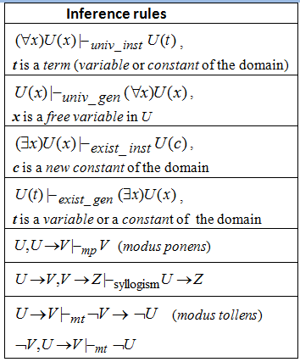
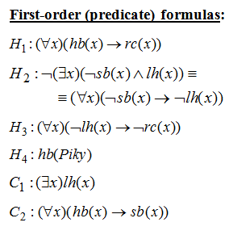
EXAMPLE 1 – BUILDING DEDUCTIONS (LECTURE)

Slide 12

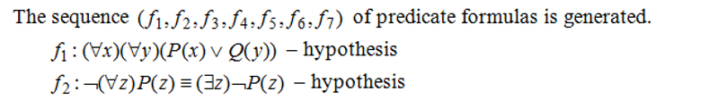
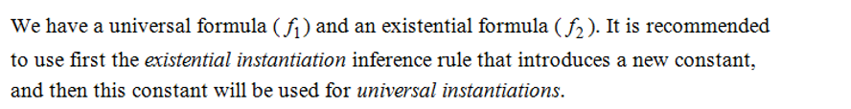

Example 2

Slide 13
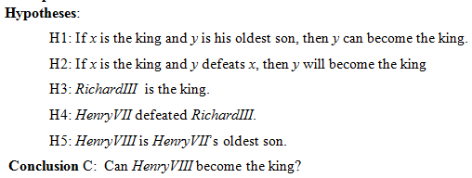
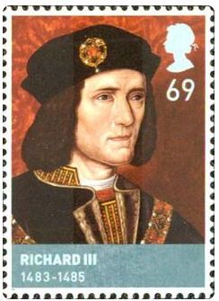
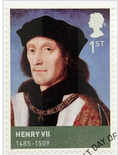
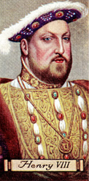
EXAMPLE 3: SUCCESSION TO THE BRITISH THRONE

Slide 14
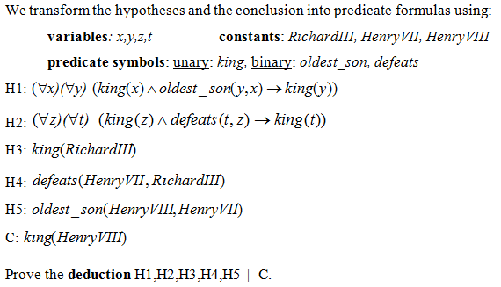
EXAMPLE 3 (HOMEWORK) SUCCESSION TO THE BRITISH THRONE

Slide 15
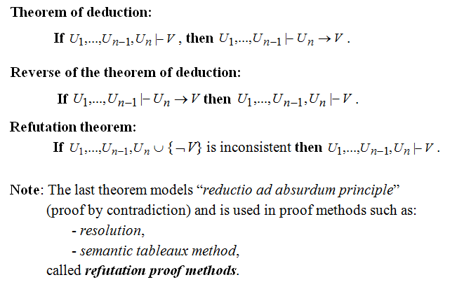
Theorems

Slide 16

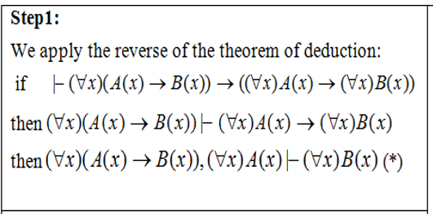
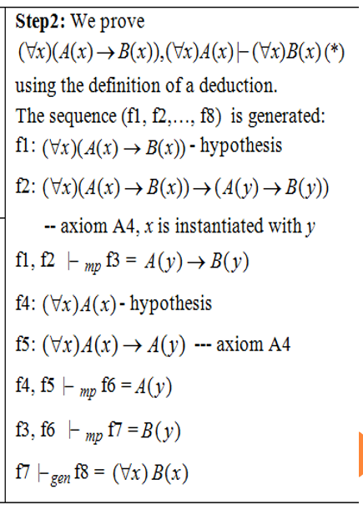
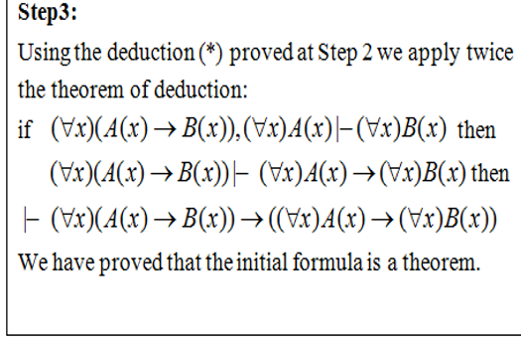

Slide 17
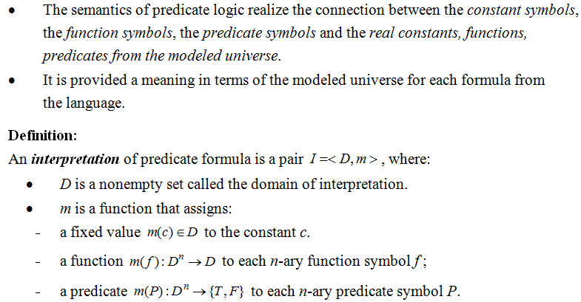
THE SEMANTICS OF FIRST-ORDER LOGIC

Slide 18
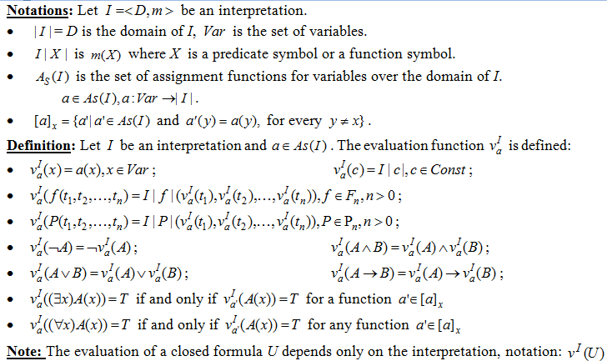

Slide 19
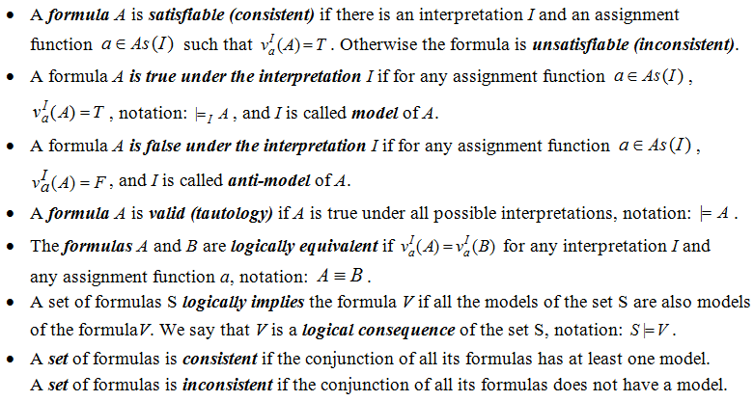
Definitions (semantic concepts)

Slide 20

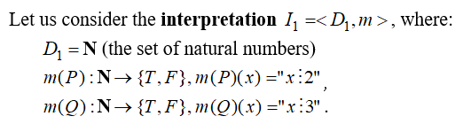

Example 5

Slide 21
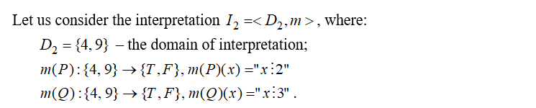


Example 5 (contd.)

Slide 22
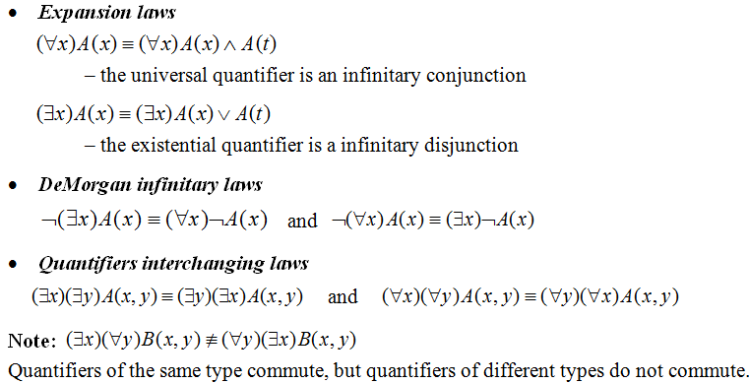
LOGICAL EQUIVALENCES IN PREDICATE LOGIC

Slide 23
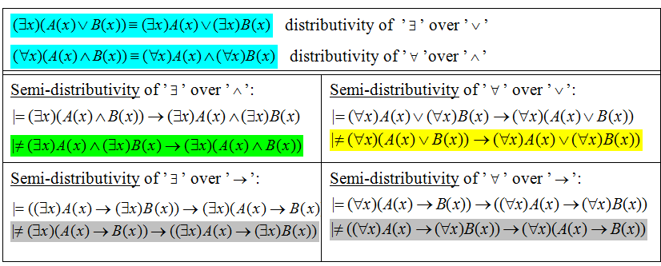
Distributive laws

Slide 24
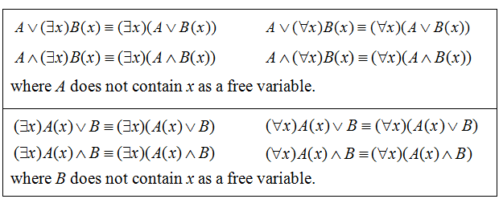
EXTRACTION OF QUANTIFIERS IN FRONT OF THE FORMULA

Slide 25
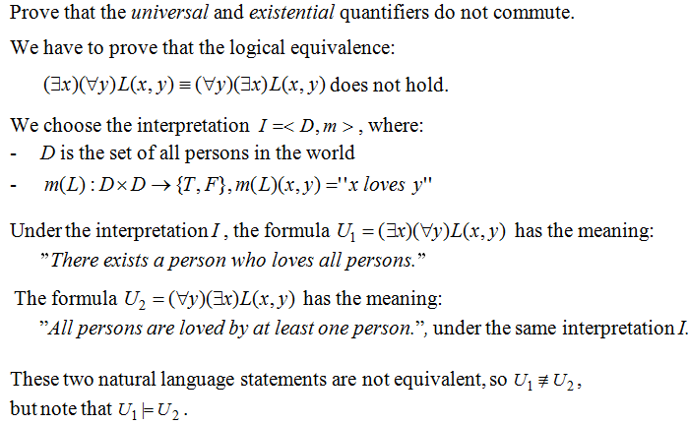
Example 6

Slide 26
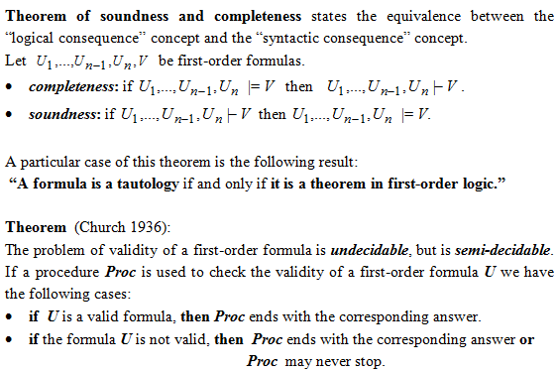
PROPERTIES OF FIRST-ORDER LOGIC: SOUNDNESS, COMPLETENESS, SEMI-DECIDABILITY

