Slide 1
Computer Networks
Adrian Sergiu DARABANT
Lecture 2

Slide 2
TCP Programming API
#include <sys/socket.h> Client + Server :
int socket (int family, int type, int protocol);
Client: int connect (int sfd, const struct sockaddr *servaddr, socklen_t addrlen);
Server:
int bind(int sfd, const struct sockaddr *servaddr, socklen_t addrlen);
int listen(int sockfd, int backlog);
int accept(int sockfd, struct sockaddr *cliaddr, socklen_t *addrlen);
Client + Server:
#include <unistd.h>
int close(int sockfd);

Slide 3
Socket Addresses - Generic
struct sockaddr { uint8_t sa_len; sa_family_t sa_family; /* address family: AF_xxx value */ char sa_data[14]; };
sa_data is a: (like when using unions) struct sockaddr_in { uint8_t sin_len; /* length of structure (16)*/ sa_family_t sin_family; /* AF_INET*/ in_port_t sin_port; /* 16 bit TCP or UDP port number */ struct in_addr sin_addr; /* 32 bit IPv4 address*/ char sin_zero[8]; /* not used but always set to zero - remaining to 14*/ };
struct in_addr{ in_addr_t s_addr; /*32 bit IPv4 network byte ordered address*/ };

Slide 4
TCP Programming API
Once a connection is setup:
#include <sys/socket.h>
ssize_t send(int sockfd, const void *buf, size_t nbytes, int flags);
int write(int sockfd, …..) – works as well
ssize_t recv(int sockfd, void *buf, size_t nbytes, int flags);
int read(int sockfd,……) – works as well

Slide 5
TCP Programming
Client Server Iterative Example

Slide 6
TCP
Connection-Oriented
Recv - when RECV return N bytes have been received
Send – when SEND returns N bytes have successfully delivered to OS and maybe to destination. Error will be signaled on next operation
Guaranteed data delivery
Guaranteed data ordering delivery
Type = SOCK_STREAM – when creating socket

Slide 7
Client-Server TCP/IP Apps
Server listens for client’s requests, executes them and answers.
Server types (from the Comm Point of View)
Iterative Servers (blocking)
Concurrent servers (blocking)(fork, threads)
Concurrent multiplexed servers. (select)

Slide 8
Concurrent TCP Servers
Servers able to handle multiple clients in the same time;
Implementation:
Fork/CreateProcess – independent client
Threads – interdependent states between clients
Select system call

Slide 9
Working with the DNS
struct hostent *gethostbyname(const char *name);
struct hostent *gethostbyaddr(const void *addr, int len, int type);
hostent structure is defined in <netdb.h> as follows:
struct hostent {
char *h_name; /* official name of host */
char **h_aliases; /* alias list */
int h_addrtype; /* host address type */
int h_length; /* length of address */
char **h_addr_list; /* list of addresses */
}
#define h_addr h_addr_list[0]
-------------------------------------------------------------------------------
Another Approach: getaddrinfo(….), getnameinfo(….)

Slide 10
Concurrent TCP Servers
Example – fork

Slide 11
Little Endian/Big endian
In memory data representation
Big endian – most significant byte first
Little endian – least significant byte first
46F4 – Little end. => F4 46
- Big end. => 46 F4

Slide 12
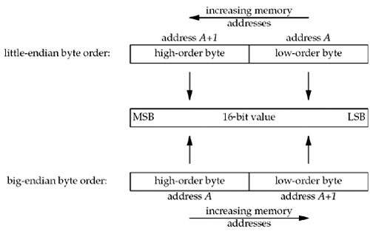
Little Endian/Big endian

Slide 13
Float and double
Float – 4 bytes
exp mantisa
Float = (sign?-1:1) * 2^exp *1.<mantisa>
Double - 8 bytes
Same endianness as integers
Swapping 8 or more byte entities ?!?
31 |  |  |  |  |  |  |  |  |  |  |  |  |  |  |  |  |  |  |  |  |  |  |  |  |  |  |  |  |  |  | 0
s | E | E | E | E | E | E | E | E | M | M | M | M | M | M | M | M | M | M | M | M | M | M | M | M | M | M | M | M | M | M | M

Slide 14
Example Concurrent Threaded Server
The server generates a random number. All connecting clients send a number to the server. The server answers with:
‘S’ – give a smaller number
‘H’ – give a larger number
‘G’ – you guessed my number
‘L’ – you lost. Somebody else guessed !
Write a client server implementation where each client is informed at the end of its status: winner/looser !

Slide 15
UDP
Connection-Less – datagram oriented
Recvfrom- N bytes received
Sendto - N bytes given to the OS/network !!!
No guarantee for datagram delivery
No guarantee for datagram ordering
Type = SOCK_DGRAM – when creating socket

Slide 16
TCP vs UDP
TCP
Write =>stream of bytes.
Read=>reads from the stream
Bytes Not read from stream stay available for next read
Flow: neither party can overflow the other! Traffic is controlled by the OS
UDP
Write =>packets of bytes.
Read=>reads bytes from one packet !
Not read bytes from a packet are lost !
Flow: one party can overflow the other =>lost packets ! No control !

Slide 17
UDP API
socket(…, SOCK_DGRAM,…)
bind – similar to TCP - has the same meaning
Data exchange – sendto, recvfrom
close – same meaning as TCP
Remark:
No listen and accept are required/permitted !

Slide 18
UDP API
ssize_t sendto(int sockfd, const void *buf, size_t len, int flags, const struct sockaddr *dest_addr, socklen_t addrlen);
Return:
no of bytes transmitted to the OS/network if positive
-1 in case of locally detected error (errno set appropriately)
No error signaling for undelivered data !
Data size must fit into a transmission unit(datagram) < 64Kb or Error !
One sendto operation must be consumed by exactly one recvfrom operation on the receiver!

Slide 19
UDP API
ssize_t recvfrom(int sockfd, void *buf, size_t len, int flags,
struct sockaddr *src_addr, socklen_t *addrlen);
Return:
no of bytes received from the OS/network and stored into buf
-1 in case of error (errno set appropriately)
Call blocks until a datagram arrives
If not all data is read in ONE call – the remaining is discarded
Cannot receive more than the maximul transfer unit (datagram) size – max. 64 Kb

Slide 20
Socket Options
setsockopt(int s, int level, int optname, void *optval, socklen_t *optlen)
getsockopt(…..)
man 7 socket/ip/udp/tcp
Optname
SO_REUSEADDR – reuse local addresses – use it to get rid of the address already in use after you terminate your TCP/IP app abruptly !
SO_BROADCAST – enables broadcast = one sender – Universal(all) receiver(s)!

Slide 21
Advanced TCP/IP – I/O Modes
Blocking I/O
Nonblocking I/O
I/O multiplexing (select and poll)
Signal driven I/O (SIGIO)
Asynchronous I/O (the POSIX aio_functions)

Slide 22
Network operation steps - READ
Waiting for the data to be ready – i.e. data arrives from the network
Copying the data from the kernel to the process – i.e. copying the data from the kernel buffer into the application space.

Slide 23
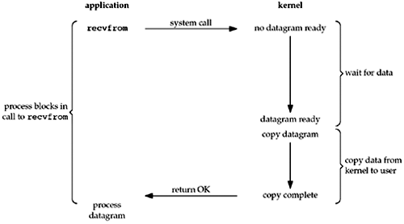
Blocking I/O Model
Process is sleeping !

Slide 24
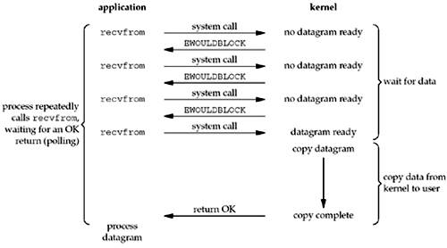
Non-Blocking I/O Model
Process is active !

Slide 25
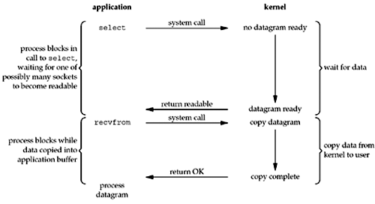
Multiplexed I/O Model
Involves using select and poll

Slide 26
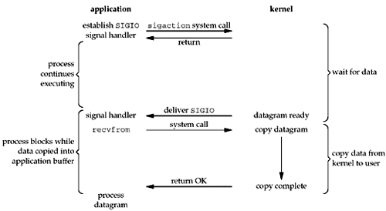
Signal I/O Model

Slide 27
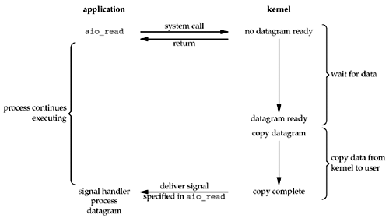
Asynchronous I/O Model
aio_read – asynchronous POSIX read
Async - Kernel tells us when the operation is complete
Signal – Kernel tells us when the operation can start !!

Slide 28
Blocking I/O Operations Sequence
Client
Server
Write(…)
Write(…)
Read(…)
Read(…)
Read(…)
Write(…)
?
Write(…)
Write(…)
Read(…)
Write(…)
Read(…)
Write(…)
?
Read(…)
Write(…)
Read(…)
Read(…)
Read(…)
Write(…)
?

Slide 29
The select system call
#include <sys/select.h>
#include <sys/time.h>
int select(int maxfd+1, fd_set *readset, fd_set *writeset, fd_set *exceptset,
const struct timeval *timeout);
Returns:
positive count of ready descriptors
0 if timeout
-1 on error
void FD_ZERO(fd_set *fdset); - clear all bits in fdset
void FD_SET(int fd, fd_set *fdset); - turn on the bit for fd in fdset
void FD_CLR(int fd, fd_set *fdset); - turn off the bit for fd in fdset
int FD_ISSET(int fd, fd_set *fdset); - IS the fd ready ?
BE WARNED – select modifies readset, writeset and exceptset

Slide 30
Conditions for a socket to be ready
Condition | Readable | Writable | Exception
Data to read Read half connection closed New connection (for listen) | Y Y Y
Space available for writing Write half connection closed |  | Y Y
Pending error | Y | Y
TCP- out-of-bound DATA |  |  | Y

Slide 31
MultiClient Chat Server -1
#include <stdio.h>
#include <stdlib.h>
#include <string.h>
#include <unistd.h>
#include <sys/types.h>
#include <sys/socket.h>
#include <netinet/in.h>
#include <arpa/inet.h>
fd_set master; // master file descriptor list
fd_set read_fds; // temp file descriptor list for select()
struct sockaddr_in myaddr; // server address
struct sockaddr_in remoteaddr;
int fdmax; // maximum file desc. number
int listener; // listening socket descriptor
int newfd; // newly accept()ed socket
char buf[256], tmpbuf[256];
int nbytes, ret;
int yes=1; // setsockopt() SO_REUSEADDR
int addrlen;
int i, j, crt, int_port,client_count=0;

Slide 32
MultiClient Chat Server -2
struct sockaddr_in getSocketName(int s, bool local_or_remote) {
struct sockaddr_in addr;
int addrlen = sizeof(addr);
int ret;
memset(&addr, 0, sizeof(addr));
ret = (local_or_remote==true?getsockname(s,(struct sockaddr *)&addr, (socklen_t*)&addrlen):
getpeername(s,(struct sockaddr *)&addr, (socklen_t*)&addrlen) );
if (ret < 0)
perror("getsock(peer)name");
return addr;
}

Slide 33
MultiClient Chat Server -3
char * getIPAddress(int s, bool local_or_remote) {
struct sockaddr_in addr;
addr = getSocketName(s, local_or_remote);
return inet_ntoa(addr.sin_addr);
}
int getPort(int s, bool local_or_remote) {
struct sockaddr_in addr;
addr = getSocketName(s, local_or_remote);
return addr.sin_port;
}

Slide 34
MultiClient Chat Server -4
// send to everyone
void sendToALL(char * buf, int nbytes) {
int j, ret;
for(j = 0; j <= fdmax; j++) {
if (FD_ISSET(j, &master))
// except the listener and ourselves
if (j != listener && j != crt)
if ( send(j, buf, nbytes, 0) == -1)
perror("send");
}
return;
}

Slide 35
MultiClient Chat Server -5
int main(int argc, char **argv) {
if (argc < 2 ) {
printf("Usage:\n%s <portno>\n",argv[0]);
exit(1);
}
int_port = atoi(argv[1]);
FD_ZERO(&master); // clear the master and temp sets
FD_ZERO(&read_fds);
// get the listener
if ((listener = socket(AF_INET, SOCK_STREAM, 0)) == -1) {
perror("socket");
exit(1);
}
// get rid of the "address already in use" error message
if (setsockopt(listener, SOL_SOCKET, SO_REUSEADDR, &yes, sizeof(int) ) == -1) {
perror("setsockopt:");
exit(1);
}

Slide 36
MultiClient Chat Server -6
// bind
memset(&myaddr, 0, sizeof(myaddr));
myaddr.sin_family = AF_INET;
myaddr.sin_addr.s_addr = INADDR_ANY;
myaddr.sin_port = htons(int_port);
if (bind(listener, (struct sockaddr *)&myaddr, sizeof(myaddr)) == -1) {
perror("bind:");
exit(1);
}
// listen
if (listen(listener, 10) == -1) {
perror("listen");
exit(1);
}
// add the listener to the master set
FD_SET(listener, &master);
// keep track of the biggest file descriptor
fdmax = listener; // so far, it's this one

Slide 37
MultiClient Chat Server -7
// main loop
for(;;) {
read_fds = master; // copy it – select
if (select(fdmax+1, &read_fds, NULL, NULL, NULL) == -1) {
perror("select");
exit(1);
}
// run through the existing connections looking for data to read
for(i = 0; i <= fdmax; i++) {
if (FD_ISSET(i, &read_fds)) { // we got one!!
crt = i;
if (i == listener) {
// handle new connections
addrlen = sizeof(remoteaddr);
if ((newfd = accept(listener, (struct sockaddr *)&remoteaddr,(socklen_t*)& addrlen)) == -1) {
perror("accept");
}

Slide 38
MultiClient Chat Server -8
else {
FD_SET(newfd, &master); // add to master set
if (newfd > fdmax) { // keep track of the maximum
fdmax = newfd;
}
printf("selectserver: new connection from %s on socket %d\n",
getIPAddress(newfd, false),newfd);
client_count++;
sprintf(buf,"Hi-you are client :[%d] (%s:%d) connected to server %s\nThere
are %d clients connected\n", newfd, getIPAddress(newfd,false), getPort(newfd, false),
getIPAddress(listener, true), client_count);
send(newfd,buf,strlen(buf)+1,0);
}
}

Slide 39
MultiClient Chat Server -9
else {
// handle data from a client
if ((nbytes = recv(i, buf, sizeof(buf), 0)) <= 0) {
// got error or connection closed by client
if (nbytes == 0) {
// connection closed
printf("<selectserver>: client %d forcibly hung up\n", i);
}
else perror("recv");
client_count--;
close(i); // bye!
FD_CLR(i, &master); // remove from master set
}
else {
// we got some data from a client - check for connection close request
buf[nbytes]=0;
if ( (strncasecmp("QUIT\n",buf,4) == 0)) {
sprintf(buf,"Request granted [%d] - %s. Disconnecting...\n",i,getIPAddress(i,false));

Slide 40
MultiClient Chat Server -10
send(i,buf, strlen(buf)+1,0);
nbytes = sprintf(tmpbuf,"<%s - [%d]> disconnected\n",getIPAddress(i,false), i);
sendToALL(tmpbuf,nbytes);
client_count--;
close(i);
FD_CLR(i,&master);
}
else {
nbytes = sprintf(tmpbuf, "<%s - [%d]> %s",getIPAddress(crt, false),crt, buf);
sendToALL(tmpbuf, nbytes);
}
}
}
}
}
}
return 0;
}

Slide 41
MultiClient Chat Client -1
….//include stuff
…..
fd_set read_fds,master; // temp file descriptor list for select()
int sock; //socket
struct sockaddr_in servaddr;
char buf[256]; // buffer for client data
int nbytes, ret, int_port;
int main(int argc, char **argv)
{
if (argc < 3 ) {
printf("Usage:\n%s <hostname or IP address> <portno>\n",argv[0]);
exit(1);
}

Slide 42
MultiClient Chat Client -2
int_port = atoi(argv[2]);
int ipaddr = inet_addr(argv[1]);
// check if address is a hostname
if (ipaddr == -1 ) {
struct in_addr inaddr;
struct hostent * host = gethostbyname( argv[1] );
if (host == NULL ) {
printf("Error getting the host address\n");
exit(1);
}
memcpy(&inaddr.s_addr, host->h_addr_list[0],sizeof(inaddr));
printf("Connecting to %s ...\n",inet_ntoa( inaddr) );
memcpy(&ipaddr, host->h_addr_list[0],sizeof(unsigned long int)) ;
}
// create the socket
if ((sock = socket(AF_INET, SOCK_STREAM, 0)) == -1) {
perror("socket");
exit(1);
}

Slide 43
MultiClient Chat Client -3
memset(&servaddr,0, sizeof(servaddr));
servaddr.sin_family = AF_INET;
servaddr.sin_addr.s_addr = ipaddr;
servaddr.sin_port = htons( int_port );
// connect to server
if (connect(sock, (struct sockaddr *)&servaddr, sizeof(servaddr)) < 0 ) {
perror("connect");
exit(1);
}
// add the socket to the master set
FD_ZERO(&read_fds); // clear the set
FD_ZERO(&master);
FD_SET(0, &master); FD_SET(sock, &master);
while(1) {
read_fds = master;
if (select(sock+1, &read_fds, NULL, NULL, NULL) == -1) {
perror("select");
exit(1);
}

Slide 44
MultiClient Chat Client -4
if ( FD_ISSET(0, &read_fds) ) { // check if read from keyboard
nbytes = read(0, buf,sizeof(buf)-1);
ret = send(sock, buf, nbytes,0);
if (ret <= 0 ){
perror("send");
exit(1);
}
}
if ( FD_ISSET(sock, &read_fds) ) { // check if read from server
nbytes = read(sock, buf, sizeof(buf)-1);
if (nbytes <= 0) {
printf("Server has closed connection... closing...\n");
exit(2);
}
write(1,buf, nbytes);
}
}
return 0;
}

Slide 45
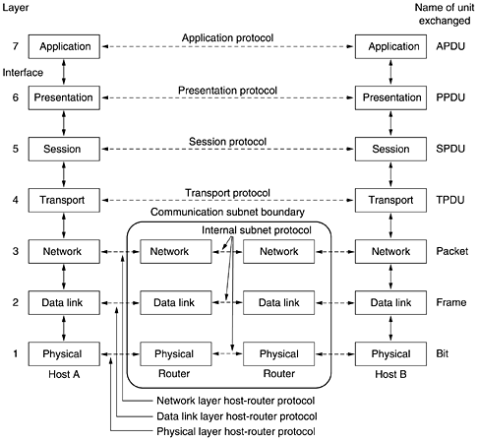
The OSI Reference Model
All People Seem To Need Data Processing

Slide 46
Principles of the OSI model
A layer should be created where a different abstraction is needed.
Each layer should perform a well-defined function.
The function of each layer should be chosen with an eye toward defining internationally standardized protocols.
The layer boundaries should be chosen to minimize the information flow across the interfaces.
The number of layers should be large enough that distinct functions need not be thrown together in the same layer out of necessity and small enough that the architecture does not become unwieldy.

Slide 47
The Physical Layer
Raw bits over a communication channel
Data representation
1–how many volts ?; 0 – how many volts ?
1 bit – How many nanoseconds ?
Bidirectional simultaneous transmission?
Electrical, mechanical, timing interfaces

Slide 48
Data Link layer
Turn the raw transmission into an error free communication line
Sets data in frames=thousands of bytes
Traffic regulation (flow control)
Access to the medium in broadcast shared communication lines

Slide 49
The Network Layer
Controls the operation of a subnet
How packets are routed from source to destination
Quality of service – congestion control
Fragmentation and inter-network problems

Slide 50
The Transport Layer
Accept data from upper layers and splits it into packets (small units)
Ensure that packets arrive correctly to the other end
Type of service: error free PtoP, preserve order or not, guarantees delivery or not, broadcast
True end-to-end layer

Slide 51
The Session Layer
Allows for establishing sessions
Session
Dialog control
Token management
Synchronization

Slide 52
The Presentation Layer
Syntax and semantics of data
Abstract data definitions/ encoding for information exchange between heterogeneous systems
Standard encoding “on the wire”
Exchange unit – record type

Slide 53
The Application Layer
Protocols needed by users:
HTTP - www
FTP – file exchange
TELNET – remote command
SSH – remote command
SMTP – mail exchange

