Slide 1
Employee Data Analysis using Excel
STUDENT NAME: R.PRIYANKA
REGISTER NO: 312208986
NM ID(USER NAME):
Asunm135122/c/106
DEPARTMENT: commerce(b.com( gen))
COLLEGE: CHEVALIER T.THOMAS ELIZABETH
COLLEGE FOR WOMEN

Slide 2
TRANING DATE
TRAINING AND DEVELOPMENT ANALYSIS USING EXCEL

Slide 3


AGENDA
Problem Statement
Project Overview
End Users
Our Solution and Proposition
Dataset Description
Modelling Approach
Results and Discussion
Conclusion
3/21/2024 Annual Review

Slide 4

PROBLEM STATEMENT
Evaluate the impact of different training programs on employee performance levels. Analyze the relationship between training type, duration, and the subsequent performance outcomes to identify patterns or areas for improvement. Specifically, address why certain employees exhibit 'LOW' performance levels despite undergoing training and determine what factors contribute to 'Very High' or 'Medium' performance levels. Provide recommendations on optimizing training programs to enhance overall employee performance."

Slide 5

PROJECT OVERVIEW
.
THE IMAGE SHOWS AN EXCEL DASHBOARD ANALYZING EMPLOYEE TRAINING AND DEVELOPMENT DATA
KEY ELEMENTS INCLUDS:
PIVOT TABLE: The top left section displays a pivot table summarizing training duration by employee performance level(high and low)and training program name
PIE CHART: The bottom left section contain a pie chart visualizing the distribution of training duration across different training programs
SLICER: The top right corner features a slicer for filering the data by training type(external or interal)

Slide 6

WHO ARE THE END USERS?
Employees: Those who will directly benefit from the training, such as sales teams, customer service representatives, or software users.
2. Managers: Supervisors who oversee employees and need training on leadership, coaching, or performance management.
3. Customers: External customers who may receive training on products or services.
4. Partners: Business partners, vendors, or suppliers who require training on products, processes, or systems.

Slide 7

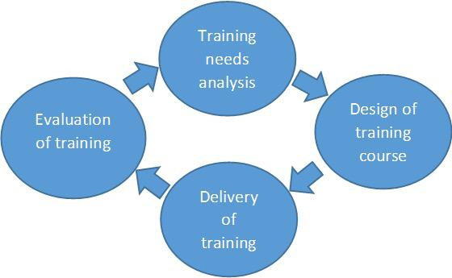
OUR SOLUTION AND ITS VALUE PROPOSITION
Our solution: Analyze and optimize training programs based on performance data.
Value Proposition: Boost training effectiveness, improve employee performance, and enhance ROI.

Slide 8
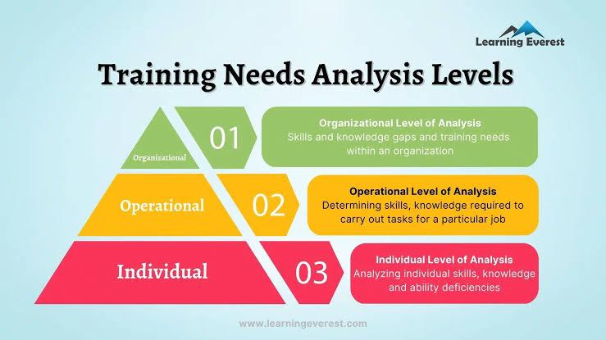
Dataset Description
A dataset detailing employee training programs, including employee IDs, program names, training type (Internal/External), duration in days, and post-training performance levels (Very High, Medium, LOW).

Slide 9

THE "WOW" IN OUR SOLUTION
By leveraging data analysis to identify key factors driving high performance, our solution offers actionable insights to tailor training programs effectively. This approach not only enhances individual and organizational performance but also maximizes the return on training investments, creating a more skilled and motivated workforce.
3/21/2024 Annual Review
9

Slide 10
MODELLING
1.Data Preparation: Clean and structure the data.
2.Feature Selection: Identify key variables (e.g., training type, duration) affecting performance.
3.Model Selection: Choose a statistical or machine learning model to analyze the impact of training on performance.
4.Training and Testing: Train the model with a portion of the data and test it with the remaining data.
5. Evaluation: Assess model accuracy and refine based on performance metrics.
6.Insights: Extract actionable insights to improve training programs.
10

Slide 11
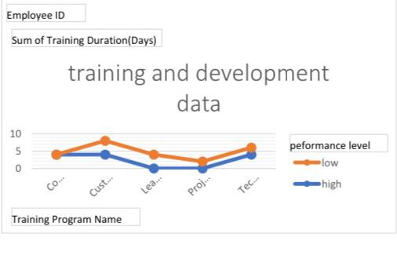
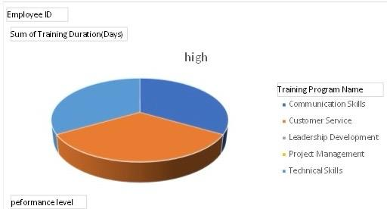
RESULTS
11

Slide 12
conclusion
The analysis of the dataset reveals that longer internal training programs, particularly in Technical Skills, tend to correlate with 'Very High' performance levels. Conversely, shorter or less intensive training programs, regardless of type, often result in 'LOW' performance. The insights suggest that investing in extended and focused internal training programs can significantly enhance employee performance, while shorter or less relevant training may not be as effective. This underscores the need for targeted, in-depth training to maximize employee development and performance outcomes.

