Slide 1
Babeș-Bolyai University, Cluj-Napoca Faculty of Mathematics and Computer Science Specialization Computer Science in English Fake News Detection using Machine Learning algorithms
Author:
Suceava Octavia
Supervisor:
PhD Student Coste Claudia-Ioana,
Prof. PhD Andreica Anca-Mirela

Slide 2
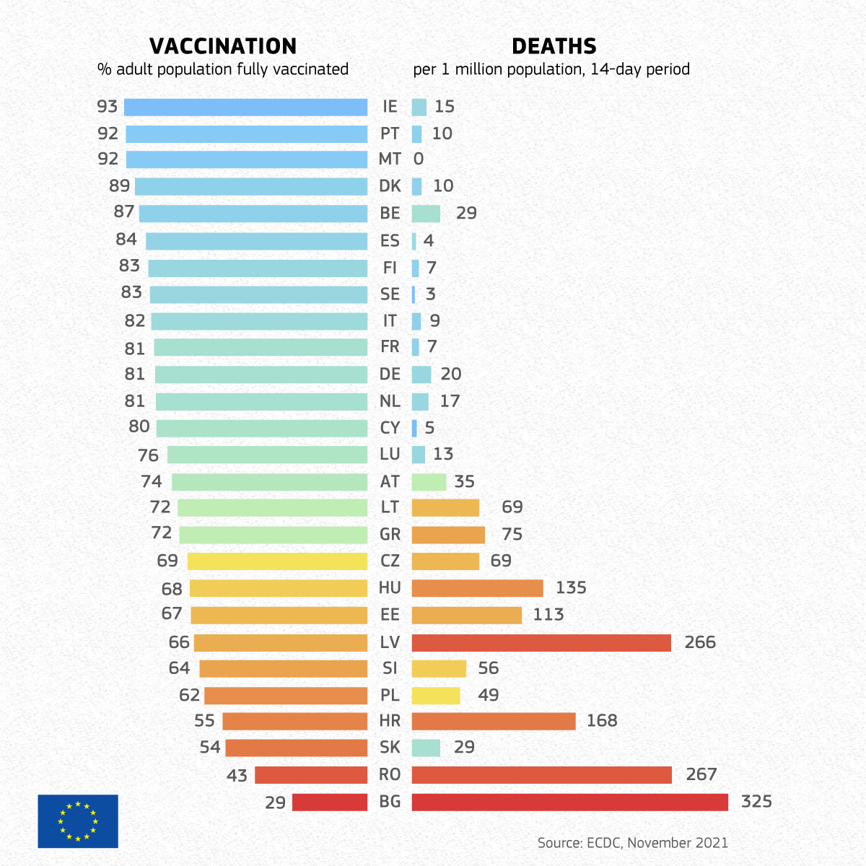
Motivation
use of social media for finding news
impact on mental health
impact on people’s decisions

Slide 3
Mărcău F-C, Purec S, Niculescu G. Study on the Refusal of Vaccination against COVID-19 in Romania. Vaccines. 2022; 10(2):261. https://doi.org/10.3390/vaccines10020261
Claim | Disagreement | Agreement
“The COVID-19 pandemic is real” | 224 (34.4%) | 297 (45.7%)
“There is a global secret society who wants to control the world” | 231 (35.5%) | 306 (47%)
“There is a world occult that wants to reduce the population of the Earth” | 263 (40.4%) | 287 (44.1%)
“COVID-19 vaccination aims to stop the pandemic” | 324 (49.8%) | 172 (26.4%)
“Vaccination aims to kill the elderly” | 295 (45.3%) | 248 (38.1%)

Slide 4
Natural Language Processing
Text Preprocessing
TF-IDF

Slide 5
Text Preprocessing
Preprocessing Step | Sentence
No preprocessing | "I have been studying Computer Science for 3 years now. What about you?"
Lower casing | "i have been studying computer science for 3 years now. what about you?"
Punctuation removal | "i have been studying computer science for 3 years now what about you"
Number removal | "i have been studying computer science for years now what about you"
Tokenization | ["i", "have", "been", "studying", "computer", "science", "for", "years", "now", "what", "about", "you"]
Stop words removal | ["studying", "computer", "science", "years"]
Stemming | [“studi”, “comput”, “scienc”, “year”]

Slide 6



Term Frequency-Inverse Document Frequency
TF: “how many times?”
IDF: “how important is it?”

Slide 7
Disadvantages:
lack of semantic understanding
vocabulary size
lack of document context

Slide 8
Algorithms
Logistic Regression
Decision Trees
Passive-Aggressive Classifier

Slide 9
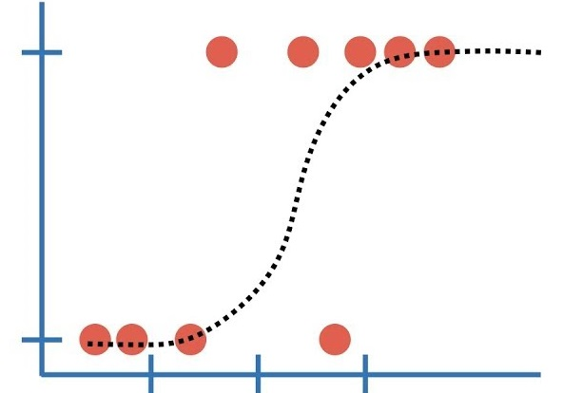

Logistic Regression
$f(x)=\frac{1}{1+e^{−f(x)}}$
Maximum Likelihood Estimation
Image source: https://www.youtube.com/watch?v=vN5cNN2-HWE&t=406s&ab_channel=StatQuestwithJoshStarmer

Slide 10
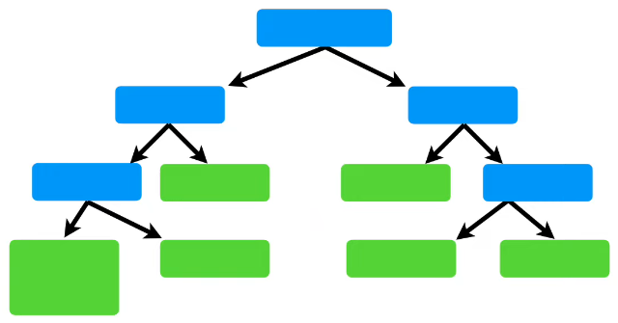
Decision Trees
splits dataset
leaf nodes = classes/probabilities
set max_depth
Image source: https://www.youtube.com/watch?v=_L39rN6gz7Y&ab_channel=StatQuestwithJoshStarmer

Slide 11

Passive-Aggressive Classifier
online algorithm
updates the weight vector $w$
$C$: regularization parameter

Slide 12
Dataset
train.csv
id | title | author | text | label
0 | realNewsTitle | realNewsArticle | realNewsText | 0
1 | fakeNewsTitle | fakeNewsArticle | fakeNewsText | 1
test.csv
id | title | author | text
20800 | newsTitle | newsArticle | newsText
submit.csv
id | label
20800 | 0

Slide 13
"Fake news detection with different models“ Vijayaraghavan, Sairamvinay, et al.
stemming not mentioned
text column only
train.csv 80-20 train-test split
modelLR = LogisticRegression(solver=’sag’, C=7.74).
TF-IDF and Logistic Regression: 94.79%

Slide 14
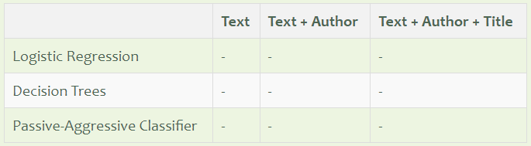
Solution Original Contributions
multiple TF-IDF vectorizers
testing on new data

Slide 15
Results
train.csv
test.csv & submit.csv
Model | Text | Text + Author | Text + Title + Author
Logistic Regression | 0.943 | 0.947 | 0.948
Decision trees | 0.874 | 0.882 | 0.931
Passive-Aggressive Classifier | 0.957 | 0.963 | 0.964
Model | Text + Title + Author
Logistic Regression | 0.641
Decision trees | 0.655
Passive-Aggressive Classifier | 0.64

Slide 16
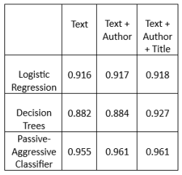
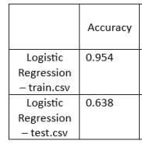
Problems:
feature vector too large?
stemming
overfitting?
grid search
vocabulary in the dataset?
data leakage?

Slide 17
Improvements Future Directions
more diverse datasets
data preparation on training set only
pre-trained models
real-time fake news detecting system

Slide 18
Demo

Slide 19
Thank you for your attention!

