Slide 1
Newton’s Laws of Motion

Slide 2
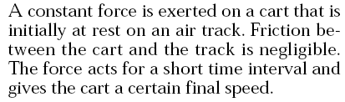

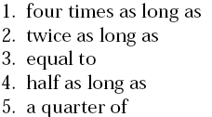


Please use:
A for 1
B for 2
C for 3
D for 4
E for 5
No Vote
for 6
Answer: 2

Slide 3
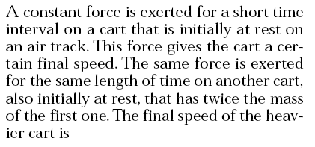
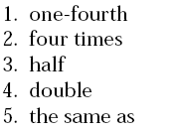


Please use:
A for 1
B for 2
C for 3
D for 4
E for 5
No Vote
for 6
Answer: 3

Slide 4
A constant force is exerted for a short time interval on a cart that is initially at rest on an air track. This force gives the cart a certain final speed. Suppose we repeat the experiment but, instead of starting from rest, the cart is already moving with constant speed in the direction of the force at the moment we begin to apply the force. After we exert the same constant force for the same short time interval, the increase in the cart’s
speed
1. is equal to two times its initial speed.
2. is equal to the square of its initial speed.
3. is equal to four times its initial speed.
4. is the same as when it started from rest.
5. cannot be determined from the information provided.
Please use:
A for 1
B for 2
C for 3
D for 4
E for 5
No Vote
for 6
Answer: 4

Slide 5
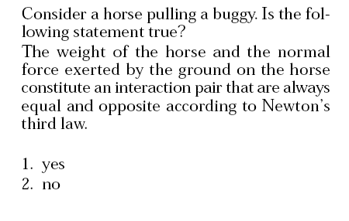
Please use:
A for 1
B for 2
C for 3
D for 4
E for 5
No Vote
for 6
Answer: 2 The “weight of the horse” is paired with the gravitational force of the horse on the planet Earth.

Slide 6
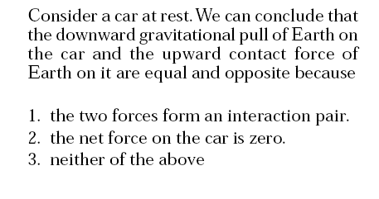
Please use:
A for 1
B for 2
C for 3
D for 4
E for 5
No Vote
for 6
Answer: 2

Slide 7
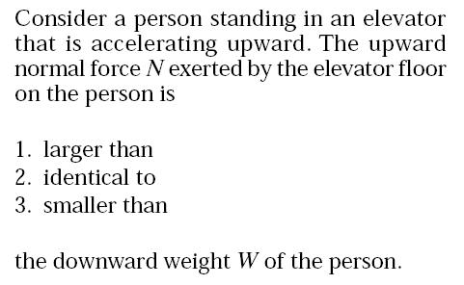
Please use:
A for 1
B for 2
C for 3
D for 4
E for 5
No Vote
for 6
Answer: 1 To produce an upward acceleration the net force on the person must be upward.

Slide 8
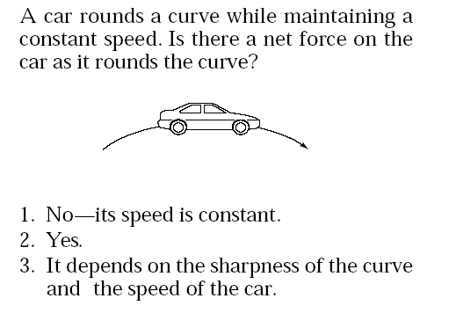
Please use:
A for 1
B for 2
C for 3
D for 4
E for 5
No Vote
for 6
Answer: 2 The car has an acceleration because the velocity is changing (direction changes). There must be a net force causing this acceleration.

