Slide 2
A hockey puck is sliding at constant velocity across a flat horizontal ice surface that is assumed to be frictionless. Which of the sketches is the correct free-body diagram for this puck?
Motion
Motion
Motion
F_{N}
F_{N}
F_{N}
F
F
F_{G}
F_{G}
F_{G}
A
B
C
Answer: B

Slide 3
In the previous question, what would your answer be if the puck slowed down?
Motion
Motion
Motion
F_{N}
F_{N}
F_{N}
F
F
F_{G}
F_{G}
F_{G}
A
B
C
Answer: C

Slide 4
An external force is being gradually applied on a box that is sitting on a surface with friction. Which graph does correctly show the behavior of the friction force versus the applied force?
F_{fr}
F_{fr}
F_{fr}
0
0
0
F_{Applied}
F_{Applied}
F_{Applied}
A
B
C
Answer: C

Slide 5
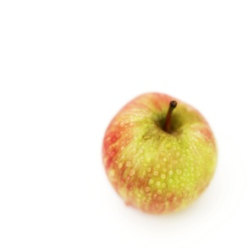
Which one of the following cases have the highest force on the apple shown (while the apple is already in flight)?
A- Object in free fall
B- Object thrown down fast
C- Object thrown up fast
D- Object in projectile motion
E- All have the same force
Answer: E

Slide 6
A bowling ball is moving along a frictionless inclined plane, which one of the following cases have the highest force along the surface of the ramp on the ball (while the ball is already in motion)?
A- Ball just released from
top
B- Ball just kicked from bottom
C- Ball just kicked from top
D- All have the same force
Answer: D

Slide 7
Suppose you went shopping one day. You pick up a shopping cart and start pushing the cart around the store. Which one of the following statements is correct?
A- You apply more force on the cart than the cart applies on you (since it is the cart that is moving, not the other way around)
B- The cart does not apply any force on you at all because you obviously move the cart.
C- You and cart apply the same force on each other, except that the direction of the forces is opposite.
D- You don’t apply any force on the cart, it is the wheels that make the cart move by itself.
Answer: C

