Slide 1
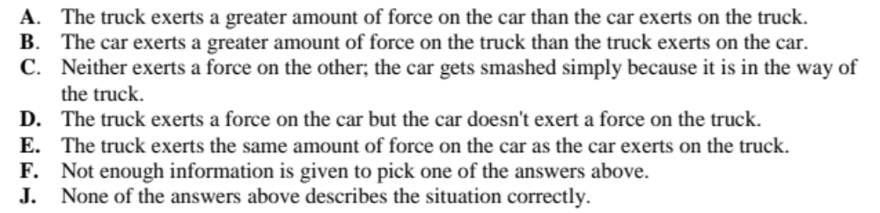
The following questions refer to collisions between a car and a much heavier truck. For each description of a collision, as given below, choose the one answer from the possibilities below that best describes the forces between the car and the truck.

Slide 2
1- They are both moving at the same speed when they collide. Which choice describes the forces?
Answer: E

Slide 3
2- The car is moving much faster than the heavier truck when they collide. Which choice describes the forces?
Answer: E

Slide 4
3- The heavier truck is standing still when the car hits it. Which choice describes the forces?
Answer: E

Slide 6
The following questions refer to collisions between a car and a truck that is the same weight as the car. For each description of a collision, as given below, choose the one answer from the possibilities below that best describes the forces between the car and the truck.

Slide 7
1- Both the truck and the car are moving at the same speed when they collide. Which choice describes the forces?
Answer: E

Slide 8
2- The truck is standing still when the car hits it. Which choice describes the forces?
Answer: E

Slide 10
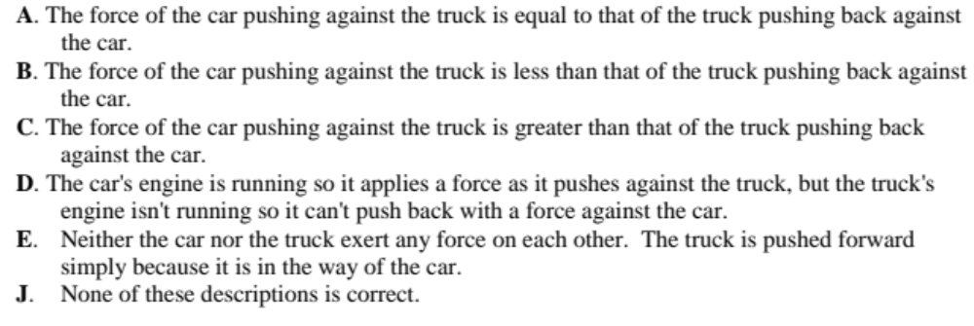
The following questions refer to a large truck which breaks down out on the road and receives a push back to town by a small compact car.
Pick one of the choices given below which correctly describes the forces between the car and the truck for each of the descriptions in the questions below.

Slide 11
1- The car is pushing on the truck, but not hard enough to make the truck move.
Answer: A

Slide 12
2- The car, still pushing the truck, is speeding up to get to cruising speed.
Answer: A

Slide 13
3- The car, still pushing the truck, is at cruising speed and continues to travel at the same speed.
Answer: A

Slide 14
4- The car, still pushing the truck, is at cruising speed when the truck puts on its brakes and causes the car to slow down.
Answer: A

Slide 16
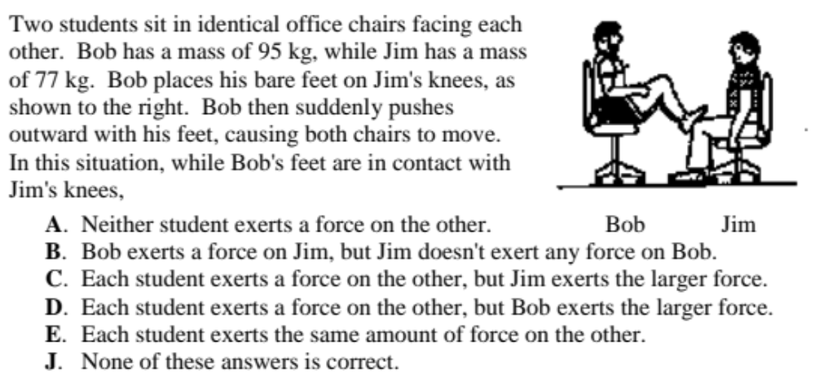
Answer: E

